Slide 1
OMICS Journals are welcoming Submissions
OMICS International welcomes submissions that are original and technically so as to serve both the developing world and developed countries in the best possible way.
OMICS Journals are poised in excellence by publishing high quality research. OMICS International follows an Editorial Manager® System peer review process and boasts of a strong and active editorial board.
Editors and reviewers are experts in their field and provide anonymous, unbiased and detailed reviews of all submissions.
The journal gives the options of multiple language translations for all the articles and all archived articles are available in HTML, XML, PDF and audio formats. Also, all the published articles are archived in repositories and indexing services like DOAJ, CAS, Google Scholar, Scientific Commons, Index Copernicus, EBSCO, HINARI and GALE. For more details please visit our website: http://omicsonline.org/Submitmanuscript.php

Slide 2
Jagadevappa Patil
Professor and Principal
VT’s Shivajirao S Jondhle College of Pharmacy
University of Mumbai
India

Slide 3
Biography
Dr. J. S. Patil received his PhD from Rajiv Gandhi University of Health Sciences, Bangalore, India during the period of 2012. Currently, he is the Professor and Principal in Shri Vithal Education & Research Institute’s College of Pharmacy under Solarpur University. He is serving as Editorial Board Member for many reputed Journals and himself has 38 publications.

Slide 4
Research Interests
Site-specific delivery of drugs for optimization of drug therapy.
Formulations for hypertension, diabetes, and peptic ulcer have been developed.
Pulmonary delivery for optimization of antitubercular therapy.
Strategies for improving bioavailability of Class II and Class III BCS drugs.
Development of Nanoparticles, microparticles and liposomes.
Optimization of formulations using software.

Slide 5
Routes of Drug Administration
Routes of drug administration into the body
Intravenous (IV): into a vein (rapid absorption)
Intraperitoneal (IP): into the gut (used in lab animals)
Subcutaneous (SC): under the skin
Intramuscular (IM): into a muscle
Inhalation of the drug into the lungs
Topical: absorbed through the skin
Oral (PO): via the mouth

Slide 6
Site-specific drug delivery
Also known as Targeted drug delivery
Advantageous over traditional drug delivery method
The medication concentrates in the tissues of interest
Improves efficacy while reducing side-effects

Slide 7
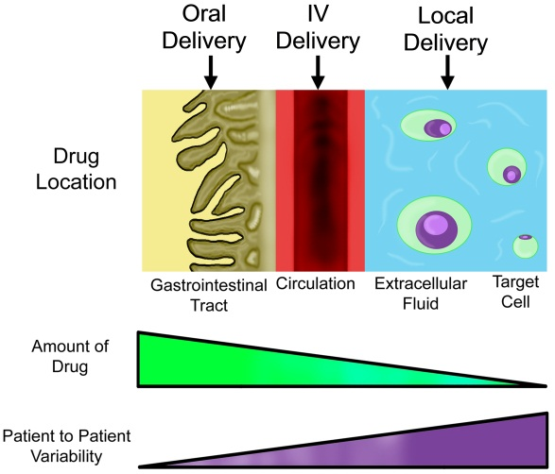

Slide 8
Advantages
Reduction in the dosages frequency
Uniform effect of the drug
Reduction side-effects by the drug to other organs
Reduced fluctuation in circulating drug levels

Slide 9
Disadvantages
Less productivity due to high cost
Reduced ability to adjust the dosages

Slide 10
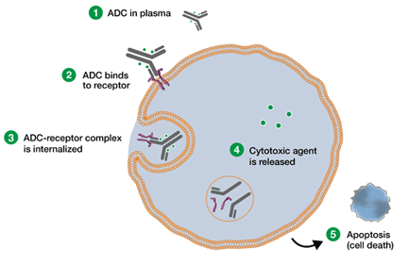
Types
Active targeted drug delivery, such as antibody medications
Passive targeted drug delivery, such as enhanced permeability and retention effect (EPR-effect)

Slide 11
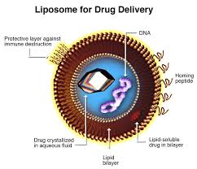
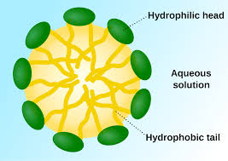
Delivery vehicles
Liposomes
Micelles

Slide 12
Applications
Cardiovascular diseases
Diabetes
Cancer tumors
Tuberculosis
Stem cell therapy
Regenerative techniques

Slide 13
Recent Publications
1.Design, Charecterization and Evaluation of Inclusion Complexes of Poorly Soluble Atorvastatin Calcium. Uniq J Pharm Biolog Sci. 2014;2 (2): 88-96.
2.Design,Charecterization and Evaluation of Inclusion Complexes of Poorly Soluble Rosuvastatin Calcium. Univer J Pharm. 2014; 3(2): 88-96.
3.Rifampicin loaded spray-dried olibanum gum resin pulmospheres for lung delivery. Special issue: “Drug Delivery using Nanomedicine & Nanotechnology”. J Drug Deliv Therapeut. 2014; 4 (3): 15-20.
4.Rifampicin loaded spray-dried olibanum gum resin pulmospheres for lung delivery. Special issue: “Drug Delivery using Nanomedicine & Nanotechnology”. J Drug Deliv Therapeut. 2014; 4 (3): 15-20.
5.Microalbuminuria as Risk Indicator in Rheumatoid Arthritis: An Updated Review. Int. J. Pharm. Clin. Res. 2014; 6(2): 138-145.

Slide 14
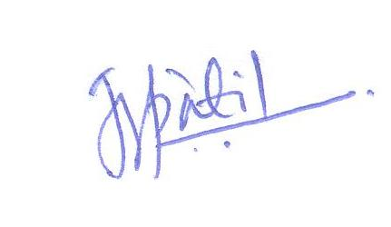
Signature

Slide 15
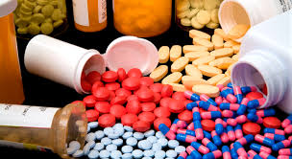
Pharmacovigilance Related Journals
Journal of Clinical Trials
Advances in Pharmacoepidemiology & Drug Safety
Journal of Drug Metabolism & Toxicology

Slide 16
Pharmacovigilance Related Conferences
For further details regarding the conference please visit
http://www.conferenceseries.com/pharmaceutical-sciences-meetings/

Slide 17
OMICS Group Open Access Membership
Open Access Membership with OMICS international enables academicians and research institutions, funders and corporations to actively encourage open access in scholarly communication and the dissemination of research published by their authors.
For more details and benefits, click on the link below:
http://omicsonline.org/membership.php

