Slide 1


OMICS Group
OMICS Group International through its Open Access Initiative is committed to make genuine and reliable contributions to the scientific community. OMICS Group hosts over 400 leading-edge peer reviewed Open Access Journals and organizes over 300 International Conferences annually all over the world. OMICS Publishing Group journals have over 3 million readers and the fame and success of the same can be attributed to the strong editorial board which contains over 30000 eminent personalities that ensure a rapid, quality and quick review process. OMICS Group signed an agreement with more than 1000 International Societies to make healthcare information Open Access.
Contact us at: contact.omics@omicsonline.org

Slide 2

OMICS Journals are welcoming Submissions
OMICS Group welcomes submissions that are original and technically so as to serve both the developing world and developed countries in the best possible way.
OMICS Journals are poised in excellence by publishing high quality research. OMICS Group follows an Editorial Manager® System peer review process and boasts of a strong and active editorial board.
Editors and reviewers are experts in their field and provide anonymous, unbiased and detailed reviews of all submissions.
The journal gives the options of multiple language translations for all the articles and all archived articles are available in HTML, XML, PDF and audio formats. Also, all the published articles are archived in repositories and indexing services like DOAJ, CAS, Google Scholar, Scientific Commons, Index Copernicus, EBSCO, HINARI and GALE.
For more details please visit our website: http://omicsonline.org/Submitmanuscript.php

Slide 3


Executive Editor
James R Forcier
Professor
Hult International Business School
USA
Tel: 415-292-0694

Slide 4
Biography
James Forcier is professor of economics and business strategy at Hult International Business School and managing director of Bay Analytics, a business consultancy which serves such firms as AT&T, Cisco Systems, and VISA.Former CEO of the Holtz Company, Alion Pharmaceuticals, and GNS Security.
Dr. Forcier is a member of the American Economic Association and the National Association for Business Economics. His research centers around strengthening decision-making effectiveness through the use of economic tools, with particular emphasis on maximizing factor productivity.

Slide 5
Dr. Forcier’s work has been cited in The Boston Globe, BusinessWeek online, InformationWeek and Reuters, and he has appeared on CBS News, Fox News, NBC Nightly News, and NPR’s “All Things Considered” and “Morning Edition” programs.
Dr. Forcier received his master’s and doctoral degrees from the University of Southern California
He received his bachelor’s degree from the University of California at Los Angeles.

Slide 6
Research Interests
Dr. Forcier is an Economic strategist with three decades of experience in
Business analysis
Business Development
Business Positioning.

Slide 7
Business analysis
Business Analysis is the practice of enabling change in an organizational context, by defining needs and recommending solutions that deliver value to stakeholders.
It is a disciplined approach for introducing and managing change to organizations, whether they are for-profit businesses, governments, or non-profits.
Business analysis is used to identify and articulate the need for change in how organizations work, and to facilitate that change.

Slide 8
Business Analysis Approach
1. Start with the Type of Project…
  Feasibility studies
  Process improvement
  Organizational change
  New software development (in-house)
  Outsourced new software development
  Software maintenance or enhancement
  Software package selection

Slide 9
  Methodology affects most planning elements
      Pre-Set vs Open to Tailoring?
      Plan-driven vs Change-driven?
  Elements:
  Timing
  Formality & Level of Detail
  Prioritization
  Change Management
  BA Planning Process

Slide 10
  6. Communication with Stakeholders
  7. Analysis and Management Tools
  8. Project Complexity
2. Conduct Stakeholder Analysis
The basics:
  Who’s out there?
  What do they do?
  How are they involved?
  Attitudes
  Influence & Authority

Slide 11
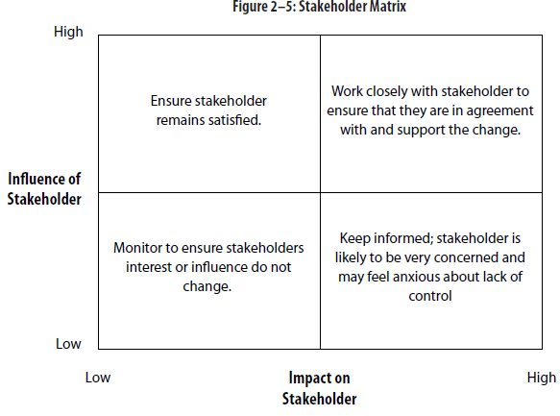
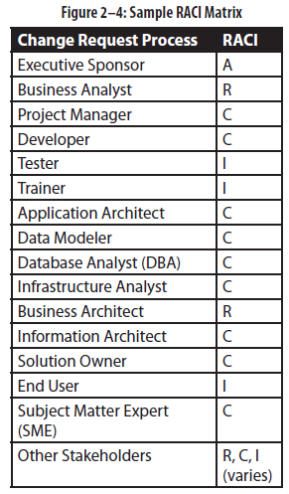
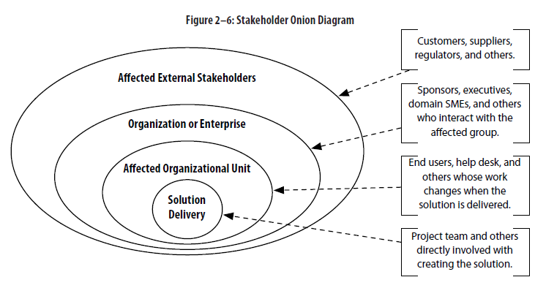
Conduct Stakeholder Analysis

Slide 12
3. Plan Business Analysis Activities
Identify business analysis deliverables
Determine the scope of work for the business analysis activities
Determine which activities the business analyst will perform and when
Develop estimates for business analysis work.

Slide 13
Plan Business Analysis Activities
The Elements:
  Where are Stakeholders?
    Co-located vs Dispersed?
  Type of project/initiative?
  Deliverables
    Begin with the end(s) in mind…
  Activities Needed
    What actions & tasks are in the process?

Slide 14
    Is a WBS just a formatted process flow?
    Details: assumptions, dependencies, milestones
  Organize the Activities
    by deliverable, phases/iterations, other?
4. Plan Business Analysis Communication
“Proposed structure and schedule for communications regarding business analysis activities”

Slide 15
“setting expectations for business analysis work, meetings, walkthroughs, and other communications.”
“how best to receive, distribute, access, update, and escalate information from project stakeholders, and determining how best to communicate with each stakeholder”
Plan for:
  what needs to be communicated
  who is the appropriate audience
  what is the appropriate delivery method
  and when the communication should occur.

Slide 16
Consider needs and constraints:
  Physical locations, time zones
  Communication approach for the stakeholder.
  What types of communications will be required
  What types of requirements will be elicited and how best to elicit them.
  How best to communicate requirements conclusions/packages.
  Time and resource availability constraints.

Slide 17
5. Plan Requirement Management
Purpose:
“approve requirements for implementation”
“manage changes to the solution or requirements scope”
Repository(ies)
WIP, in review, approved
Whiteboards
Traceability – if & how
Adds overhead
→ LAN folders → Share point → big tools

Slide 18
Manages risk if correct and consistent
Requirements Attributes
  Meta-data: unique ID, status, ownership, priority
Prioritization
  Formality, frequency, techniques, participants
Change Management
  Approach depends on methodology & culture
  Change-driven vs Plan-driven
  Large-scale, Contractual vs small, informal

Slide 19
Consider:
  Process for requests – create, assess, approve
  Participants: impact assessment & approval
  Impact analysis: who, how detailed, consolidation
  Prioritization and integration into scope
Tailoring the Requirements Management process
6. Manage BA Performance
Approach depends on methodology & project type
Change-driven vs Plan-driven
Large-scale, high risk vs small, low-impact

Slide 20
  Consider:
Short-term project metrics to help meet milestones and ensure quality in deliverables
Long-term BA metrics to develop efficiency, measure benefits of training, etc.
Risk of missing targets vs Costs of tracking & monitoring
Techniques include interviews, surveys, PMPRs, Root cause analysis and lot’s more

Slide 21
Thank You..!

Slide 22



Journal of Accounting and Marketing
International Journal of Accounting Research
Related Journals

Slide 23

2nd International Conference on Business Economics and Management

Slide 24


OMICS Group Open Access Membership
OMICS publishing Group Open Access Membership enables academic and research institutions, funders and corporations to actively encourage open access in scholarly communication and the dissemination of research published by their authors.
For more details and benefits, click on the link below:
http://omicsonline.org/membership.php

