Slide 1
Javier García Sanabria B.SC,M.SC,PHD
University of Cádiz
Editor of
Journal of Coastal Zone Management

Slide 2
Biography
Dr. Javier García Sanabria have studied his Degree on environmental sciences in the University of Granada in 2006. He was fully interested on the relations between society and the marine and coastal environment. Those interests took him to further develop his studies at Cádiz University where he achieved several Master Degrees related with coastal and marine management in 2008.
He finished his PhD on integrated marine management in 2014 and currently working at Cádiz University as a professor and researcher on the subject. In PhD where he developed a conceptual and methodological framework for guiding governance of marine-coastal areas.
Dr. Javier García Sanabria was a speaker at many local, national and international congress and meetings.

Slide 3
Research Interests
Integrated Coastal Zone Management
Integrated marine management
Marine Spatial Planning
Governance
Participation process
Coordination and participation mechanisms
Capacity building

Slide 4
Recent Publications
García Sanabria J, García Onetti J, Barragán JM (2011). “The Authonomous regions and the integrated coastal zone management of Spain. Materials for a debate on governance”. University of Cádiz and Biodiversity Foundation. 220 pp.
García Sanabria, J. et al. “Integrated Coastal Zone Management in Spain. Proposals towards a change”. Pp. 253-277. In “Integrated Coastal Zone Management and public policy in latin American, caribean, and Iberian region: proposals to action”.
García Sanabria, J. Spyglass Framework for Integrated Marine Management: from Public Policies to Environmental Changes. Second International Ocean Research Conference. UNESCO. Barcelona, 16-21 November, 2014-12-04
García Sanabria, J. Marine Spatial Planning: a useful tool for application areas. 7th International Congress for Spatial Planning. FUNDICOT & CONAMA. Madrid, 27-29 November, 2014.

Slide 5
Recent Publications
García Sanabria, J. Marine management evolution. The case of Spain. First Iberoamerican congress of Integrated Coastal Zone Management. University of Cádiz. January 2013.
García Sanabria, J. Comunication strategy among science, public administration and society for integrated coastal zone management of Cádiz. First Iberoamerican congress of Integrated Coastal Zone Management. University of Cádiz. January 2013.
García Sanabria, Javier. Integrated marine management. Cases of Spain and United Kingdom. National Environmental Congress (CONAMA 2012). Spanish Government. Madrid.
García Sanabria, J. Marine Spatial Planning: a useful tool for application areas. 7th International Congress for Spatial Planning. FUNDICOT & CONAMA. Madrid, 27-29 November, 2014.

Slide 6
Introduction-Marine Spatial Planning
Marine Spatial Planning generally uses maps to create a more comprehensive picture of a marine area – identifying where and how an ocean area is being used and what natural resources and habitat exist. It is similar to land-use planning, but for marine waters.
Through the planning and mapping process of a marine ecosystem, planners can consider the cumulative effect of maritime industries on our seas, seek to make industries more sustainable and proactively minimize conflicts between industries seeking to utilize the same sea area.

Slide 7
Introduction
The intended result of MSP is a more coordinated and sustainable approach to how our oceans are used – ensuring that marine resources and services are utilized, but within clear environmental limits to ensure marine ecosystems remain healthy and biodiversity is conserved.
Among the Government's stated aims for the new marine planning system is to ensure that coastal areas, the activities within them and the problems they face are managed in an integrated and holistic way.

Slide 8
Professional Prospects
The main elements of marine spatial planning include an interlinked system of plans, Policies, strategies and Regulations. Those are the components of environmental management systems (e.g. setting objectives, initial assessment, implementation, monitoring, audit and review); and some of the many tools that are already used for land use planning. Whatever the building blocks, the essential consideration is that they need to work across sectors and give a geographic context in which to make decisions about the use of resources, development, conservation and the management of activities in the marine environment.

Slide 9
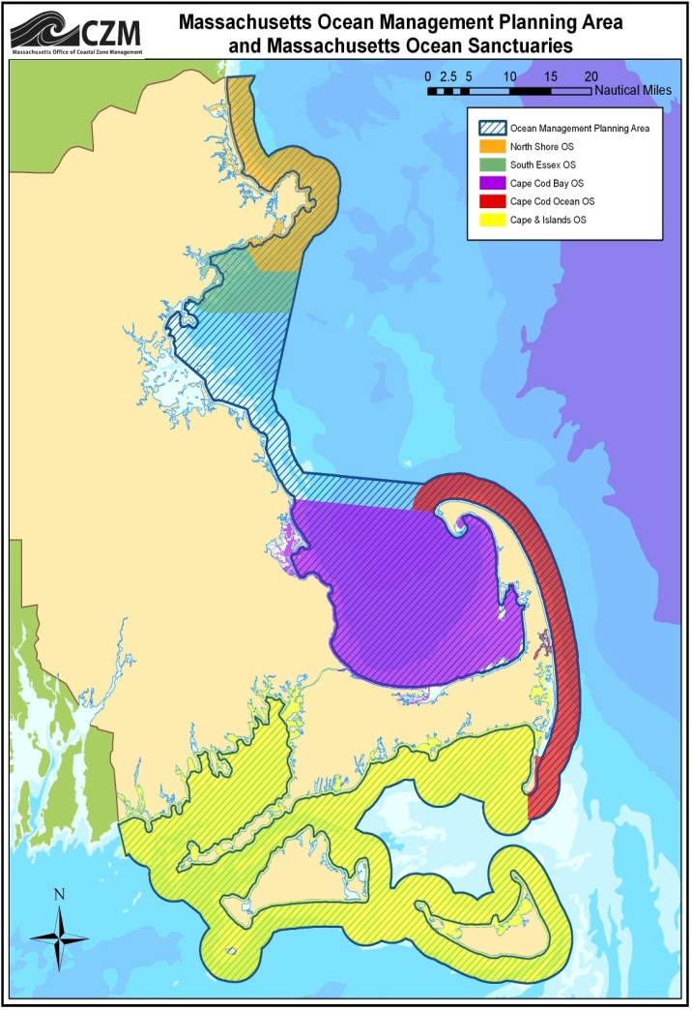
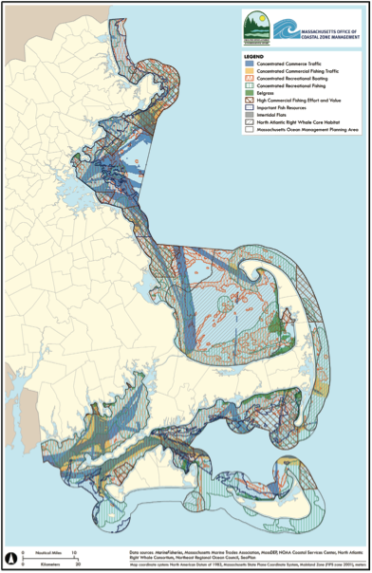
Professional Prospects-Example of MSP off Massachusetts, USA

Slide 10
Characteristics-MSP
Effective marine spatial planning has essential attributes:
Multi-objective. Marine spatial planning should balance ecological, social, economic, and governance objectives, but the over riding objective should be increased sustainability.
Spatially focused. The ocean area to be managed must be clearly defined, ideally at the ecosystem level - certainly being large enough to incorporate relevant ecosystem processes.
Integrated. The planning process should address the interrelationships and interdependence of each component within the defined management area, including natural processes, activities, and authorities.

Slide 11
Definition
Marine Spatial planning (MSP) is a process that brings together multiple users of the ocean – including energy, industry, government, conservation and recreation – to make informed and coordinated decisions about how to use marine resources sustainably

Slide 12
Approved By
Javier García Sanabria

