Slide 1
The Impact of Inter-Center Competition on Liver Transplant Practices and Outcomes
Jeff Halldorson M.D.
Associate Professor
Transplant Surgery
UCSD Department of Surgery

Slide 2
Liver Allocation Proceeds by “Sickest First” Principle
Chronic Liver Failure
Acute “Fulminant” Liver Failure (Expected Lifespan <7 days without Transplantation)
or
Waitlist Mortality Priority
based on MELD score
Status 1
Highest Priority

Slide 3
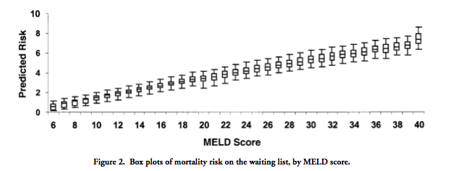
MELD and Waitlist Mortality
Merion,RM Liver Transplantation. 2004

Slide 4
Liver Transplant Waitlist
Offer List 1
Status 1
A1
A2
A3
A4
A5
A6
A7
A8
A9
Donor X (22year old MVA)
high
MELD
“Match”
low
Expected Outcome
Risk A1/RiskX

Slide 5
Transplant Center Report Card
Center 1
Center 2

Slide 6
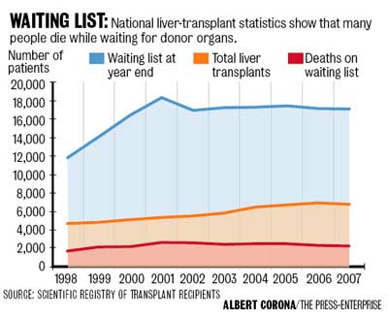
Waitlist/Transplants/Deaths by Year

Slide 7
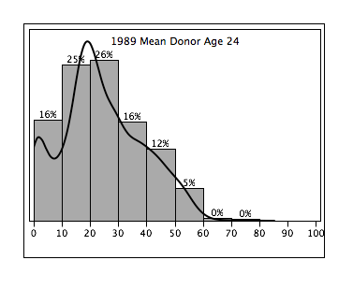
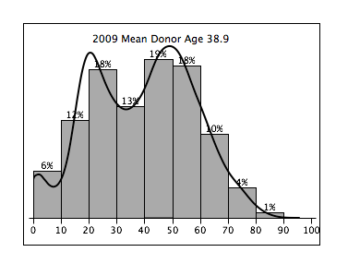
The Changing Liver Donor Population1989-2009
X
X
Y
X
1989
2009
No ECD Donors
No Matching considerations Necessary
No Special Informed Consent

Slide 8
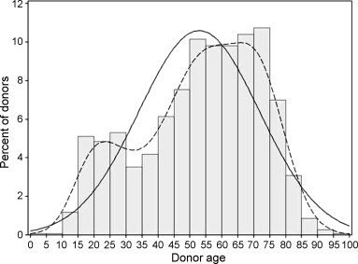
The Older Donor European Challenges
Mario Angelico M.D.
Y
X
Z
Fig. 1.
Age distribution of overall donor population. Continuous line: estimated normal density (mean = 52.9, SD = 18.9). Dashed line: empirical density (kernel estimate).
The Bad News: Donor age will continue to increase
The Good News: There is a great potential in the US to expand utilization of older donors for Liver Transplantation
7

Slide 9
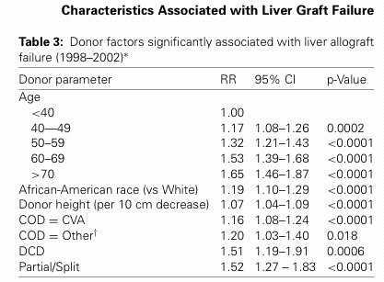
Donor Risk Index
Donor Risk Index, Feng, et. al., AJT 2006

Slide 10
Liver Transplant Waitlist
Offer List 1
Status 1
A1
A2
A3
A4
A5
A6
A7
A8
A9
Donor Y (69 year old Stroke)
high
MELD
“Best Match?”
low
Predicted Outcome
A1/Y
A5/Y

Slide 11
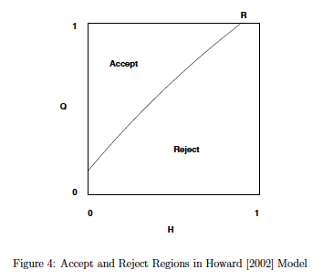
Organ Acceptance Decisions in Liver Transplantation: Howard Model
A

Slide 12
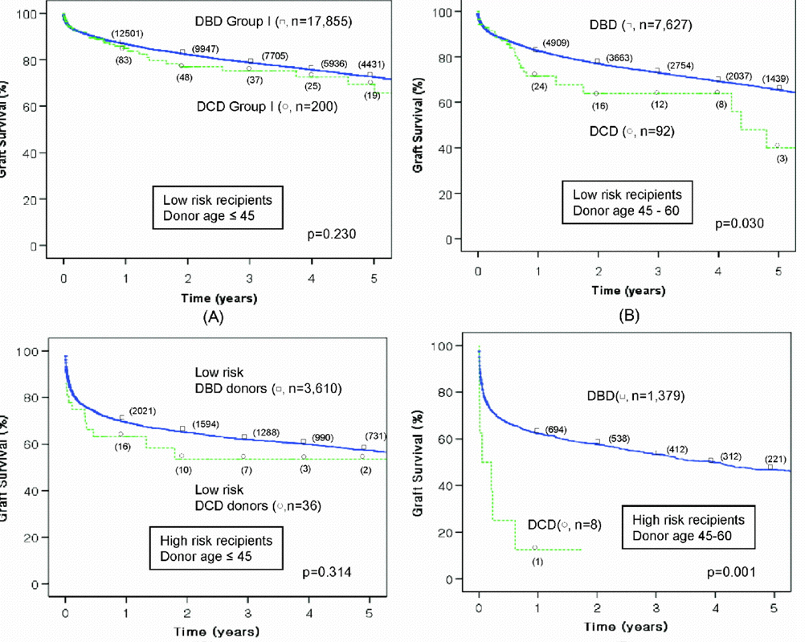
Matching Donors and Recipients
Lee KW, Simpkins CE, Montgomery RA, Locke JE, Segev DL, Maley WR. Factors affecting graft survival after liver transplantation from donation after cardiac death donors. Transplantation 2006; 82: 1683-8

Slide 13
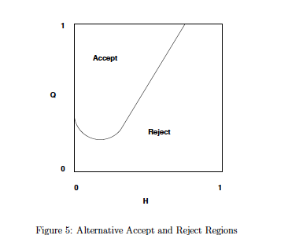
Organ Acceptance Decisions in Liver Transplantation: Alagosz Model

Slide 14
Matching Donors and Recipients:
“Window of Appropriate Use”
Benefit Bar
“Risk Cap”
Standard Donor
Extended Donor*
MELD
10
20
30
40
*DCD, Split, Older Donor…..Steatosis

Slide 15
Adam Smith
On competition…
In general, if any branch of trade…….. be advantageous to the public, the freer and
more general the competition, it will always be the more so.
The Wealth Of Nations, Book II, Chapter II, p.329, para. 106.
Hypothesis: “Local Competition Between Liver Transplant Centers Within a DSA should Advantage the Public”
1. Improved Outcomes
2. Greater Access/Improved Organ Utilization
3. Decreased Cost

Slide 16
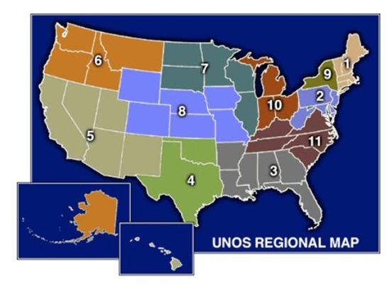
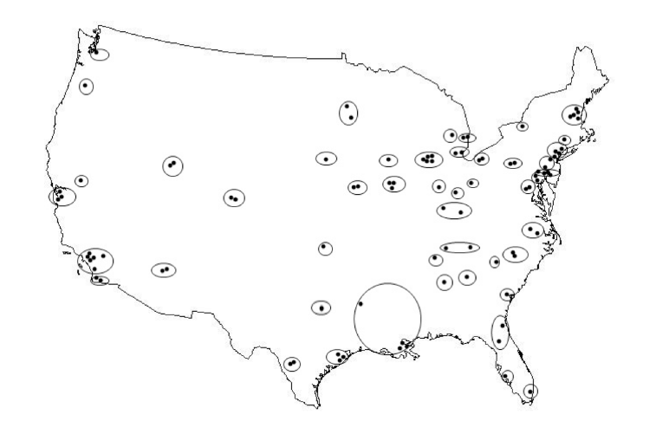
Distribution of Liver Transplant Centers
UNOS Regions
DSAs/Centers
The competitive environment for organs varies greatly at the local level. (1-6 Liver Centers/DSA)

Slide 17
Overall Patient Survival
Non-Competitive(NC) vs. Competitive(C) Centers
NC(22%)
C(78%)
p-value
88.0% | 85.3% | <0.001
88.3% | 86.4% | <0.001
80.8% | 76.5% | <0.001
80.2% | 77.4% | <0.001
1 year actual Survival
1 year expected Survival
3 year actual Survival
3 year expected Survival
2003-2010

Slide 19
What is the Impact of Competitive Environment on?
1. Post Transplant Outcomes?
2. Organ Utilization?
3. Disease Severity at Transplantation
4. Listing/Organ acceptance

Slide 20
Methods
All liver transplants from the MELD era (2003 and 2009) were studied using the UNOS database (n=38,385). Competitive environment for a local market was stratified into tertiles using the Herfindahl–Hirschman Index* (HHI).
Herfindahl–Hirschman Index (HHI) a commonly accepted measure of market concentration. The HHI is calculated by squaring the market share of each firm competing in the market and then summing the resulting numbers.
Example 1: A market consisting of four centers with shares of 30%, 30%, 20% and 20%, the HHI = 2,600 (30² + 30² + 20² + 20²).
Example 2: A market consisting of three centers with shares of 90%, 7% and 3%, the HHI = 8158 (90² + 7² + 3²).
Example 3: A market consisting of a single center. HHI=10,000 (100²)

Slide 21
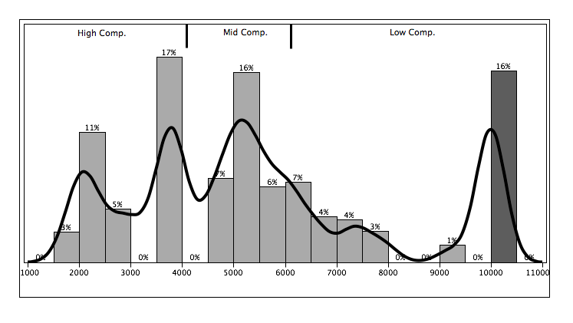
Distribution of HHI
HHI

Slide 22
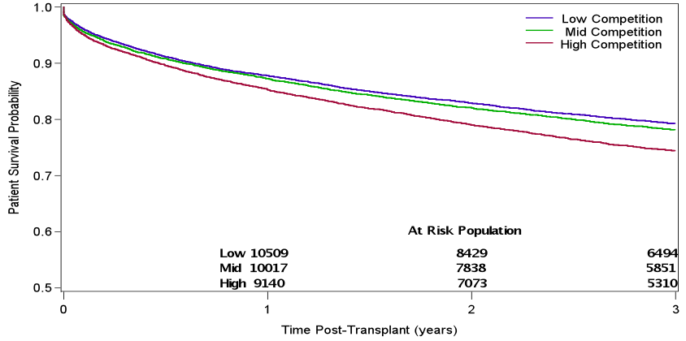
Post Transplant Survival and Competition

Slide 23
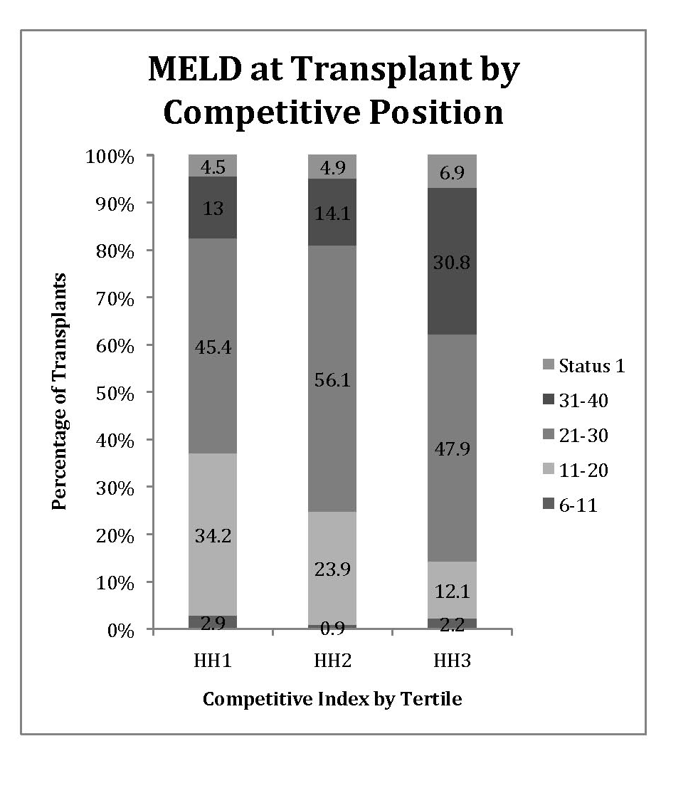
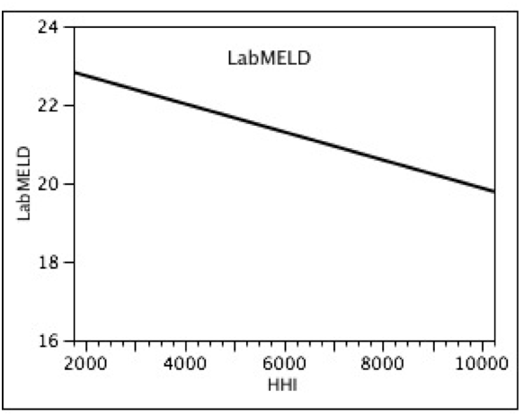
Recipient Risk and Competition
Transplant MELD vs. HHI
Prob > F
<.0001*

Slide 24
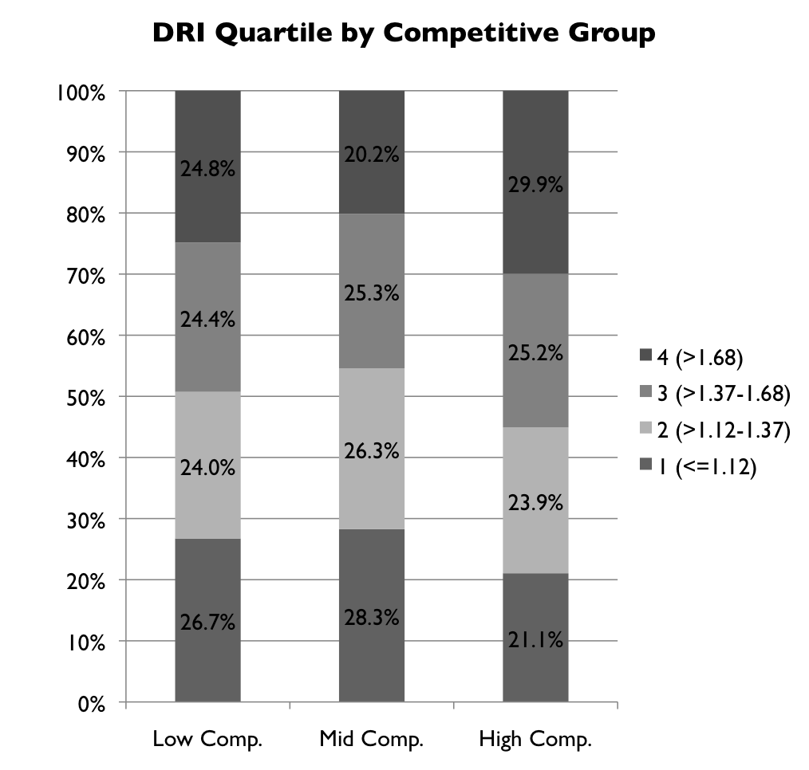
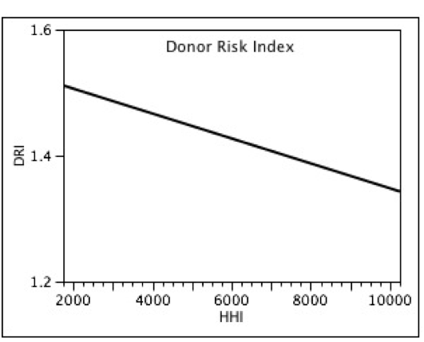
Donor Risk and Competition
DRI vs. HHI
Prob > F
<.0001*

Slide 25
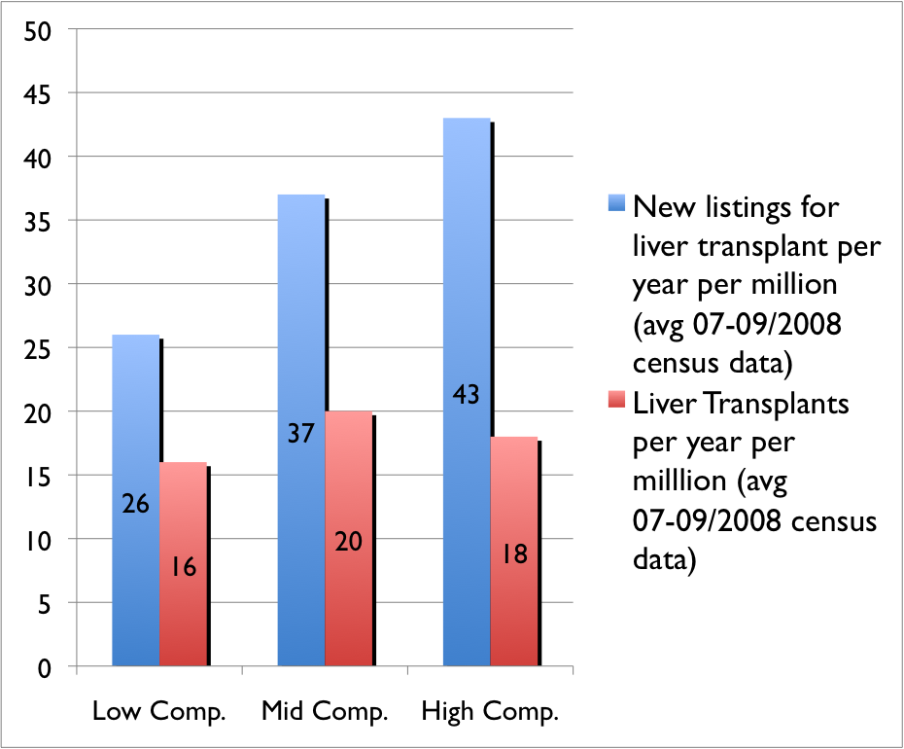
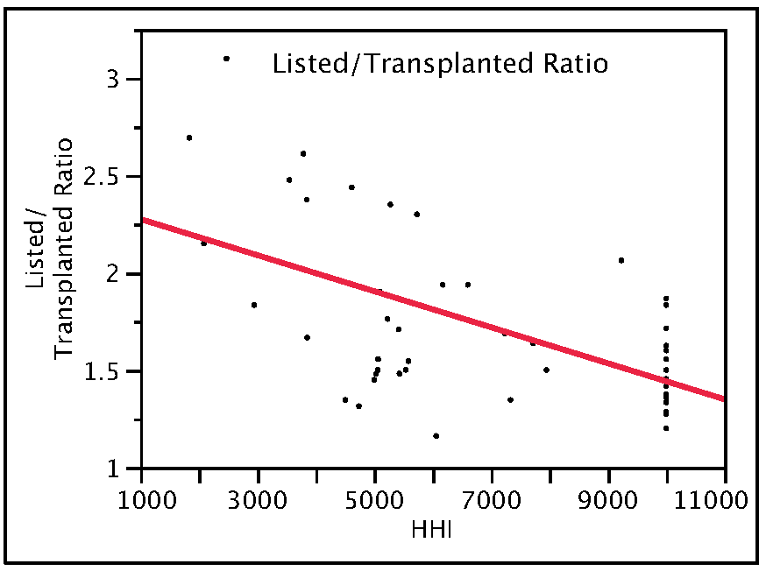
Listed/Transplanted Ratio and Competition
Listed/p.m.p and Transplanted/p.m.p. by HHI tertile
Listed/Transplanted ratio by HHI
(OPO Center Data)

Slide 26
Impact of Competition
Univariate and Multivariate Analysis
 |  | Univariate |  |  | Multivariate
Risk of patient death (D)
Characteristic | HR | 95% CI | p-value | HR | 95% CI | p-value
HHI tertile
1 (low comp, >0.57) | 1.00 |  |  | 1.00
2 (mid comp, 0.38-0.57) | 1.05 | 1.00-1.11 | 0.037 | 1.04 | 0.99-1.09 | 0.133
3 (high comp, <0.38) | 1.23 | 1.18-1.29 | <0.001 | 1.04 | 0.99-1.10 | 0.119
Comparison of donor and recipient characteristics by DSA competition level (described by HHI tertile) (characteristics significant in SRTR reports.)

Slide 27
Competition for Limited Resources
in Liver Transplantation
Poorer Outcomes
Increased Disease Severity/ Resource Utilization and Cost
Greatly Improved Access to Listing
Small Improvement In Access to Transplantation
Adam Smith??

Slide 28
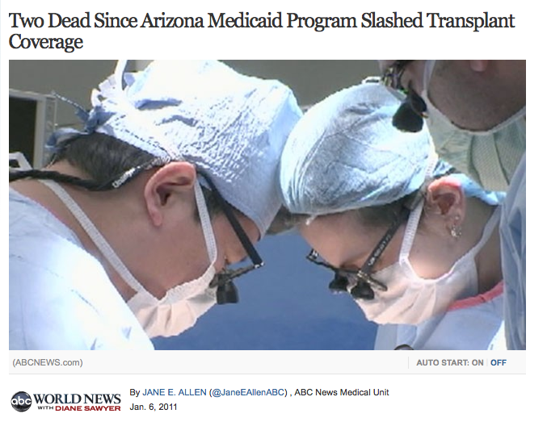
“Tragedy of the Commons”
“We can make little progress ... until we explicitly exorcize the spirit of Adam Smith, ... the idea that an individual who "intends only his own gain," is, "led by an invisible hand to promote ... the public interest"
Garritt Hardin, Science Dec. 13, 1968
Hardin’s Example: Herdsman sharing a common pasture are each individually motivated to add more cattle to their herd. The result is an overgrazed common in which the animals starve.

Slide 29
Proposed Mechanism: Match List Competition
Equal Competition
Dominant Competitor
No Competition
A
A
A
A
A
A
A
A
A
A
B
C
D
E
A
B
C
D
A
B
A
A
A
A
A
A
B
Absence of Competition
Accept
“Best Match”
Under Competition
Accept
“Maximum Tolerated Risk”

Slide 30
Donor/Recipient Matching in Liver Transplantation, the Advantage of List Dominance (ECD Donor)
Equal Competition
Dominant Competitor
A
B
C
D
E
A
B
C
D
A
B
A
A
A
A
A
A
B
Donor 2:
66 y.o. C.O.D.: C.V.A.
high
MELD
low

Slide 31
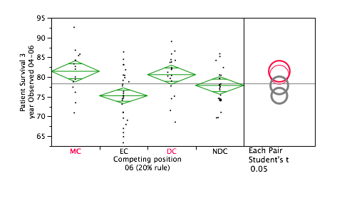
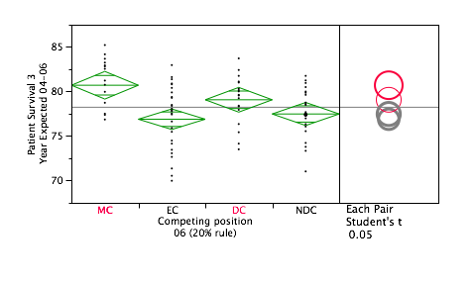
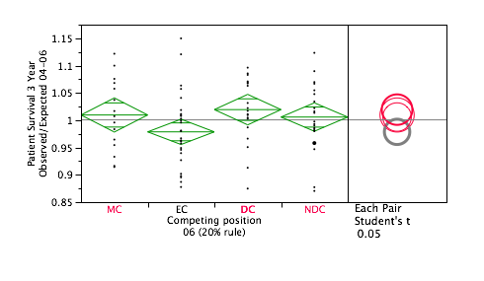
Outcome vs. Market Position MC=Monopoly Center, EC=Equal-Competitor, DC Dominant Competitor, NDC Non-Dominant Competitor
Observed 3 Year Patient Survival
Expected 3 Year Patient Survival
Observed/Expected

Slide 32
Competition, Utilization, and MELD
Less Competition
More Competition
-Opportunity for better control of
Donor/Recipient Risk and Matching
-Decreased Access to listing
-Risk Aversion/Decreased Utilization
-Inability to control match risk for both
donors and recipients
-Poorer Outcomes/Higher Cost
in “Sickest First” Paradigm

Slide 33
What Should We Compete For?
How do we Avoid a “Race to the Bottom” in
“Sickest first” Allocation?
Is it time for the Liver transplant community
to better balance utility against
disease severity in allocation policy?
What can be done on a local level to mitigate the
negative influence of competition

Slide 34
Acknowledgements
John Roberts M.D., UCSF
Jennifer Dodge M.S., UCSF
Harry Paarsch, Ph.D. ,University of Melbourne
Alberto Segre Ph.D., University of Iowa

