Slide 1
OMICS Journals are welcoming Submissions
OMICS International welcomes submissions that are original and technically so as to serve both the developing world and developed countries in the best possible way.
OMICS Journals are poised in excellence by publishing high quality research. OMICS International follows an Editorial Manager® System peer review process and boasts of a strong and active editorial board.
Editors and reviewers are experts in their field and provide anonymous, unbiased and detailed reviews of all submissions.
The journal gives the options of multiple language translations for all the articles and all archived articles are available in HTML, XML, PDF and audio formats. Also, all the published articles are archived in repositories and indexing services like DOAJ, CAS, Google Scholar, Scientific Commons, Index Copernicus, EBSCO, HINARI and GALE.
For more details please visit our website: http://omicsonline.org/Submitmanuscript.php

Slide 2
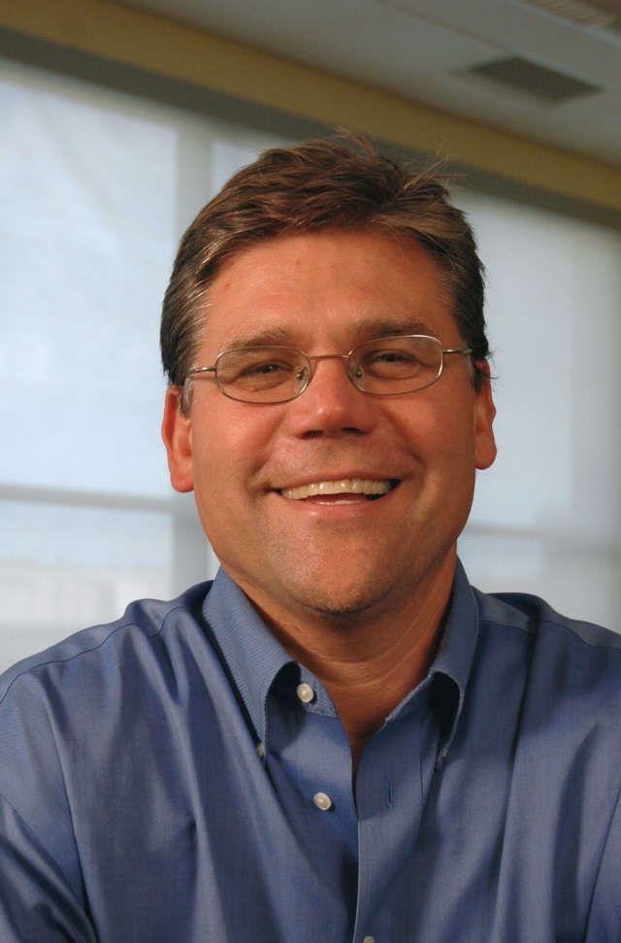
Dr. Jered B. Kolbert
Professor of Counselor Education
Duquesne University, Pittsburgh, Pennsylvania

Slide 3
Education
The College of William and Mary, Williamsburg, Virginia
Doctorate of Philosophy in Counseling, May 1998
The College of William and Mary, Williamsburg, Virginia
Education Specialist in Counseling, May 1995
Kean College of New Jersey, Union, New Jersey
Master of Arts in Counselor Education/Guidance Counseling, May 1994
Rutgers College, Rutgers University, New Brunswick, New Jersey
Bachelor of Arts in History and Political Science, May 1992

Slide 4
Administrative Experience
Director, Counselor Education Program, Duquesne Univ.
June 2012 – present
Coordinator, School Counseling Program, Slippery Rock Univ. of Pennsylvania, Sept. 2008-June 2011

Slide 5
Honors and Awards
Duquesne University, School of Education, 2013 Barbara A. Sizemore Urban Education Initiative Spirit Award

Slide 6
Teaching Experience
Dr. Kolbert currently teaches master’s and doctoral counselor education courses at Duquesne University. He teaches courses in school counseling, marriage and family counseling, counseling theories, counseling techniques, instructional methods, lifespan development, practicum and internship.

Slide 7
Reviewer and Editorial Board member
Editorial Board for the Journal of Addictive Behaviors, Therapy & Rehabilitation (2012-present)
Editorial Board for the International Journal of School and Cognitive Psychology (2013-present)

Slide 8
Professional organizations
American Counseling Association (ACA)
American School Counselor Association (ASCA)
Pennsylvania School Counselors Association (PSCA)

Slide 9
Conferences and Workshops
Behun, R. J., Cerrito, J., & Kolbert, J. B. (2014, July). Recognizing and reporting child sexual abuse. Presented at the annual meeting of the American School Counselor Association, Orlando, FL (national peer reviewed)
Field, J. E., Kolbert, J. B., & Crothers, L. M. (2013, March). Whole-school methods to address bullying. Presentation conducted at the annual meeting of the American Counseling Association, Cincinnati, OH. (national peer reviewed)
Mulcahy, M., Kolbert, J. B., & Crothers, L. M. (2013, March). The process and strategies LGBTQ students employ to establish an informal, school-based mentor in high school. Poster session conducted at the annual meeting of the American Counseling Association, Cincinnati, OH. (national peer reviewed)
Crothers, L. M., Kolbert, J. B., Kanyongo, G. Y., Schmitt, A. J., Fenclau, E.,Albright, C. M., Woodarek, J., & Wells, D. (2013, February). Relational and social aggression and reflective processing in late adolescence. Poster session presented at the annual meeting of the National Association of School Psychologists, Seattle, WA.
Crothers, L. M., Field, J. E., Kolbert, J. B., Kanyongo, G. Y., Buzgon, J.,Stephenson, E., & Fenclau, E. (2013, February). Identity, cognitive processing, and relational and social aggression in adolescence. Poster session presented at the annual meeting of the National Association of School Psychologists, Seattle, WA.
Kolbert, J. B., & Crothers, L. M. (2012, March). The relationship between hyperfemininity and achievement of ego identity among college females. Presentation conducted at the annual meeting of the American Counseling Association, San Francisco, CA. (national peer reviewed)

Slide 10
Research Interests:
relational and social aggression
bullying
cognitive and moral development

Slide 11
Publications
Crothers, L. M., Kolbert, J. B., Kanyongo, G. Y., Field, J. E., & Schmitt, A. J. (2014). Relational and social aggression and reflective processing in a university sample. Journal of Aggression, Maltreatment, and Trauma, 23(6), 670-681.
Kolbert, J. B., Schultz, D., & Crothers, L. M. (2014). Bullying prevention and the parent involvement model. Journal of School Counseling, 12(7).
Clinton, A., Crothers, L. M., Kolbert, J. B., Hughes, T. L., Schreiber, J. B., Schmitt, A.J., Lipinski, J., Vázquez, G. R., & Field, J. E. (2014). A cross-cultural investigation of relational and social aggression in Puerto Rican and American female college students. Journal of Aggression, Maltreatment & Trauma, 23(2), 99-115.

Slide 12
Publications
Durand, V., Hennessy, J., Wells, D. S., Crothers, L. M., Kolbert, J. B., & Hughes, T. L.(2013). Bullying and substance use in children and adolescents. Journal of Addiction Research and Therapy, 4, 1-6.
Comstock, L. A., Crothers, L. M., Schreiber, J. B., Schmitt, A. J., Field, J. E., Hughes, T. L., Kolbert, J. B., & Lipinski, J. (2013). Relational, social, and overt aggression among aggressive and nonaggressive female adolescents. Journal of Child & Adolescent Trauma, 6, 106-117.
Kolbert, J. B., Crothers, L. M., & Field, J. E. (2013). Clinical interventions with adolescents using a family systems approach. The Family Journal, 21, 87-94.

Slide 13
Books
Kolbert, J. B., & Crothers, L. M. (Eds.). (2012). Understanding and managing behaviors of children with psychological disorders. New York: Continuum Books.
Field, J. E., Kolbert, J. B., Crothers, L. M., & Hughes, T. L. (2009). Understanding girl bullying and what to do about it: Healing the divide. Thousand Oaks, CA: Corwin Press. ISBN: 1412964873

Slide 14
International Journal of School and Cognitive Psychology Related Journals
Journal of Psychological Abnormalities in Children
Journal of Psychology & Psychotherapy

Slide 15
For upcoming conferences visit www.conferenceseries.com

