Slide 1
OMICS Journals are welcoming Submissions
OMICS International welcomes submissions that are original and technically so as to serve both the developing world and developed countries in the best possible way.
OMICS Journals are poised in excellence by publishing high quality research. OMICS International follows an Editorial Manager® System peer review process and boasts of a strong and active editorial board.
Editors and reviewers are experts in their field and provide anonymous, unbiased and detailed reviews of all submissions.
The journal gives the options of multiple language translations for all the articles and all archived articles are available in HTML, XML, PDF and audio formats. Also, all the published articles are archived in repositories and indexing services like DOAJ, CAS, Google Scholar, Scientific Commons, Index Copernicus, EBSCO, HINARI and GALE.
For more details please visit our website: http://omicsonline.org/Submitmanuscript.php

Slide 2
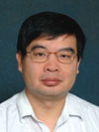
 | Jianhua Luo Professor Department of Pathology University of Pittsburgh School of Medicine Pittsburgh, USA

Slide 3
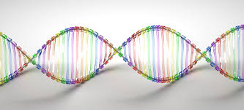
Biography
Dr. Luo been studying molecular pathology related to human malignancies in the last 23 years. Currently, he is a Professor of Pathology and Director of High Throughput Genome Center at University of Pittsburgh.
In the last 13 years, Dr. Luo has been largely focusing on genetic and molecular mechanism of human prostate and hepatocellular carcinomas. In this period, his group has identified and characterized several genes that are related to prostate cancer and hepatocellular carcinoma, including SAPC, myopodin, CSR1, GPx3, ITGA7, MCM7, MT1h and GPC3.
He is one of the pioneers in utilizing high throughput gene expression and genome analyses to analyze field effects in prostate cancer and liver cancer. He is also the first in using methylation array and whole genome methylation sequencing to analyze prostate cancer.

Slide 4
Research Interest
Has research interests to identify new tumor suppressor genes, oncogenes and tumor markers in prostate cancer and hepatocellular carcinoma using high throughput and comprehensive analyses. Subsequently, we will direct our effort to evaluate the prognostic values of these genes and markers in making early diagnosis of these malignancies and serving as drug targets for cancer prevention program.
As the Director of High Throughput Genome Center, I have collaborated extensively with faculty members in the UPMC and University campuses to use high throughput genome sequencing and high throughput microarray analyses to develop tests for molecular pathology and to investigate novel mechanisms for signal transduction and identifying markers for human diseases.

Slide 5
Introduction

Slide 6
Categories of Tumour Supressor Gene
Caretaker Gene:
Maintain the integrity of the genome by repairing DNA damage
GatekeeperGene
Inhibit the proliferation the death of the cells with damaged DNA.

Slide 7
Tumor protein p53
Known as p53, cellular tumor antigen p53, phosphoprotein p53, or tumor suppressor p53, is a protein which encoded by the TP53 gene.
Located at the short arm of chromosome17.
It can activate the DNA repair protein when DNA sustains damage.
regulates the cell cycle and, thus, functions as a tumor suppressor, preventing cancer. As such, p53 has been described as "the guardian of the genome" because of its role in conserving stability by preventing genome mutation.[

Slide 8
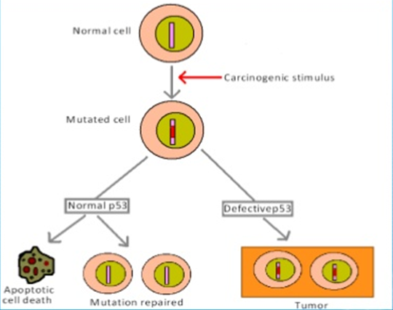
Role of p53 in cells with damaged DNA

Slide 9
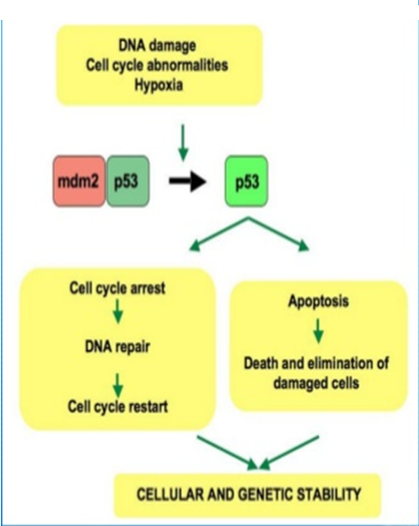
Role of p53 gene

Slide 10
Other Supressor Gene
APC Gene
WT-1
NF-1
Von Hippel- lindau Gene
P15 & P16
BRCA1 & BRCA2
P10 gene

Slide 11
Journal of Next Generation Sequencing & Applications Related Journals
Advancements in Genetic Engineering
Journal of Computer Science & Systems Biology
Journal of Proteomics & Bioinformatics
Transcriptomics: Open Access

Slide 12
Journal of Next Generation Sequencing & Applications
Upcoming Conferences
http://www.conferenceseries.com/

