Slide 1

OMICS Journals are welcoming Submissions
OMICS International welcomes submissions that are original and technically so as to serve both the developing world and developed countries in the best possible way.
OMICS Journals are poised in excellence by publishing high quality research. OMICS International follows an Editorial Manager® System peer review process and boasts of a strong and active editorial board.
Editors and reviewers are experts in their field and provide anonymous, unbiased and detailed reviews of all submissions.
The journal gives the options of multiple language translations for all the articles and all archived articles are available in HTML, XML, PDF and audio formats. Also, all the published articles are archived in repositories and indexing services like DOAJ, CAS, Google Scholar, Scientific Commons, Index Copernicus, EBSCO, HINARI and GALE.
For more details please visit our website: http://omicsonline.org/Submitmanuscript.php

Slide 2
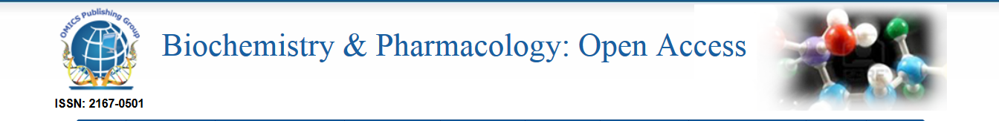
Jiapu Zhang
(Emails: jiapuzhang@swin.edu.au, j.zhang@federation.edu.au
Phones: +61-3-5327 6335, +61-3-9214 5596)
Molecular Dynamics (MD), Quantum Mechanics / Molecular Mechanics (QMMM), and Molecular Modeling (MM) Studies of Prion Proteins and Prions
A Seminar at Swinburne University of Technology
30th Jan 2014

Slide 3
Introduction to Prions (PrPSc) and Prion Proteins (PrPC)
1. MD
2. MM
3. QM/MM
Notes:
3

Slide 4
0. Introduction to Prions and Prion Proteins
Notes:
4

Slide 5
Introduction to prion diseases (Prions)
Unlike conventional infectious diseases which require that a microorganism bring DNA, RNA or both into the body, prion diseases can be caused by the body’s own proteins.
Prions differ from conventional infectious agents in being highly resistant to treatments that destroy the nucleic acids found in bacteria and viruses.
A prion is neither a virus, a bacteria nor any microorganism so the disease cannot be caused by the vigilance of the organism immune system and it can freely spread from one species to another species.

Slide 6
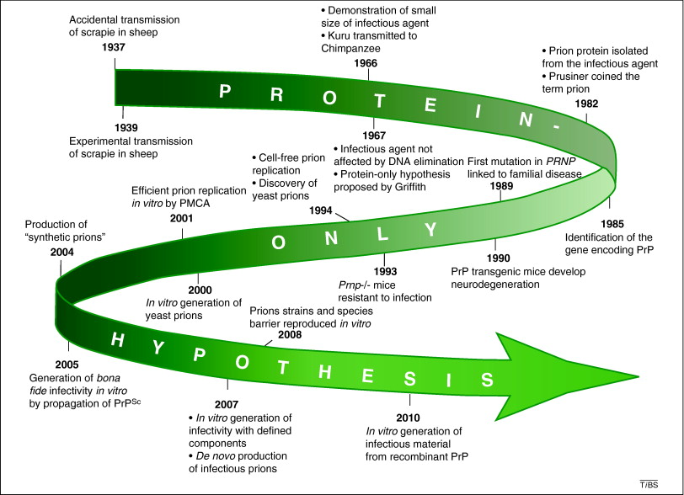

Slide 7

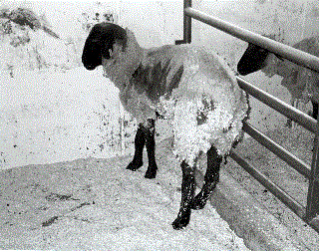
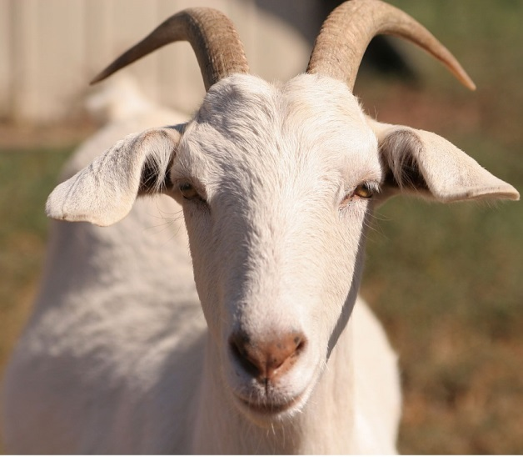

Cow
is
mad:
Sheep
goat
scrapie:
Deer
chronic
wasting
disease
(CWD):

Slide 8


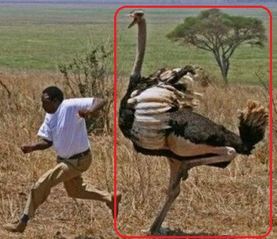
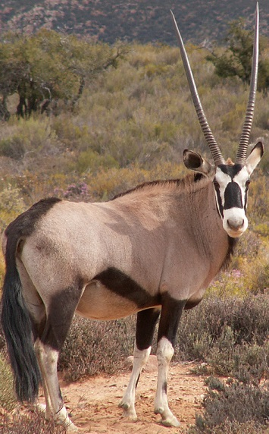
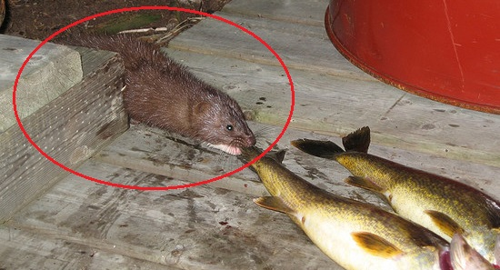
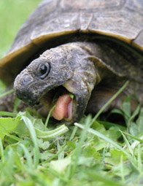
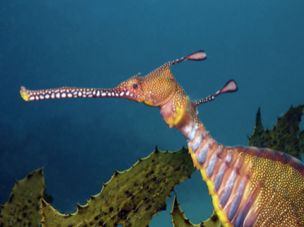
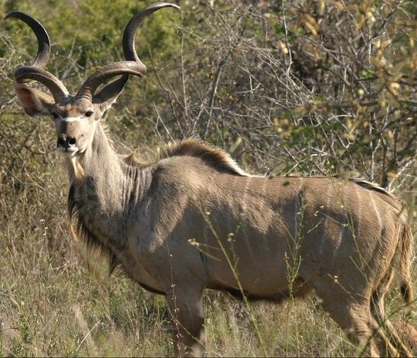

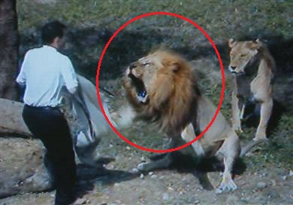
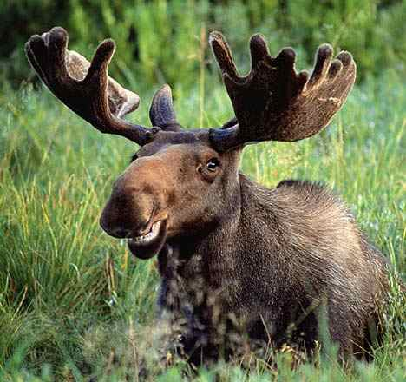
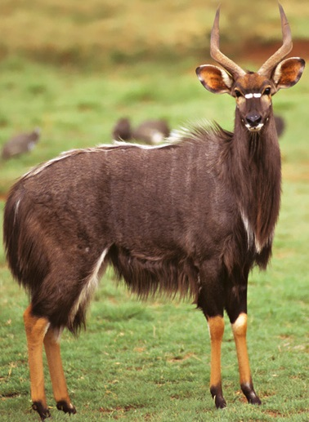
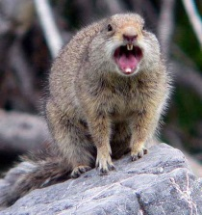
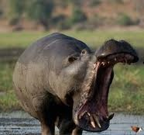
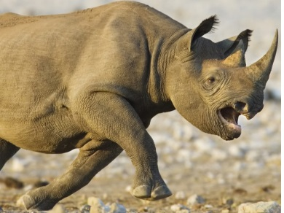

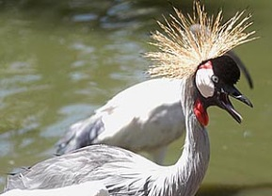
“Mad”:

Slide 9
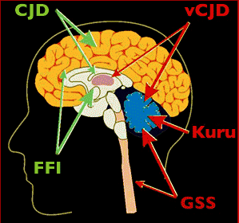
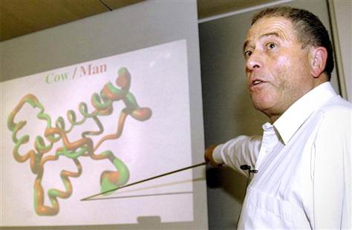
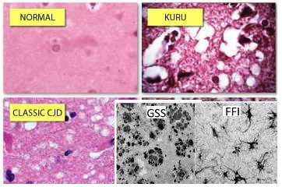
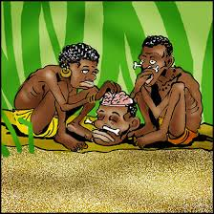

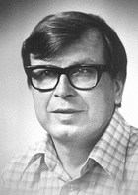
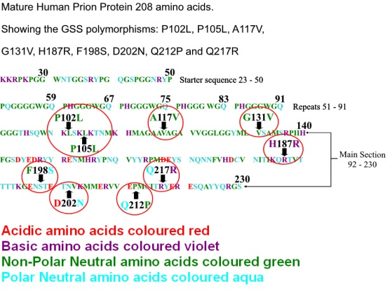


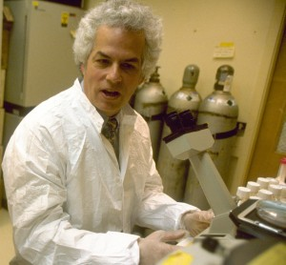
Humans:
CJD
Nobel Prize in 2002
Kuru
disease
GSS
FFI
Nobel Prize in 1976
Nobel Prize in 1997

Slide 10
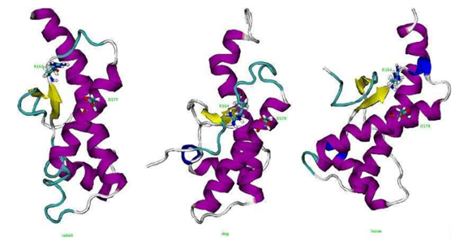
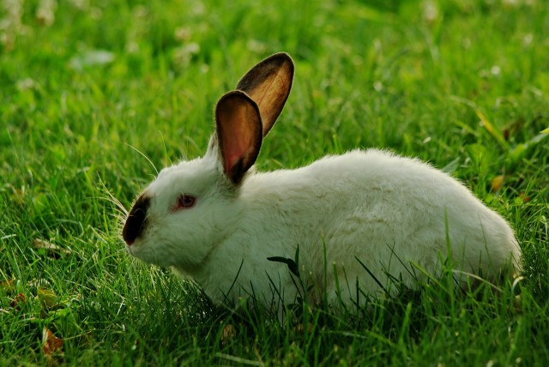
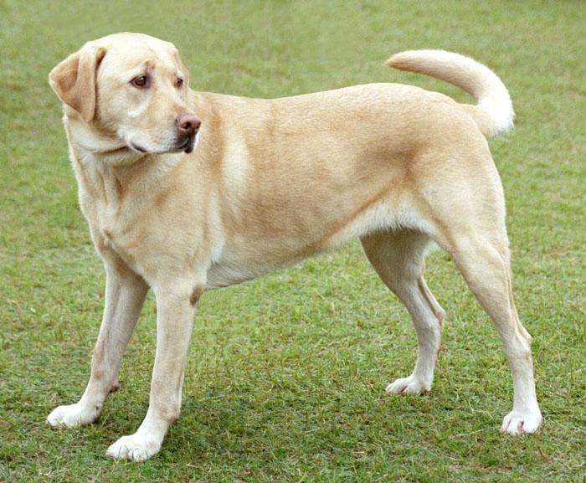
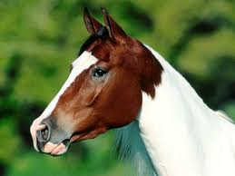
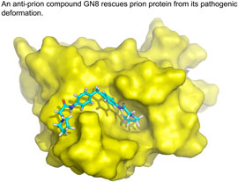
Rabbits, Dogs, and Horses are
not easily “mad”:
Jiapu Zhang (2011) Molecular Dynamics - Practical Application: Mechanism underlying the resistance to prion diseases in rabbits. ISBN 978-3-8465-4843-1.

Slide 11
Novels on prion diseases:
[1] Mad cows and cannibals: a guide to the transmissible spongiform encephalopathies / Charlotte A.Spencer, Pearson Prentice Hall,2004 - 38 pages
[2] Mad cow disease: the history of BSE in Britain - "Dead-end host?"/ Richard W.Lacey, Cypsela,1994 - 200 pages
[3] Deadly feasts : tracking the secrets of a terrifying new plague / Richard Rhodes, Simon & Schuster,1997 - 259 pages
[4] Deadly feasts: the "prion" controversy and the public's health / Richard Rhodes, Touchstone Books,1998 - 278 pages
[5] Death on the menu: CJD victims - diagnosis and cure : families devastated by "mad cow" disease reve / Narang, Harash, Newcastle upon Tyne: H.H.,1997 - 266 pages
[6] The trembling mountain : a personal account of kuru, cannibals, and mad cow disease / Robert Klitzma, Plenum Trade,1998 - 333 pages (free download at website: ishare.iask.sina.com.cn/f/36888814.html)
[7] Mad Cow U.S.A. - Could the Nightmare Happen Here? / Sheldon Rampton & John Stauber, Common Courage Press, 1997 (free download at website: http://healthcoalition.ca/archive/mcusa.pdf)
[8] Brian Trust: The Hidden Connections Between Mad Cow and Misdiagosed Alzheimer's Disease / Colm A. Kelleher, 2004 - 312 pages
[9] How the Cow Turned Mad: Unlocking the Mysteries of Mad Cow Disease / Maxime Schwartz, University of California Press, 2004 - 238 pages
[10] The Pathological Protein: Mad Cow, Chronic Wasting, and Other Deadly Prion Diseases / Philip Yam, Copernicus Books, 2003 - 284 pages (free download at website: http://ishare.iask.sina.com.cn/f/33613529.html)
[11] The Social Construction of Disease: From Scrapie to Prion / Kiheung Kim, Routledge Taylor & Francis Group, 2007 - 253 pages
[12] Fatal Flaws - How a Misfolded Protein Baffled Scientists and Changed the Way We Look at the Brain, Jay Ingram, Harper Collins Publishers Ltd, 2012 - 260 pages
[13] Mad Cow Disease - The Risks for Humans, Jean-Philippe Deslys & André Picot, Flammarion, 2001 - 125 pages free download at website: www.neuroprion.org/resources/pdf_docs/documentation/madcow_deslys.pdf
[14] Infectious Process, Knowledge, Discourse and the Politics of Prions, Eve Seguin (ed), Palgrave macmillan, 2004 - 191 pages
……

Slide 12
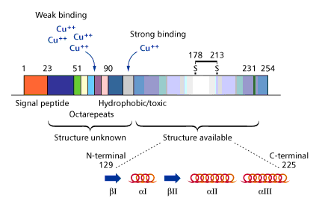
Structured region we use MD, unstructured region we use MM, and the cooper bindings we use QM/MM.

Slide 13
1. MD (Molecular Dynamics)
Notes:
13

Slide 14
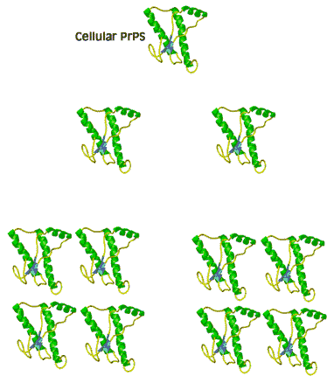
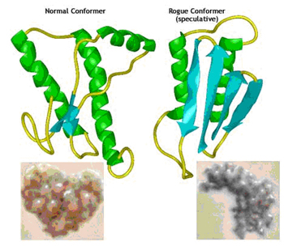
Prion:
Prion diseases are caused by the conversion from a soluble normal cellular prion protein (PrPC) into insoluble abnormally folded infectious prions (PrPSc) and the conversion of PrPC→PrPSc is believed to involve conformational change from a predominantly α-helical protein to one rich in β-sheet structure.
Notes:
The forces between β-sheets were maintained by the forces introduced in our Program 1.

Slide 15
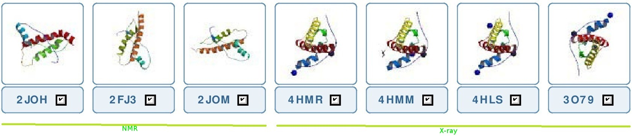
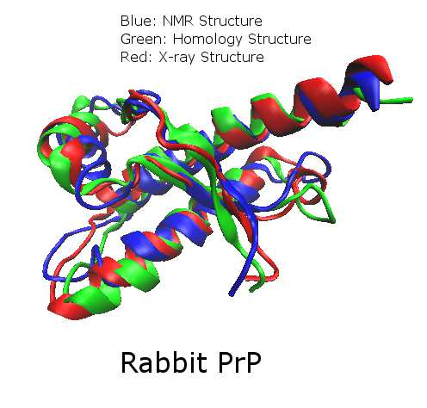
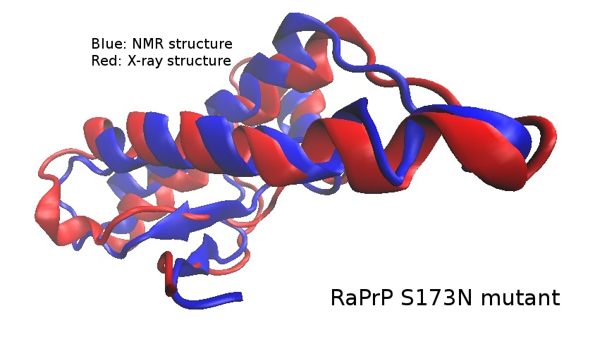
Molecular structures of RaPrP:

Slide 16
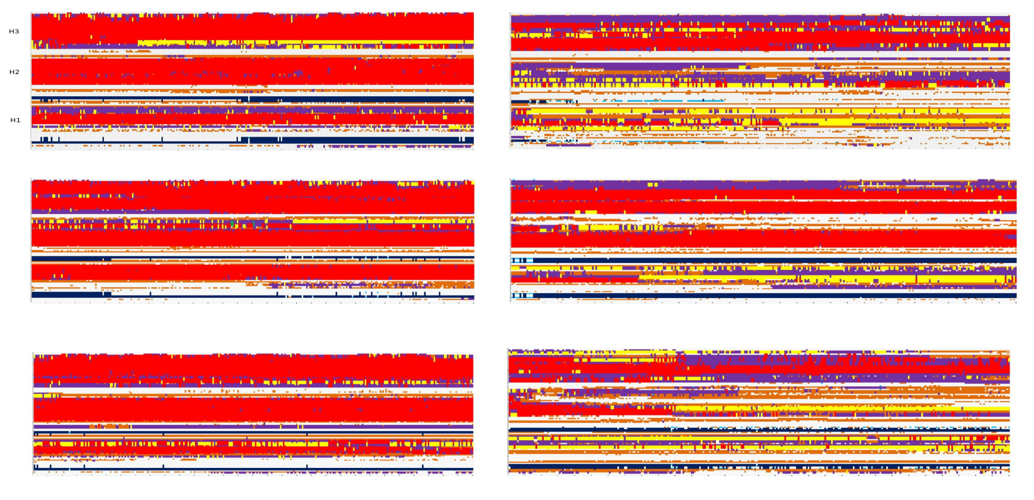
The Dynamics of molecular structures of RaPrP (at 300 K):
predominant in α-helices → rich in β-sheet

Slide 17
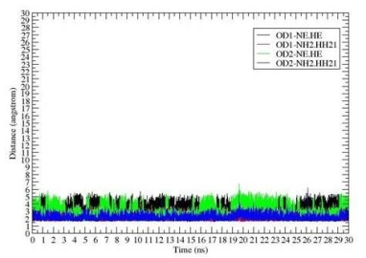
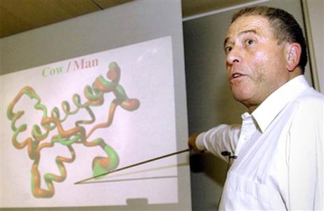
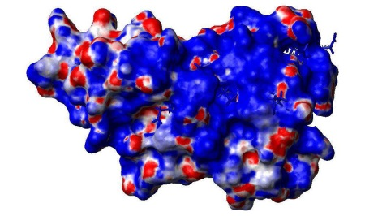
My proposed reasons for the “structural conformational” changes of PrPC→PrPSc:
The salt bridge network (of ASP201–ARG155,
ASP177–ARG163, HIS186-ARG155 etc) contributes greatly to the structural stability of RaPrP [J Theor Biol 342(1) 70-82].
Surface electrostatic charge distributions contribute greatly to the structural stability of RaPrP [Bioinformatics Research: New Developments, Editors Chiheb Battik and Khalil Belhassine, NOVA Science Publishers, Feb 15th 2012, ISBN 978-1-61942-363-3, Chapter 7, pp. 131-138].

Slide 18
Amber computer codes (http://ambermd.org/tutorials/advanced/tutorial8):
Minimization with Cartesian restraints for the solute
&cntrl
imin=1, maxcyc=200,
ntpr=5,
ntr=1,
&end
Group input for restrained atoms
100.0
RES 1 155
END
END
Minimization of the entire molecular system
&cntrl
imin=1, maxcyc=200,
ntpr=5,
&end
Before we start a MD simulation, we need to remove bad contacts. The reason is that if we start the molecular dynamics with these bad contacts, the energy in that region will be unrealistically high and that can either crash the simulation or cause the trajectory to proceed in an unrealistic direction. We remove these bad contacts by performing energy minimization (EM).

Slide 19
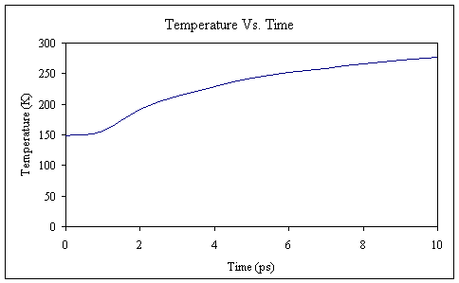
Heating up the system equilibration stage 1
&cntrl
nstlim=5000, dt=0.002, ntx=1, irest=0, ntpr=500, ntwr=5000, ntwx=5000,
tempi =100.0, temp0=300.0, ntt=1, tautp=2.0, ig=209858,
ntb=1, ntp=0, //constant volume
ntc=2, ntf=2,
nrespa=2,
&end
Constant pressure constant temperature equilibration stage 2 & 3 & 4 & 5
&cntrl
nstlim=5000, dt=0.002, ntx=5, irest=1, ntpr=500, ntwr=5000, ntwx=5000,
temp0=300.0, ntt=1, tautp=2.0,
ntb=2, ntp=1, //constant pressure
ntc=2, ntf=2,
nrespa=1,
&end
Go to Production phase.

Slide 20
2. MM (Molecular Modeling)
Notes:
20

Slide 21
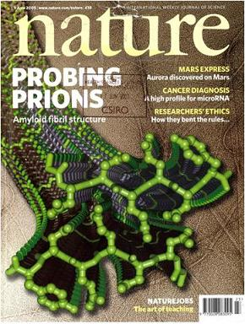
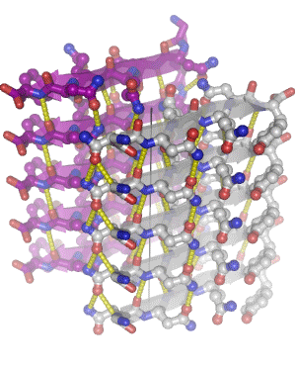
Jiapu Zhang, Yuanli Zhang (2013) Molecular dynamics studies on 3D structures of the hydrophobic region PrP(109-136). Acta Biochim Biophys Sin 45(6) 509–519.

Slide 22
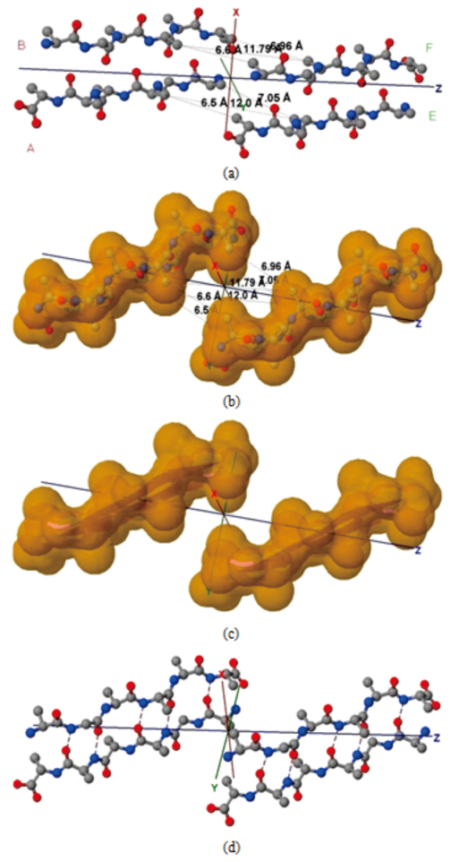
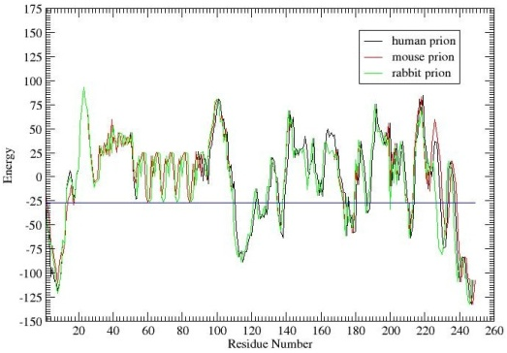

Slide 23
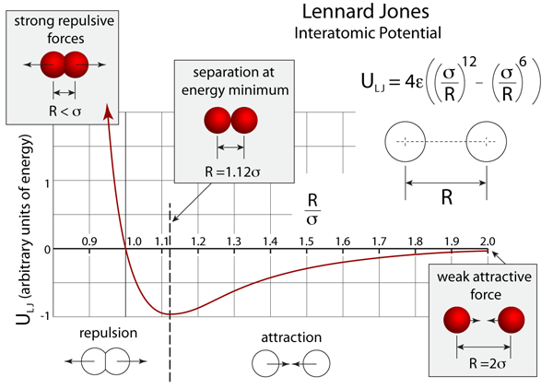
Lennard-Jones function

Slide 24
Jiapu Zhang, Jie Sun, Changzhi Wu (2011) Optimal atomic-resolution structures of prion AGAAAAGA amyloid fibrils. J Theor Biol 279(1) 17–28.
Jiapu Zhang, Yating Hou, Yiju Wang, Changyu Wang and Xiangsun Zhang (2012) The LBFGS quasi-Newtonian method for molecular modeling prion AGAAAAGA amyloid fibril, Natural Science 4(12A) (Issue: Bioinformatics, Proteomics, Systems Biology and Their Impacts to Biomedicine) 1097-1108.
Jiapu Zhang, David Y Gao, John Yearwood (2011) A novel canonical dual computational approach for prion AGAAAAGA amyloid fibril molecular modelling. J Theor Biol 284 (1) 149-157.
Jiapu Zhang (2011) Optimal molecular structures of prion AGAAAAGA palindrome amyloid fibrils formatted by simulated annealing. J Mol Model 17 (1) 173-179.
Jiapu Zhang (2011) Practical global optimization computing methods in molecular modeling – for atomic-resolution structures of amyloid fibrils. ISBN 978-3-8465-2139-7.

Slide 25
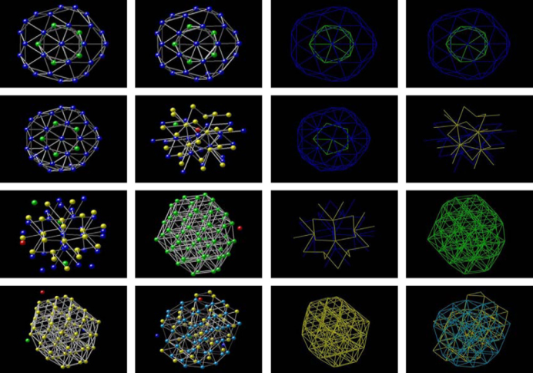
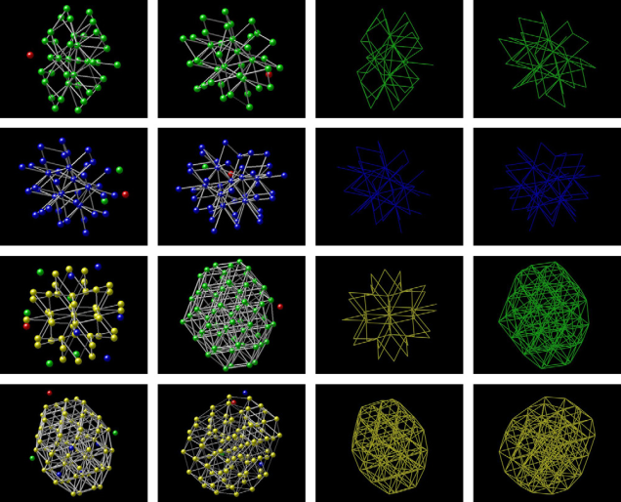
Jiapu Zhang, Jie Sun, Changzhi Wu (2011) Optimal atomic-resolution structures of prion AGAAAAGA amyloid fibrils. J Theor Biol 279(1) 17–28.

Slide 26
Jiapu Zhang, Yating Hou, Yiju Wang, Changyu Wang and Xiangsun Zhang (2012) The LBFGS quasi-Newtonian method for molecular modeling prion AGAAAAGA amyloid fibril, Natural Science 4(12A) (Issue: Bioinformatics, Proteomics, Systems Biology and Their Impacts to Biomedicine) 1097-1108:
“In a (macro) molecular system, if it is very far from equilibrium, then the forces may be excessively large, a robust energy minimization (EM) is required; another reason to perform an EM is the removal of all kinetic energy from the system: EM reduces the thermal noise in the structures and potential energies [20]. EM, with the images at the endpoints fixed in space, of the total system energy provides a minimum energy path. EM can be done using steepest descent (SD), conjugate gradient (CG), and Limited-memory Broyden Fletcher Goldfarb Shanno (LBFGS) methods.”
“SD local search method converges fast [21]. SD is robust and easy to implement but it is not most efficient especially when closer to minimum; at this moment, we may use the efficient CG. CG is slower than SD in the early stages but more efficient when closer to minimum. The hybrid of SD-CG will make SD or CG more efficient than SD or CG alone. However, CG cannot be used to find the EM path, for example, when “forces are truncated according to the tangent direction, making it impossible to define a Lagrangian” [22,23]. In this case, the powerful and faster quasi-Newtonian method (e.g. the LBFGS quasi-Newtonian minimiser) can be used [22,24-28]. The relaxation is done in the use of local search LBFGS Quasi-Newton method (lbfgs_memory_depth = 3) within AMBER 11 [23].”

Slide 27
Jiapu Zhang, David Y Gao, John Yearwood (2011) A novel canonical dual computational approach for prion AGAAAAGA amyloid fibril molecular modelling. J Theor Biol 284 (1) 149-157.

Slide 28
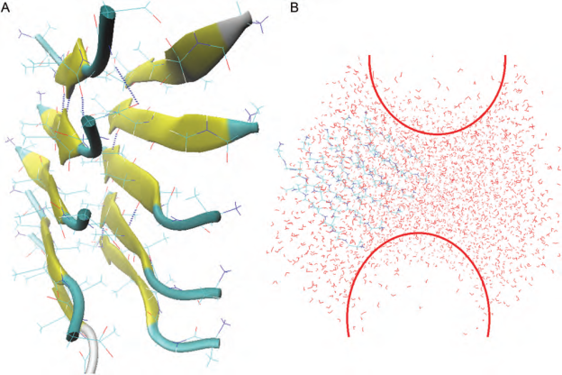
Jiapu Zhang (2011) Optimal molecular structures of prion AGAAAAGA palindrome amyloid fibrils formatted by simulated annealing. J Mol Model 17 (1) 173-179.

Slide 29
3. QM/MM (Quantum Mechanics / Molecular Mechanics)
Notes:
29

Slide 30
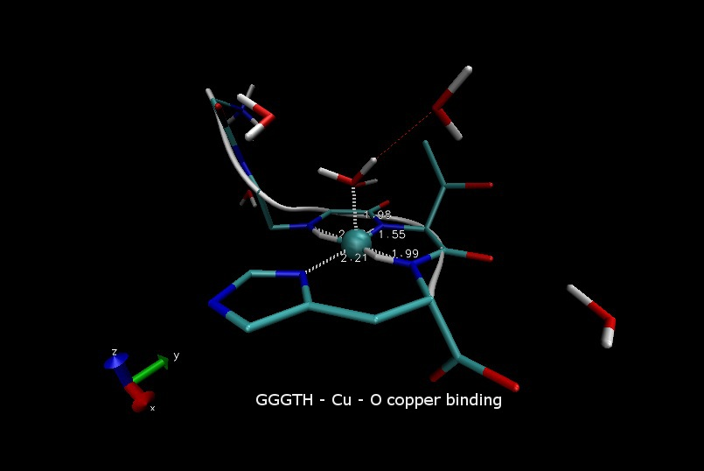
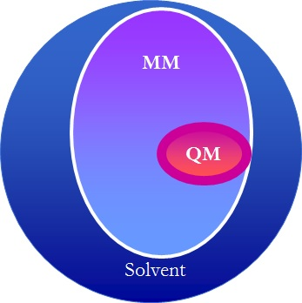



Slide 31
Amber computer codes (http://ambermd.org/tutorials/advanced/tutorial1_adv):
plc.frcmod:
# modifications to force field for poplar plastocyanin
MASS
SM 32.06
CU 65.36
BOND
NB-CU 70.000 2.05000 #kludge by JRS
CU-S 70.000 2.10000 #kludge by JRS
CU-SM 70.000 2.90000 #for pcy
CT-SM 222.000 1.81000 #met(aa)
ANGLE
CU-NB-CV 50.000 126.700 #JRS estimate
CU-NB-CR 50.000 126.700 #JRS estimate
CU-NB-CP 50.000 126.700 #JRS estimate
CU-NB-CC 50.000 126.700 #JRS estimate
CU-SM-CT 50.000 120.000 #JRS estimate
CU-S -CT 50.000 120.000 #JRS estimate
CU-S -C2 50.000 120.000 #JRS estimate
CU-S -C3 50.000 120.000 #JRS estimate

Slide 32
NB-CU-NB 10.000 110.000 #dac estimate
NB-CU-SM 10.000 110.000 #dac estimate
NB-CU-S 10.000 110.000 #dac estimate
SM-CU-S 10.000 110.000 #dac estimate
CU-SM-CT 50.000 120.000 #JRS estimate
CT-CT-SM 50.000 114.700 #met(aa)
HC-CT-SM 35.000 109.500
H1-CT-SM 35.000 109.500
CT-SM-CT 62.000 98.900 #MET(OL)
DIHE
X -NB-CU-X 1 0.000 180.000 3.000
X -CU-SM-X 1 0.000 180.000 3.000
X -CU-S -X 1 0.000 180.000 3.000
X -CT-SM-X 3 1.000 0.000 3.000
NONBON
CU 2.20 0.200
SM 2.00 0.200
$AMBERHOME/exe/xleap -s -f $AMBERHOME/dat/leap/cmd/leaprc.ff99
> loadamberparams plc.frcmod
> loadoff 1PLC.lib
> saveamberparm 1PLC 1PLC.prmtop 1PLC.inpcrd

Slide 33
Amber computer codes (http://ambermd.org/tutorials/advanced/tutorial2/section3.htm):
Initial min of our structure QMMM
&cntrl
imin=1, maxcyc=500, ncyc=200,
cut=8.0, ntb=1, ntc=2, ntf=2,
ifqnt=1 //This is the flag that tells sander that we want a QMMM run. It will then look for a &qmmm namelist.
/
&qmmm
qmmask=':1-2', //This specifies what (residues) to treat quantum mechanically using standard AMBER mask notation.
qmcharge=0, //The integer charge of the QM region (default = 0)
qmtheory=1, //Use the PM3 Hamiltonian (default = 1)
qmshake=1, //Shake QM hydrogen atoms (default = 1 if ntc=2)
qm_ewald=1, //Use an Ewald type treatment for long range electrostatics (default = 1 if ntb>0)
qm_pme=1 //Use an Particle Mesh Ewald method as Ewald type (default = 1 if qm_ewald=1 and use_pme=1)
/

Slide 34

300K constant temp QMMM MD
&cntrl
imin=0, ntb=1
cut=8.0, ntc=2, ntf=2,
tempi=300.0, temp0=300.0,
ntt=3, gamma_ln=1.0,
nstlim=1000, dt=0.002,
ntpr=1, ntwx=1,ifqnt=1
/
&qmmm
qmmask=':1-2',
qmcharge=0,
qmtheory=1,
qmshake=1,
qm_ewald=1, qm_pme=1
/

Slide 35
Acknowledgements:
All the pictures of this presentation were gotten from Google internet search.
Notes:
35

Slide 36


Biochemistry & Pharmacology Journal
Related Journals
Biochemistry & Physiology
Biochemistry & Analytical
Biochemistry
Biomolecular Research & Therapeutics
Plant Biochemistry and Physiology

Slide 37

For more details on Conferences related to Biochemistry & Pharmacology: Open Access journal please visit the link given below
www.conferenceseries.com/pharmaceutical-sciences-meetings

Slide 38


OMICS International Open Access Membership
Open Access Membership with OMICS International enables academic and research institutions, funders and corporations to actively encourage open access in scholarly communication and the dissemination of research published by their authors.
For more details and benefits, click on the link below:
http://omicsonline.org/membership.php

