Slide 1
OMICS Journals are welcoming Submissions
OMICS International welcomes submissions that are original and technically so as to serve both the developing world and developed countries in the best possible way.
OMICS Journals are poised in excellence by publishing high quality research. OMICS International follows an Editorial Manager® System peer review process and boasts of a strong and active editorial board.
Editors and reviewers are experts in their field and provide anonymous, unbiased and detailed reviews of all submissions.
The journal gives the options of multiple language translations for all the articles and all archived articles are available in HTML, XML, PDF and audio formats. Also, all the published articles are archived in repositories and indexing services like DOAJ, CAS, Google Scholar, Scientific Commons, Index Copernicus, EBSCO, HINARI and GALE.
For more details please visit our website: http://omicsonline.org/Submitmanuscript.php

Slide 2
Mapping protein-protein interactions and architecture of large protein complexes using mass spectrometry.
Jie Luo, PhD
Research Scientist
Institute for Systems Biology

Slide 3
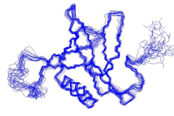
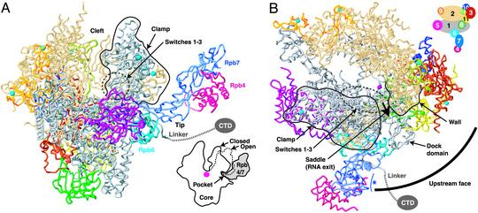
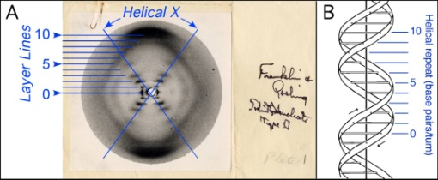
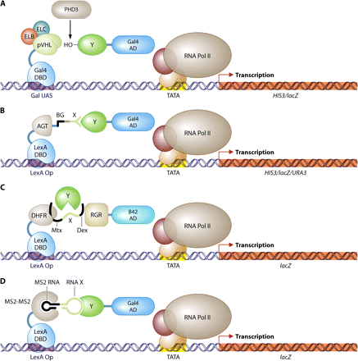
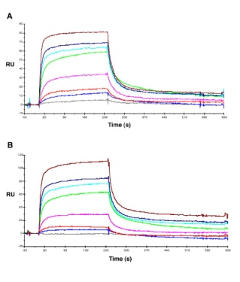
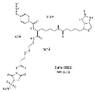
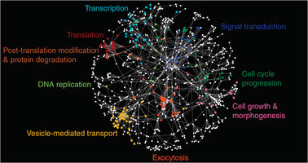
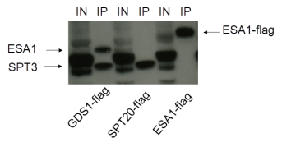
X-ray
Crystallography
Computer modeling
Homology
/ab initio
NMR
EM
Yeast 2 hybrid
SPR
Protein-Protein interactions &
Protein structure
Genetics/
mutagenesis
Chemical/ Enzymatic
labeling /crosslinking
Mass spectrometry
AP-MS
Native MS
IM-MS
H/D exchange MS
CXMS
Co-IP
Chromatography
FRET/
Co-localization

Slide 4
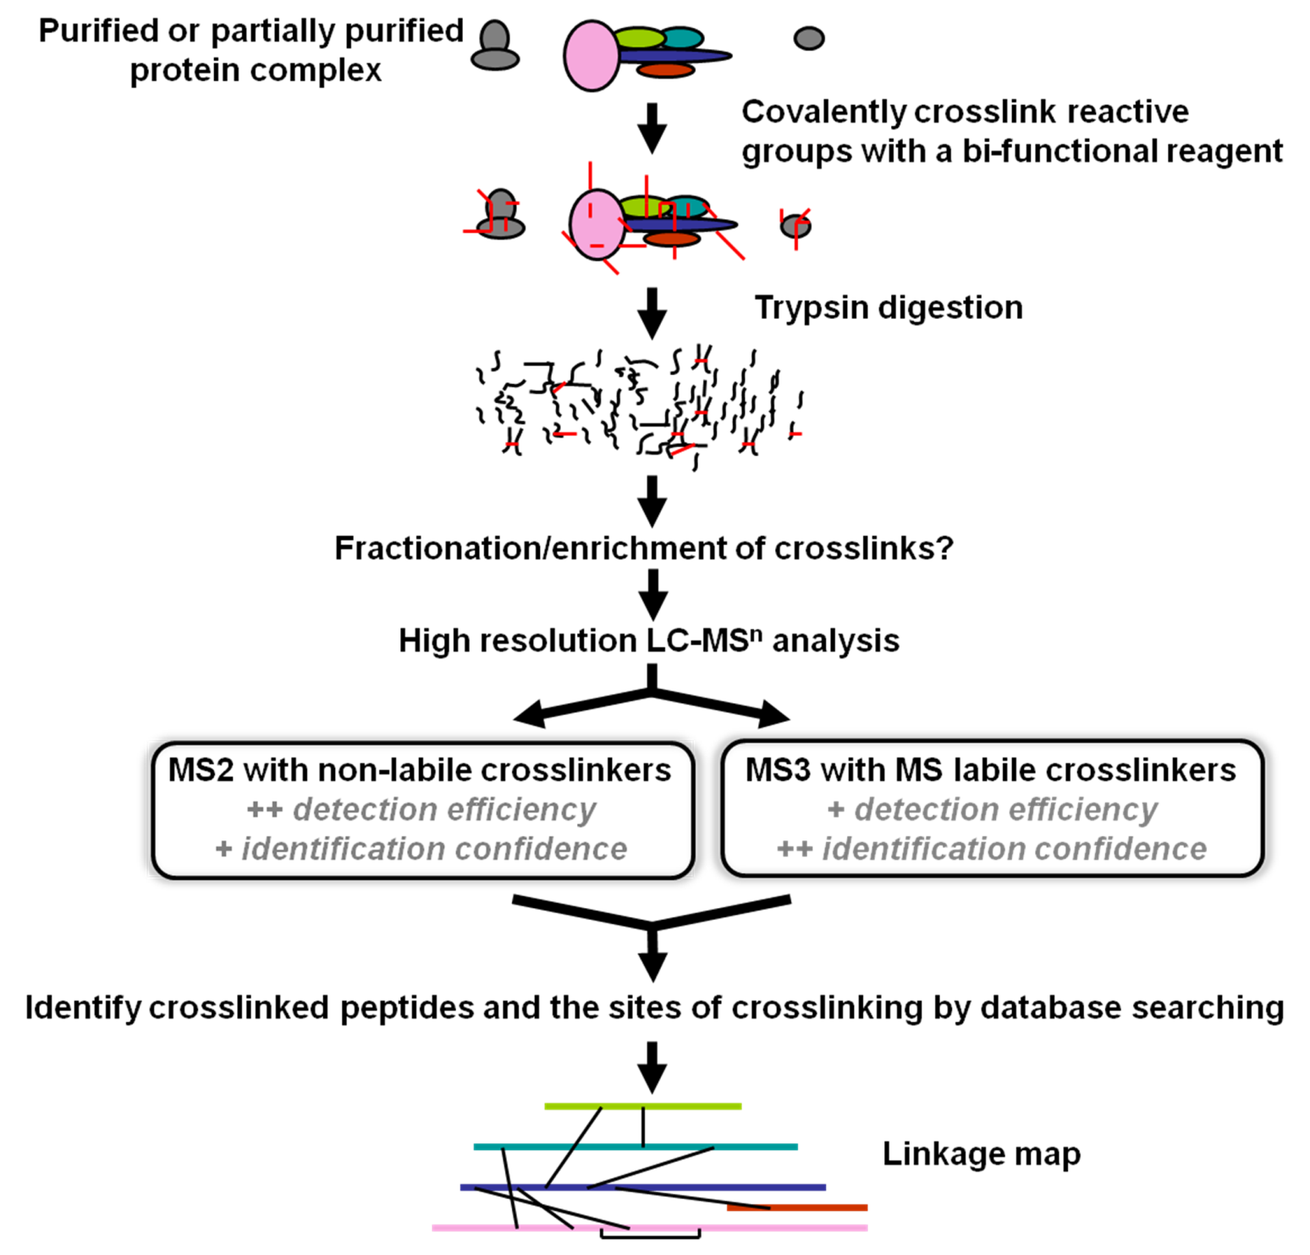

Slide 5
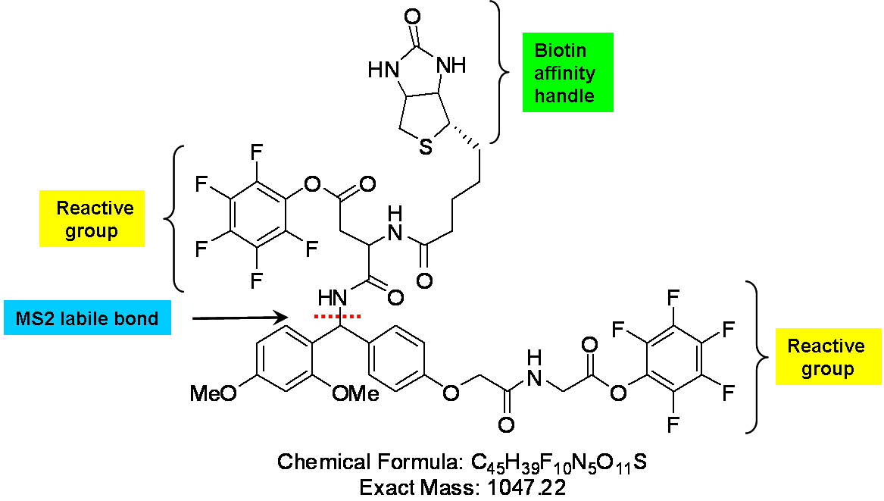
BDRG crosslinker
C14H20N4O4S MW: 340.12
C19H19NO5 MW: 341.12
Ranish and Luo, US Patent No. 8,535,948

Slide 6
Identification of Crosslinked peptides
Single differential search on Lys residue.
Only two major fragments for either A---B or B---A linkage.

Slide 7
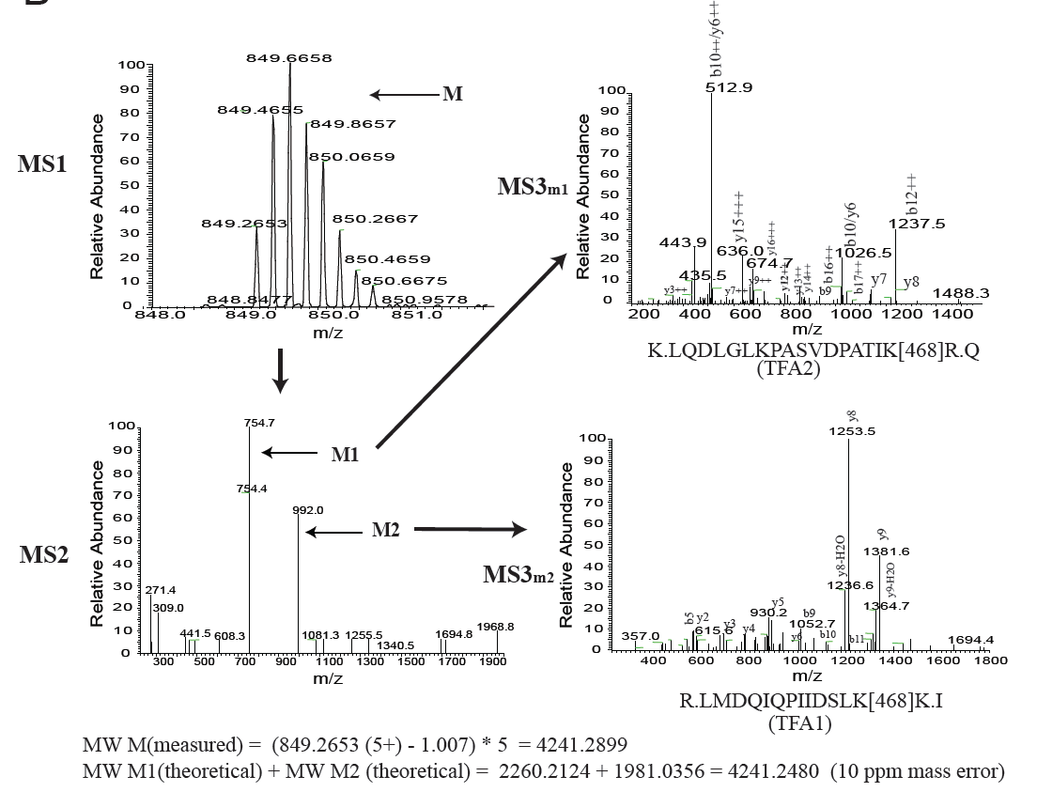
Example of a crosslinked peptide
IDed modified peptides from the same precursors.
Independent verification of crosslinks by the high accurate masses.
Luo et al., Mol Cell Proteomics, 2012 mcp.M111.008318

Slide 8
Crosslinking map of RNA Pol I Core factor

Slide 9
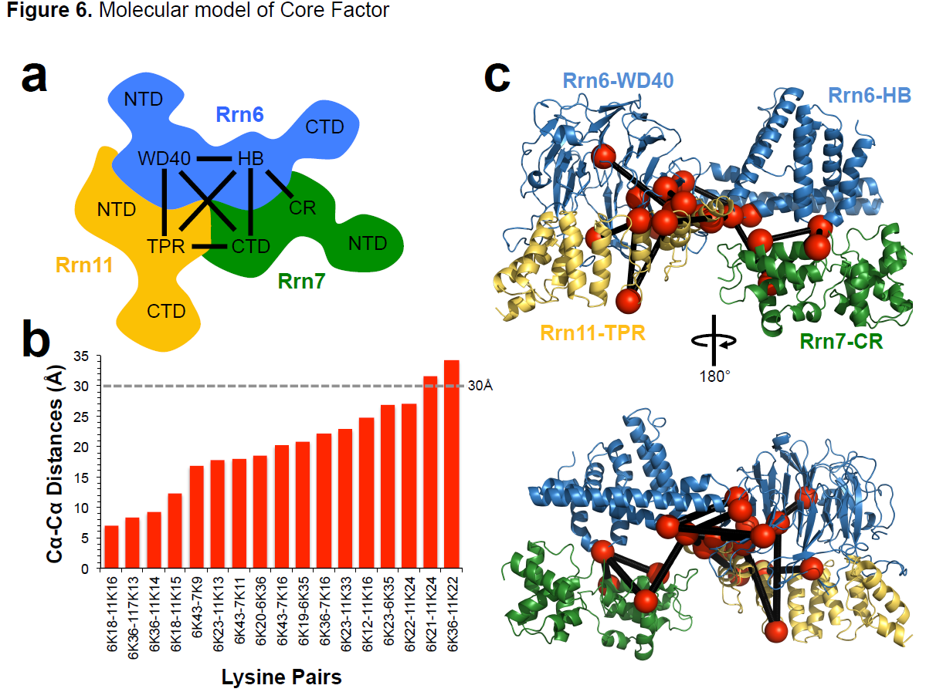
Knutson, Luo, Ranish and Hahn, Nature Struct Mol Biol., 2014

Slide 10
Study the architecture of the SAGA complex
Martinez, Plant Molecular Biology, 2002

Slide 11
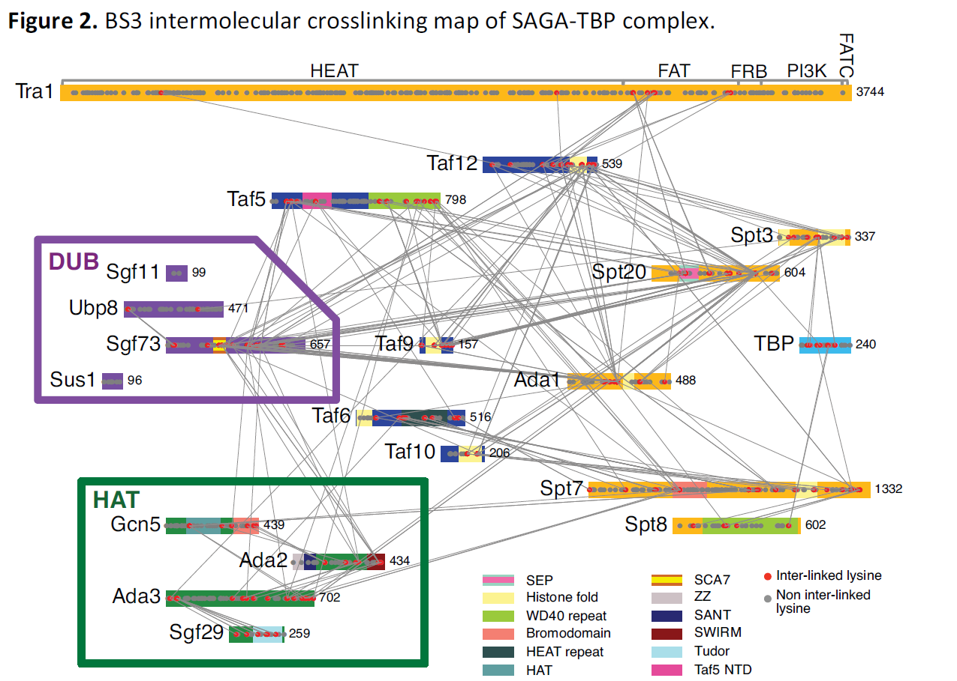

Slide 12
Yan, Luo, Ranish and Hahn, EMBO J, 2014

Slide 13
Acknowledgement
Ranish Lab, ISB
Hahn Lab, FHCRC
Jeff Ranish
Bong Kim
Wei Yan (now Shanghai Jiaotong U)
Bruce Knutson
Yan Han
Funding:

Slide 14
Journal of Proteomics & Bioinformatics Related Journals
Transcriptomics: Open Access
Journal of Pharmacogenomics & Pharmacoproteomics
Journal of Data Mining in Genomics & Proteomics

Slide 15
For more details on Conferences Related
Journal of Proteomics & Bioinformatics please visit:
http://www.conferenceseries.com/biochemistry-meetings

Slide 16
Open Access Membership with OMICS International enables academicians, research institutions, funders and corporations to actively encourage open access in scholarly communication and the dissemination of research published by their authors.
For more details and benefits, click on the link below:
http://omicsonline.org/membership.php

