Slide 1
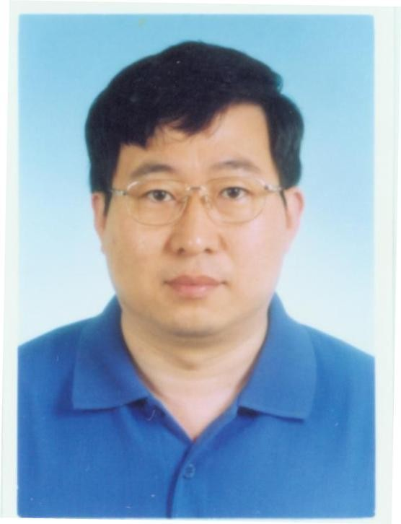

Dr. Jing-Bo Chen
Professor
Institute of Geology and Geophysics Chinese Academy of Sciences Beijing
China

Slide 2


Biography
Jing-Bo Chen received a B.S. (1990) in mathematics from Heibei University in China and a Ph.D. (2001) in computational mathematics from the Academy of Mathematics and Systems Sciences, Chinese Academy of Sciences. In 2001–2002, he was a postdoctoral fellow at the Institute of Theoretical Physics, Chinese Academy of Sciences. He is now a professor at the Institute of Geology and Geophysics, Chinese Academy of Sciences.

Slide 3

Research interests
Numerical modeling of seismic wave
Seismic migration imaging Full waveform inversion
Structure-preserving algorithms for differential equations

Slide 4


Seismic Modeling
Seismic modeling plays an important role in exploration geophysics. High-order
modeling schemes are in demand for practical reasons.
Three kinds of high-order time discretizations:
Lax-Wendroff methods
Nyström methods
Splitting methods.
Lax-Wendroff methods are based on the Taylor expansion and the replacement of
high-order temporal derivatives by spatial derivatives.
Nyström methods are simplified Runge-Kutta algorithms, and splitting methods comprise substeps for one-step computation.
Numerical experiments show that the fourth-order Lax-Wendroff scheme is more efficient for short-time simulations while the fourth-order Nyström scheme and the third-order splitting scheme are more efficient for long-term computations.

Slide 5



Main stages of Seismic Modeling
Two main stages of seismic modeling are geological model building, and
numerical computation of seismic response for the model.
It describes the forward process of propagating waves from sources to scatterers
down in the subsurface and back to the receivers.
The quality of the computed seismic response is partly related to the type of model that is built.
Therefore the model building approaches become equally important as seismic
forward realization methods.
Models are considered to be representations of real objects and can be 1D, 2D, or
3D.
1D models are usually generated at well locations to predict the seismic response of the geological model and further to investigate the link between the geological beds at the well to the real reflection seismic data (seismic to well tie analysis).

Slide 6


Primary Concerns
Primary concern in seismic modeling necessarily focuses on determination of the true subsurface
medium. Clearly, the accuracy of this information significantly impacts all aspects of the exploration process. Even when we do not have a completely detailed visualization of what is below us, a reasonable concept can provide guidelines for surface acquisition that improves subsurface imaging. The underlying
Earth model strongly influences what we must do to migrate the data successfully and produce an
optimum image.
Another primary concern focuses on which of the myriad available imaging algorithms has the best chance of producing the highest quality image. Making this choice requires an understanding of the most important such technology. Because algorithm development and implementation is a highly mathematical endeavor, acquiring this understanding can be quite difficult.
A third concern arises from the fact that, in general, the Earth does not respond well to high frequency sources since high frequency sound waves are absorbed rather quickly. Depending on rock type they penetrate only to a few thousand meters. On the other hand, low frequency sound waves are known to provide narrow bandwidth images at depths in excess of 30 or 40 kilometers.

Slide 7




Approaches to Seismic Modeling
The two main approaches to seismic modeling produce models for the underground velocities: the first is a process called time migration, which takes seismic data in time coordinates, and produces images and time-migration velocities, which are an averaged velocity of a particular type. The second, depth migration, takes seismic data in depth coordinates and produces seismic images in depth coordinates.
Time migration
Depth migration
Adequate for
mild lateral velocity
variation
arbitrary velocity variation
Implementation
requires
seismic data
seismic data + velocity model
Produces images in
time coordinates
depth coordinates

Slide 8


















migration
Time
has the advantage
that
it is fast
and efficient,
however:
It works best in areas where the seismic velocity depends only on the depth, in other words, the sound speed is constant along horizontal lines. However, most interesting phenomena, including the presence of underground oil, tend to occur in the areas where flat horizontal structures inside the earth are distorted;
Tranforming these images and information from time coordinates to regular Cartesian (depth) coordinates is subtle and non-obvious in cases where the velocity is not horizontally constant and in fact depends on the lateral coordinates.
In contrast, depth migration produces images in the regular Cartesian coordinates and can be applied when there is considerable lateral distortion in underground structures. However, one needs to start with seismic velocity in depth coordinates in
order to apply depth migration: this seismic velocity is never known, and is typically
found by "guessing and trying".

Slide 9


OMICS International Open Access Membership
OMICS International Open Access Membership enables academic and research institutions, funders and corporations to actively encourage open access in scholarly communication and the dissemination of research published by their authors.
For more details and benefits, click on the link below:
http://omicsonline.org/membership.php

