Slide 1
OMICS Group
OMICS Group International through its Open Access Initiative is committed to make genuine and reliable contributions to the scientific community. OMICS Group hosts over 400 leading-edge peer reviewed Open Access Journals and organizes over 300 International Conferences annually all over the world. OMICS Publishing Group journals have over 3 million readers and the fame and success of the same can be attributed to the strong editorial board which contains over 30000 eminent personalities that ensure a rapid, quality and quick review process. OMICS Group signed an agreement with more than 1000 International Societies to make healthcare information Open Access.
Contact us at: contact.omics@omicsonline.org

Slide 2
OMICS Journals are welcoming Submissions
OMICS Group welcomes submissions that are original and technically so as to serve both the developing world and developed countries in the best possible way.
OMICS Journals are poised in excellence by publishing high quality research. OMICS Group follows an Editorial Manager® System peer review process and boasts of a strong and active editorial board.
Editors and reviewers are experts in their field and provide anonymous, unbiased and detailed reviews of all submissions.
The journal gives the options of multiple language translations for all the articles and all archived articles are available in HTML, XML, PDF and audio formats. Also, all the published articles are archived in repositories and indexing services like DOAJ, CAS, Google Scholar, Scientific Commons, Index Copernicus, EBSCO, HINARI and GALE.
For more details please visit our website: http://omicsonline.org/Submitmanuscript.php

Slide 3
Prof. John K Triantafillidis
Director
Inflammatory Bowel Disease Unit
IASO General Hospital
Greece

Slide 4
Biography
John K Triantafillidis started his career as a research Fellow Gastroenterology Unit, University of Oxford, UK (1981-1982). Then as the Head of Department of Gastroenterology “METAXAS” Cancer Hospital, Piraeus, Greece (1988-1991) AND Head, Department of Gastroenterology: “Saint Panteleimon” General State Hospital, Greece during 1991 - 2013. Head Inflammatory Bowel Disease Unit, “Iaso General” Hospital, Athens, Greece (2013). Visiting professor, Department of Gastroenterology, University of Washington, Seattle, U.S.A. (1995). Fellow of the European Board of Gastroenterology (2002). Associated Professor, Medical University of IASI, Romania (2007). Editor of the official Medical Journal of the Hellenic Society of Gastroenterology “Annals of Gastroenterology” (1996 till 2010) published in the English language. Editor of the official Medical Journal of the Hellenic Society of Gastrointestinal Oncology entitled “Digestive Oncology” (2000-2010) published in the Greek and English language. Translations of many books in the Greek language including “The acute abdomen” (ed. De Dombal), “Diseases of the Gut and Pancreas” (Ed. Miscievitz et al), etc.

Slide 5
Reviewer in many Greek and International medical journals including Digestive and Liver Disease, Pharmacological Research, Aging Health etc. Member of many National and International Medical Societies including The American College of Gastroenterology, British Medical Association, European Association for Clinical Investigation, International Society for the study of the Esophagus, Mediterranean Medical Society for Digestive Diseases etc. President of the Organizing Committee of many International and Greek Congresses. President of the Hellenic Society of Gastroenterology, Hellenic Society of Digestive Oncology, Hellenic Helicobacter Pylori Study Group, and Hellenic Inflammatory Bowel Disease Study Group. Papers: Up to the end of 2012 more than 210 papers appeared in peer review international medical journals and more than 340 in the Greek medical literature. Books: Editor of many books including the book INFLAMMATORY BOWEL DISEASE (4th Edition in the English language (International Edition 2012) “Gastrointestinal lymphomas”, “Digestive Oncology” (award of the Hellenic Academy of Sciences 1991) etc. Up to the end of 2013 more than 2000 citations appeared in the international literature.

Slide 6
Research Interests
Inflammatory Bowel Disease
Digestive Oncology

Slide 7
Some recent publications
Triantafillidis JK ,Gikas A (2013) Over-time changes of Helicobacter pylori infection rate in patients with inflammatory bowel disease. Journal of Crohn's & colitis 7: 681.
Triantafillidis JK, Merikas E, Gikas A (2013) Psychological factors and stress in inflammatory bowel disease. Expert review of gastroenterology & hepatology 7: 225-238.
Triantafillidis JK, Malgarinos G (2013) Severe psoriasis preceding diagnosis of large bowel Crohn's disease for 15 years. Journal of Crohn's & colitis 7: e80.

Slide 8
Some recent publications
Effect of mesalamine and prednisolone on TNBS experimental colitis, following various doses of orally administered iron. Triantafillidis JK, Douvi G, Agrogiannis G, Patsouris E, Gikas A, Papalois AE. Biomed Res Int. 2014;2014:648535.
Diagnostic capabilities of high-definition white light endoscopy for the diagnosis of gastric intestinal metaplasia and correlation with histologic and clinical data. Panteris V, Nikolopoulou S, Lountou A, Triantafillidis JK. Eur J Gastroenterol Hepatol. 2014 Jun;26(6):594-601.
Long-term efficacy and safety of otilonium bromide in the management of irritable bowel syndrome: a literature review. Triantafillidis JK, Malgarinos G.Clin Exp Gastroenterol. 2014 Apr 7;7:75-82. doi: 10.2147/CEG.S46291. eCollection 2014. Review.

Slide 9
Some recent publications
The role of primary care physicians in early diagnosis and treatment of chronic gastrointestinal diseases. Gikas A, Triantafillidis JK. Int J Gen Med. 2014 Mar 13;7:159-73.
The role of total parenteral nutrition in inflammatory bowel disease: current aspects. Triantafillidis JK, Papalois AE. Scand J Gastroenterol. 2014 Jan;49(1):3-14.
Nutritional status and nutritional support before and after pancreatectomy for pancreatic cancer and chronic pancreatitis. Karagianni VT, Papalois AE, Triantafillidis JK. Indian J Surg Oncol. 2012 Dec;3(4):348-59.
Non-colorectal intestinal tract carcinomas in inflammatory bowel disease: results of the 3rd ECCO Pathogenesis Scientific Workshop (II). Egan L, D'Inca R, Jess T, Pellino G, Carbonnel F, Bokemeyer B, Harbord M, Nunes P, Van der Woude J, Selvagg F, Triantafillidis J. J Crohns Colitis. 2014 Jan;8(1):19-30.

Slide 10
Some recent publications
Sedation in gastrointestinal endoscopy: current issues. Triantafillidis JK, Merikas E, Nikolakis D, Papalois AE. World J Gastroenterol. 2013 Jan 28;19(4):463-81.
Crohn's disease of the small bowel, complicated by primary biliary cirrhosis, Hashimoto thyroiditis, and Raynaud's phenomenon: favorable response of all disorders to adalimumab treatment. Triantafillidis JK, Durakis S, Merikas E. Gastroenterol Hepatol Bed Bench. 2013 Spring;6(2):101-5
A prospective study of pre-illness diet in newly diagnosed patients with Crohn's disease. Octoratou M, Merikas E, Malgarinos G, Stanciu C, Triantafillidis JK. Rev Med Chir Soc Med Nat Iasi. 2012 Jan-Mar;116(1):40-9.

Slide 11
Some recent publications
Randomised clinical trial: otilonium bromide improves frequency of abdominal pain, severity of distention and time to relapse in patients with irritable bowel syndrome. Clavé P, Acalovschi M, Triantafillidis JK, Uspensky YP, Kalayci C, Shee V, Tack J; OBIS Study Investigators. Aliment Pharmacol Ther. 2011 Aug;34(4):432-42
Pistacia lentiscus resin regulates intestinal damage and inflammation in trinitrobenzene sulfonic acid-induced colitis. Gioxari A, Kaliora AC, Papalois A, Agrogiannis G, Triantafillidis JK, Andrikopoulos NK. J Med Food. 2011 Nov;14(11):1403-11.
Current and emerging drugs for the treatment of inflammatory bowel disease. Triantafillidis JK, Merikas E, Georgopoulos F. Drug Des Devel Ther. 2011 Apr 6;5:185-210.
Impact of beta-glucan on the faecal microbiota of polypectomized patients: a pilot study. Turunen K, Tsouvelakidou E, Nomikos T, Mountzouris KC, Karamanolis D, Triantafillidis J, Kyriacou A. Anaerobe. 2011 Dec;17(6):403-6.

Slide 12
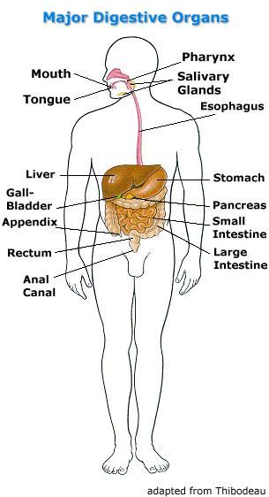
Journal of General Practice-Open Access
ISSN: 2329-9126

Slide 13
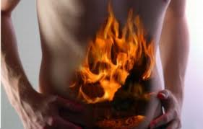
Digestive Disorders
Journal of General Practice-Open Access
ISSN: 2329-9126
Digestive disorders are of the following types:
Structural: a physical abnormality that interferes with normal function.
Malabsorptive: problems with nutrient absorption.
Inflammatory: Something causes swelling and/or bleeding.
Neoplastic (Cancer)

Slide 14
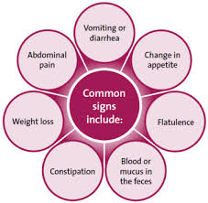
Symptoms
Journal of General Practice-Open Access
ISSN: 2329-9126
The symptoms of digestive disorders are the following:
Indigestion or heartburn
Pain in the abdomen
Nausea and vomiting
Diarrhea or constipation
Bloating after eating
Loss of appetite
Vomiting blood or blood in the stool (feces)

Slide 15
Digestive Diseases
Journal of General Practice-Open Access
ISSN: 2329-9126
Some of the diseases of digestive system are as follows:
Tooth Decay
Cold Sores
Heart Burn
Gastroenteritis
Appendicitis
Cirrhosis
Crohn’s Disease, etc.

Slide 16
Tooth Decay
Journal of General Practice-Open Access
ISSN: 2329-9126
This is an endogenous infection.
Young are more susceptible than old.
Occurs due to Streptococcus mutans and sucrose

Slide 17
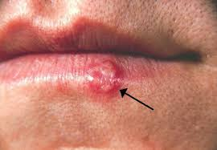
Cold sores
Journal of General Practice-Open Access
ISSN: 2329-9126
It is caused by herpes simplex virus Type I Virus.
It is easily transmitted by close physical contact with saliva or the lesions
HSV-1 can infect almost any body tissue

Slide 18
Heart Burn
Journal of General Practice-Open Access
ISSN: 2329-9126
Acid Reflux
Symptoms- burning sensation
Remedies- avoid chocolate and peppermint, coffee, citrus, fried or fatty foods, tomato products – stop smoking- take antacids – don’t lay down 2-3 hours after eating.
When small quantities of stomach acid are regurgitated into the esophagus

Slide 19
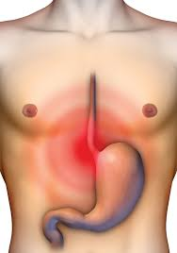
Gastroenteritis
Journal of General Practice-Open Access
ISSN: 2329-9126
Inflammation of mucous membrane lining of stomach and intestine
Common cause = Virus
Symptoms=diarrhea and vomiting for 24-36 hours
Complication=dehydration

Slide 20
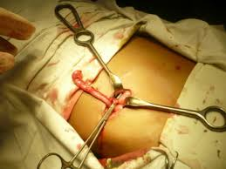
Appendicitis
Journal of General Practice-Open Access
ISSN: 2329-9126
A blind sac attached to the cecum and has no known function.
When appendix becomes inflamed
If it ruptures, bacteria from appendix can spread to peritoneal cavity.
Symptoms- RLQ pain, rebound tenderness, fever, nausea, and vomiting
RX - appendectomy

Slide 21
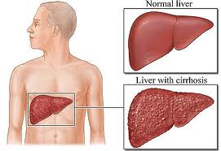
Cirrhosis
Journal of General Practice-Open Access
ISSN: 2329-9126
Chronic progressive disease of the liver
Normal tissue replaced by fibrous connective tissue
75% caused by excessive alcohol consumption

Slide 22
Crohn’s Disease
Journal of General Practice-Open Access
ISSN: 2329-9126
Inflammatory disorder
A chronic inflammation of the intestines.
Ulcers in the intestines.
Rectal bleeding, weight loss and fever.
It has no known cause.
Nuclear imaging or colonoscopy are used to diagnose it.
Treatment may include medication, surgery or nutritional supplements.

Slide 23
Journal of General Practice
Journal of Primary Health Care: Open Access
Journal of Health Care : Current Reviews
Journal of General Medicine: Open Access
Journal of Family Medicine & Medical Science Research

Slide 24
Journal of General Practice Related Conferences
3rd International Conference on Surgery and Anesthesia
3rd International Conference on Nursing & Emergency Medicine
2nd International Conference on Nursing & Healthcare

Slide 25
OMICS Group Open Access Membership
OMICS publishing Group Open Access Membership enables academic and research institutions, funders and corporations to actively encourage open access in scholarly communication and the dissemination of research published by their authors.
For more details and benefits, click on the link below:
http://omicsonline.org/membership.php

