Slide 1
OMICS Journals are welcoming Submissions
OMICS International welcomes submissions that are original and technically so as to serve both the developing world and developed countries in the best possible way.
OMICS Journals are poised in excellence by publishing high quality research. OMICS International follows an Editorial Manager® System peer review process and boasts of a strong and active editorial board.
Editors and reviewers are experts in their field and provide anonymous, unbiased and detailed reviews of all submissions.
The journal gives the options of multiple language translations for all the articles and all archived articles are available in HTML, XML, PDF and audio formats. Also, all the published articles are archived in repositories and indexing services like DOAJ, CAS, Google Scholar, Scientific Commons, Index Copernicus, EBSCO, HINARI and GALE.
For more details please visit our website: http://omicsonline.org/Submitmanuscript.php

Slide 2
Jonathan J. Caguiat
Associate Professor
Department of Biological Sciences
Youngstown State University
USA

Slide 3
Biography
Jonathan Caguiat is an Associate Professor in the Department of Biological Sciences and the Center for Applied Chemical Biology at Youngstown State University. He received his Bachelor’s degree in Biology with a concentration in Molecular Biology from the University of Michigan and his Ph.D. in Microbiology from Michigan State University. His research focuses on metal resistant bacteria. He has reviewed manuscripts for Bioremediation Journal, Current Microbiology and Applied Microbiology and Biotechnology.

Slide 4
Research Interests
Mechanisms of metal resistances in bacteria
Particularly, selenium homeostasis
Selenium is an important trace element for bacterial growth
In the presence of toxic levels of selenite, how do resistant bacteria process selenite without poisoning themselves?

Slide 5
Recent Publications
CAGUIAT, J. (2014). Generation of Enterobacter sp. YSU Auxotrophs Using Transposon Mutagenesis, Journal of Visualized Experiments (JoVE), in press.
Jasenec A., N. Barasa, S. Kulkarni, N. Shaik, S. Moparthi, V. Konda and J. Caguiat (2009). Proteomic profiling of cysteine induced selenite resistance in Enterobacter sp. YSU. Proteome Science 7:30.
Holmes A., A Vinayak, C. Benton, A. Esbenshade, C. Heinselman, D. Frankland, S. Kulkarni, A. Kurtanich and J. Caguiat (2009). Comparison of two multimetal resistant bacterial strains: Enterobacter sp. YSU and Stenotrophomonas maltophilia ORO2. Current Microbiology 59:526. DOI 10.1007/s00284-009-9471-2
Summers, A. O. and J. CAGUIAT (2004). Metal binding proteins, recombinant host cells and methods. Patent Number 6,750,042.
Song, L., J. CAGUIAT, Z. Li, J. Shokes, R. A. Scott, L. Olliff and A. O. Summers (2004). Engineered single chain, antiparallel, coiled coil mimics MerR metal binding site. J. Bacteriol. 186:1861-1868.
Caguiat, J. J., A. L. Watson and A. O. Summers (1999). Cd(II)-responsive and constitutive mutants implicate a novel domain in MerR. J. Bacteriol. 181:3462-3471.

Slide 6
Poplar Creek
Y-12 plant used to produce materials for nuclear weapons
Early 40’s – uranium enrichment
1950’s and 60’s lithium enrichment using mercury
Mercury and other metal wastes contaminated East Fork Poplar Creek in Oak Ridge, TN
Widner et al (1996). Health Phys. 71:457-459
Revis et al (1988). Patent # 4,728,427
Notes:
Has anybody worked with plasmids? What are they?

Slide 7
Poplar Creek Strains
Stenotrophomonas maltophilia OR02 (S. maltophilia 02)
Enterobacter sp. YSU
MIC experiments in liquid cultures
Growth detected by turbidity

Slide 8
Holmes et al (2009).
Current Microbiology 59:526

Slide 9
MIC Results
S. maltophilia 02 is more resistant to most of the tested metal salts than Enterobacter sp. YSU
AgNO₃ is an exception
Enterobacter sp. YSU is more resistant to the tested metal salts than E. coli strain HB101
CuSO₄ and K₂CrO₄ are exceptions
Holmes et al (2009).Current Microbiology 59:526

Slide 10
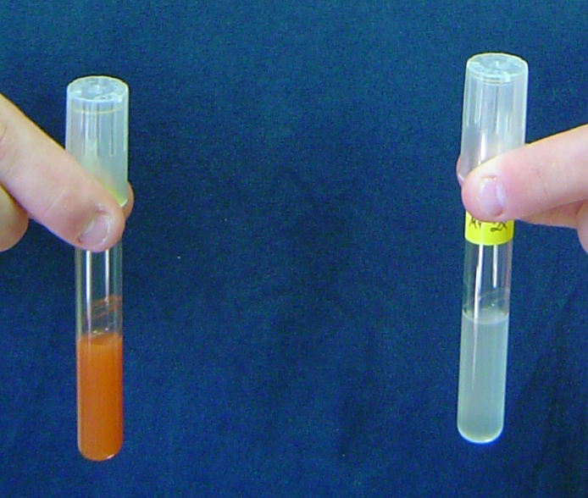
MIC Results
Pb(NO₃)₂ MIC difficult to determine because it is precipitates in most growth media
Na₂SeO₃ MIC difficult to determine because red color produced by cell reduction of selenite (SeO₃²⁻) to elemental selenium interfered with turbidity readings
No selenite
Selenite

Slide 11
Selenium Characteristics
Compound | Formula | Oxidation State
Selenate | SeO₄²⁻ | +6
Selenite | SeO₃²⁻ | +4
Elemental Selenium | Se⁰ | 0
Selenide | Se²⁻ | -2
Oxidized
Reduced
SeO₄²⁻
SeO₃²⁻
Se⁰
Se²⁻
Reduction of selenite to elemental selenium

Slide 12
Selenite Resistance Study
Selenite transported into E. coli using two pathways
Sulfate transport – CysA, CysW and CysT
The non-specific pathway
Undetermined selenite-specific pathway
The specific pathway
Enterobacter sp. YSU requires cysteine for selenite resistance in M-9 minimal salts medium
Sabine Müller · Johann Heider · August BöckThe path of unspecific incorporation of selenium in Escherichia coli Arch Microbiol (1997) 168 : 421–427c

Slide 13
Methods - Growth
Grow cells in the presence and absence of cysteine to early-log phase
Split the cultures – original set
No cysteine, no selenite (NCNS) and
Cysteine, no selenite (CNS)
Add 40 mM selenite to the second set
No cysteine, selenite (NCS) and
Cysteine, selenite (CS)
Follow growth by viable cell count
Jasenec et al. (2009). Proteome Science 7:30

Slide 14
Cysteine Requirement for Selenite Resistance
Jasenec et al. (2009). Proteome Science 7:30

Slide 15
Hypothesis
Cysteine confers selenite resistance by blocking transport through the non-specific (sulfate permease) pathway
Jasenec et al. (2009). Proteome Science 7:30

Slide 16
Methods - Proteomics
Grow cells in the presence and absence of cysteine to early-log phase
Remove no selenite samples
No cysteine, no selenite (NCNS) and
Cysteine, no selenite (CNS)
Add 40 mM selenite
Remove selenite samples one hour after exposure
No cysteine, selenite (NCS) and
Cysteine, selenite (CS)
Jasenec et al. (2009). Proteome Science 7:30

Slide 17
Methods - Proteomics
Extract proteins from each sample and separate equal amounts by charge (isoelectric focusing) and size (SDS-polyacrylamide gel electrophoresis)
Jasenec et al. (2009). Proteome Science 7:30

Slide 18
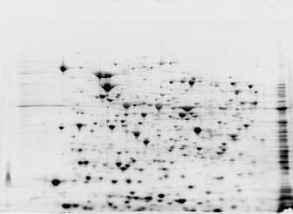
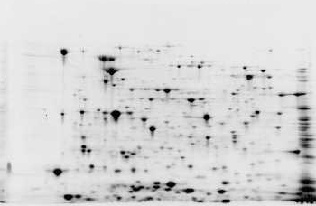
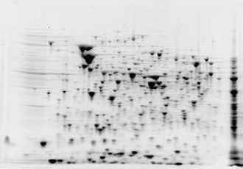
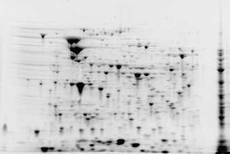
4
pI
7
4
pI
7
250 kDa
NCNS – 2.5 hrs
NCS – 3.5 hrs
4
1
3
1
7
3
8
2
2
10 kDa
9
250 kDa
CNS – 2.5 hrs
CS – 3.5 hrs
4
1
11
1
7
2
5
6
10
2
10 kDa
Jasenec et al. (2009). Proteome Science 7:30

Slide 19
Findings
Controls – all four conditions
Spot 1 - OmpF porin
Spot 2 - protein chain elongation factor EF-Ts
Unique spot from samples lacking cysteine (NC)
Spot 3 - conserved hypothetical lipobinding protein
Spots from samples lacking selenite (NS)
Spots 4, 5 and 6 - translation elongation factor EF-Tu
Spots from samples treated with selenite (S)
Spot 8 - putative tellurium resistance protein C
Spot 9 - small heat shock protein
Jasenec et al. (2009). Proteome Science 7:30

Slide 20
Findings
Spots from samples treated with selenite (S)
Spots 10 and 11 (CS) – proteins for outer membrane protein + hydrogenase component
Spot 7 (NCS) contains CysK
Spot 7 (CS) lacked CysK
Does the addition of cysteine also decrease the expression levels of other non-specific sulfate transport genes?
Jasenec et al. (2009). Proteome Science 7:30

Slide 21
Reverse Transcriptase – PCR (RT-PCR)
Grow cells – Mid-log phase
Take NS samples
Add Se
Take samples after 1 hr (S samples)
Purify RNA
Make cDNA
PCR with primers for sulfate transport genes
NCNS
NCS
CNS
CS
cysK
cysA
cysT
cysW
cysE
Jasenec et al. (2009). Proteome Science 7:30

Slide 22
Conclusions
Enterobacter sp. YSU requires Cysteine for resistance to 40 mM selenite
Proteomic and RT-PCR data support the hypothesis that cysteine confers resistance by blocking selenite transport through the sulfate permease pathway
Red color of the cultures containing cysteine and selenite suggest that the selenite still enters through a selenite specific pathway and is reduced to elemental selenium
Jasenec et al. (2009). Proteome Science 7:30

Slide 23
Other Work
Identify other metal resistances gene from Enterobacter sp.YSU and S. maltophilia OR02 using a transposon mutagenesis system
2,500 colonies isolated from Poplar creek in Oak Ridge.
Screen for resistances to Hg(II) and other metals
Identify metal resistance genes
Compare them to the metal resistance genes in Enterobacter sp. YSU and S. maltophilia OR02

Slide 24
Digital Signature

Slide 25
Journal of Proteomics & Bioinformatics Related Journals
Transcriptomics: Open Access
Journal of Pharmacogenomics & Pharmacoproteomics
Journal of Data Mining in Genomics & Proteomics

Slide 26
For more details on Conferences Related
Journal of Proteomics & Bioinformatics please visit:
http://www.conferenceseries.com/biochemistry-meetings

Slide 27
Open Access Membership with OMICS International enables academicians, research institutions, funders and corporations to actively encourage open access in scholarly communication and the dissemination of research published by their authors.
For more details and benefits, click on the link below:
http://omicsonline.org/membership.php

