Slide 1
OMICS Group
OMICS Group International through its Open Access Initiative is committed to make genuine and reliable contributions to the scientific community. OMICS Group hosts over 400 leading-edge peer reviewed Open Access Journals and organizes over 300 International Conferences annually all over the world. OMICS Publishing Group journals have over 3 million readers and the fame and success of the same can be attributed to the strong editorial board which contains over 30000 eminent personalities that ensure a rapid, quality and quick review process. OMICS Group signed an agreement with more than 1000 International Societies to make healthcare information Open Access.
Contact us at: contact.omics@omicsonline.org

Slide 2
OMICS Journals are welcoming Submissions
OMICS Group welcomes submissions that are original and technically so as to serve both the developing world and developed countries in the best possible way.
OMICS Journals are poised in excellence by publishing high quality research. OMICS Group follows an Editorial Manager® System peer review process and boasts of a strong and active editorial board.
Editors and reviewers are experts in their field and provide anonymous, unbiased and detailed reviews of all submissions.
The journal gives the options of multiple language translations for all the articles and all archived articles are available in HTML, XML, PDF and audio formats. Also, all the published articles are archived in repositories and indexing services like DOAJ, CAS, Google Scholar, Scientific Commons, Index Copernicus, EBSCO, HINARI and GALE.
For more details please visit our website: http://omicsonline.org/Submitmanuscript.php

Slide 3
Multidimensional Fluorescence Studies
Jonathan E. Kenny
Professor of Chemistry
Tufts University
Medford, MA 02155

Slide 4
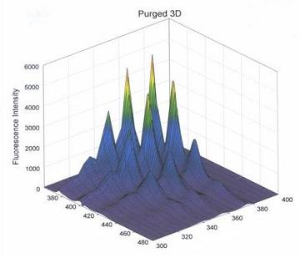
Because of its intrinsic dependence on a large number of parameters (excitation wavelength, emission wavelength, polarization, concentration, decay time, sample location, etc.), fluorescence intensity is multidimensional and its measurement has become an important analytical tool in environmental chemistry. In addition, fluorescence measurements may often be performed in situ, offering additional benefits of minimal or no sample preparation, generation of chemical waste, or exposure of workers to hazardous substances. In recent years, the excitation-emission matrix, or EEM, a matrix of fluorescence intensities which can also be plotted as a three-dimensional “fingerprint” of a sample, has gained favor over individual emission spectra or synchro-scanned excitation-emission spectra because of its high information content.
Multidimensional
Fluorescence
Spectroscopy
Because of its intrinsic dependence on a large number of parameters (excitation wavelength, emission wavelength, polarization, concentration, decay time, sample location, etc.), fluorescence intensity is multidimensional and its measurement has become an important analytical tool in environmental chemistry. In addition, fluorescence measurements may often be performed in situ, offering additional benefits of minimal or no sample preparation, generation of chemical waste, or exposure of workers to hazardous substances. In recent years, the excitation-emission matrix, or EEM, a matrix of fluorescence intensities which can also be plotted as a three-dimensional “fingerprint” of a sample, has gained favor over individual emission spectra or synchro-scanned excitation-emission spectra because of its high information content.

Slide 5
Chemometric Analysis
Extraction of the information in EEMs has been hampered until recently by the possible contributions to the signal from substances not in the investigator’s spectral library. That limitation has been transcended, at least apparently, by PARAFAC, an acronym for PARAllel FACtor analysis, a form of multi-way analysis recently introduced into the chemical community. The rotational ambiguity in decomposing spectral data using conventional chemometric tools such as principal component analysis is removed by the additional dimension in the data set. In the case of EEMs, which may be viewed as two-dimensional rectangular arrays of intensities, this may be achieved simply by stacking a set of individual EEMs along an axis to form a three-dimensional “data cube”. This third axis may corresponding to sample number; it may also represent a more meaningful dimension such as sample date, pH, etc. (Additional axes may be added to permit the use of PARAFAC and related multi-way analysis methods.)
Subject to certain limitations, PARAFAC decomposes a data cube (or hypercube, in the case of additional axes) into a set of component spectra

Slide 6
(excitation and emission) along with a set of scores indicating relative concentration of each component in each sample. The intensity at the jth excitation wavelength and kth emission wavelength of the ith sample is modeled as a sum of contributions from R fluorophores.
The conditions required, namely, that the fluorescence contribution of each component at each excitation emission wavelength pair be trilinear, i.e., a product of an extinction coefficient, a fluorescence quantum yield, and the concentration of the component, are met by solutions of sufficient diluteness, with no interactions among the fluorophores.
Determination of Complexation or Distribution Constants
"Application of PARAFAC to determination of distribution constants and spectra of fluorescent solutes in micellar solutions," Hao Chen and Jonathan E. Kenny, Analyst, 2010, 135, 1704–1710.

Slide 7
Photophysics of Aromatic Molecules: Oxygen Quenching Studies
Evidence from fluorescence quenching experiments suggests that, in addition to the dominant dynamic quenching of naphthalene and pyrene by oxygen, there is a small static component. An understanding of oxygen interactions with aromatic compounds is important for several reasons. Oxygen quenches the fluorescence of most polynuclear aromatic hydrocarbons. Polynuclear aromatic hydrocarbons (PAH) are by-products of petroleum combustion and common environmental pollutants that can be analyzed by fluorescence methods. By removing dissolved oxygen from solution, PAH concentrations can be determined with higher sensitivity.
"Fluorescence intensities and lifetimes of aromatic hydrocarbons in cyclohexane solution purged with nitrogen," J. Thomas Brownrigg and Jonathan E. Kenny, J. Phys. Chem. A, 2009,113 (6), 1049-1059.

Slide 8
Spectroscopic Investigations of Dissolved Organic Carbon
The largest reservoir in the global carbon cycle is represented by the humic substances, the partially decomposed organic matter from dead plants and animals. These complex materials are a key factor in determining soil fertility and metal bioavailability. When present in natural waters as DOM, they can affect drinking water quality, both by fouling membranes used in water treatment and by providing the chemical precursors that become toxic disinfection byproducts such as trihalomethanes (THMs). There is evidence that both the amount and nature of DOM are likely changing as a result of global climate change.
“Multidimensional Fluorescence Studies of the Phenolic Content of Dissolved Organic Carbon in Humic Substances,” Todd Pagano, Annemarie D. Ross, Joseph Chiarelli, and Jonathan E. Kenny, J. Environ. Monit., 2012, 14 (3), 937-943.
"Study of pH Effects on Humic Substances using Chemometric Analysis of Excitation-Emission Matrices," H. Chen and J. E. Kenny, Annals of Env. Science 1, 1 (2007).

Slide 9
Fingerprinting of organisms and water samples by location of origin, species, etc.
“Multidimensional Fluorescence Fingerprinting for Classification of Shrimp by Location and Species,” Jake Eaton, Acacia Alcivar-Warren, and Jonathan E. Kenny, Environ. Sci. Technol., 2012, 46 (4), pp 2276–2282.
"Estuarine water classification using EEM spectroscopy and PARAFAC-SIMCA," G.J. Hall and J.E. Kenny, Analytica Chimica Acta 581 (2007), 118-124.
"Estuarial Fingerprinting through Multidimensional Fluorescence and Multivariate Analysis," G.J. Hall, K.E. Clow, and J.E. Kenny, Environ. Sci. Technol., 39 (19), 7560 -7567, 2005.
"Spectral fingerprinting and classification by location of origin of natural waters by multidimensional fluorescence," Clow, K.E.; Hall, G.J.; Chen, H.; Kenny, J.E. Proc. SPIE (2004), 5586 (Advanced Environmental, Chemical, and Biological Sensing Technologies), 107-115.

Slide 10
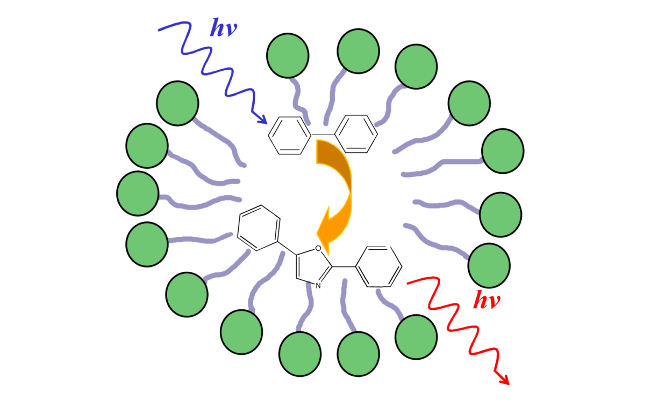
Extension of PARAFAC to Interacting Fluorophores
"Application of PARAFAC to a two-component system exhibiting Fluorescence Resonance Energy Transfer: from theoretical prediction to experimental validation," Hao Chen and Jonathan E. Kenny, Analyst, 2012, 137, 153-162.

Slide 11
Spectroscopic Methods and Instrumentation
“Standardization and Quality Assurance in Fluorescence Measurements I: Techniques” (Invited Book review), Jonathan E. Kenny, J. Am. Chem. Soc., (2009), 131(10), 3789-3790.” (Invited Book review), Jonathan E. Kenny, J. Am. Chem. Soc., (2009), 131(10), 3789-3790.
“Improvement of Inner Filter Effect Correction Based on Determination of Effective Geometric Parameters Using a Conventional Fluorimeter," Qun Gu and Jonathan E. Kenny,Anal. Chem., 2009, 81 (1), 420-426.
"Nitrogen Gas Purging for the Deoxygenation of Polyaromatic Hydrocarbon Solutions in Cyclohexane for Routine Fluorescence Analysis," T. Pagano, A. J. Biacchi, and J.E. Kenny, Appl. Spectrosc. 62, 333-336 (2008).
"A laser induced fluorescence dual fiber optic array detector applied to rapid HPLC separation of polycyclic aromatic hydrocarbons," S. J. Hart, G. J. Hall and J. E. Kenny, Anal. Bioanal. Chem. (2002) 372: 205-215.
"In Situ Measurements of Subsurface Contaminants with a Multi-channel Laser-Induced Fluorescence System," J. W. Pepper, A. O. Wright, and J. E. Kenny, Spectrochimica Acta A58, 2002, 317.

Slide 12
Subsurface Contaminant Monitoring Using Laser Fluorescence, J. E. Kenny, J. W. Pepper, A. O. Wright, Y.-M. Chen, S. L. Schwartz, and C. G. Shelton, ed. Balshaw-Biddle, Oubre and Ward, Lewis Publishers, 2000.
"Speciation of Aromatic Compounds with Excitation-Emission Matrix Measurements," Pepper, Jane W.; Chen, Y.-M,; Wright, Andrew O.; and Kenny, Jonathan E., Proceedings of SPIE. 1999, 3856, 252-260
"Assessment of Inner Filter Effects in Fluorescence Spectroscopy using the Dual- Pathlength Method– a Study of Jet Fuel JP-4", Pagano, Todd E. and Kenny, Jonathan E., Proceedings of SPIE. 1999, 3856, 289-297.
"Two-Fiber Spectroscopic Probe with Improved Scattered Light Rejection," Andrew O. Wright, Jane W. Pepper, and Jonathan E. Kenny, Analytical Chemistry 71, 2582-2585 (1999).
"Subsurface Contaminant Monitoring by Laser Excitation-Emission Matrix/Cone Penetrometer," J. Pepper, Y.-M. Chen, A. Wright,R. Premasiri, J.E. Kenny. Proc. SPIE 3534, pp. 234-242 (1998).
"A Fiber Optic Laser Induced Fluorescence Excitation Emission Detector Applied to Flow Injection Analysis of PAHs," S. J. Hart, G. J. Hall, and J. E. Kenny, Proc., SPIE 3534, pp. 601-611 (1998).

Slide 13
"Laser-Induced Fluorescence and Fast Gas Chromatography/Mass Spectrometry with Subsurface Thermal Extraction of Organics: Field Analytical Technologies for Expediting Site Characterization and Cleanup," A. Robbat Jr., J. E. Kenny, S. Smarason, J.W. Pepper, and A. O. Wright, Remediation Winter 1998, 95-111
"Field Demonstration of a Multichannel Fiber Optic Laser Induced Fluorescence System in a Cone Penetrometer Vehicle," S. J. Hart, Y.- M. Chen, J. E. Kenny, B. K. Lien and T. W. Best, Field Analytical Chemistry and Technology, 1, 343 (1997).
"Improved Two-Fiber Probe for In Situ Spectroscopic Measurements," J. Lin, S. J. Hart, and J.E. Kenny, Analytical Chemistry 68, 3098 (1996).
"A Fiber Optic Multichannel Laser Spectrometer System for Remote Fluorescence Detection in Soils," S.J. Hart, Y.-M. Chen,B.K. Lien, and J.E. Kenny, Proc. SPIE 2835, 73 (1996).
"Spectroscopy in the Field: Emerging Techniques for On-Site Environmental Measurements," A.Henderson-Kinney and J.E. Kenny, Spectroscopy, 10, No. 7, p. 32 (1995).
"Laser Fluorescence EEM Probe for Cone Penetrometer Pollution Analysis," J. Lin, S. J. Hart, T. A. Taylor and J. E. Kenny,Proc. SPIE 2367, 70 (1994).
"Evaluation of Nd:YAG-Pumped Raman Shifter as a Broad-Spectrum Light Source," G.B. Jarvis, S. Mathew and J.E. Kenny, Appl. Opt. 33, 4938 (1994).

Slide 14
Journal of Physical Chemistry & Biophysics Related Journals
Journal of Electrical & Electronic Systems
Journal of Lasers, Optics & Photonics

Slide 15
Gynecology & Obstetrics Related Conferences
3rd International Conference and Exhibition on
Lasers, Optics & Photonics

Slide 16
OMICS Group Open Access Membership
OMICS publishing Group Open Access Membership enables academic and research institutions, funders and corporations to actively encourage open access in scholarly communication and the dissemination of research published by their authors.
For more details and benefits, click on the link below:
http://omicsonline.org/membership.php

