Slide 1
OMICS International
OMICS International through its Open Access Initiative is committed to make genuine and reliable contributions to the scientific community. OMICS International signed an agreement with more than 1000 International Societies to make healthcare information Open Access.
Contact us at: contact.omics@omicsonline.org

Slide 2
OMICS Journals are welcoming Submissions
OMICS International welcomes submissions that are original and technically so as to serve both the developing world and developed countries in the best possible way.
OMICS Journals are poised in excellence by publishing high quality research. OMICS International follows an Editorial Manager® System peer review process and boasts of a strong and active editorial board.
Editors and reviewers are experts in their field and provide anonymous, unbiased and detailed reviews of all submissions.
The journal gives the options of multiple language translations for all the articles and all archived articles are available in HTML, XML, PDF and audio formats. Also, all the published articles are archived in repositories and indexing services like DOAJ, CAS, Google Scholar, Scientific Commons, Index Copernicus, EBSCO, HINARI and GALE.
For more details please visit our website: http://omicsonline.org/Submitmanuscript.php

Slide 3
Prof. Dr. JOSÉ ANTONIO LUPIÁÑEZ
University of Granada
Spain
Department of Biochemistry and Molecular Biology I

Slide 4
About J. A. LUPIÁÑEZ
Full Professor in the Department of Biochemistry and Molecular Biology I of the University of Granada (Spain) since 1989.
Head of this Department since May 2014.
Master Thesis entitled "Succinic acid production by Saccharomyces cerevisiae grown under hypoxic conditions”, realized in the Department of Biochemistry and Molecular Biology and defended in the University of Granada in July 1972. Qualified as “high distinction” and special award.
Ph.D. Thesis entitled “Induction of renal gluconeogenesis by selective inhibition of hepatic gluconeogenesis” realized in the Department of Biochemistry and Molecular Biology and defended in the University of Granada in September 1975. Qualified as “distinction cum-laude” and special award of doctorate.

Slide 5
Teaching career
Teaching in Grade Courses:
“General Biochemistry”,” Structural and dynamic Biochemistry”, ”Expansion of Biochemistry”, “Metabolism regulation”, “Control and Integration of cellular metabolism”, “Enzimology and kinetics”, “Molecular Basis of the Human Pathology”. These subjects have been teaching in the degrees of Chemistry, Biology, Pharmacy and Biochemistry.
Teaching in Master Courses:
Doctoral Program: "Biotechnology and Proteomics"; Course: “Proteomics and protein dynamics” from 2006 to 2014. Doctoral Program: “Biochemistry and Molecular Biology”; Course: “Enzymatic determinations. Kinetic studies" from 1999 to 2005. Course: "Renal metabolic homeostasis" from 1996 to 1998. Course: "Regulation of protein turnover" from 1994 to 1995. Doctoral Programs: “Biochemistry and Molecular Biology” and “Experimentation and methodology in molecular biological systems”; Course: "Renal metabolic homeostasis" from 1987 to 1991. All years inclusive.

Slide 6
Research career
Carbohydrate metabolism and its regulation
Enzimology and kinetics
Metabolism and evolution
Cell growth: Protein synthesis and degradation
Cell proliferation and Apoptosis
Cancer, metastasis and angiogenesis
Oxidative stress
Genomic, Proteomic and Metabolomic

Slide 7
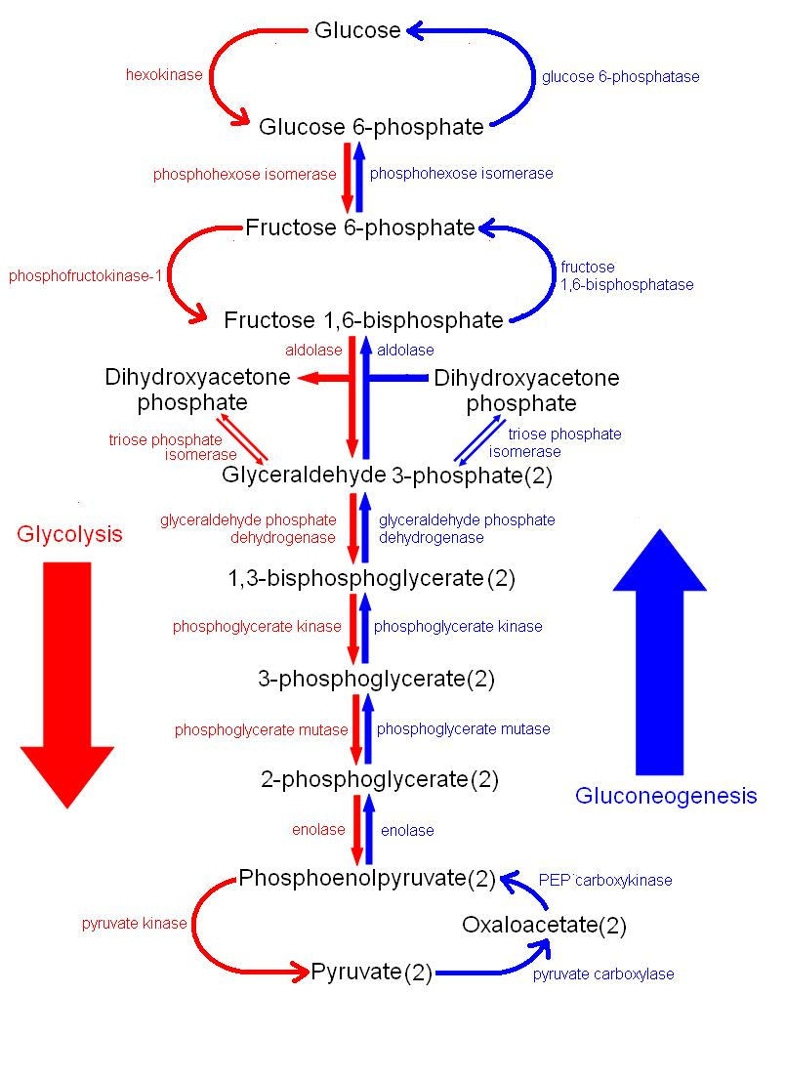
Glucose metabolism

Slide 8
Pentose phosphate pathway
Fatty acid synthesis
FA elongation
and instaturation
Cholesterol
synthesis
Free radical
scavenger
Biosynthesis
Steroid
hormones
Cell protection
Hydroxylation
reactions
NADPH
Detoxification
processes
PUFA peroxidation
CO₂ assimilation
(photosynthesis)
Metabolism of carbohydrates
of 3,4, 5, 7 y 8 carbons
Carbohydrates
interconvertion
PPP
Carbohydrates
interconvertion
Entner- Doudoroff pathway
Synthesis of eritrose 4-P
Aromatic amino acids
Energy
Rib5P
Nucleotides
Intracelular
regulation
signals
Nucleotidic
coenzymes
synthesis
Nucleic acid
synthesis

Slide 9
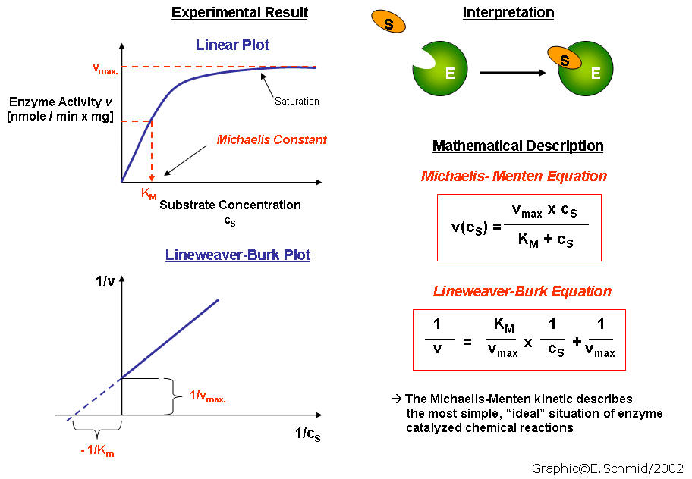
Enzimology and kinetics

Slide 10
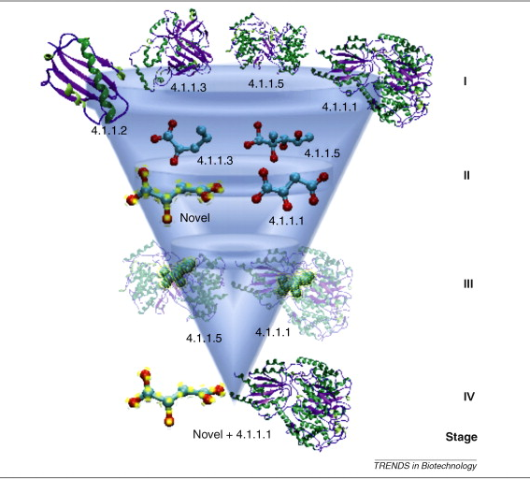
Metabolism and evolution

Slide 11
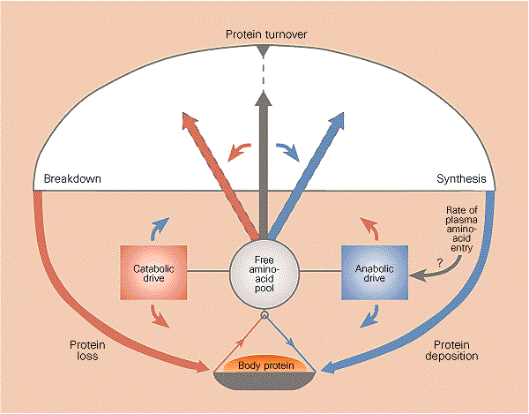
Cell growth: Protein synthesis and degradation

Slide 12
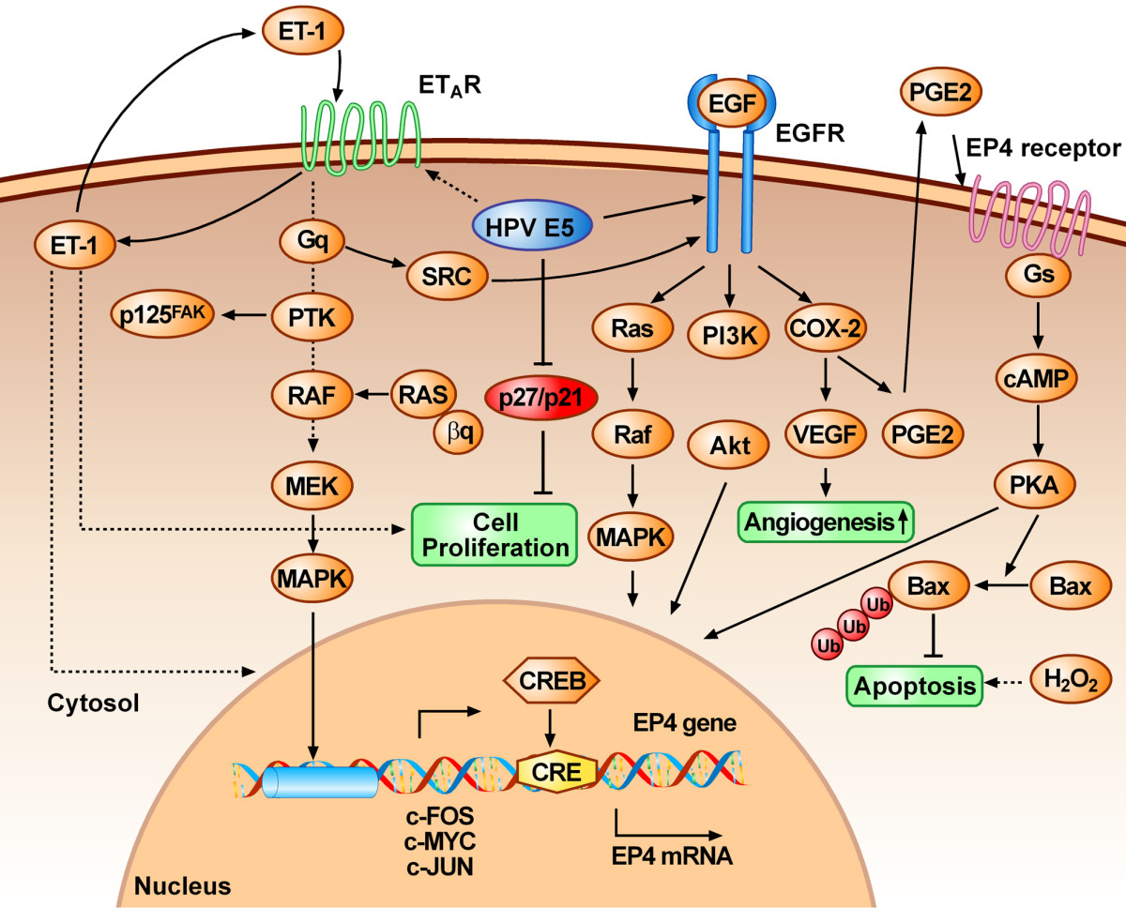
Cell Proliferation and Apoptosis Metastasis and Angiogenesis

Slide 13
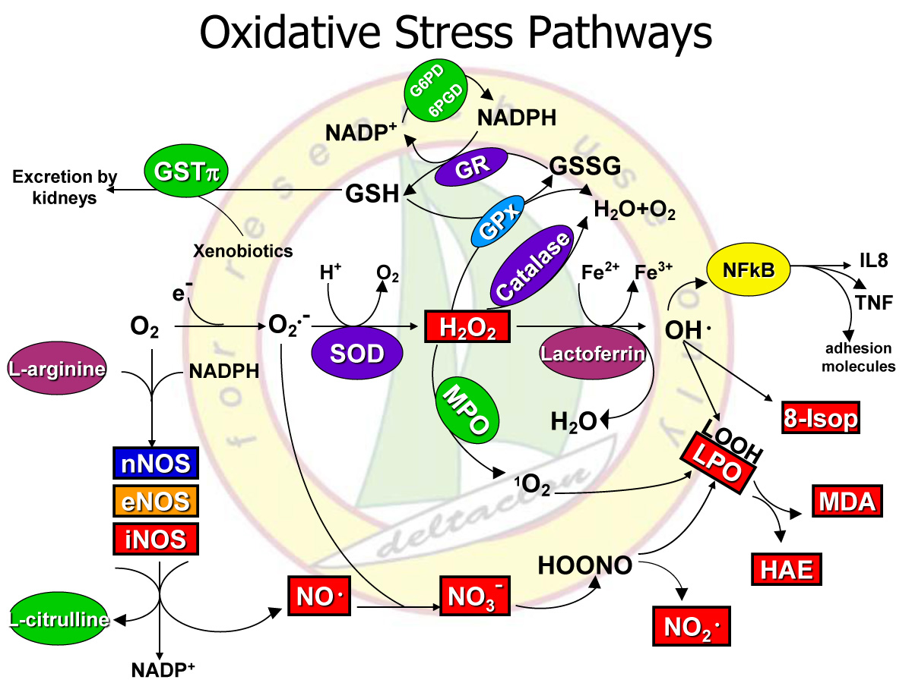
Oxidative stress

Slide 14
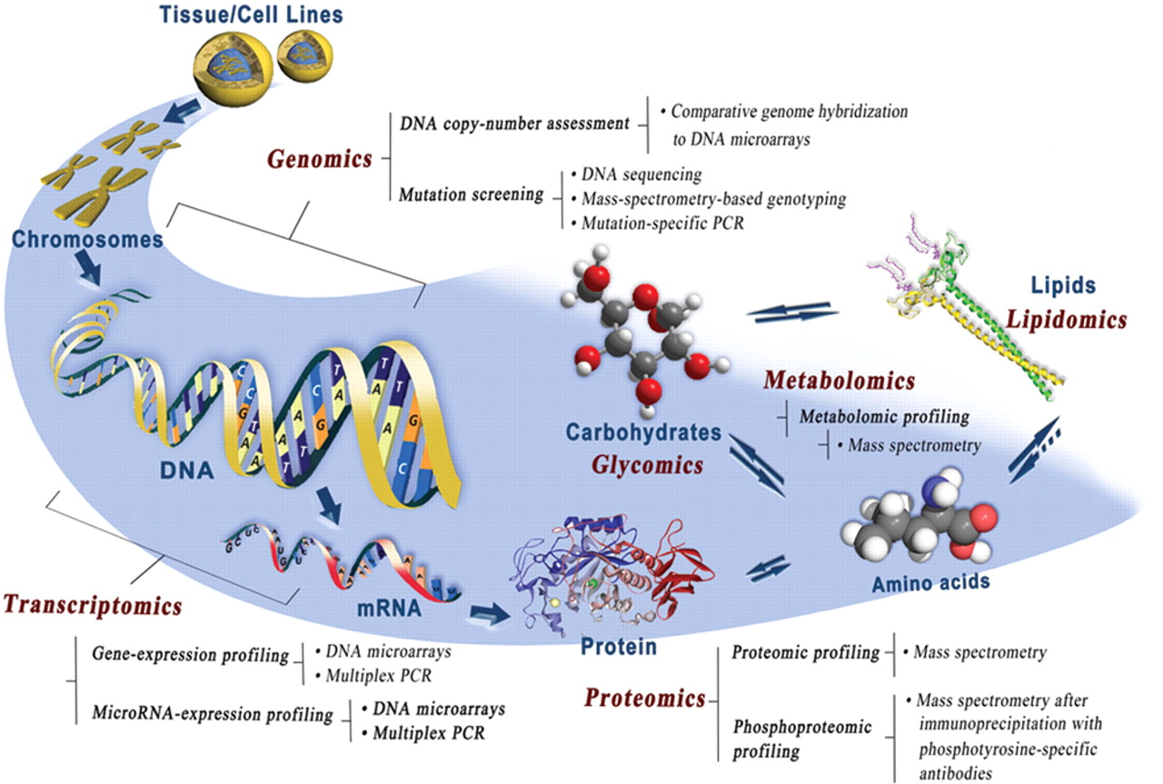
Genomic, Proteomic and Metabolomic

Slide 15
Signature

Slide 16
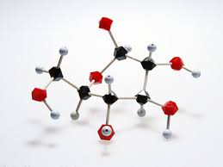
Medicinal chemistry Related Journals
Drug Designing: Open Access
Biochemistry & Pharmacology
Advances in Pharmacoepidemiology & Drug Safety

Slide 17
Medicinal chemistry Related Conferences
3rd International Conference on Medicinal Chemistry &
Computer Aided Drug Designing
3rd International Conference and Exhibition on Pharmacognosy, Phytochemistry & Natural Products

Slide 18
OMICS International Open Access Membership
OMICS International Open Access Membership enables academic and research institutions, funders and corporations to actively encourage open access in scholarly communication and the dissemination of research published by their authors.
For more details and benefits, click on the link below:
http://omicsonline.org/membership.php

