Slide 1
OMICS Group
OMICS Group International through its Open Access Initiative is committed to make genuine and reliable contributions to the scientific community. OMICS Group hosts over 400 leading-edge peer reviewed Open Access Journals and organizes over 300 International Conferences annually all over the world. OMICS Publishing Group journals have over 3 million readers and the fame and success of the same can be attributed to the strong editorial board which contains over 30000 eminent personalities that ensure a rapid, quality and quick review process. OMICS Group signed an agreement with more than 1000 International Societies to make healthcare information Open Access.
Contact us at: contact.omics@omicsonline.org

Slide 2
OMICS Journals are welcoming Submissions
OMICS Group welcomes submissions that are original and technically so as to serve both the developing world and developed countries in the best possible way.
OMICS Journals are poised in excellence by publishing high quality research. OMICS Group follows an Editorial Manager® System peer review process and boasts of a strong and active editorial board.
Editors and reviewers are experts in their field and provide anonymous, unbiased and detailed reviews of all submissions.
The journal gives the options of multiple language translations for all the articles and all archived articles are available in HTML, XML, PDF and audio formats. Also, all the published articles are archived in repositories and indexing services like DOAJ, CAS, Google Scholar, Scientific Commons, Index Copernicus, EBSCO, HINARI and GALE.
For more details please visit our website: http://omicsonline.org/Submitmanuscript.php

Slide 3
Jung Weon Lee
Editor of
Journal of Pharmaceutical Care & Health systems

Slide 4
Biography
He got a Ph.D. degree in Pharmacology, from Department of Pharmacology, University of North Carolina at Chapel Hill, NC, USA. His is currently a professor at Department of Pharmacy, Seoul National University, Seoul, Korea (Republic of). His research interests in signal transduction of membrane proteins including integrin, tetraspanin, growth factor receptor, and others, which are involved in cell adhesion, morphology, migration, and invasion through activations of diverse intracellular signaling connections. More specifically, he has published reports on fibrotic and tumorigenic roles of a tetraspanin TM4SF5 that can collaborate with integrins and growth factor receptors for diverse cellular functions for tumorigenesis and metastasis. For the researches, he uses in vitro cell cultures in 2D or 3D ECM-surrounded system, animal system, and clinical tissues. The key words for his researches can include cancer, signal transduction, cell adhesion, actin organization, migration, invasion, 3D environment, metastasis, and epithelial-mesenchymal transition.

Slide 5
Research Interests
Signal transduction of membrane proteins including integrin, tetraspanin, growth factor receptor, and others, which are involved in cell adhesion, morphology, migration, and invasion through activations of diverse intracellular signaling connections.

Slide 6
Recent Publications
Lee JW (2014) The biological significance of TM4SF5-mediated epithelial-mesenchymal transition. In preparation
Kim S and Lee JW (2014) Membrane proteins involved in epithelial-mesenchymal transition and tumor invasion; studies on TMPRSS4 and TM4SF5. Submitted
Y-J Choi*, H-H Kim*, H-J Kim, M Kang, M-S Lee, J Ryu, HE Song, SH Nam, D Lee, K-W Kim, and Lee JW (Co-corresoonding authors). TM4SF5 suppression disturbs integrin a5-related signaling and muscle development in zebrafish. Submitted. * equally contributed.
J Ryu, M Kang, M-S Lee, H-J Kim, SH Nam, HE Song, D Lee, and Lee JW (Corresponding author). Cross-talk between the TM4SF5/FAK and IL6/STAT3 pathways controls invasion and immune escape of human liver cancer cells. In Revision
M Kang, J Ryu, D Lee, M-S Lee, H-J Kim, SH Nam, HE Song, J Choi, G-H Lee, H Lee, SJ Kim, S-G Ye, S Kim, and Lee JW (Corresponding author) Correlations between TM4SF5, CD151, and CD63 in Liver Fibrotic Phenotypes and Hepatic Migration and Invasive Capacities. Submitted
M-S Lee, S Kim, BG Kim, C Won, SH Nam, S Kang, H- Kim, M Kang, J Ryu, HE Song, D Lee, S-K Ye, NL Jeon, NH Cho, and Lee JW (Corresponding author). Snail1 induced in breast cancer cells in 3D collagen I gel environment suppresses cortactin and impairs effective invadopodia formation. In Revision
Min H-J, Lee MK, Lee JW, and Kim S (2014) TMPRSS4 induces cancer cell invasion through pro-uPA processing. Biochem. Biophys. Res. Commun. doi: 10.1016/j.bbrc.2014.01.013.

Slide 7
SIGNAL TRANSDUCTION

Slide 8
Cell-Cell Interactions
For a coordinated function of cells in a tissue, tissues in an organ, organs in a system and systems in the body, cells need to be able to communicate with each other.
Each cell should be capable of sending chemical signals to other cells and of receiving chemical signals from other cells, as well as signals (chemical or other) from its immediate environment.

Slide 9
A cell can communicate signals to other cells in various ways.
Autocrine signaling
Paracrine signaling
Endocrine signaling
Direct signaling
Synaptic signaling

Slide 10
Autocrine signaling
is a way for a cell to alter its own extracellular environment, which in turn affects the way the cell functions. The cell secretes chemicals outside of its membrane and the presence of those chemicals on the outside modifies the behavior of that same cell. This process is important for growth.

Slide 11
Paracrine signaling
is a way for a cell to affect the behavior of neighboring cells by secreting chemicals into the common intercellular space. This is an important process during embryonic development.

Slide 12
Endocrine signaling
utilizes hormones. A cell secretes chemicals into the bloodstream. Those chemicals affect the behavior of distant target cells.

Slide 13
Direct signaling
is a transfer of ions or small molecules from one cell to its neighbor through pores in the membrane. Those pores are built out of membrane proteins and are called gap junctions. This is the fastest mode of cell-cell communication and is found in places where extremely fast and well-coordinated activity of cells in needed. An example of this process can be found in the heart. The muscle cells in the heart communicate with each other via gap junctions which allows all heart cells to contract almost simultaneously.

Slide 14
Synaptic signaling
is found in the nervous system. It is a highly specific and localized type of paracrine signaling between two nerve cells or between a nerve cell and a muscle cell.

Slide 15
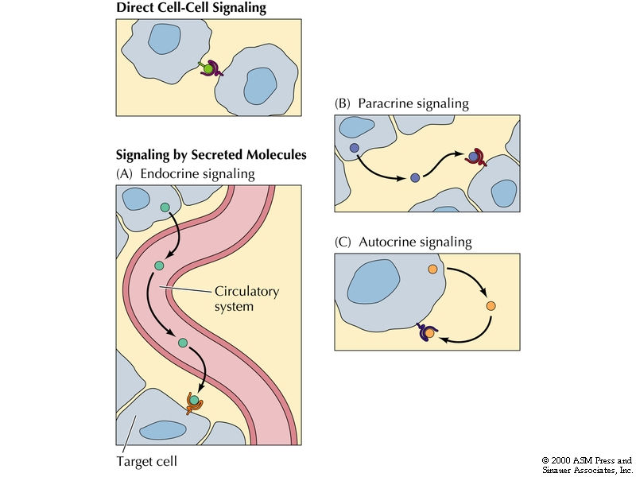

Slide 16
Target cells
Specific cells are affected by hormone and respond in unique fashion:
Cells have specific receptors on membrane or in cell that respond to hormone
Can have receptors for several different hormones
Number of active receptors can change
Down-regulation - number of receptors decreases & target is less sensitive
Up-regulation - number increases & target is more sensitive

Slide 17
How does a cell receive a signal?
Some small molecules are capable of entering the cell through the plasma membrane.
Some small hormones also enter the cell directly, by passing through the membrane. Examples are steroid hormones and thyroid hormones.

Slide 18
Approved By
E-signature:
Jung Weon

Slide 19
OMICS Group Open Access Membership
OMICS publishing Group Open Access Membership enables academic and research institutions, funders and corporations to actively encourage open access in scholarly communication and the dissemination of research published by their authors.
For more details and benefits, click on the link below:
http://omicsonline.org/membership.php

