Slide 1
OMICS Journals are welcoming Submissions
OMICS International welcomes submissions that are original and technically so as to serve both the developing world and developed countries in the best possible way.
OMICS Journals are poised in excellence by publishing high quality research. OMICS International follows an Editorial Manager® System peer review process and boasts of a strong and active editorial board.
Editors and reviewers are experts in their field and provide anonymous, unbiased and detailed reviews of all submissions.
The journal gives the options of multiple language translations for all the articles and all archived articles are available in HTML, XML, PDF and audio formats. Also, all the published articles are archived in repositories and indexing services like DOAJ, CAS, Google Scholar, Scientific Commons, Index Copernicus, EBSCO, HINARI and GALE.
For more details please visit our website: http://omicsonline.org/Submitmanuscript.php

Slide 2
On Effectiveness Factor during Roll-to-Roll Transfer Process for Graphene in Horizontal Low Pressure Chemical Vapor Deposition Annular Plug Flow Reactor
Dr. Kal Renganathan Sharma PE
Adjunct Professor, Department of Physics
227 Spearman Technology Bldg., College of Science and Technology
Texas Southern University
3100 Cleburne Street, Houston, TX 77004
Tel: (713) 313 1944
Email: jyoti_kalpika@yahoo.com
Paper 17 at 247th American Chemical Society National Meeting, Dallas, TX, March 16th – 20th 2014

Slide 3
Graphene
Graphene is a distinct Allotrope of Carbon
Other Allotropes – Fullerenes, C₆₀, Diamond, Graphite, Carbon Nanotubes, CNTs
Unscrolled CNT is graphene. Graphite comprises of graphene layers with interlayer bondind strength of 5.9 KJ.mol⁻¹.
Graphene has a unique 2D, two dimensional, hexagonal lattice structure made up of sp² hybrized planar sheet of carbon atoms.
Possesses interesting electronic, optical, mechanical and thermal properties.
Interesting applications are expected for SG in the areas of computing , energy and medicine.
EU, European Union, is investing 1 billion euros as funding for ten years in order to explore commercial applications for graphene.
The Russian initiative is to spend $8.55 billion in order to create nanotech industry by the year 2015.

Slide 4
Korea ~ $350 million & 7500 patents related to graphene. China, US and South Korea are leading in number of patents acquired in graphene.
Top industrial participants - IBM, Xerox and Samsung.
€ 10 million is invested in Germany on carbon innovation center.
100 papers were presented at a APS, American Physical Meeting at Denver, CO in 2007. Nobel Prize was awarded in ’10 to A. Geim and Novosolev.
Prof. R. Ruoff at University of Texas, Austin has rubbed tiny pillars of graphite against a silicon wafer surface causing them to spread out like a deck of cards
Electrons are delocalized in the hexagonal sheet of atoms and move without obstacle
Chiral, arm chair and puckered morphology of graphenes are possible.
In order to puncture a graphene sheet with the thinness of saran wrap an elephant balanced on a pencil is needed.

Slide 5
..attributes
Graphene is a natural substance. It is 200 times stronger than steel and has a tensile strength of 1.5 million psi. International standards have yet to be established for graphene.
According to recent Lux report the projected market value of graphene by 2018 is $180 million.
According to the BBC, British Broadcasting Corporation by 2020 the market value of graphene will be $675 million. The Lux report did not include a economically scalable model of fabrication of graphene in their estimates.
A number of scalable methods to make graphene is discussed in my book.
The cost of production of graphene is expected to come down as the technologists move past the learning curve. It costs $60 per square inch of graphene on copper substrate. Expectations are for the costs to come down to $1 per square inch of industrial electronic applications and 10 cents per square inch for use in touch screen displays
Applications range from higher capacity electrodes, anti-reflection coatings in solar cells, carbon composites for lighter weight BMWs, panel displays in wireless telephones and laptops, thermal management, cancer treatments, feather-weight HD, high definition televisions, inks, NEMS, . Graphene can be used in study of sequences of RNA and DNA.
von Newmann bottle neck can be obviated by design of novel MLG, magneto logic gates. Bilayer graphene can be used to provide tunable bandgap needed in supercapacitors, LEDS and other applications.

Slide 6
Delocalized Electrons - Resonant

Slide 7
XRD Pattern of Graphene

Slide 8
XRD, x-ray diffraction has been used to obtain the Bravais lattice structures in materials science.
Graphene can also be characterized using XRD.
The peak found in graphite broadens in graphene.
Larger nterlayer spacing d estimates can be used to confirm graphene.
The graphene formed from different process conditions can be distinguished using the XRD spectra.

Slide 9
Roll-to-Roll Transfer Process – Annular Plug Flow Reactor
Three Steps
Adhesion of polymer supports to the graphene on copper foil. Two rollers are used to get the graphene film grown on a copper foil to be attached to a polymer film coated with adhesive film as it passes through;
Etching of copper layers. Electrochemical reaction with aqueous 0.1 M ammonium persulphate solution (NH₄)₂S₂O₈ enables the removal of copper layers and;
Release of the graphene layer onto a target substrate. Thermal treatment is used to detach the graphene from the polymer support and reattach the film onto a target substrate. This target substrate could have been placed below the copper foil in order to obviate the third step.

Slide 10
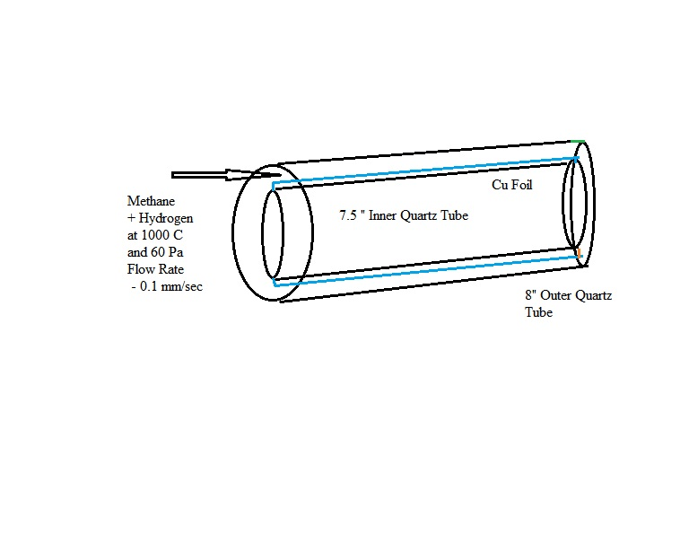

Slide 11
Mechanism of Formation of Graphene on Carbon Foil
Dissociation
2CH₄ → C₂H₂ + 3H₂ (1)
1000 ⁰ C
Adsorption
C₂H₂ + 2Cu → Cu.C₂ + H₂ (2)
Surface Reaction
Cu.C₂ ⇔ Cu + 2C (3)

Slide 12
Adsorbtion – Langmuir Isotherm
[filled sites] + [empty sites] ⇔ [filled sites] (4)
Sites are subject to chemical equilibrium;
[bulk solute] + [empty site] ⇔ [filled site] (5)
(6)
(7)
The rate of adsorption can be written as follows;
Rate of adsorption r” = (8)

Slide 13
Effectiveness Factor
Effectiveness Factor

Slide 14
Autocatalytic Reaction – Simultaneous Diffusion in Annular Space of APFR
Mass Balance on a cylindrical shell in annular space of a APFR of length L (long) and outer radius R and inner radius κR;
Method of Separation of Variables
Obtain Concentration Profile as a Function of Space and Time
APFR
Chemical Vapor Deposition of Graphene on Copper Foil
Branched, Free Radical Mechanism
Free Radicals will be Neutralized at the Surface
Surface to Volume Ratio
Free Radicals makes the Reaction Autocatalytic

Slide 15
Time and Space Conditions
Initial Condition – 0 concentration of acetylene
At infinite time the concentration of the acetylene in the entire reactor reaches the maximum value and that r = R.
At r = R, at the wall of the quartz reactor is impervious
at r = 0 although the interest is only in the annular space the resulting function has to be symmetric at r = 0. There is no good reason for asymmetry in the radial direction.

Slide 16
Governing Equation
The governing equation can be obtained by eliminating J_{r} between governing equation and the damped wave diffusion and relaxation equation. The damped wave diffusion and relaxation equation can be written as follows;
Damped Wave Diffusion and Relaxation Equation
Eliminate the cross derivative of molar flux J with respect to space and time

Slide 17
…in Concentration
Governing Equation
Dimensionless form of the equation is obtained

Slide 18
Solution
The solution is obtained by the method of separation of variables. First the damping term is removed by multiplying the above equation by e^{nτ}. It can be seen that the terms group as W = ue^{nτ} and the governing equation becomes at n = (1-k*)/2;
Let W = V(τ) φ (X)

Slide 19
Solution
φ = c₁ J₀ (λ X) + c₂ Y₀ (λ X)
It can be seen that c₂ = 0 from the symmetry condition that the derivative of the concentration with respect to r = 0. Now from the BC at the surface,

Slide 20
Time Domain
The solution for time domain is the sum of two exponentials. The term containing the positive exponential power exponent will drop out as with increasing time the system may be assumed to reach steady state. At steady state or infinite time W = uexp(τ/2), becomes zero multiplied with infinity. This is in a inderdeterminate form of the fourth kind (Piskunov). This can be shown to go to zero. Thus,
Infinite Modified Fourier Bessel Series Solution

Slide 21
The c_{n} can be solved for from the initial condition by using the principle of orthogonality for Bessel functions. At time is zero the LHS And RHS are multiplied by J₀ (λ_{m} X). Integration between the limits of 0 and R is performed. When n is not m the integral is zero from the principle of orthogonality. Thus when n = m,
c_{n} = - ∫₀^{R} J₀ (λ_{n} X) / ∫₀^{R} J₀² (λ_{n} X)
It can be noted from Eq. [3.191] that when
( 1 + k*)²/4 < λ_{n}²
the solution will be periodic with respect to time domain. This can be obtained by using De Movries theorem and obtaining the real part to exp(-iτ √ (λ_{n}² - ( 1 + k*)²/4 ) ).

Slide 22
Bifurcated Solution
For Large Relaxation Times the Concentration of Graphene (Product) will undergo Oscillations.
Estimates of Relaxation Time from Stokes-Einstein Formulation from Chemical Potential (Sharma, 2006)
For Graphene at 5 torr this can be 50 minutes

Slide 23
Shape Limit
The surface to volume ratio needs to be maintained high. It can be seen that there exist a critical value of R above which the rate at which the free radicals are produced in the reaction is larger than the rate at which it is removed by diffusion. This will lead to a runaway condition in autocatalytic reactions. At the critical value,
(2R h π) ∂u/ ∂X C_{s} D/√Dτ_{r} = (π R² h) (k”’ C) (3.202)
or R_{crit} = 4 √D/k”’ J₁ (R √(k”’/D) )/J₀(R √(k”’/D) (3.203)
Considering the average reaction rate instead,
R_{crit} = 2√D/k”’ J₁ (R √(k”’/D) (3.204)

Slide 24
Conclusions
Graphene can be made in Large Scale
Annular Plug Flow Reactor
Simultaneous Diffusion and Reaction of Acetylene in Annular Space Considered
Damped Wave Diffusion Effects Significant. Relaxation Time ~ 50 minutes
Governing Equation Solved for by Method of Separtion of Variables
Infinite Modified Fourier-Bessel Series Solution
For Large Relaxation Times – Subcritical Oscillations
Steady State – Shape Factor Effect. Critical Size for R.

Slide 25
Journal of Laser Optics & Photonics
Journal of Photonics
Journal of Wave theory
Journal of Optics
Journal of Lasers
Signal Crystal

Slide 26
Journal of Laser Optics & Photonics
For upcoming Conference visit
http://www.conferenceseries.com/

