Slide 1
Journal of Molecular Imaging and Dynamics
OMICS Group International through its Open Access Initiative is committed to make genuine and reliable contributions to the scientific community. OMICS Group hosts over 400 leading-edge peer reviewed Open Access Journals and organizes over 300 International Conferences annually all over the world. OMICS Publishing Group journals have over 3 million readers and the fame and success of the same can be attributed to the strong editorial board which contains over 30000 eminent personalities that ensure a rapid, quality and quick review process. OMICS Group signed an agreement with more than 1000 International Societies to make healthcare information Open Access.

Slide 2
OMICS Journals are welcoming Submissions
OMICS Group welcomes submissions that are original and technically so as to serve both the developing world and developed countries in the best possible way.
OMICS Journals are poised in excellence by publishing high quality research. OMICS Group follows an Editorial Manager® System peer review process and boasts of a strong and active editorial board.
Editors and reviewers are experts in their field and provide anonymous, unbiased and detailed reviews of all submissions.
The journal gives the options of multiple language translations for all the articles and all archived articles are available in HTML, XML, PDF and audio formats. Also, all the published articles are archived in repositories and indexing services like DOAJ, CAS, Google Scholar, Scientific Commons, Index Copernicus, EBSCO, HINARI and GALE.
For more details please visit our website: http://omicsonline.org/Submitmanuscript.php

Slide 3
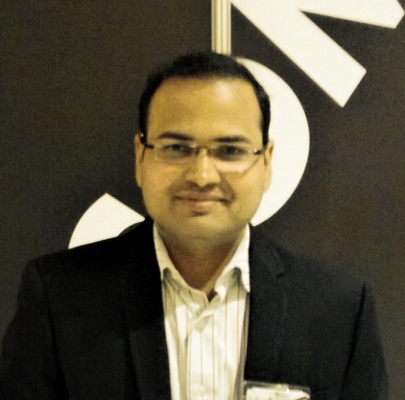
Dr. Kanhaiyalal Agrawal
M.D. Nuclear Medicine, PGIMER, Chandigarh, India
Specialist registrar in Guy’s Hospital, London, UK
Currently Nuclear Medicine Physician, PGIMER, India
Authored 37 scientific papers in national and international journals and a book chapter in a reputed book
Editorial board member of an international journal and reviewer in IJNM
Honored with many national and international awards including prestigious “Kataria memorial gold medal” for best postgraduate student of PGIMER, Chandigarh
Presented many scientific papers in national and international meetings
Areas of interest are musculoskeletal hybrid imaging, PET/CT and radionuclide therapies

Slide 4
Thank you

