Slide 1
OMICS Group
OMICS Group International through its Open Access Initiative is committed to make genuine and reliable contributions to the scientific community. OMICS Group hosts over 400 leading-edge peer reviewed Open Access Journals and organizes over 300 International Conferences annually all over the world. OMICS Publishing Group journals have over 3 million readers and the fame and success of the same can be attributed to the strong editorial board which contains over 30000 eminent personalities that ensure a rapid, quality and quick review process. OMICS Group signed an agreement with more than 1000 International Societies to make healthcare information Open Access.
Contact us at: contact.omics@omicsonline.org

Slide 2
OMICS Journals are welcoming Submissions
OMICS Group welcomes submissions that are original and technically so as to serve both the developing world and developed countries in the best possible way.
OMICS Journals are poised in excellence by publishing high quality research. OMICS Group follows an Editorial Manager® System peer review process and boasts of a strong and active editorial board.
Editors and reviewers are experts in their field and provide anonymous, unbiased and detailed reviews of all submissions.
The journal gives the options of multiple language translations for all the articles and all archived articles are available in HTML, XML, PDF and audio formats. Also, all the published articles are archived in repositories and indexing services like DOAJ, CAS, Google Scholar, Scientific Commons, Index Copernicus, EBSCO, HINARI and GALE.
For more details please visit our website: http://omicsonline.org/Submitmanuscript.php

Slide 3
KHALED H. S. BARAKAT
Editor of
Journal of Pharmaceutical Care & Health systems

Slide 4
Research Interests
Molecular Modelling
Bioinformatics
Computer Architecture
Computer Programming
Methods

Slide 5
Recent Publications
Barakat KH, Law J, Prunotto A, Magee WC, Evans DH, Tyrrell DL, Tuszynski J, Houghton
M. “Detailed Computational Study of the Active Site of the Hepatitis C Viral RNA Polymerase to Aid Novel Drug Design.” J Chem Inf Model. 2013 Oct 24.
Barakat KH, Huzil TJ, Jordan KE, Evangelinos C, Houghton M, Tuszynski J. “A
Computational Model for Overcoming Drug Resistance Using Selective Dual-Inhibitors for
Aurora Kinase A and its T217D Variant.” 2013 Oct 4. [Epub ahead of print].
Jordheim LP, Barakat KH, Heinrich-Balard L, Matera EL, Cros-Perrial E, Bouledrak K, El
Sabeh R, Perez-Pineiro R, Wishart DS, Cohen R, Tuszynski J, Dumontet C., “Small
Molecule Inhibitors of ERCC1-XPF Protein-Protein Interaction Synergize Alkylating Agents
in Cancer Cells”, Mol Pharmacol. 2013 Apr 11. Figure 3C of this paper has been selected as
the cover illustration for the July, 2013 issue of Molecular Pharmacology.

Slide 6
Molecular Modeling
Molecular modeling encompasses all theoretical methods and computational techniques used to model or mimic the behaviour of molecules.

Slide 7
Working at the Intersection
Structural Biology
Biochemistry
Medicinal Chemistry
Toxicology
Pharmacology
Biophysical Chemistry
Information Technology

Slide 8
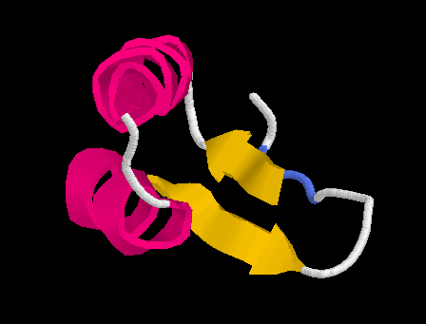
Structural Biology
Fastest growing area of biology
Protein and nucleic acid structure and function
How proteins control living processes

Slide 9
Medicinal Chemistry
Organic Chemistry
Applied to disease
Example: design new enzyme inhibitor drugs
doxorubicin (anti-cancer)

Slide 10
Pharmacology
Biochemistry of Human Disease
Different from Pharmacy: distribution of pharmaceuticals, drug delivery systems

Slide 11
New Ideas From Nature
Natural Products Chemistry
Chemical Ecology
During the next two decades: the major activity in organismal biology
Examples: penicillin, taxol (anti-cancer)

Slide 12
Bio/Chem-informatics
The collection, representation and organisation of chemical data to create chemical information, to which theories can be applied to create chemical knowledge.
Aim
To examine how computational techniques can be used to assist in the design of novel bioactive compounds.
To give an idea of how computational techniques can similarly be applied to other emerging areas such as Bio-informatics, Cheminformatics & Pharmainformatics.

Slide 13
Overview
Drug discovery process
How do drugs work?
Overview of Computer-Aided Drug Design

Slide 14
Pharmaceutical/Agrochemical Industry
Identification of novel compounds with useful and commercially valuable biological properties.
vastly complex,
multi-disciplinary task
many stages over extended periods of time
Risk
most novel compounds do not result in a drug.
those that do may cause unexpected, long-term side-effects.

Slide 15
Why CADD…?
Drug Discovery today are facing a serious challenge because of the increased cost and enormous amount of time taken to discover a new drug, and also because of rigorous competition amongst different pharmaceutical companies.

Slide 16
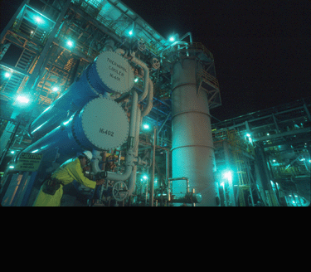
Drug Discovery & Development
Identify disease
Find a drug effective
against disease protein
(2-5 years)
Isolate protein
involved in
disease (2-5 years)
Scale-up
Preclinical testing
(1-3 years)
Human clinical trials
(2-10 years)
File IND
Formulation
File NDA
FDA approval
(2-3 years)

Slide 17
Drug Development Process
develop
assay
10,000’s
compounds
lead
identification
On average it takes 12 -15 years and costs ~$500 -800 million to bring a drug to market
lead
optimisation
clinical
trials
1 drug
to market
Notes:
Now I’d just like to briefly describe the steps involved in bringing a new drug to market. The development of a new drug is a long and expensive process. A new compound must produce the desired response, have minimal side-effects and be better than existing therapies.
The first step in drug discovery is to develop an assay to test a potential drug’s effectiveness (e.g. adding the compound to tissue samples of microorganism colonies to see visable indication of effective treatment). Next, is the process of finding lead compounds, that is compounds that have some activity against the disease and provide a starting point for further refinement. At this stage we may have a candidate molecule that is capable of showing activity.
The next step is lead optimisation which is the process of modifying the lead to enhance its potency and to ensure that it has minimal side effects and that it has the right properties so that it can be transported to the site of action within the body (for example, does it need to pass through a cell-membrane). Next the candidate drugs are put through pre-clinical (animal and test-tubes) and clinical trials (various stages of testing in healthy and diseased humans).
On average, it takes 12 years and cost >$350million and during this process many 10s of 1000s of compounds will have been investigated.

Slide 18
Cont…

Slide 19
Technology is impacting this process
GENOMICS, PROTEOMICS & BIOPHARM.
Potentially producing many more targets
and “personalized” targets
HIGH THROUGHPUT SCREENING
Identify disease
Screening up to 100,000 compounds a
day for activity against a target protein
VIRTUAL SCREENING
Using a computer to
predict activity
Isolate protein
COMBINATORIAL CHEMISTRY
Rapidly producing vast numbers
of compounds
Find drug
MOLECULAR MODELING
Computer graphics & models help improve activity
Preclinical testing
IN VITRO & IN SILICO ADME MODELS
Tissue and computer models begin to replace animal testing

Slide 20
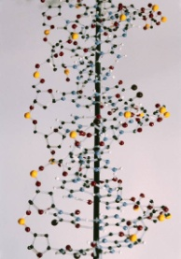
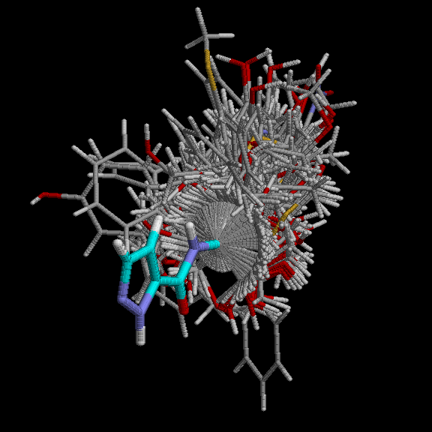
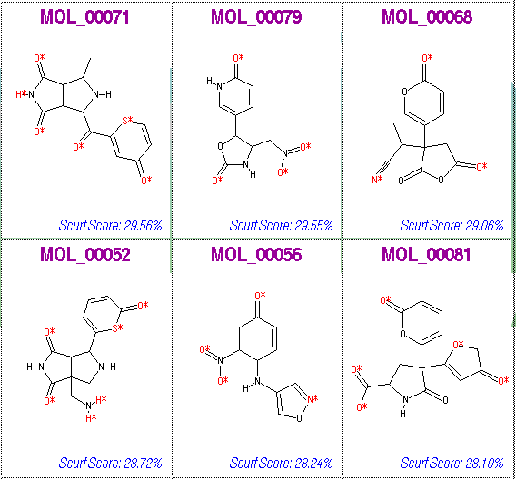
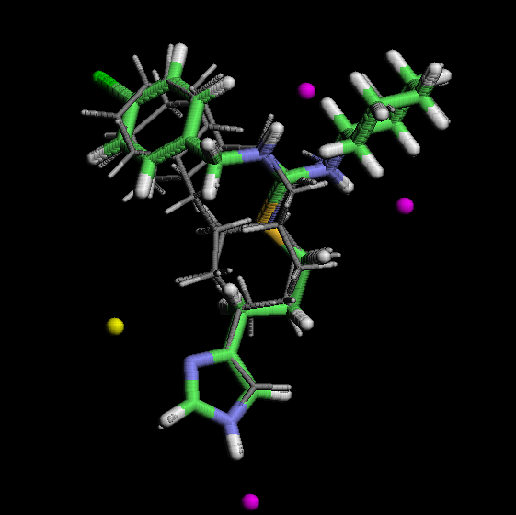
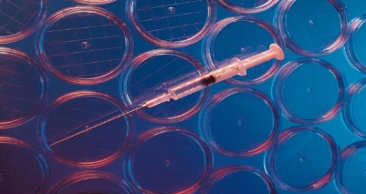
Automating the CADD Process
X-ray or
Homology
Med Chem/Combichem
Gene sequence data
LibmakerTM
Designed libraries
Skelgen™
Designed Templates
Library synthesis
Ligand binding data
Screening
Pharmacophore
Model

Slide 21
Phases of CADD
Target discovery
Lead discovery
Target
Identification
Target
Validation
Lead
Identification
Lead
Optimization
Database
filtering
Alignment
QSAR
Similarity
analysis
Biophores
ADMET
Computer Aided
Drug Design
(CADD)
VHTS
diversity
selection
Combinatorial libraries
de novo design
SAVING 12 – 15 years, Costs: 500 - 800 million US $

Slide 22
How Drugs Work
+
Enzyme
Substrate
Enzyme-substrate
complex
Lock-and-key model
Notes:
Ehrlich (1854-1915) formulated the concept of a drug as a magic bullet - homing in on its target and leaving the rest of the body unharmed.
However, a magic bullet hasn't yet been found: all drugs have side effects. But this concept still drives drug discovery.
The idea is that the enzyme can be thought of as a lock and a substarte (or drug) will only bind if it is complementary to the lock, i.e. like a key. We now know that the lock-and key model is an over-simplification and in reality both the enzyme and the substrate are likely to be flexible molecules and binding occurs by induced fitting where both the enzyme and the substrate can adopt different positions.
However, this is an added layer of complexity and at least for this talk its more useful if we assume the simplified model. Thus, in order for a drug to bind to a receptor site it should have complementary shape to the receptor site and it should also have complementary chemical properties.
Most drugs are small organic compounds.

Slide 23
Methodologies and strategies of CADD:
Structure based drug design (SBDD) “DIRECT DESIGN”
Followed when the spatial structure of the target is known.
Ligand based drug design (LBDD) “INDIRECT DESIGN”
Followed when the structure of the target is unknown.

Slide 24
Computer-Aided Drug Design
3-D target structure unknown (LBDD)
Random screening if no actives are known
Similarity searching
Pharmacophore mapping
QSAR (2D & 3D) etc.
Combinatorial library design etc.
Structure-based drug design (SBDD)
Molecular Docking
De novo design
Notes:
DISCO (DIStance COmparison) rapidly generates multiple pharmacophore hypotheses for a given set of active compounds. Using fast computing techniques and a method of clique detection developed by Dr. Yvonne Martin and co-workers at Abbott Laboratories, DISCO identifies common pharmacophoric features in each structure, produces optimally aligned structures, and extracts the key features of the pharmacophore. These pharmacophore hypotheses can then be compared, refined, and used to guide lead generation and lead optimization.
User control of tolerance, number and type of pharmacophoric features required in the model
Seamless interface to both Multisearch in Advanced Computation and RECEPTOR
User-defined pharmacophoric features can be used to extend built-in DISCO features
Optional use of chirality
Automatic overlap of possible binding groups
Ability to examine pharmacophore models with SYBYL interactive graphics
works with a set of precomputed conformers.

Slide 25
In Pharmacophore…
Pharmacoporic Studies on ACE inhibitors
Pharmacological Studies on HIV-1RT
Nucleosidic Inhibitors
Non-Nucleosidic Inhibitors
Interaction Energy – Potency Correlation

Slide 26
What is Pharmacophore…?
Pharmacophore model
Set of points in space defining the binding of ligands with target.
Key factors in developing such a model are the determination of functional groups essential for binding, their correspondence from one ligand to another, and the common spatial arrangement of these groups when bound to the receptor
The pharmacophore model of HIV protease.

Slide 27
Pharmacophore…..?
“a molecular framework that carries (phoros) the essential features responsible for a drug’s (pharmacon) biological activity” Paul Erlich, early 1990
“a set of structural features in a molecule that is recognized at a receptor site and is responsible for that molecule’s activity” Peter Gund, 1977

Slide 28
Basic Features
A set of features common to a series of active molecules
What are the features…?
HBD
HBA
+ve &-ve charged groups and
Hydrophobic regions
Functional groups or molecules with similar physical and chemical properties
Bioisosteres - substituents or groups that have chemical or physical similarities and which produce broadly similar biological properties

Slide 29
Pharmacophore model
Set of points in space defining the binding of ligands with target.
Key factors in developing such a model are the determination of functional groups essential for binding, their correspondence from one ligand to another, and the common spatial arrangement of these groups when bound to the receptor.

Slide 30
Approved By : Khaled Barakat
E-signature: Khaled Barakat

Slide 31
OMICS Group Open Access Membership
OMICS publishing Group Open Access Membership enables academic and research institutions, funders and corporations to actively encourage open access in scholarly communication and the dissemination of research published by their authors.
For more details and benefits, click on the link below:
http://omicsonline.org/membership.php

