Slide 1

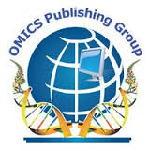
OMICS Group
OMICS Group International through its Open Access Initiative is committed to make genuine and reliable contributions to the scientific community. OMICS Group hosts over 400 leading-edge peer reviewed Open Access Journals and organizes over 300 International Conferences annually all over the world. OMICS Publishing Group journals have over 3 million readers and the fame and success of the same can be attributed to the strong editorial board which contains over 30000 eminent personalities that ensure a rapid, quality and quick review process. OMICS Group signed an agreement with more than 1000 International Societies to make healthcare information Open Access.
Contact us at: contact.omics@omicsonline.org

Slide 2

OMICS Journals are welcoming Submissions
OMICS Group welcomes submissions that are original and technically so as to serve both the developing world and developed countries in the best possible way.
OMICS Journals are poised in excellence by publishing high quality research. OMICS Group follows an Editorial Manager® System peer review process and boasts of a strong and active editorial board.
Editors and reviewers are experts in their field and provide anonymous, unbiased and detailed reviews of all submissions.
The journal gives the options of multiple language translations for all the articles and all archived articles are available in HTML, XML, PDF and audio formats. Also, all the published articles are archived in repositories and indexing services like DOAJ, CAS, Google Scholar, Scientific Commons, Index Copernicus, EBSCO, HINARI and GALE.
For more details please visit our website: http://omicsonline.org/Submitmanuscript.php

Slide 3
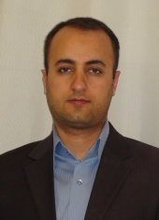
Khosro Adibkia
Associate professor
Department of Pharmaceutics
Tabriz University of Medical Sciences
Iran

Slide 4
Honors and awards:
Awarded prize for the best educational pattern of Tabriz University of Medical Sciences ,5th Educational Festival of Shahid Motahari, Tabriz, Iran (2013).
Awarded prize for the best educational pattern of Tabriz University of Medical Sciences ,4th Educational Festival of Shahid Motahari, Tabriz, Iran (2012).
Selected as the distinguished researcher of East Azerbaijan Province, Iran. (2010).
Awarded prize for the best PhD student of Tabriz University of Medical Sciences, Tabriz, Iran. (2009)
Winner of Rhazes (Razi) Research prize (first rank in novel drug delivery systems) in Iran. (2008)
Selected as a Member of the National Elites Organization (2008).
Awarded prize for the best PhD student of Tabriz University of Medical Sciences, Tabriz, Iran. (2008)
Awarded prize from the President of Iran for the best PhD student of Iran. (2007)
Awarded prize for the best PhD student of Tabriz University of Medical Sciences, Tabriz, Iran. (2007)

Slide 5
Recently published articles
Application of electrospraying as a one-step method for the fabrication of triamcinolone acetonide-PLGA nanofibers and nanobeads, Colloids and Surfaces B: Biointerfaces, 2014.
Antimicrobial Activity of the Metals and Metal Oxide Nanoparticles, Materials Science and Engineering C, 2014.
In vitro and In vivo evaluation of Clarithromycin-Urea solid dispersions prepared by solvent evaporation, electrospraying and freeze drying methods, Powder Technology, 2014.

Slide 6
Principles of Drug Delivery and Pharmaceutical Nano Technology

Slide 7
Drug Delivery
Definition
  The appropriate administration of drugs through various routes in the body for the purpose of improving health
  It is highly interdisciplinary
  It is not a young field
  It has recently evolved to take into consideration
    Drug physico-chemical properties
    Body effects and interactions
    Improvement of drug effect
    Patient comfort and well being
Controlled
Drug Delivery

Slide 8
Drug Delivery
Conventional
Controlled
Enteral
Sustained
Extended
Parenteral
Site-specific
Other
Pulsatile

Slide 9
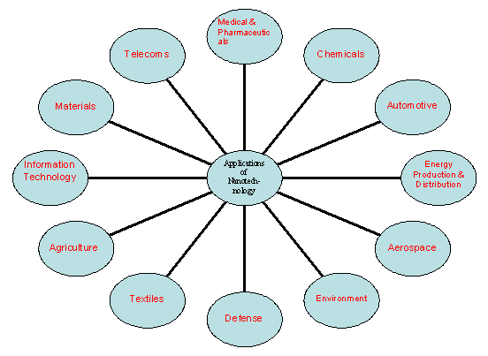
Applications of Nanotechnology

Slide 10
Nanoparticles for Drug Delivery
Metal-based nanoparticles
Lipid-based nanoparticles
Polymer-based nanoparticles
Biological nanoparticles

Slide 11
Nanobiopharmaceuticals
In biopharmaceuticals, in addition to the main technologies covered-liposomal, monoclonal antibody-based, and polymer-based technologies host of newer technologies such as nanoparticles including various nanodimensional entities such as molecular imprinted polymers, metallofullerenes, prodrug delivery, oral, injectable and implantable, pulmonary, and transdermal and transmucosal delivery have come up.

Slide 12
SOME SIGNIFICANT ACHIEVEMENTS OF NANODEVICES
Development of one dose a day ciprofloxacin using nanotechnology
Tumor targeted taxol delivery using nanoparticles in Phase 2 clinical trial stage
Improved ophthalmic delivery formulation using smart hydrogel nanoparticles
Oral insulin formulation using nanoparticles carriers.
Liposomal based Amphotericin B formulation

Slide 13
PRIORITY AREAS
Cancer Nanotechnology
(i) Diagnosis using Quantum
Dots
(ii) Tumor Targeted Delivery
(iii) Imaging
(iv) Cancer Gene Therapy

Slide 14
Nanopowder
Nanopowders are powders composed of nanoparticles, that is particles having an average diameter below 50 nanometers (nm).
A jar of a true nanopowder when emptied from chest height to toward the floor will disperse into the air before reaching the floor.
Most manufacturers of “nanopowders” produce micropowder assemblies of nanoparticles but the powder itself is rarely a nanopowder.
Such compounds have two or more different cations (positively charged elements) in their chemical formula. An example of a complex compound is calcium titanate (CaTiO3).

Slide 15
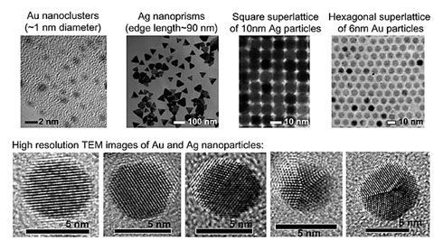
Nanocluster

Slide 16
Nanocluster
One of the central themes in nanoscience research is to synthesize high quality nanoparticles with precise control over particle size, shape, structure, and composition.
For inorganic nanoparticles (e.g. metal and semiconductor), two regimes are of particular interest, that is, nanoclusters in a size range from subnanometer to ~2 nm and nanocrystals (typically 2-100 nm).

Slide 17
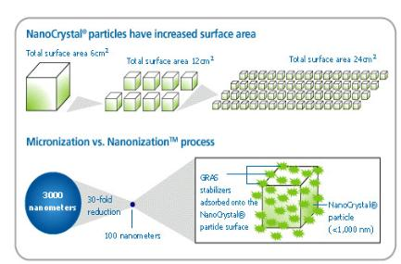
Nanocrystals

Slide 18
Nanocrystals
When the size of the material is reduced to less than 100 nanometers, the realm of quantum physics takes over and materials begin to demonstrate entirely new properties.
Nano-design of drugs by various techniques like milling, high pressure homogenization, controlled precipitation etc., are explored to produce, drug nanocrystals, nanoparticles, nanoprecipitates, nanosuspensions (which for ease of understanding commonly mentioned as nanocrystals).
As decreased size will increase the solubility of drugs hence, this technology is explored to increase oral bioavailability of sparingly water soluble drugs.

Slide 19
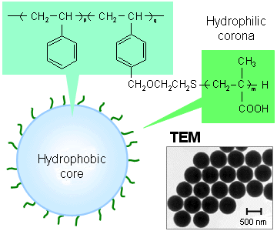
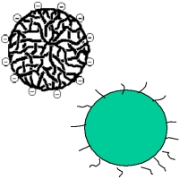
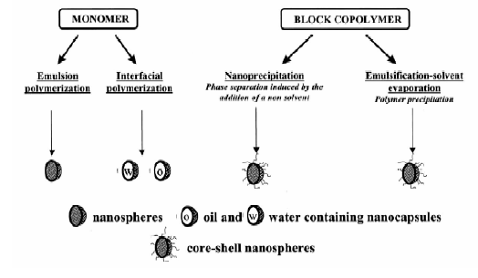
Polymeric Nanoparticles

Slide 20
Polymeric Nanoparticles
In recent years, biodegradable polymeric nanoparticles have attracted considerable attention as potential drug delivery devices in view of their applications in drug targeting to particular organs/tissues, as carriers of DNA
in gene therapy, and in their ability to deliver proteins, peptides and genes
through a per oral route of administration.

Slide 21
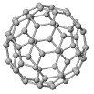
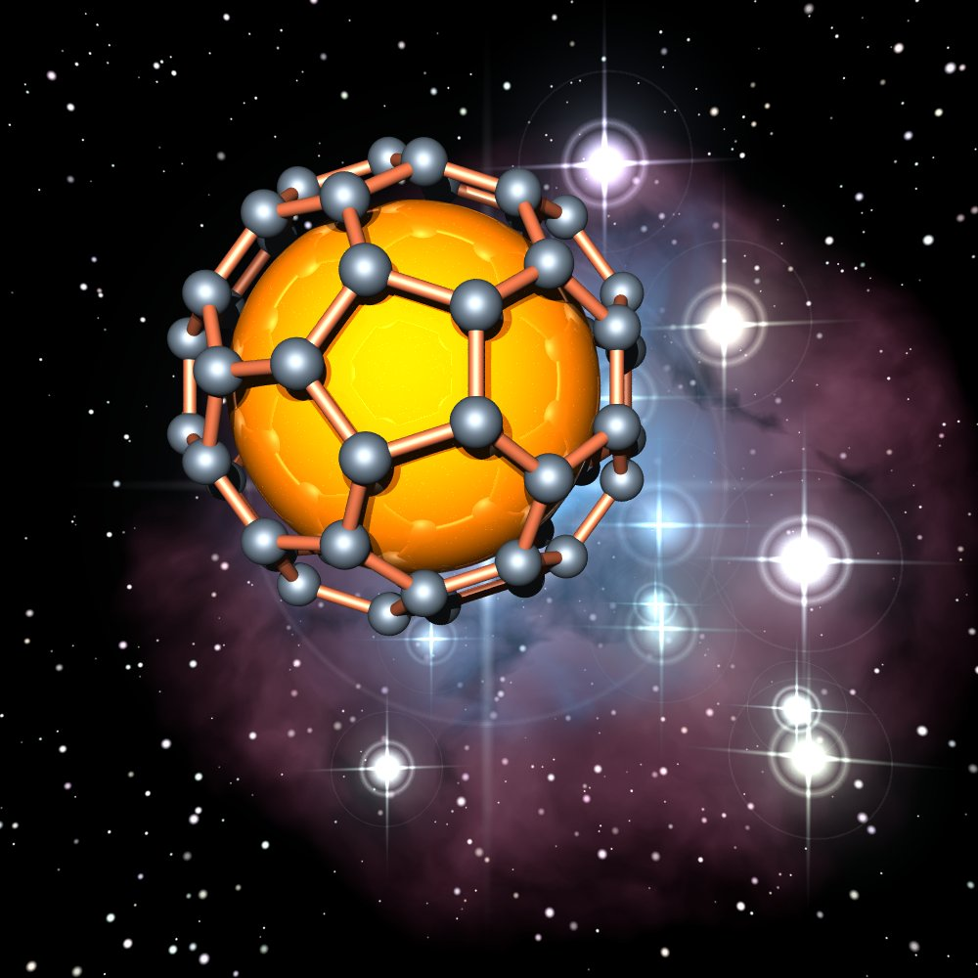
Carbon 60

Slide 22
Carbon 60
C60 are spherical molecules about 1nm in diameter, comprising 60 carbon atoms
arranged as 20 hexagons and 12 pentagons: the configuration of a football.
Hence they find application as NanoPharmaceuticals with large drug payload in their cage like structure.
On the other hand with development of various chemical substitutes for C60, it is possible to develop functionalized C60 with better drug targeting properties

Slide 23
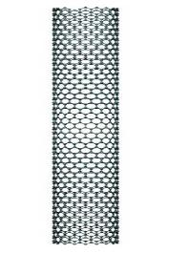
Carbon Nanotube

Slide 24
Carbon Nanotube
Carbon nanotubes are adept at entering the nuclei of cells and may one day be used to deliver drugs and vaccines.
The modified nanotubes have so far only been used to ferry a small peptide into the nuclei of fibroblast cells.
But the researchers are hopeful that the technique may one day form the basis for new anti-cancer treatments, gene therapies and vaccines.

Slide 25
Equipment's for Nanoparticles
Homogenizer
Ultra Sonicator
Mills
Spray Milling
Supercritical Fluid Technology
Electrospray
Ultracentrifugation
Nanofiltration

Slide 26
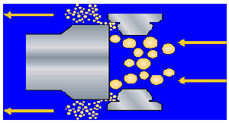
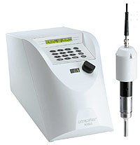
Homogenizer & Ultra Sonicator

Slide 27
Oral Administration
Advantages
  Patient: Convenience, not invasive, higher compliance
  Manufacture: well established processes, available infrastructure
Disadvantages
  Unconscious patients cannot take dose
  Low solubility
  Low permeability
  Degradation by GI enzymes or flora
  First pass metabolism
  Food interactions
  Irregular absorption

Slide 28
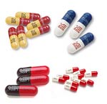

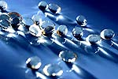
Oral Administration
Traditional oral delivery systems
  Tablets
  Capsules
  Soft gelatin capsules
  Suspensions
  Elixirs

Slide 29

Buccal/Sublingual
Advantages
  By-pass First pass metabolism
  Rapid absorption
  Low enzymatic activity
Disadvantages
  Discomfort during dissolution
  Probability of swallowing- lost of effect
  Small doses
Traditional delivery system/devices
  Tablets
  Chewing gum

Slide 30
Rectal
Advantages
  By-pass first pass metabolism
  Useful for children
Disadvantages
  Absorption depends on disease state
  Degradation by bacterial flora
  Uncomfortable
Traditional delivery system/devices
  Suppository
  Enema

Slide 31

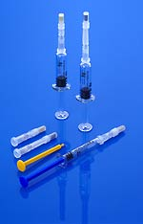
Intravenous (IV)
Advantages
  Drug 100% bioavailable
  Rapid response
  Total control of blood concentration
  Maximize incorporation of degradable drugs
  By-pass FPM
Disadvantages
  Invasive
  Trained personnel
  Possible toxicity due to incorrect dosing
  sterility
Traditional delivery system/devices
  Injection-bolus
  IV bag - infusion

Slide 32
Subcutaneous
Advantages
  Patient self-administration
  Slow, complete absorption
  By-pass FPM
Disadvantages
  Invasive
  Irritation, inflammation
  Maximum dose volume - 2mL

Slide 33
Intramuscular
Advantages
  Patient can administer the drug himself
  Larger volume than subcutaneous
  By-pass first pass metabolism
Disadvantages
  Invasive – patient disconfort
  Irritation, inflamation
  May require some training

Slide 34
Inhalers
Advantages
  By-pass FPM
  Gases are rapidly absorbed
Disadvantages
  Solids and liquids can be absorbed if size is below 0.5um

Slide 35


Transdermal
Advantages
  Local effect
  Ease of administration
Disadvantages
  Low absorption for some drugs
  May cause allergic reactions
Requirements
  Low dosage <10 mg/mL
  MW< 1,000

Slide 36
Factors Influencing the Selection of the Delivery Route
Drug physico-chemical properties
  Drug molecular size (molecular weight)
  Half-life
  Chemical stability
  Loss of biological activity in aqueous solution
    Proteins
      Denaturation, degradation

Slide 37
Factors Influencing the Selection of the Delivery Route
  Solubility in aqueous solution (hydrophobicity/hydrophilicity)
    pH
    pKa - ionization
    Temperature
    Concentration
    Crystalinity
    Particle size
    State of hydration

Slide 38
Factors Influencing the Selection of the Delivery Route
Drug biological interactions
  Sensitive to FPM
  Low membrane permeabiltiy
    Efflux pumps (MRP, MDR) – cancer drugs
    Hydrophilicity
    High-density charge
  Enzymatic degradation
  Bacterial degradation
  Half-life
  Side effects
    Irritation

Slide 39
Factors Influencing the Selection of the Delivery Route
Desired pharmacological effect
  Local
    topical, vaginal
  Systemic
    oral, buccal, IV, SC, IM, rectal, nasal
  Immediate response
    IV, SC, IM, nasal
  Dose size
  Drug molecular size

Slide 40
Pharmacokinetics and Pharmacodynamics
Pharmacokinetics
Pharmacodynamics
Design
of dosage regimen
Where?
How much?
How often?
How long?
Plasma
Concentration
Effects
Plasma refers to the clear supernatant fluid that results from blood after the cellular components have been removed

Slide 41
Plasma Concentration
Toxicity
Plasma concentration
(mg/mL)
Therapeutic window
No therapeutic effect
Time (min)

Slide 42
Unsuccessful
therapy
Plasma concentration
(mg/mL)
Successful
therapy
Time (min)

Slide 43
Oral
Administration
Gastrointestinal
Tract
Intravenous
Injection
Circulatory
System
Excretion
Intramuscular
Injection
Tissues
Metabolic
Sites
Subcutaneous
Injection

Slide 44
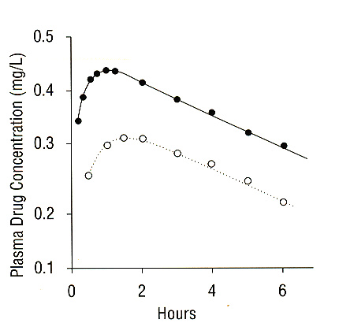
Absorption of drugs could vary within different administration routes
500 mg dose given
  intramuscularly
  orally
**to the same subject on
separate occasions
Biological barriers greatly affect the extent of drug absorption

Slide 45

Journal of Nanomedicine & Biotherapeutic Discovery
Journal of Nanomedicine & Biotherapeutic Discovery
Journal of Nanomedicine & Nanotechnology

Slide 46

Journal of Nanomedicine & Biotherapeutic Discovery
International Conference on Nanotek & Expo
International Conference on Signal Processing

Slide 47
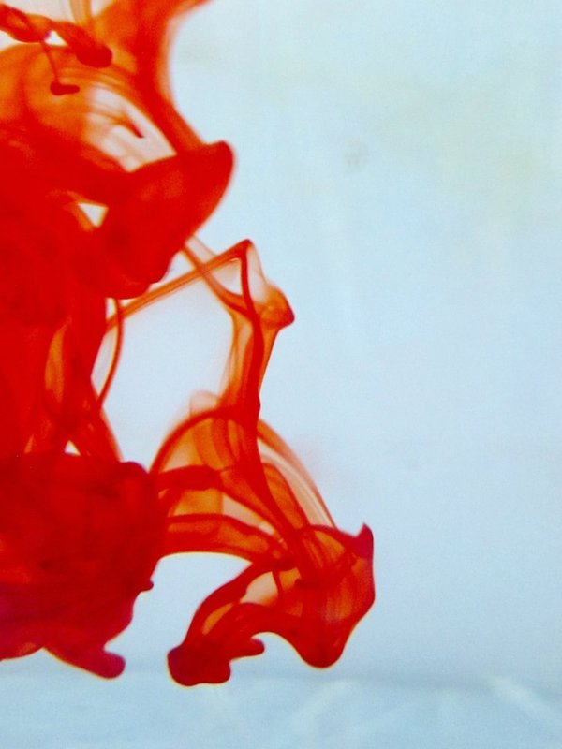
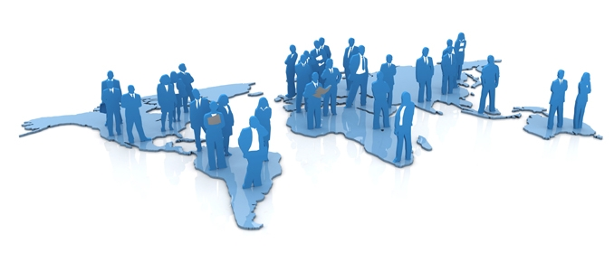
OMICS Group Open Access Membership
OMICS publishing Group Open Access Membership enables academic and research institutions, funders and corporations to actively encourage open access in scholarly communication and the dissemination of research published by their authors.
For more details and benefits, click on the link below:
http://omicsonline.org/membership.php

