Slide 1
Research interests of Dr Konstantinos Papadimitriou
Research associate
Laboratory of Dairy Research
Department of Food Science and Human Nutrition
Agricultural University of Athens
2014

Slide 2
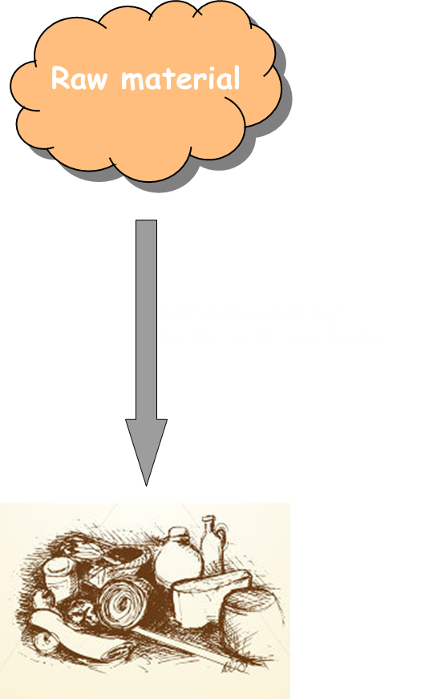
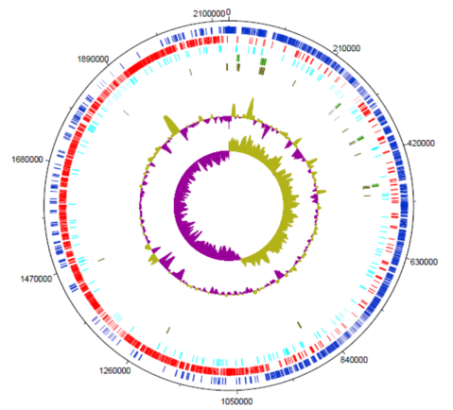
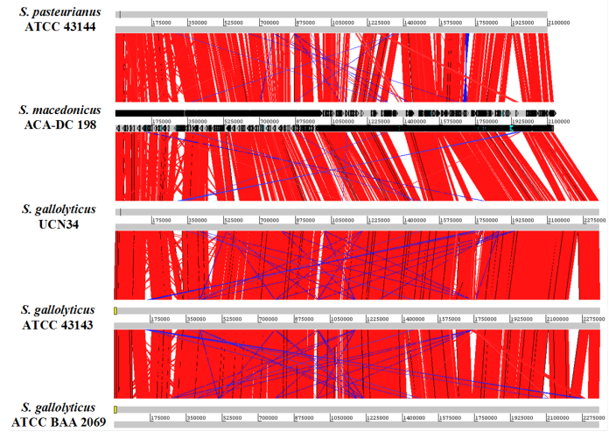
Research topic 1: Physiology, genetics and genomics of lactic acid bacteria
Lactic acid bacteria are involved in food fermentations as starter cultures. Understanding their biology is of outmost importance for high quality fermented foods
Lactic acid bacteria exhibit sometimes important health-promoting probiotic properties

Slide 3
Research topic 1: Screening for novel starters and probiotics

Slide 4
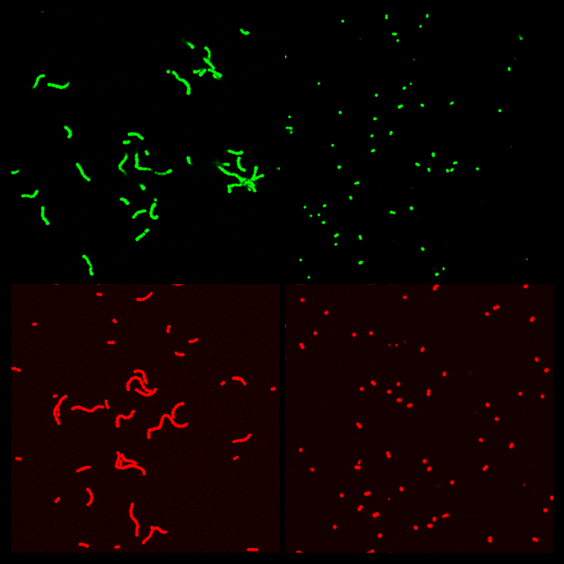
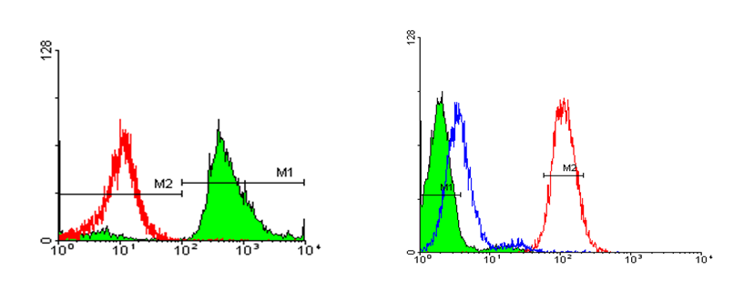
Research topic 2: Single cell microbiology
Flow cytometry coupled with fluorescence probes is a powerful tool to analyze microbial populations at the single cell level

Slide 5
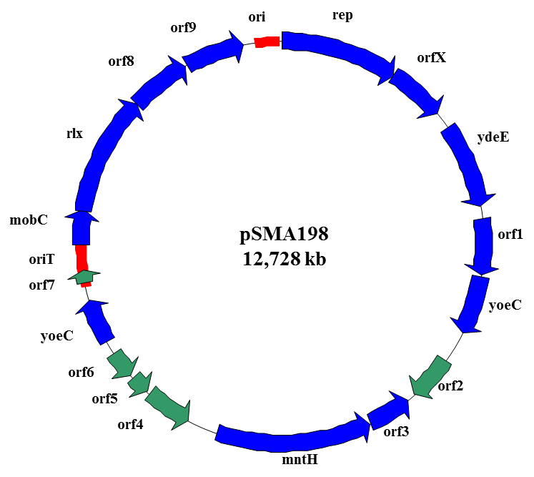
Research topic 3: Plasmid biology
Plasmids are extra-chromosomal genetic elements
Plasmids of lactic acid bacteria often carry important technological properties
Plasmids can be used to create cloning vectors

Slide 6
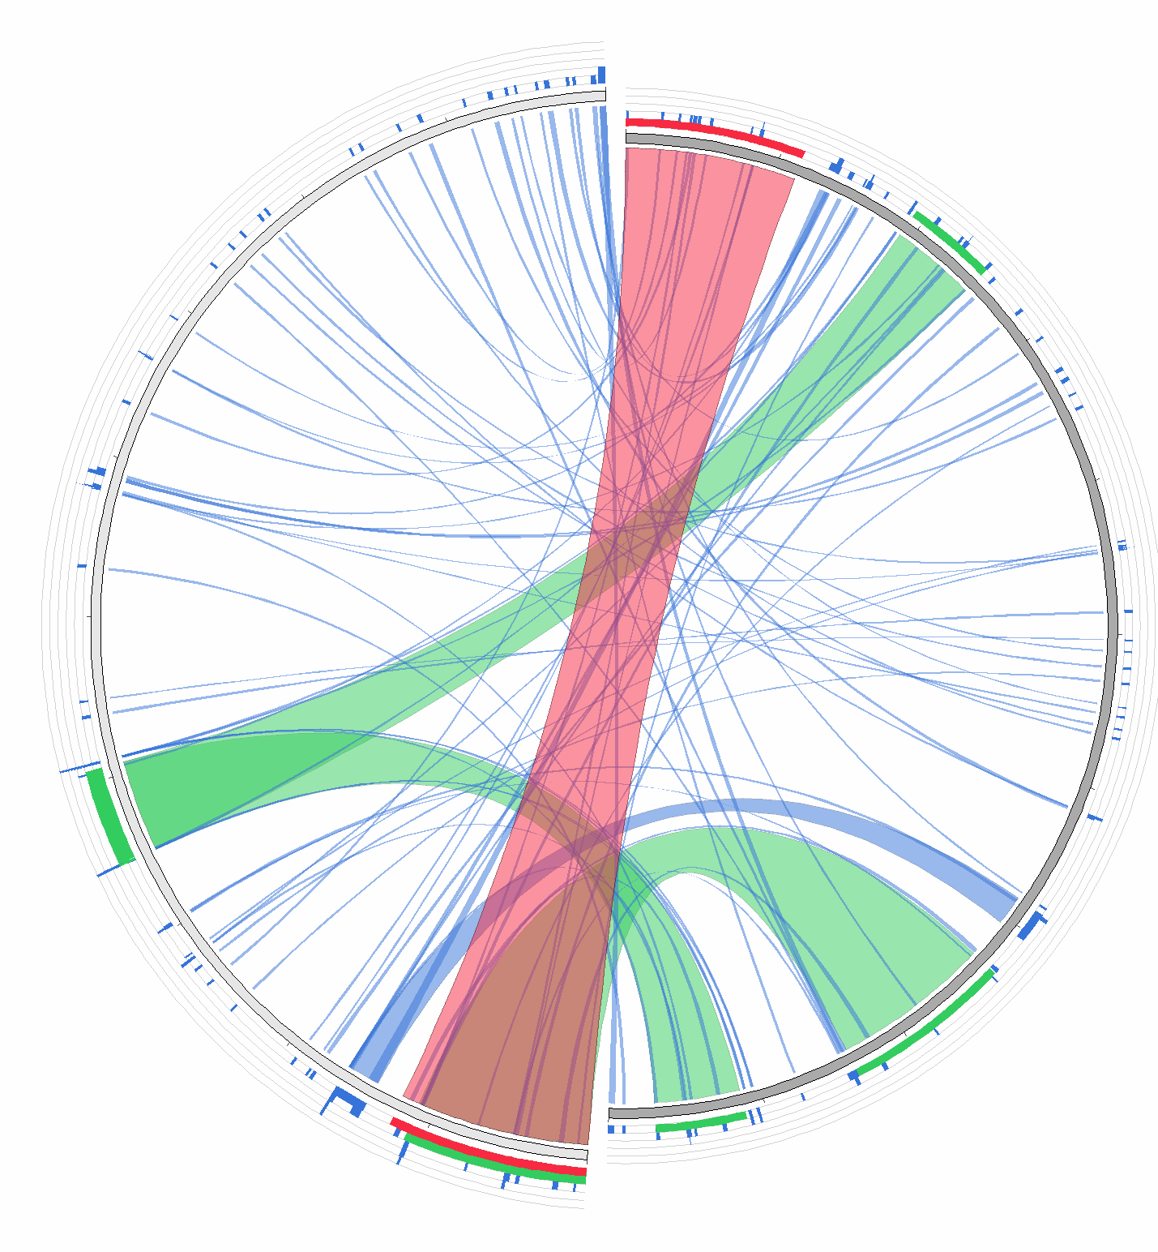
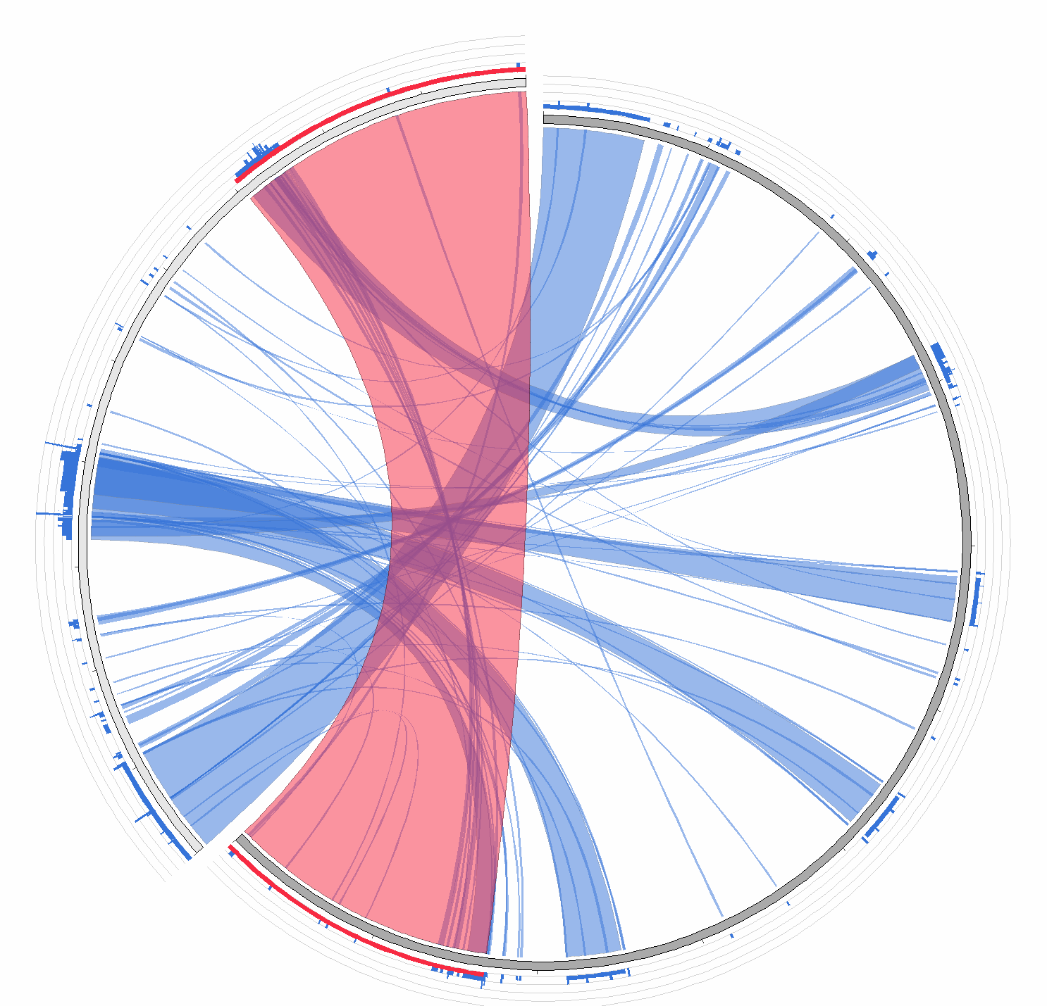
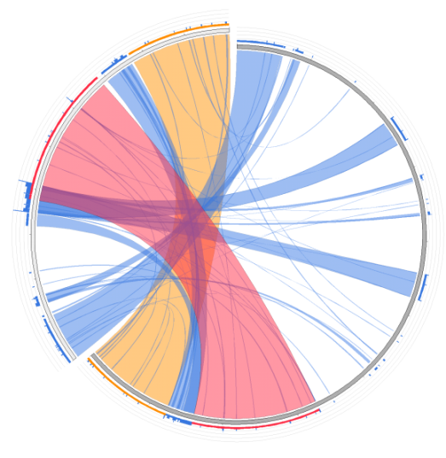
Research topic 4: Applied Bioinformatics
Application of specialized bioinformatics tools for genome analysis and annotation, as well as comparative and evolutionary genomics

Slide 7
OMICS International Open Access Membership OMICS International Open Access Membership enables academic and research institutions, funders and corporations to actively encourage open access in scholarly communication and the dissemination of research published by their authors.
For more details and benefits, click on the link below:
http://omicsonline.org/membership.php

