Slide 1
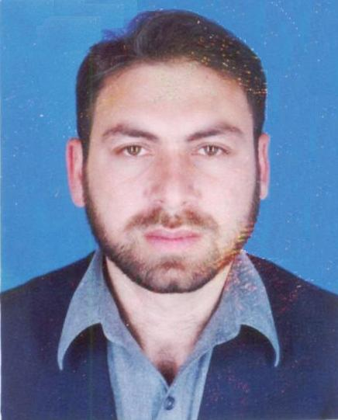
LAIQ KHAN
Department of Electrical Engineering, COMSATS Institute of IT
Abbottabad, KPK, Pakistan
Nationality: Pakistani
Contact No: +92 300-9009472
URL: http:// ciit-atd.edu.pk/researchgroups/NewResearchMembers.aspx?templateid=2

Slide 2
EDUCATION
1998-2003 PhD in Electrical Engineering (Power System Dynamics and Control)
Department of Electronic and Electrical Engineering, Strathclyde, University Glasgow, United Kingdom (UK)
Supervisor: Professor K. L. Lo
Thesis Title: Hybrid AI Paradigms Applied to Power system Damping Controls
1991-1996 BSc (Hons) in Electrical (Power) Engineering, KPK University of Engineering & Technology Peshawar, Pakistan

Slide 3
SCHOLARSHIPS & AWARDS:
1. Annual Research Productivity award (every year from 2008-2013) from COMSATS Institute of IT, Pakistan.
2. SS-100 Merit Scholarship for PhD abroad awarded by Ministry of Education Govt., of Pakistan.
3. Merit Scholarship in BSc Electrical Engineering awarded by KPKUniversity of Engineering and Technology Peshawar, Pakistan.

Slide 4
PROFESSIONAL EXPERIENCE:
01-02-2008-19-07-2011 Associate Professor, COMSATS Institute of IT Abbottabad, Pakistan
08-06-2003-31-01-2008 Assistant Professor, Ghulam Ishaq Khan Institute of Engineering Sciences and Technology Topi, KPK, Pakistan
Visiting Faculty: University of Engineering and Technology Peshawar, KPK, Pakistan.
10-05-1996-20-08-1998 Field Engineer: Power Division Siemens Pakistan Engineering Company Ltd., Islamabad, Pakistan.
Participation in Projects:
Installation, testing & commissioning of Diesel Generating Sets.
Nizampure Cement Plant (3000 T.P.D (tons per day)).
Maple Leaf Cement Plant (3300 T.P.D.)
Metering system of P.S.O (Pakistan State Oil) terminal at Sihala.

Slide 5
BOOKS PUBLISHED
1. Recurrent Adaptive NeuroFuzzy Paradigms: Vehicle’s Suspension
Control, Publisher: LAP LAMBERT Academic Publishing,
Saarbrücken, Germany, ISBN: 13-9783659480003, Dec. 25, 2013.
2. Adaptive NeuroFuzzy Control Paradigms: Applications to Full Car
Active Suspension System, LAP LAMBERT Academic Publishing,
Saarbrücken, Germany, ISBN-13: 978-3659373886, June 7, 2013.
3. Adaptive Soft Computing Techniques: Full Car Suspension Control,
LAP LAMBERT Academic Publishing, Saarbrücken, Germany, ISBN:
3659350109, Aug 17, 2013.

Slide 6
SOFTWARE TOOLS DEVELOPED
1: SPSPS Matlab Toolbox
2: PSTSS Matlab Toolbox:
3: HPSST Matlab Toolbox
4. SCRFS Matlab Toolbox
5. OANIS Matlab Toolbox

Slide 7
REFERENCES:
Professor K. L. Lo
CEPE,
Electronic & Electrical Engg. Deptt.,
Royal College Building,
University of Strathclyde,
204 George Street,
Glasgow, UK.
Professor Fazal ur Rehman
Electrical Engineering Deptt.,
Muhammad Ali Jinnah University,
Islamabad, Pakistan.

Slide 8
Thank you

