Slide 1
Biography
Dr. Laurent Picot
Dr. Picot currently is an assistant professor of biochemistry and pharmacology in the University of La Rochelle, France.
His qualification includes
PhD Post-doctoral position, University of La Rochelle, France: 2002-2005: Marine bioprospecting for anticancer peptides and pigments.
PhD, June 2003, University of Rouen, France: Neuroscience and cellular microbiology of infectious diseases in the human central nervous system.
Master 2 degree in Cellular and molecular Pharmacology, University Paris VI, France: Pharmacology of the NMDA receptor in the cortex of a genetic absence epilepsy rat model (neuroscience).
Licence and Master 1 degree in Cell biology and physiology, university of Rouen, France.
Training period in the Sanofi Winthrop pharmaceutical company.

Slide 2
Research Interests
Marine and terrestrial Biochemistry and Pharmacology
Biotechnology of marine resources
Anticancer molecules
Marine microalgae, pigments

Slide 3
Major achievements
2014
Demonstrated the
possibility to extract phycobiliproteins
from
marine
microalgae using Microwaves-assisted extraction.
2014
Developed and
optimized an extraction process to purify carotenoids from
marine microalgae.
2013
Identified zeaxanthin and b-cryptoxanthin from Cyanophoara paradoxa as potent
inhibitors of human invasive melanoma cells growth
2012
Developed and optimized an extraction process to purify metabolites from marine microalgae
2012
Reviewed the potential of microalgae for the production of bioactive molecules of pharmaceutical interest
2012
Reviewed all the data demonstrating the anticancer activity of microalgal epoxycarotenoids
2011
Identified Violaxanthin from Dunaliella tertiolecta as a potent inhibitor of human breast cancer cells growth
2011
Performed the first Microwaves-assisted extraction of phytoplankton pigments in the world
2011
Demonstrated that microalgae pigments have a high potential as tumor photosensitizers (ANR Project Photomer)

Slide 4
Selected papers from our research group
Juin C., Chérouvrier J.R., Thiéry V., Gagez A.L., Bérard J.B., Joguet N., Kaas R., Cadoret J.P. & Picot L. Microwave-assisted extraction of phycobiliproteins from Porphyridium purpureum. Accepted in Applied Biochemistry and Biotechnology 2014 (http://www.ncbi.nlm.nih.gov/pubmed/25231233).
Juin C., Thiéry V., Cadoret J.P. & Picot L. Towards the clinical use of Phytoplankton carotenoid pigments to cure cancer. Oceanography open access 1(3), 2013.
Baudelet P.H., Gagez A.L., Bérard J.N., Juin C., Bridiau N., Kaas R., Thiéry V., Cadoret J.P. & Picot L. Antiproliferative activity of Cyanophora paradoxa pigments in melanoma, breast and lung cancer cells. Marine Drugs 11(11), 4390-4406, 2013.
Serive B., Kaas R., Bérard J.B., Pasquet V., Picot L. & Cadoret J.P. Selection and optimisation of a method for efficient metabolites extraction from microalgae. Bioresource technology 124, 311- 320, 2012.
Mimouni V., Ulmann L., Pasquet V., Mathieu M., Picot L., Cadoret J.P., Morant-Manceau A. & Schoefs B. The potential of microalgae for the production of bioactive molecules of pharmaceutical interest (review). Current Pharmaceutical Biotechnology 13(15), 2733-2750, 2012.
Gagez A.L, Thiery V., Pasquet V., Cadoret J.P. & Picot L. Epoxycarotenoids and cancer (review).
Current Bioactive compounds 8(2), 109-141, 2012.
Pasquet V., Morrisset P., Ihammouine S., Chepied A., Aumailley L., Berard J.B., Serive B., Kaas R., Lanneluc I., Thiery V., Lafferiere M., Piot J.M., Patrice T., Cadoret J.P. & Picot L. Antiproliferative activity of violaxanthin isolated from bioguided fractionation of Dunaliella tertiolecta extracts. Marine Drugs 9(5), 819-831, 2011
Pasquet V., Chérouvrier J.R., Farhat F., Thiéry V., Piot J.M., Bérard J.B.,Kaas R., Serive B., Patrice T., Cadoret J.P. & Picot L. Study on the microalgal pigments extraction process: Performance of microwave assisted extraction. Process Biochemistry 46(1), 59-67, 2011.

Slide 5
Oceanography is the science of oceans and seas including marine environment, coastal zone management, fishery economics, and marine pollution.
Oceanography increases the scope of marine pollution impact and possible effects of the exploitation of marine resources, together with the role of the ocean in possible global warming and climate change.
Oceanography: Open Access is an Open Access journal and aims to publish most complete and reliable source of information on the discoveries and current developments in the mode of original articles, review articles, case reports, short communications, etc. in all areas of the field and making them freely available through online without any restrictions or any other subscriptions to researchers worldwide
Notes:
Oceanography is the science of oceans and seas including marine environment, coastal zone management, fishery economics, and marine pollution. Oceanography increases the scope of marine pollution impact and possible effects of the exploitation of marine resources, together with the role of the ocean in possible global warming and climate change.
Oceanography: Open Access is an Open Access journal and aims to publish most complete and reliable source of information on the discoveries and current developments in the mode of original articles, review articles, case reports, short communications, etc. in all areas of the field and making them freely available through online without any restrictions or any other subscriptions to researchers worldwide

Slide 6
Littoral Environment Society Environmental molecules and human health (UMRi CNRS 7266 LIENSs La Rochelle)
Dr. Laurent Picot, Associate editor of Oceanography Open access
LP
Pigment extraction, purification,
chemistry and pharmacology
Our team has been working for years with IFREMER PBA Nantes lead by Dr Jean-Paul CADORET
JPC
Algae Physiology and Biotechnology (PBA Nantes)
Microalgae culture, selection, molecular biology, biotechnology

Slide 7
Location of the Labs : Nantes and La Rochelle, France

Slide 8
The Labs : PBA IFREMER Nantes and UMRi CNRS 7266 La Rochelle, France

Slide 9
Research and Methodology
Notes:
Research and Methodology

Slide 10
Our Research
Isolate bioactive pigments from marine microalgae, develop innovative extraction and purification processes.
Clean and innovative pigments extraction processes
Understand the biological and pharmacological
activity of microalgae pigments in cancer cells
Proliferation studies, apoptosis, videomicroscopy
Confirm the anticancer activity in vivo
in animal models and validate the clinical interest of microalgae pigments
Murine models for melanoma and other tumors
Pharmacomodulate the bioactive molecules
to optimize their activity and biodisponibility
Chemical and Enzymatic modification

Slide 11
Microalgae taxonomic diversity

Slide 12
An example of one of our research projects : Isolation of an antiproliferative
pigment from Dunaliella tertiolecta
  Selection of the species for this study
unstudied for the purification of anticancer pigments
available in banks and easy to grow in photobioreactors
Possible extraction of pigments
Dunaliella tertiolecta
green
Chlorophyceae
  The purpose
get most pigments in a wide polarity range, work in non denaturating conditions for pigments extraction, check the reproducibility of extracts and define the pigment composition, optimize the pigments extraction yields
Assess the anticancer activity of DT pigments

Slide 13
IC50 of Dunaliella tertiolecta pigments extracts
Cancer cell line
Extract
Dunaliella tertiolecta
Water EtOH
DCM
>
>
>
A549 (lung)
Water EtOH
>
61,5 µg.ml⁻¹
MCF-7 (breast)
DCM
56,1 µg.ml⁻¹
MDA-MB-231
(breast)
Water EtOH DCM
>
>
>
Water EtOH
>
>
LNCap (prostate)
DCM
60,9 µg.ml⁻¹
> means IC50 > 100 µg.mL⁻¹
Dunaliella tertiolecta
Dichloromethane extract
MCF-7

Slide 14
RP-HPLC fractionation of Dunaliella tertiolecta DCM extract
EExxttrraaiitt DDiicchhlloorroomméétthhaanniiqquuee
FF₁₁ FF₂₂ FF₃₃ FF₄₄
DExCtrMaiteDxicthralocrotméthanique
F₁
F₂
F₃
F₄
Chromatogram at 435 nm
Dunalliela tertiolecta Dichloromethane extract
Fraction |  | F₁ | F₂ | F₃ | F₄
MCF-7 | IC₅₀ (µg.ml⁻¹) | 14,3 | > | > | >
F₁
>
IC₅₀ > 100 µg.ml⁻¹

Slide 15
RP-HPLC sub-fractionation of Dunaliella tertiolecta Fraction 1
FF₁₁
^{FF}11..11 ^{FF}11
^{FF}11..22 ^{FF}11
FF₁₁
F₁
Fraction
F
F
F
F
1.1
1.2
1.3
1.4
MCF-7 | CI₅₀ (µg.ml⁻¹) | > | 20,5 | 18,9 | 11,7
sem | + /- |  | 2,2 | 8,85 | 0,2
^{F}1.1
^{F}1.3
^{F}1.2
^{F}1.4
>
IC₅₀ > 50 µg.ml⁻¹
Chromatogram at 435 nm
^{F}1.4
Dunalliela tertiolecta
Dichloromethane extract Fraction 1

Slide 16
Molecular characterization of F1.4.
Carotenoid pigment Band III/II ratio 96% One major peak in F1.4 corresponding to 95% of the fraction peak surface

Slide 17
Molecular characterization of F1.4.
High Resolution Mass Spectroscopy ESI Bruker MicrO-Tof-Q 2 Solvent :
CH₂Cl₂ /CH₃OH : 90/10
Formula C₄₀H₅₆0₄
violaxanthin neoxanthin prasinoxanthin siphonaxanthin
Molecular formula
[M+Na]+ (C40 H56 O4 Na)
623.40763
623.4068 (0 ppm)
Theorical MW Experimental m/z

Slide 18
Molecular characterization of F1.4.
  Comparison with standard carotenoids
The retention time of F1.4 is the same as standard violaxanthin and different from the 3 other pigments
sample
Rt (min)
^{F}1.4
13,963
Standard Violaxanthin
14,047

Slide 19
Molecular characterization of F1.4.
  Absorption maxima and Band III/II ratio are equivalent to that of standard Violaxanthin
Sample
Absorption spectrum 300 à 600 nm
Absorption maxima (nm)
% III/II
0,90
17,327Peak1
441,5 _{471,9}
0,80
070,
0,60
417,2
417,2
441,5
471,9
0,50
^{F}1.4
AU
96
0,40
0,30
0,20
0,10
329,5
0,00
300,00 32000, 34000, 36000, 380,00 400,00 42000, 44000, 46000, 48000, 500,00 520,00 54000, 56000, 58000, 60000,
nm
0,038
0,036
0,034
17,438 Peak 1
^{441,5} 471,9
0,032
0,030
417,2
441,5
471,9
Standard violaxanthin
0,028
0,026
0,024
417,2
AU
0,022
0,020
98
0,018
0,016
0,014
0,012
0,010
0,008
0,006
0,004
0,002
0,000
329,5
562,3
300,00
350,00
400,00
450,00
nm
500,00
550,00 600,00
  Conclusion
OH
O
F1.4 = violaxanthin
O
HO

Slide 20
Biological activity of Violaxanthin in MCF-7 breast cancer cells
Induction of early apoptosis (translocation
Antiproliferative
of Phosphatidyl Serines) and necrosis at 8 µg.ml⁻¹
IC₅₀= 11,7 ± 0,2 µg.ml⁻¹
= 18,5 ± 0,3 µM
No internucleosomal fragmentation at 40 µg .ml⁻¹
cytostatic at 40,0 µg.ml⁻¹
= 63 µM
M
T- 1
V 40
pb
T-
T+
2,5
0 µg.ml⁻¹
0,1 µg.ml⁻¹
1,0 µg.ml⁻¹
10,0 µg.ml⁻¹
40,0 µg.ml⁻¹
3000
2000
1500
1200
2,0
Absorbance (λ=550nm)
1,5
1000
Violaxanthine : 8 µg.ml⁻¹
900
800
700
600
500
400
300
200
100
1,0
0,5
40
Time (h)
0,0
0
20
60
80

Slide 21
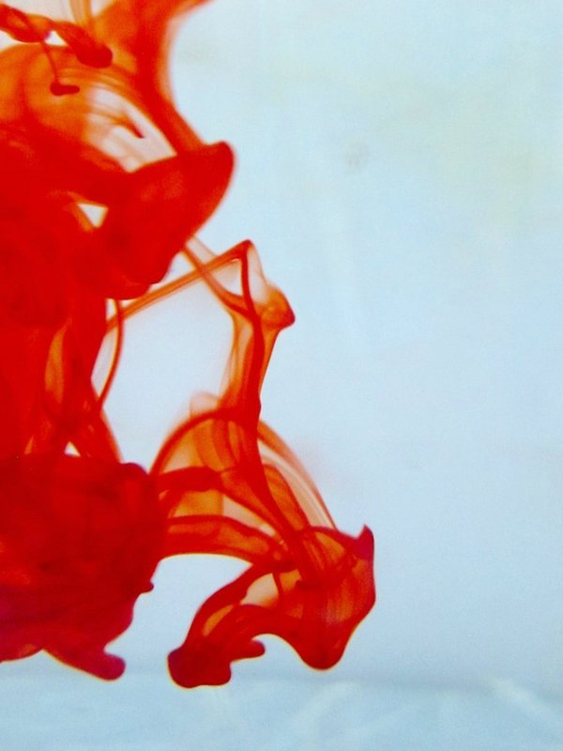
OMICS International Open Access Membership
OMICS International Open Access Membership enables academic and research institutions, funders and corporations to actively encourage open access in scholarly communication and the dissemination of research published by their authors.
For more details and benefits, click on the link below:
http://omicsonline.org/membership.php

