Slide 1
OMICS Group
OMICS Group International through its Open Access Initiative is committed to make genuine and reliable contributions to the scientific community. OMICS Group hosts over 400 leading-edge peer reviewed Open Access Journals and organizes over 300 International Conferences annually all over the world. OMICS Publishing Group journals have over 3 million readers and the fame and success of the same can be attributed to the strong editorial board which contains over 30000 eminent personalities that ensure a rapid, quality and quick review process. OMICS Group signed an agreement with more than 1000 International Societies to make healthcare information Open Access.
Contact us at: contact.omics@omicsonline.org

Slide 2
OMICS Journals are welcoming Submissions
OMICS Group welcomes submissions that are original and technically so as to serve both the developing world and developed countries in the best possible way.
OMICS Journals are poised in excellence by publishing high quality research. OMICS Group follows an Editorial Manager® System peer review process and boasts of a strong and active editorial board.
Editors and reviewers are experts in their field and provide anonymous, unbiased and detailed reviews of all submissions.
The journal gives the options of multiple language translations for all the articles and all archived articles are available in HTML, XML, PDF and audio formats. Also, all the published articles are archived in repositories and indexing services like DOAJ, CAS, Google Scholar, Scientific Commons, Index Copernicus, EBSCO, HINARI and GALE.
For more details please visit our website: http://omicsonline.org/Submitmanuscript.php

Slide 3
Editor-in-Chief
Journal of Transplantation Technologies & Research
Lavjay Butani, MD, MACM Professor and Chief Pediatric Nephrology UC Davis Medical Center Sacramento, CA 95817 USA

Slide 4
Biography:
Lavjay Butani, Professor of Pediatrics and Chief of Pediatric Nephrology, has board certification from the American Board of Pediatrics in pediatric nephrology. He is a member of the American Society of Nephrology, American Society of Transplantation and the International Pediatric Transplantation Association among others. He is on the editorial board of several leading pediatric nephrology and transplant journals and has served on various committees in national organizations including the American Society of Pediatric Nephrology, the National Kidney Foundation and the Organ Procurement and Transplantation Network.

Slide 5
Research Interest:
Improving the outcomes after kidney transplantation by optimally using newer immunosuppressive medications and regimens for children and also studying the implications of calcium excretion in the urine on the risk of stones and osteoporosis in children of different ethnic backgrounds.

Slide 6
Recent Publications:
Winnicki ED, Butani L (2013) Use of Surveillance Biopsies in Pediatric Renal Transplant Recipients. J Transplant Technol Res 3:e124.
Lau KK, Butani L (2013) Increasing Organ Donation: We Can Do Better! J Transplant Technol Res S2:e001.
Lau KK, Butani L (2012) Expanding the Organ Donor Pool: Using En Bloc Kidneys in Pediatric Recipients. J Nephrol Therapeut 2:e106.
Lau KK, Butani L (2012) Steroid Minimization in Pediatric Renal Transplantation. J Nephrol Therapeutic 2:e105.

Slide 7
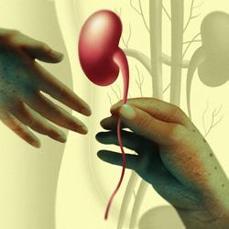
Kidney Transplantation:
Kidney Transplantation is a technique of implanting a kidney from one person to another who has end-stage kidney disease.

Slide 8
Kidney Transplantation is the ultimate treatment of choice for patients with end stage renal disease as it offers better long term survival and quality of life compared to dialysis.

Slide 9
Kidney Donors:
Living Donors play a vital role in Kidney Transplantation.
Becoming a kidney donor is a highly altruistic decision and one that needs to made after considerable thought since there are some specific conditions donors should have both physically and mentally.

Slide 10
Criteria for Kidney Donor:
Brain-dead Patients are eligible for kidney transplantation.
There should not be any evidence of preexisting kidney disease.
Donor should not have any transmissible diseases.

Slide 11
Donor should have the relative or similar blood group.
They should have excellent medical condition with normal renal function.
Donors should be highly motivated.

Slide 12
Retrieval of kidneys from young donors for transplantation, either as single kidneys or in an ‘en bloc’ manner, allows utilization of allografts that were previously abandoned and wasted.

Slide 13
While the transplantation of pediatric donor kidneys, especially from donors less than 5 years old, is still limited to a few specialized centers, the practice seems to be increasing as evidence of the successes of this strategy grows.

Slide 14
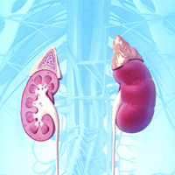
The success of kidney transplantation technology has grown such that 1 year graft survival now exceeds 95%

Slide 15
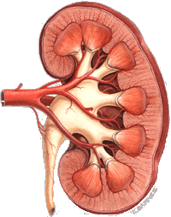
Kidney transplantation has become an effective treatment and serves as the pillar of renal replacement therapy.

Slide 16
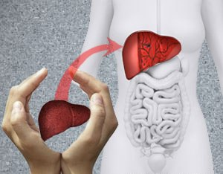
Transplantation Technologies & Research Related Journals
Hair: Therapy & Transplantation
Liver: Disease & Transplantation
Surgery: Current Research

Slide 17
Transplantation Technologies & Research Related Conferences
4th International Conference on Surgery and Anesthesia
World Summit on Pediatric Cardiology and Cardiac Surgery

Slide 18
OMICS Group Open Access Membership
OMICS publishing Group Open Access Membership enables academic and research institutions, funders and corporations to actively encourage open access in scholarly communication and the dissemination of research published by their authors.
For more details and benefits, click on the link below:
http://omicsonline.org/membership.php

