Slide 1
OMICS Journals are welcoming Submissions
OMICS International welcomes submissions that are original and technically so as to serve both the developing world and developed countries in the best possible way.
OMICS Journals are poised in excellence by publishing high quality research. OMICS International follows an Editorial Manager® System peer review process and boasts of a strong and active editorial board.
Editors and reviewers are experts in their field and provide anonymous, unbiased and detailed reviews of all submissions.
The journal gives the options of multiple language translations for all the articles and all archived articles are available in HTML, XML, PDF and audio formats. Also, all the published articles are archived in repositories and indexing services like DOAJ, CAS, Google Scholar, Scientific Commons, Index Copernicus, EBSCO, HINARI and GALE.
For more details please visit our website: http://omicsonline.org/Submitmanuscript.php

Slide 2
Lawrence R. Faziola
Assistant Professor
Department of Psychiatry and Human Behavior
UCI Medical Center
California, USA

Slide 3
Biography
Dr. Faziola received his MD degree from Creighton University in Omaha, Nebraska, USA, and completed residency training in psychiatry at the University of California at Irvine (UCI), Medical Center, where he joined the clinical faculty. His clinical duties include attending to hospitalized patients in crisis as director of a 19 bed inpatient adult ward, and providing instruction to medical students and resident physicians. He has been involved with clinical research, and has been active in organized psychiatry, where he advocates for more rational and comprehensive services for the mentally ill. As a physician educator, he has been recognized with teaching awards from both the UCI school of medicine and the department of psychiatry.

Slide 4
Research Interests
His research interests are
Psychiatry and Behavioral Health
Hospital Psychiatry
Psychopharmacology for Schizophrenia
Bipolar Disorder
Major Depression

Slide 5
Psychopharmacology
Psychopharmacology is the study of the effects of drugs on affect, cognition, and behaviour
The term drug has many meanings:
Medication to treat a disease
A chemical that is likely to be abused
An “exogenous” chemical that significantly alters the function of certain bodily cells when taken in relatively low doses (chemical is not required for normal cellular functioning)

Slide 6
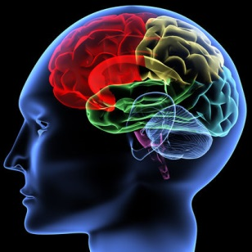
Main Psychopharmacological Drugs
Antipsychotics
Antidepressants
Anxiolytics
Hypnotics
Cognitives
Psychostimulants

Slide 7
Neurotransmitters go through 7 steps
Synthesis
Storage
Enzymatic destruction if not stored
Exocytosis
Termination of release via binding with autorecptors
Binding to receptors
Inactivated

Slide 8
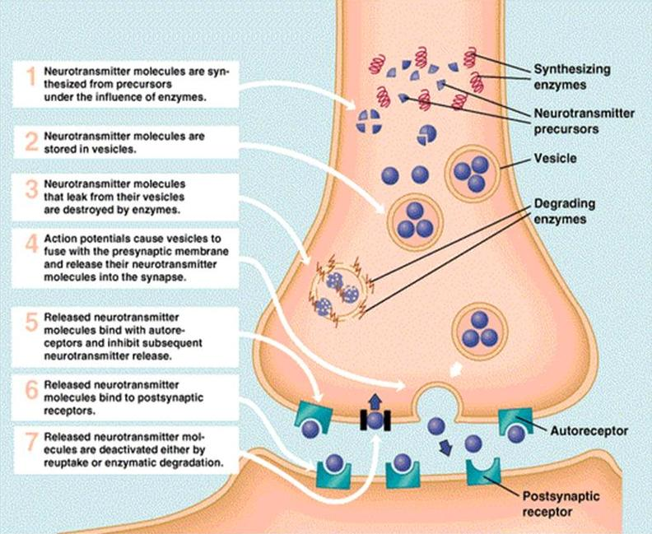

Slide 9
Mechanism of Drug Action
Drugs either act as an AGONIST (mimic the NT ) or ANTAGONIST (block the NT)
Drug molecules interact with target sites to effect the nervous system
The drug must be absorbed into the bloodstream and then carried to the target site(s)
Pharmacokinetics is the study of drug absorption, distribution within body, and drug elimination
Absorption depends on the route of administration
Drug distribution depends on how soluble the drug molecule is in fat (to pass through membranes) and on the extent to which the drug binds to blood proteins (albumin)
Drug elimination is accomplished by excretion into urine and/or by inactivation by enzymes in the liver.

Slide 10
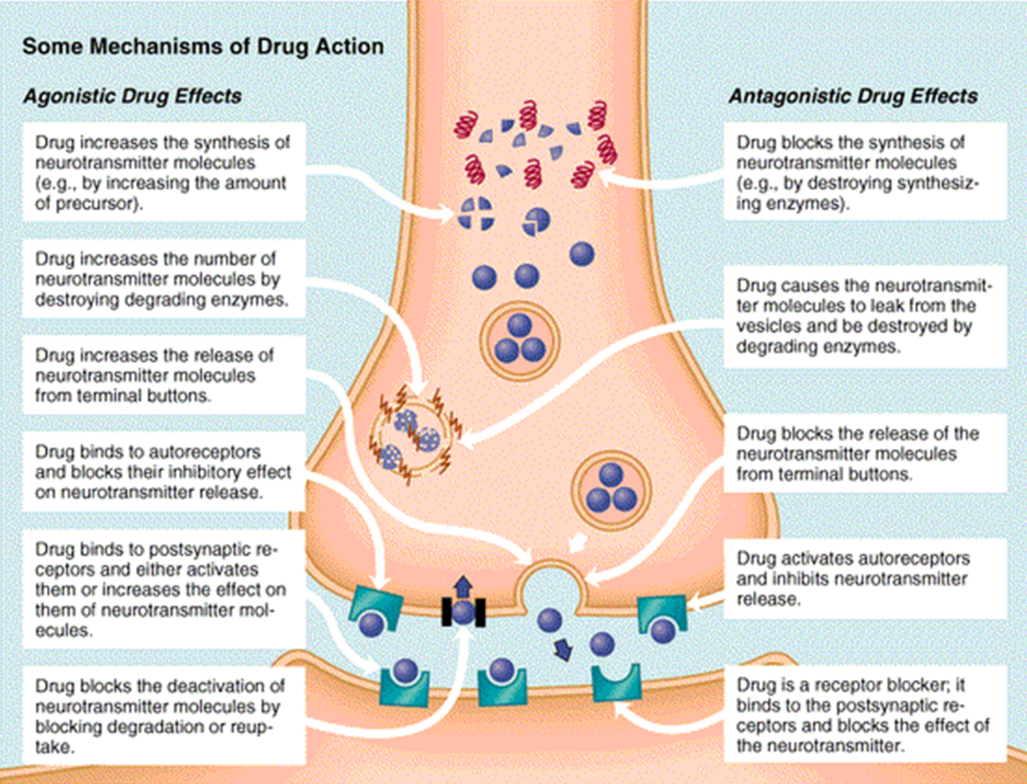

Slide 11
Summary of Medications Role in Psychiatry
Medications are used to treat the symptoms of mental disorders often called as manic-depressive illness. They are part of a comprehensive treatment plan.
Basic knowledge of medications is important in daily clinical practice. Some medications are used with other treatments such as psychotherapy.

Slide 12
Antipsychotic medications
Used to treat schizophrenia or schizophrenia-related disorders.
Conventional "typical" antipsychotics are the first generation and available since the mid-1950's.
For e.g.: Chlorpromazine (Thorazine), Haloperidol (Haldol), Perphenazine (generic only), Fluphenazine (generic only).
The new antipsychotic medications or the second generation of antipsychotics were developed in the 1990's and are known as "atypical" antipsychotics.
Source: http://www.nimh.nih.gov/health/publications/mental-health-medications/index.shtml

Slide 13
Potential Adverse Effects of Antipsychotic drugs
Hypotension
Anticholinergic Effects
Extrapyramidal Symptoms
Pseudoparkinsonism
Akathisia
Dystonic Reactions
Tardive Dyskinesia
Hyperprolactinemia
Sexual Dysfunction
Agranulocytosis
Cardiac Arrhythmias
Seizures
Metabolic Syndrome Issues
Source: http://www.ncbi.nlm.nih.gov/pubmed/20187598

Slide 14
Recent Publication
Converting positive and negative symptom scores between PANSS and SAPS/SANS. Schizophrenia research. 152(1): 289-94
Authors: van Erp TG, Preda A, Nguyen D, Faziola L, Turner J, Bustillo J, Belger A, Lim KO, McEwen S, Voyvodic J
http://www.ncbi.nlm.nih.gov/pubmed/24332632

Slide 15
Pharmacovigilance Related Journals
Journal of Clinical Trials
Advances in Pharmacoepidemiology & Drug Safety
Journal of Drug Metabolism & Toxicology

Slide 16
Pharmacovigilance Related Conferences
For further details regarding the conference please visit
http://www.conferenceseries.com/pharmaceutical-sciences-meetings/

Slide 17
OMICS Group Open Access Membership
Open Access Membership with OMICS international enables academicians and research institutions, funders and corporations to actively encourage open access in scholarly communication and the dissemination of research published by their authors.
For more details and benefits, click on the link below:
http://omicsonline.org/membership.php

