Slide 1
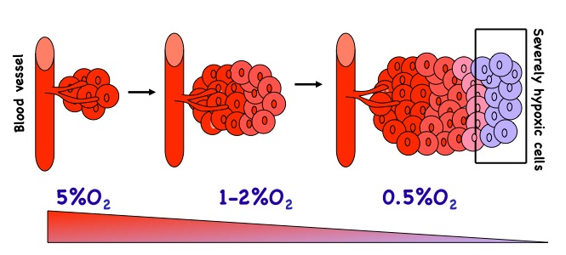
HYPOTHESIS
Gradients of O₂
control
skeletal
development
and homeostasis
by regulating
the HIF pathway

Slide 2
HIF-1α (Hypoxia Inducible Factor)
. PAS (PER-ARNT-SIM) subfamily of bHLH transcription factors
. heterodimer HIF-1α/ARNT; HIF-1α, the hypoxia -responsive
component of the complex
. ubiquitously expressed and highly unstable
. another member in the family, HIF-2α

Slide 3
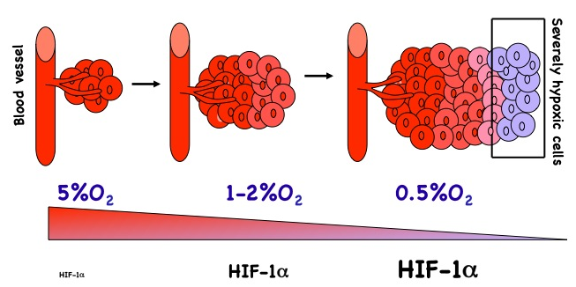
HIF-1α: A KEY FACTOR IN CELLULAR ADAPTATION TO HYPOXIA

Slide 4
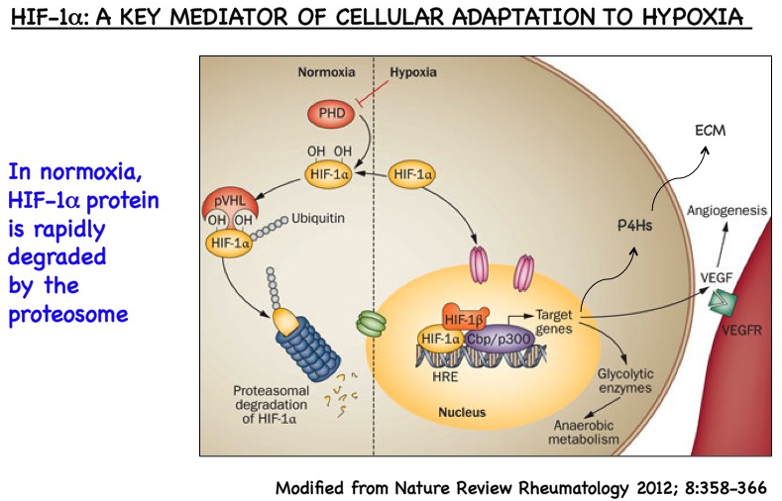
HIF-1α
proliferation

Slide 5
HIFs: A Homeostatic Response
TO KEEP HYPOXIA “in Check”
MITOCHONDRIAL
METABOLISM
O₂ CONSUMPTION CELL NUMBER
/MATRIX RATIO
BLOOD VESSELS
O₂ AVAILABILITY
RED BLOOD CELLS
ROS METABOLISM
REDOX STRESS

Slide 6
HYPOTHESIS
The complex actions of HIFs on O₂ homeostasis are exploited to modulate development and homeostasis of skeletal elements.
HIF-1α
proliferation

Slide 7
OMICS International Open Access Membership
OMICS International Open Access Membership enables academic and research institutions, funders and corporations to actively encourage open access in scholarly communication and the dissemination of research published by their authors.
For more details and benefits, click on the link below:
http://omicsonline.org/membership.php

