Slide 1

Magali Cucchiarini
Executive Editor
Orthopedic & Muscular System: Current Research

Slide 2
Biography
Dr. Magali Cucchiarini, PhD, has been a senior scientist in Gene Therapy physiology genetics metabolism injuries genetics methods and is currently an Associate Professor in Molecular Biology at the Saarland University Medical Center, Homburg/Saar, Germany.

Slide 3
Research Interest
Development of gene transfer vectors based on the adeno-associated virus Gene therapy for human regenerative medicine
Pathogenesis, gene and immunotherapy of viral infections

Slide 4
Recent Publication
Frisch J, Venkatesan JK, Rey-Rico A, Schmitt G, Madry H, Cucchiarini M (2014) Determination of the Chondrogenic Differentiation Processes in Human Bone Marrow-Derived Mesenchymal Stem Cells Genetically Modified to Overexpress TGF-ß via rAAV Vectors. Hum Gene Ther. 2014 Oct 21.
Frisch J, Venkatesan JK, Rey-Rico A, Madry H, Cucchiarini M (2014) Current Progress in Stem Cell-Based Gene Therapy for Articular Cartilage Repair. Curr Stem Cell Res Ther. 2014 Sep 22.

Slide 5

viral infections
These are tables of the clinically most important viruses. A vast number of viruses cause infectious diseases, but these are the major ones. Basic structural characteristics, such as genome type, virion shape, and replication site generally share the same features among virus species within the same family. There are currently 21 families of viruses known to cause disease in humans.

Slide 6

viral infections
There are five double-stranded DNA families: three are non-enveloped (Adenoviridae, Papillomaviridae and Polyomaviridae) and two are enveloped (Herpesviridae and Poxviridae). All of the non-enveloped families have icosahedral nucleocapsids. There is one family of partly double-stranded DNA viruses: Hepadnaviridae. These viruses are enveloped.

Slide 7
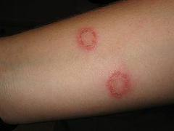
viral infections
There is one family of single-stranded DNA viruses that infect humans: Parvoviridae. These viruses are non-enveloped.
There are seven positive single-stranded RNA families: three non-enveloped (Astroviridae, Caliciviridae and Picornaviridae) and four enveloped (Coronoviridae, Flaviviridae, Retroviridae and Togaviridae).

Slide 8
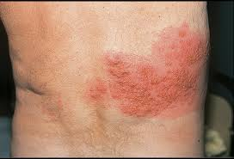
viral infections
There are six negative single-stranded RNA families: Arenaviridae, Bunyaviridae, Filoviridae, Orthomyxoviridae, Paramyxoviridae and Rhabdoviridae. All are enveloped with helical nucleocapsids.
There is one family with a double-stranded RNA genome: Reoviridae.

Slide 9

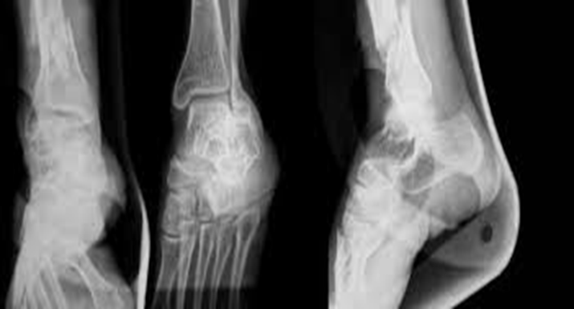
Orthopedic & Muscular System: Current Research
Physiotherapy
Sports Medicine
Doping studies
Orthopedic surgery
Musculoskeletal systems
Spine
Arthritides
Osteoclast
Viral infections

