Slide 1

OMICS Journals are welcoming Submissions
OMICS International welcomes submissions that are original and technically so as to serve both the developing world and developed countries in the best possible way.
OMICS Journals are poised in excellence by publishing high quality research. OMICS International follows an Editorial Manager® System peer review process and boasts of a strong and active editorial board.
Editors and reviewers are experts in their field and provide anonymous, unbiased and detailed reviews of all submissions.
The journal gives the options of multiple language translations for all the articles and all archived articles are available in HTML, XML, PDF and audio formats. Also, all the published articles are archived in repositories and indexing services like DOAJ, CAS, Google Scholar, Scientific Commons, Index Copernicus, EBSCO, HINARI and GALE.
For more details please visit our website: http://omicsonline.org/Submitmanuscript.php

Slide 2
OMICS Journals are welcoming Submissions
OMICS International welcomes submissions that are original and technically so as to serve both the developing world and developed countries in the best possible way.
OMICS International are poised in excellence by publishing high quality research. OMICS Group follows an Editorial Manager® System peer review process and boasts of a strong and active editorial board.
Editors and reviewers are experts in their field and provide anonymous, unbiased and detailed reviews of all submissions.
The journal gives the options of multiple language translations for all the articles and all archived articles are available in HTML, XML, PDF and audio formats. Also, all the published articles are archived in repositories and indexing services like DOAJ, CAS, Google Scholar, Scientific Commons, Index Copernicus, EBSCO, HINARI and GALE.
For more details please visit our website: http://omicsonline.org/Submitmanuscript.php

Slide 3

Aging and Neurodegenerative disease
Neurodegeneration
Synaptic dysfunction
Synapse loss
Dendrite regression
Impaired neurogenesis
AGING
Glial/Immuno alterations
Cytokine cascade
Microglial activation
Impaired detoxification
Demyelination
Neurons and glial cells may adapt to the adversities of aging. If adaptation is not successful, then molecular damage to neurons and inflammatory processes result in synaptic dysfunction and neuronal degeneration and death
Mattson M P et al. Physiol Rev 2002;82:637-672

Slide 4
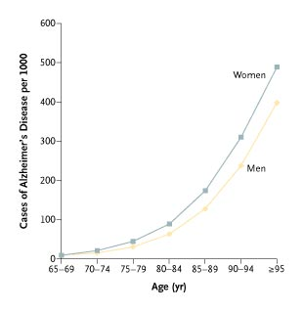
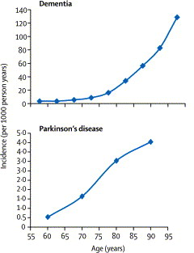
Neurodegenerative disease prevalence:
Alzheimer’s disease:
1-2% age 65-75; 50% over age 85
Parkinson’s disease:
0.5-1% age 60-69; 1-3% over age 80

Slide 5

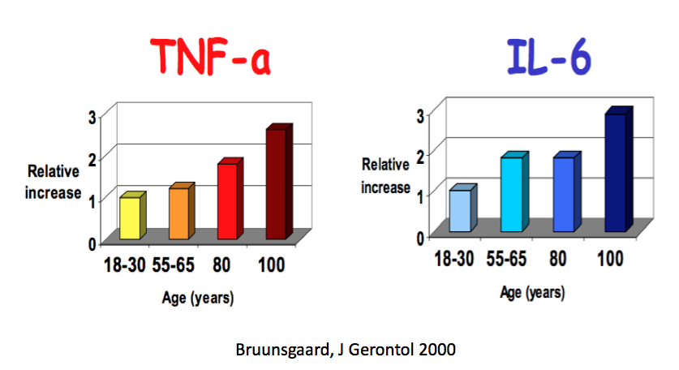

Inflammation in neurodegeneration:
Cause, Effect, or Both?
Aging is associated with systemic low-grade inflammation
INFLAMMATION
Systemic inflammation can influence the progression of dementia

Slide 6
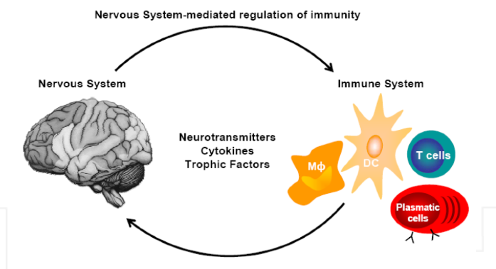
Bidirectional communication between nervous and immune system
bidirectional communication takes place between nervous and immune system in both health and disease.
The same molecules, including cytokines, neurotransmitters and trophic factors, participate as mediators in both directions.
Pacheco R, 2012
The brain responds to inflammation with sickness behavior
But also initiates an opposing, anti-inflammatory response to restore homeostasis
locally mediated through efferent autonomic nervous system (acetylcholine)
systemically mediated through activation of the HPA axis (glucocorticoids)

Slide 7
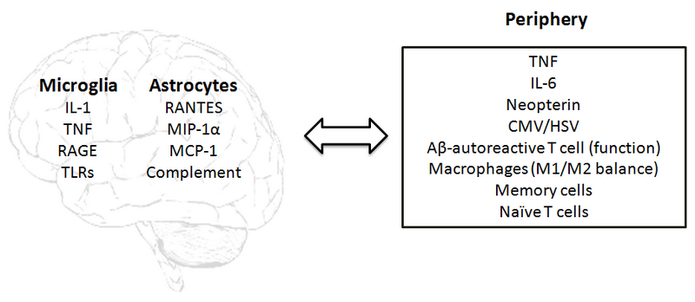
The immune response and AD
The inflammatory component is very strong in AD.
The main markers identified as associated or causative are shown not only for the brain but for the periphery as well.
Fulop et a. 2013

Slide 8
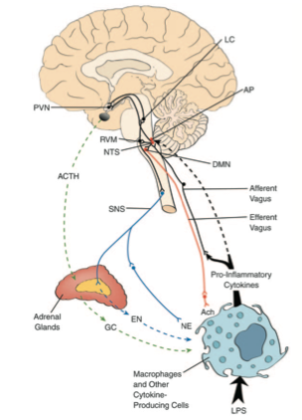
Routes of Communication between Brain and Immune system
SNS
Sympathetic fibers release Norepinephrine and innervate thymus, bone marrow, spleen, lymph nodes, and tissues exerts anti-inflammatory effects by interacting with adrenoceptors expressed on lymphocytes and macrophages. Adrenal medulla release Adrenaline
HPA axis
specialized neurons in the PVN synthesize CRH that induces the production of ACTH in the pituitary. Synthesis and release of glucocorticoids in the adrenalglands
SN sympathetic- vagus
the vagus innervating the reticuloendothelial system induce the release of acetylcholine
Pavlov V. et al. Mol. Med. 2003; 9,5-9:125

Slide 9
Routes of Communication between Immune system and Brain
Neural pathway
Activation of of vagus nerve afferent sensory fibers, directly by cytokines released from dendritic cells, macrophages, and other vagal-associated immune cells, or indirectly through the chemoreceptive cells located in vagal paraganglia, signal the brain that inflammation is occurring
Humoral pathway
Activated cells release cytokines that can cross the blood-brain barrier and enter cerebrospinal fluid and the interstitial fluid spaces of the brain were signal the brain for activation of immunomodulatory mechanisms.
Cytokine-to-brain communication also may occur via circum- ventricular organs such as AP, providing a way of signaling the SNS and HPA axis. Cytokine-induced production of prostaglandins may result in HPA axis activation
Pavlov V. et al. Mol. Med. 2003; 9,5-9:125

Slide 10
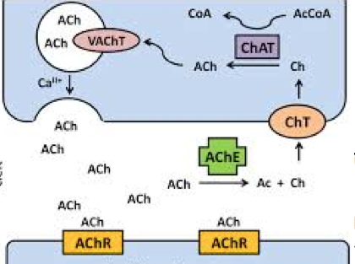
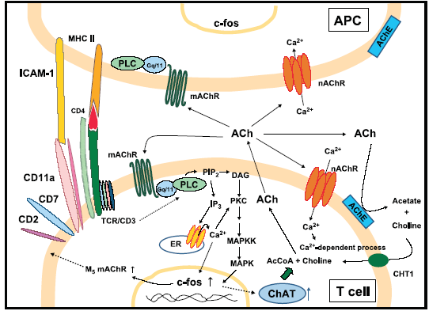
Non-neuronal immune cholinergic system
* Synthesis of ACh
* Expression of the enzyme
cholineacyltransferase (ChAT)
* Response to cholinergic signals; muscarnic and nicotinic
* Expression of a7 nicotinic acetylcholine receptor (AChR)
* Termination of cholinergic signals is mediated by AChE
10
Notes:
10

Slide 11
Cholinergic system and neuro-immune interactions
* The nervous system is a major producer of ACh
* The immune cholinergic system can mediate neuro-immune interactions
* or serve as an internal regulator of immune responses
* α7nAChR on macrophages and T-cells can be anti-inflammatory target
* Stimulation of M1/M5 mAChRs expressed on CD4+ T cells potentiates Th2 responses
* Stimulation of α7 nAChRs expressed on CD4+ T cells favors Th1 responses and impairs Th2 and Tregs differentiation.

Slide 12
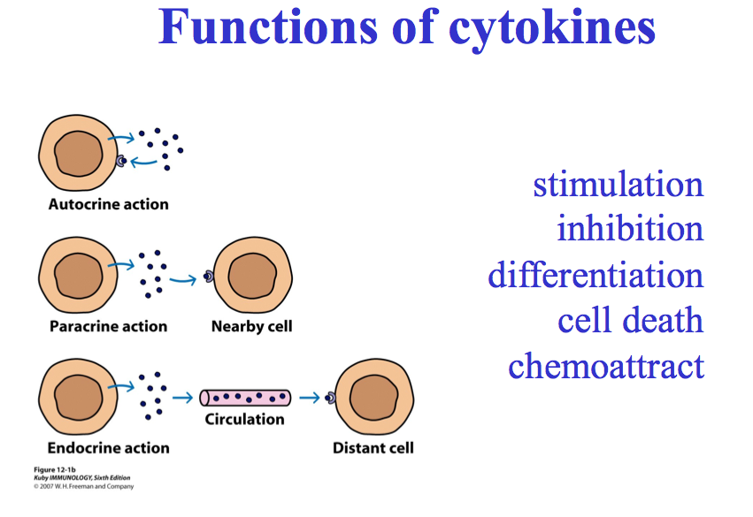

Slide 13
Cytokines
A hierarchical order of cytokine actions has been observed with some early cytokines pre-activating cells so that they then can respond to late-acting cytokines
Many cytokines induce the synthesis of novel gene products once they have bound to their respective receptors
Cytokine mediators can be transported quickly to remote areas of a multicellular organism
They can be degraded quickly.
Concentration gradients can be used to elicit specific responses
They also play a key role in neuroimmunological, neuroendocrinological, and neuroregulatory processes

Slide 14
Chemoattractant Cytokines were called Chemokines
They are Small (8-10kd) secreted heparin-binding
Promote recruitment and activation of leukocytes
Can be divided into subclasses by virtue of structural properties:
CC class – The first two cysteines are adjacent (example: MCP-1, RANTES)
CXC class- The first two cysteines are not adjacent (example: IL-8)
C class – Only has 2 cysteines not 4 (example: Lymphotactin)
CX3C class – Has 3 amino acids between the first two cysteines and a different N-terminal

Slide 15
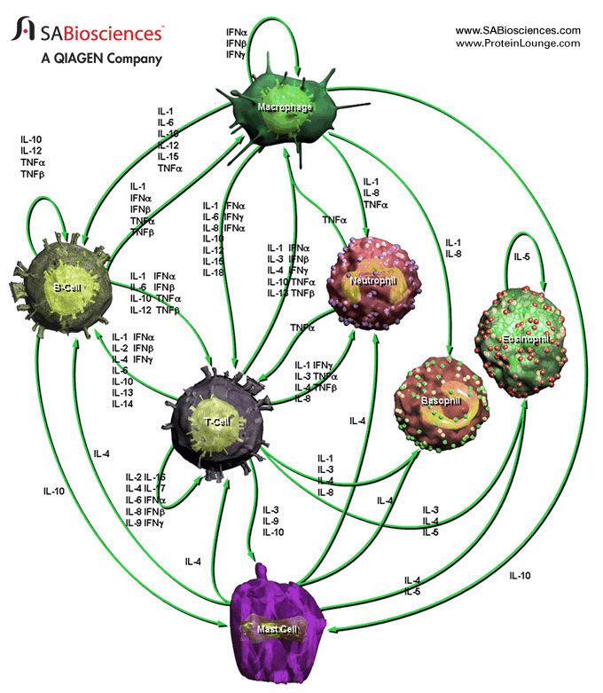
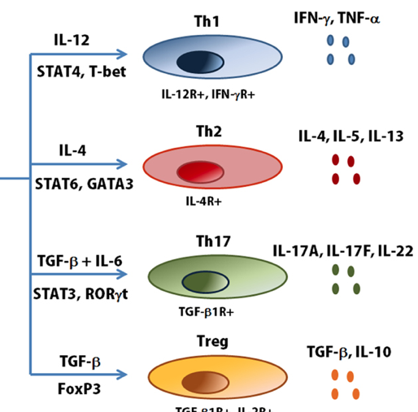
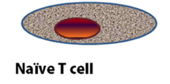
Cytokine network

Slide 16
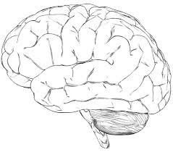

Cholinergic anti-inflammatory pathway
ACh
Vagus nerve signals
TNF
TNF
IL
IL-1
IL-1
α7nAChR
α7nAChR
TNF
X
Cytokine producing cell
JAK2
Pro-inflammatory cytokines
p50
STAT3
NFkB
p65
Acetylcholine binding to α7 nAChR leads to the inhibition of the phosphorylation of inhibitor of NF-B (IkB), the downregulation of the activation of mitogen-activated protein kinases (MAPKs), inhibition of the release of intracellular Ca²⁺ stores and the formation of a heterodimeric protein complex with Janus kinase 1 (JAK2), which activates signal transducer and activator of transcription 2 (STAT3).

Slide 17
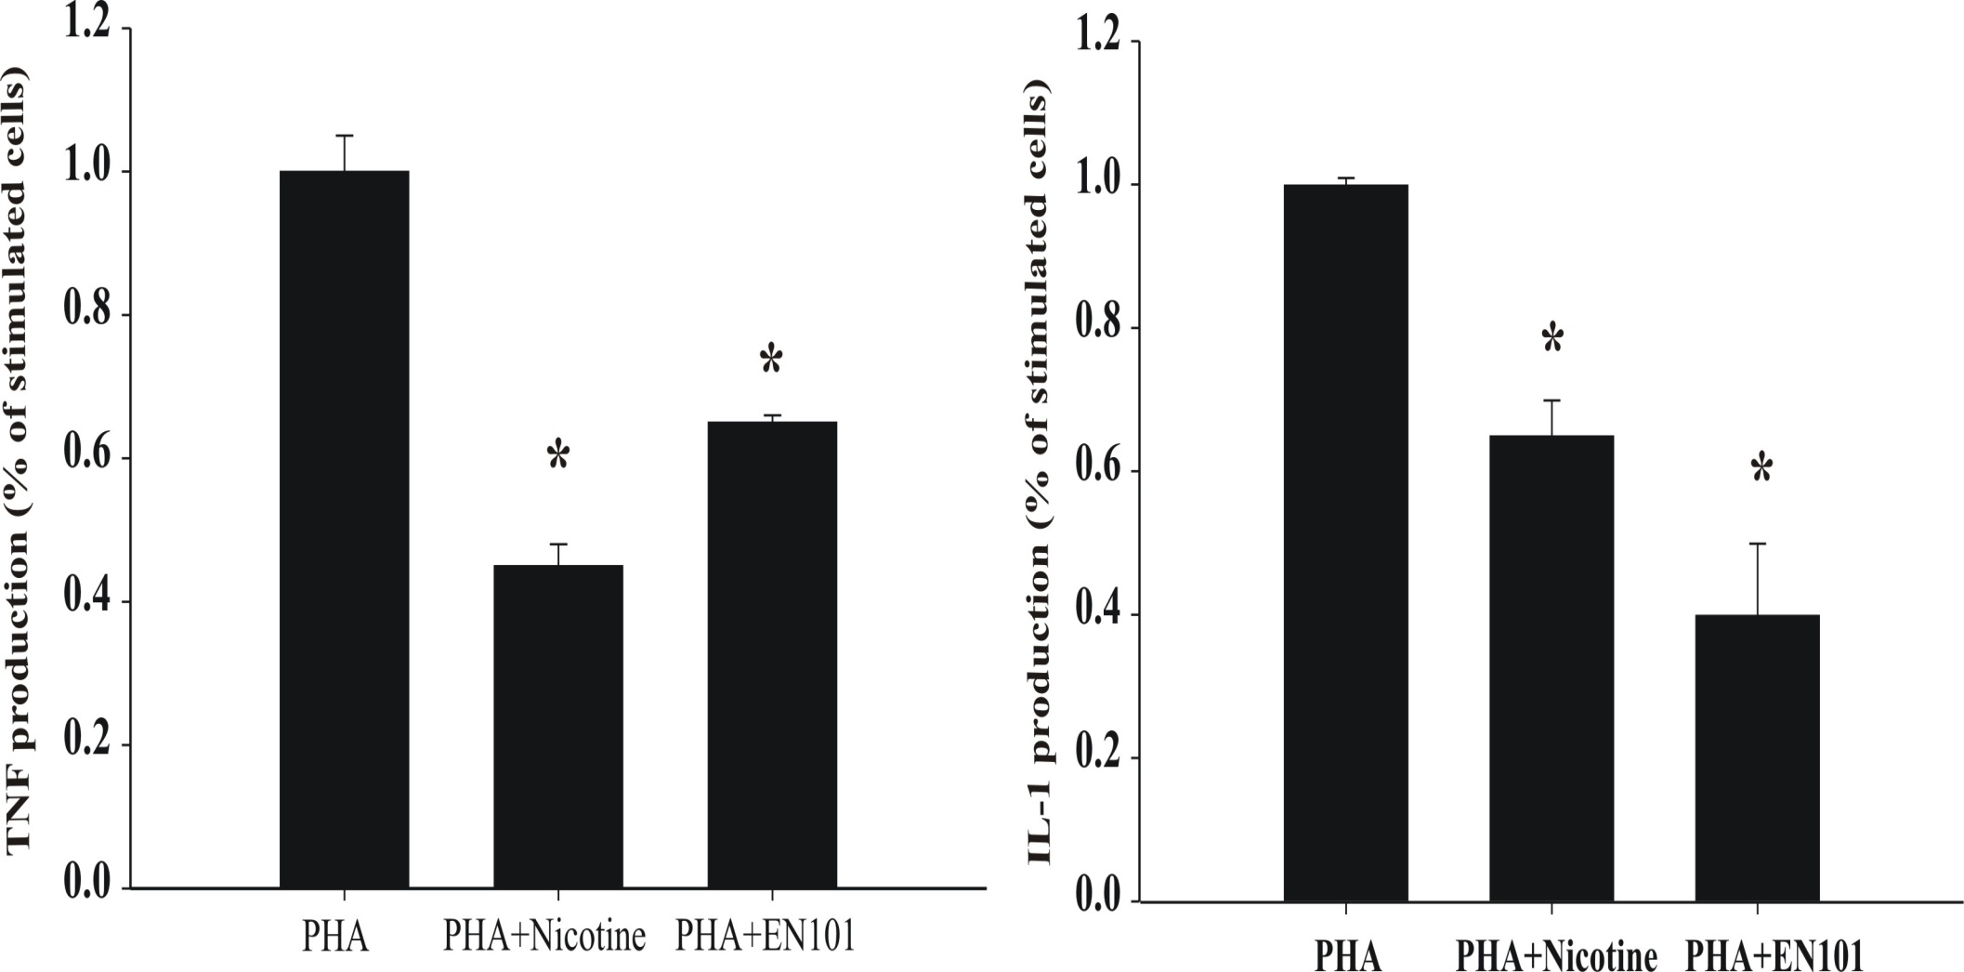
Attenuation of pro-inflammatory cytokine production by α7 nAChR activation
Nizri et al Neuropharmacology 2006

Slide 18
Butyrylcholinesterase and Acetylcholinesterase
Butyrylcholinesterase (BuChE) and acetylcholinesterase (AChE) are members of the same family of enzymes
Both AChE and BuChE regulate the neurotransmitter acetylcholine (ACh) in the brain
Likely to play a key role (rather than just aback-up role) in improving cholinergic neurotransmission
Mesulam et al. 2002; Darvesh et al. 2003
Inhibition of either AChE or BuChE in the brain increases ACh concentration
AChE or BuChE specific inhibitors improve cognitive performance of elderly rats
Greig et al. 2001

Slide 19
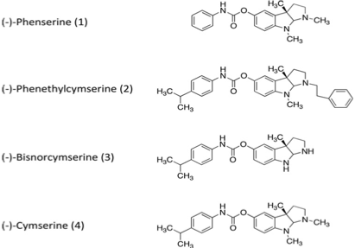
ChE inhibitors

Slide 20
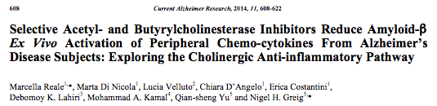
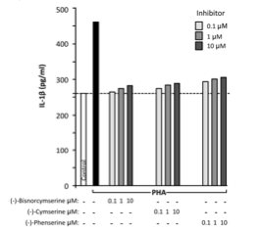
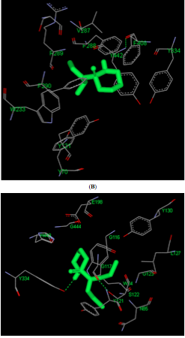

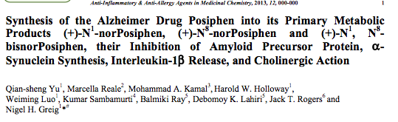
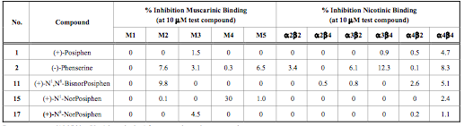

Slide 21
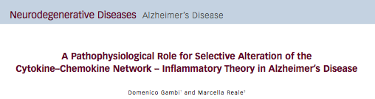
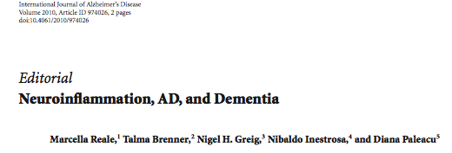
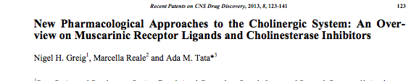
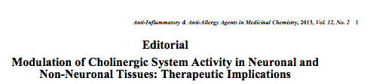
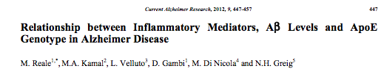
EUROPEAN NEUROLOGICAL REVIEW 2009

Slide 22
Working hypothesis:
ACh
α7 nAChR
α7 nAChR
ACh
Peripheral immune cells
Peripheral immune cells
AChEI
AChE
AChE
AChE
AChE
AChE
AChE
Cholinergic up-regulation: inhibition of pro-inflammatory cytokine release
Inhibition of (extra-cellular) AChE: can activate the α7 nAChR
Activation of the α7 nAChR: anti-inflammatory effects

Slide 23
AChEI mediate anti-inflammatory effects: Suppression of cell activities, proliferation and pro-inflammatory cytokine production
AChEI mechanism involves activation of α7nAChR
Expression of α7nAChR on cell producing cytokines surface increases following stimulation
Nicotine treatment reduced Th1 and Th17 activity and Th2 polarization with inhibition of NFkb induced signaling
Cholinergic up-regulation by treatment results in reduction of neuroinflammation and improvement of cognitive deficit

Slide 24
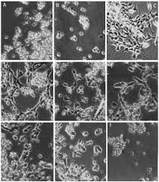



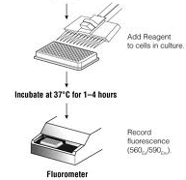
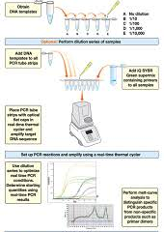
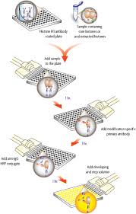
Methods
Cell lines:
SH-SY5Y
THP-1
Place cells in culture tubes or disches , add ChEIs or agonist/antagonist of α7nAChR to study their effects on immune response
PBMCs
Collect whole blood
Centrifuge blood over a Ficoll-Hypaque gradient to isolate mononuclear cells
Cell Signaling and activities
Cytokines assay
Transcription
Secretion
Real time PCR
Elisa Assay

Slide 25
Conclusions
The immune cholinergic system play a role in the immunomodulation
Cholinergic up-regulation by AChEI treatment results in reduction of neuroinflammation and improvement of cognitive deficit
Sustained inhibition of both AChE and BuChE is correlated with clinical benefit
Selective BuChE inhibition reduces APP and Aβ levels
AChE and BuChE inhibition versus AChE- specific inhibition currently being studied
activation of α7nAChR reduced Th1 and Th17 cytokine synthesis

Slide 26


Journal of Gerontology& Geriatric Research Related Journals
Aging Science
Alzheimer's Disease & Parkinsonism
Depression and Anxiety
Emergency Mental Health
Palliative Care & Medicine

Slide 27

Journal of Gerontology& Geriatric Research Upcoming Conferences
http://www.conferenceseries.com/

Slide 28


OMICS International Open Access Membership
OMICS International Open Access Membership enables academic and research institutions, funders and corporations to actively encourage open access in scholarly communication and the dissemination of research published by their authors.
For more details and benefits, click on the link below:
http://omicsonline.org/membership.php
www.ilmo.it

