Slide 1
OMICS International
OMICS International International through its Open Access Initiative is committed to make genuine and reliable contributions to the scientific community. OMICS International signed an agreement with more than 1000 International Societies to make healthcare information Open Access.
Contact us at: contact.omics@omicsonline.org

Slide 2
OMICS Journals are welcoming Submissions
OMICS International welcomes submissions that are original and technically so as to serve both the developing world and developed countries in the best possible way.
OMICS Journals are poised in excellence by publishing high quality research. OMICS International follows an Editorial Manager® System peer review process and boasts of a strong and active editorial board.
Editors and reviewers are experts in their field and provide anonymous, unbiased and detailed reviews of all submissions.
The journal gives the options of multiple language translations for all the articles and all archived articles are available in HTML, XML, PDF and audio formats. Also, all the published articles are archived in repositories and indexing services like DOAJ, CAS, Google Scholar, Scientific Commons, Index Copernicus, EBSCO, HINARI and GALE.
For more details please visit our website: http://omicsonline.org/Submitmanuscript.php

Slide 3
Mariano Martin
Editor PPT

Slide 4
Biography
Dr. Martin obtained a FPU predoctoral fellowship from the ministry of Science in Spain to carry out his PhD. He graduated in 2008 with honors and was recipient of the Outstanding PhD award from the University of Salamanca. Dr. Martin joined Procter and Gamble, Newcastle Technical Centre, for a postdoctoral appointment at Modeling and Simulation dealing with complex chemical reactors, for which he received the P&G award for his contributions to modeling and simulation. Next, her was awarded a Fulbright Postdoctoral Fellowship at CMU. Currently, Dr. Martin is also Mobility coordinator for the Chemical engineering degree and Head of the Master Studies in Chemical Engineering at Univ. Salamanca. Prof. Martin is coauthor of 49 papers in international Journals and 13 book chapters, his h index is 15 and editor of a undergraduate textbook. He has also presented 49 papers in international conferences and prepared international teaching material.
His research interests include renewable based energy and fuels production.
Biofuels production
Solar and wind energy to chemicals

Slide 5
Recent Publications
Bueno, L., Toro, C.A., Martín M Techno-economic evaluation of the production of added value polymers from glycerol.Chem Eng. Res. Des. 10.1016/j.cherd.2014.05.010
Davis, W., Martín, M Optimal year-round operation for methane production from CO₂ and Water using wind and/or Solar energy. J. Cleaner Prod. 80 , 252-261.
Martín, M.; Grossmann, I.E. Simultaneous dynamic optimization and heat integration for the co-production of diesel substitutes: Biodiesel (FAME & FAEE) and glycerol ethers from algae oil. Ind. Eng. Chem. Res. 53, 11371-11383
Grossmann, I.E.,Martín, M., Yang, L. Review of Optimization Models for Integrated Process Water Networks and their Application to Biofuel Processes. COCHE. http://dx.doi.org/10.1016/j.coche.2014.07.003 5 101-109
De la Cruz, V, Hernández, S,Martín M. Grossmann. I.E. Integrated synthesis of Biodiesel, Bioethanol, Ibutene and glycerol ethers from algae. Ind. Eng. Chem Res. 10.1021/ie5022738
Martín, M.; Grossmann, I.E. Optimal simultaneous enhanced production of biodiesel and bioethanol from algae oil via Glycerol fermentation Applied. Energy. 10.1016/j.apenergy.2014.08.054
Martín M (2014) On the challenges of the use and integration of renewable energy sources. Energy Research J. 5 (1) 1-3 DOI : 10.3844/erjsp.2014.1.3

Slide 6
Biofuel Production

Slide 7
By product sales
Fuel distribution
and retail
Feedstock
Conversion process
Conversion inputs

Slide 8
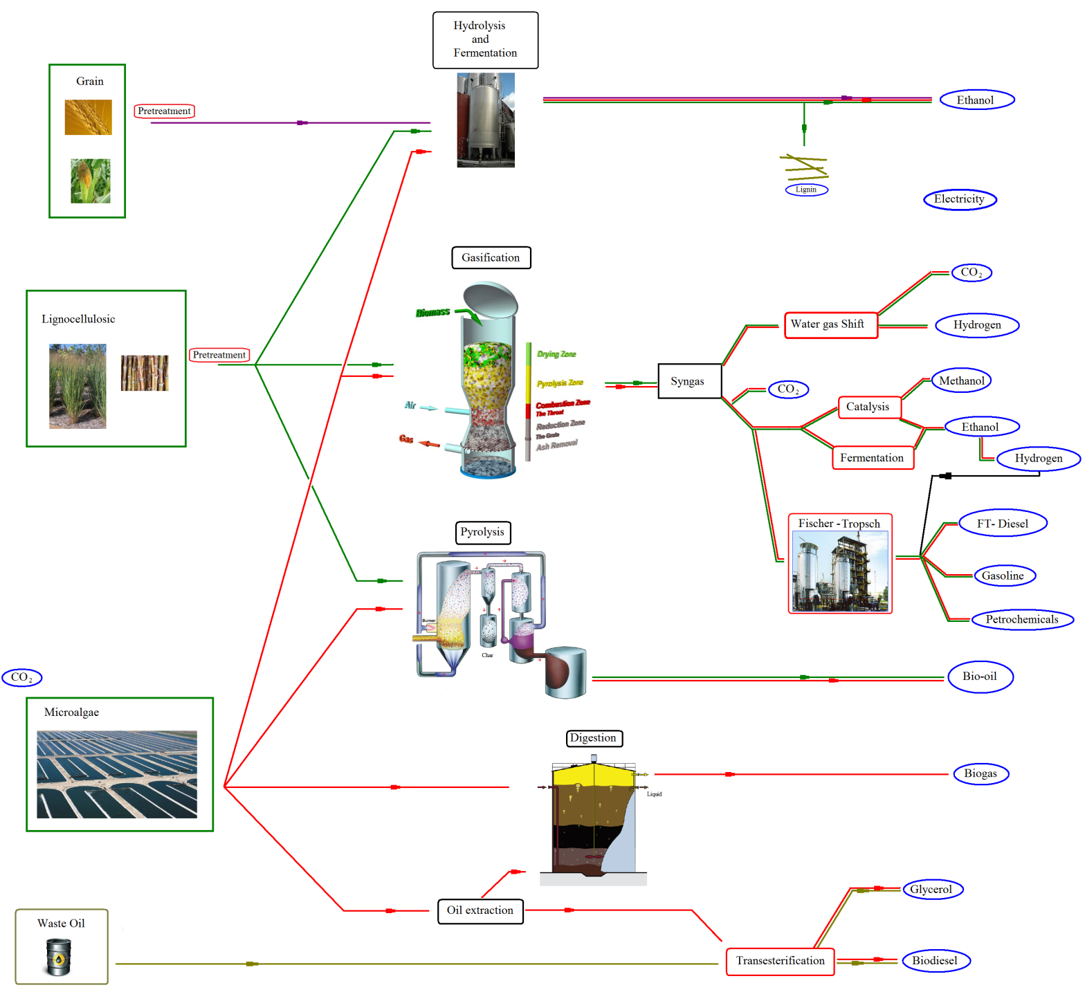

Slide 9
Liquid biofuel feed stocks
Biodiesel – oil bearing crops
Rape seed, sunflower, soya oil, palm oil
Waste vegetable oils
Bioethanol – starch and sugar crops
Cereals, sugar beet, sugar cane
All feed stocks are traded on the food commodity markets
Typically feedstock accounts for 40-50% of biofuel cost

Slide 10
Biomass resources
Supply systems
Conversion
End products
Oil bearing plants
Agricultural crops and residues
Woody biomass
Industrial and municipal waste
Transportation fuels
(biodiesel, bioethanol)
Harvesting,
collection,
handling,
and storage
Chemical (trans esterification)
Physical chemical (extraction)
Solid fuels (wood pellets, charcoal)
Biochemical
(fermentation)
Heat Electricity
Thermochemical (gasification)

Slide 11
Biomethane feedstocks
Commercial or domestic waste may provide a revenue for AD as a waste treatment option.
Agricultural manures are used in partnership with farmers, with digestive spread back to land.
Energy crops have a cost of lost food production.

Slide 12
Second generation fuels
Wide range of input feed stocks
Woody biomass, waste, etc
Generally lower cost feed stocks
Non-food crops so less competition with food
Can use whole crops so get better land use and energy balance

Slide 13
Overview of Biofuel Production Technologies First Generation of Biofuels

Slide 14
Overview of Biofuel Production Technologies Second/Third Generation Biofuels
Gasification & Synthesis

Slide 15
Biomass
Extraction of chemicals
Thermochemical conversion
Biodiesel production
Sugar fermentation
Ethanol
Lactic acid
Proteins
Vitamins
Fragrances
Pharmaceuticals
Glycerol
Bio-SNG
Chemicals
Chemicals
Chemicals

Slide 16
Biofuel production technology selection criteria:
Energy content
Non renewable energy consumed
Availability
Carbon residue
Sulfur content
Viscosity
Density
Efficiency
Scale up

Slide 17
Comparison of technologies Economic versus environmental aspects

Slide 18
Solar and WIND

Slide 19
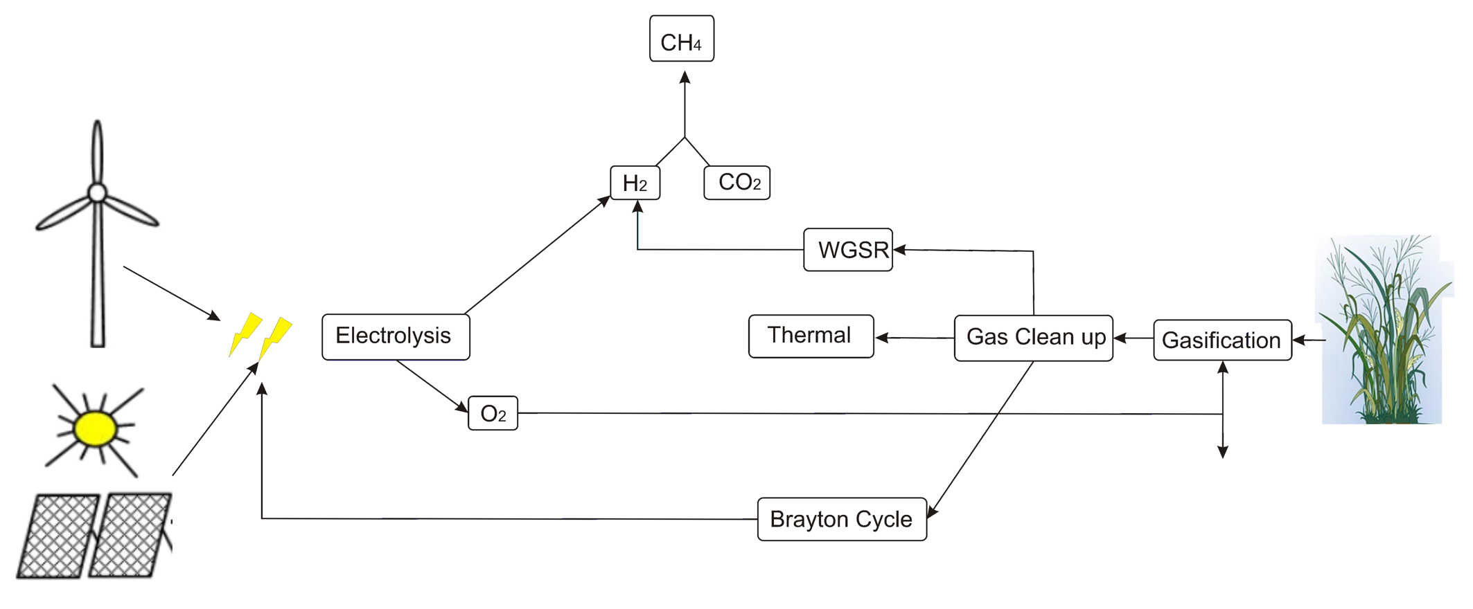
Renwables For CO2 ReUSE

Slide 20
Related Journals
Chemical Sciences Journal
Chemical Engineering & Process Technology

Slide 21
Signature: Mariano MARTIN

Slide 22
OMICS International Open Access Membership
OMICS International’s Open Access Membership enables academic and research institutions, funders and corporations to actively encourage open access in scholarly communication and the dissemination of research published by their authors.
For more details and benefits, click on the link below:
http://omicsonline.org/membership.php

