Slide 1
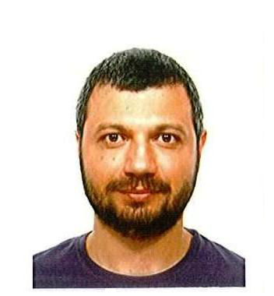
International Journal of Sensor Networks and Data Communications
Massimo Vecchio
Senior Researcher
CREATE-NET
Italy

Slide 2
International Journal of Sensor Networks and Data Communications
Education:
Massimo Vecchio received the Laurea degree in Computer Engineering (Magna cum Laude) from the University of Pisa and the Ph.D. degree in Computer Science and Engineering (with Doctor Europaeus mention) from IMT Lucca Institute for Advanced Studies in 2005 and 2009, respectively.
His research background is on computational and artificial intelligence techniques, such as metaheuristics for global optimization and fuzzy logic.
During his Ph.D. degree, however, his research interests moved towards power-efficient engineering and application designs for pervasive systems and devices.

Slide 3
International Journal of Sensor Networks and Data Communications
Brief biography:
From October 2008 to March 2010 he worked as simulation engineer at INRIA-Saclay (France). Then, he joined the Signal Processing in Communications group at the University of Vigo (Spain) as a post-doctoral researcher, until September 2012.
Recently he moved back to Italy to work as senior researcher at CREATE-NET, mainly in the field of Internet of Things devices and resources virtualization.
Besides, current Massimo’s research interests include metaheuristic and stochastic methods for wireless sensor nodes self-localization, node mobility for efficient data collection and power-aware consensus techniques. He is author of one book monograph, and co-author of two book chapters, 10 journal papers and various conference papers.

Slide 4
International Journal of Sensor Networks and Data Communications
RESEARCH INTERESTS :
Metaheuristic and stochastic methods for wireless sensor nodes self-localization
Node mobility for efficient data collection and power-aware consensus techniques.

Slide 5
Sensor Networks and Data Communications Related Journals
Information Management & Computer Security
Computers & Security
Industrial Management and Data Systems
International Journal of Medical Informatics
Online Information Review
International Journal of Sensor Networks
Computer Networks
Computer Communications
International Journal of Computer Networks & Communications

Slide 6
Sensor Networks and Data Communications Related Conferences
Global Summit on Electronics and Electrical Engineering, November 03-05, 2015 Valencia, Spain
4th International Conference and Exhibition on Biometrics & Biostatistics, November 16-18, 2015 San Antonio, USA
2ndInternational Conference on Big Data Analysis and Data Mining, November 30-December 02, 2015 San Antonio, USA
2nd International Conference and Business Expo on Wireless & Telecommunication April 21-22, 2016 Dubai, UAE

Slide 7
OMICS International Open Access Membership
OMICS International Open Access Membership enables academic and research institutions, funders and corporations to actively encourage open access in scholarly communication and the dissemination of research published by their authors.
For more details and benefits, click on the link below:
http://omicsonline.org/membership.php

