Slide 1
Michael A Kirby Professor Departments of Pediatrics Pathology and Human anatomy Neurosurgery Linda University, Loma Linda, CA USA
Editor of
Anatomy & Physiology: Current Research

Slide 2
Biography
Dr. Michael A. Kirby received his Ph.D. in neurosciences from University of California. He worked as research assistant in California state University for 2 years and then as research associate for 4 years. He rose from Assistant to Associate Professor at the Department of Pediatrics and Anatomy and the Center for Perinatal Research, Loma Linda University and came to Departments of Pathology and Human Anatomy as full Professor in 2002. He worked as Associate vice chair, Chair, Associate vice chancellor and has Secondary Appointment at Department of Surgery, Neurosurgery.

Slide 3
Research Interest
Neuroscience; Neurophysiology; Neuroanatomy with special concentration in Developmental Neurobiology; neural mechanisms in labor and parturition.

Slide 4
Recent publications
Clyde, L.A., Lechuga, T.J., Ebner, Charlotte, A., Burns, AE., Kirby, M.A., Yellon, S.M. (2010). Transection of the pelvic or Vagus nerve forestalls ripening of the cervix and delays birth in rats. In submission.
S.M. Yellon, L.A. Grisham, G. Rambau, T.J. Lechuga, M.A. Kirby (2010). Pregnancy-related reduction in connections from the cervix to forebrain and hypothalamus in mice. J. of Reproduction, 140, 1-10.
L. Anissian, M.A. Kirby, and A. Stark (2009). Primary Cortical Brain Cells influence Osteoblast Activity. J. of Biochemical and Biophysical Research Communications. In Press: Ms. No.: BBRC-09-5889.
M. A. Kirby, M. M. Groves, and S. M. Yellon, (2009). Retrograde tracing of spinal cord connections tothe cervix with pregnancy in mice. J. of Reproduction, 139:1-10,2009.
Boyd J.W., T.J. Lechuga, C.A. Ebner, M.A. Kirby, Yellon S.M. (2009). Cervix remodeling and parturition in the rat: lack of a role for hypogastric innervation. J. of Reproduction 137: 739-748.
Yellon S.M., Bur ns A.E., J.L. See, T.J. Lechuga, M.A. Kirby (2009). Progesterone Withdrawal Promotes Remodeling Processes in the Nonpregnant Mouse Cervix. Biol. Reprod. 81: 1-6, 2009.
Kirby L.S., M.A. Kirby, J.W. Warren, L.T. Tran, and S.M. Yellon. Increased innervation and ripening of the prepartum murine cervix. J. Soc. Gynecol Invest. 12:578-85, 2005.
Yellon S.M., A.M. Mackler, M.A. Kirby. The role of leukocyte traffic and activation in parturition. J. Soc. Gynecol. Invest. 10: 323-338, 2003 (invited review).
Yellon, S.M., A.M. Mackler, and M.A. Kirby (2003). Contribution of leukocyte trafficking and activation in the pregnant uterus and cervix at term to an immune hypothesis for parturition. J. Society for Gyne. Invest. 10:323-338.

Slide 5
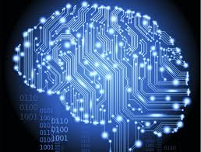
introduction
Neuroscience is the scientific study of the nervous system. Traditionally, neuroscience has been seen as a branch of biology.

Slide 6
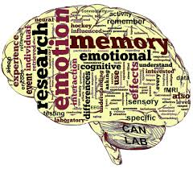

Slide 7
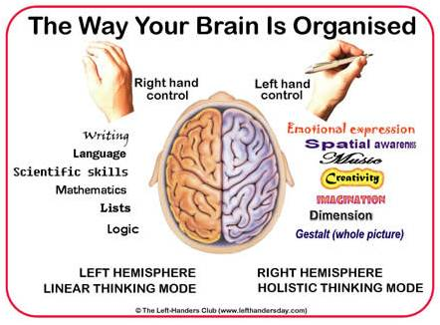

Slide 9
Professional Prospects
Neuroscience is an excellent preparation for the entry in different professional programs related to the neurology such as medicine and other health professions. Neuroscience career opportunities exist at the M.Sc and Ph.D. level in government, hospitals, universities, and industries. There are different jobs currently advertised in biotechnology and pharmaceutical companies are perusing neuroscience. Neuroscience also forms a link with computer science and different control systems of engineering to forge new areas of technology required for the development of smart machines, robotics, artificial intelligence and many other areas. Neuroscience itself have several branches in it which helps one to create several innovations here.

Slide 10
Issues related to neuroscience
1. Development and evolution: How and why did the brain evolved? What are the molecular determinants of an individual brain development?
2. Perception : How perception is well organized? How does the brain neurons transfer sensory information into coherent and private percepts? What could be the objective that constitute our perceptual experience of internal and external environment? How the senses generated in our body?
3. Learning and memory : Where our memories get stored and how do they retrieved again? How can person’s learning get improved? What are the differences in between explicit and implicit memories? What molecules are responsible for the synaptic tagging?

Slide 11
Issues related to neuroscience
4. Neuroplasticity: How plastic can be used for the matured brain?
5. Consciousness : How to recover from the neuronal basis of subjective experience, cognition, wakefulness, alertness, arousal, and attention? How hard is the problem of consciousness to be solved and its function?
6. Free will, particularly the neuroscience of free will.
7. Sleep: What are the physiological functions of sleep? Why do dream comes at any time we sleep?
8. Language: How is it implemented neurally? What is the basis of semantic meaning?

Slide 12
Issues related to neuroscience
9. Cognition and decisions: How our brain knows about how to work and how does it evaluate reward value and effort (cost) to modulate behavior? How does one’s previous experience get altered perception and behavior? What are the genetic and environmental contributions to the function of brain?
10. Diseases: What are the neural basis of mental diseases like psychotic disorders (e.g. mania, schizophrenia), Parkinson's disease, Alzheimer's disease, or addiction? How does it possible to recover a patient from the lost memory?
11. Movement: How our movements are so controllably, even though the motor nerve impulses seem haphazard and unpredictable?
12. Thinking: How do our brain knows what to think?

Slide 13
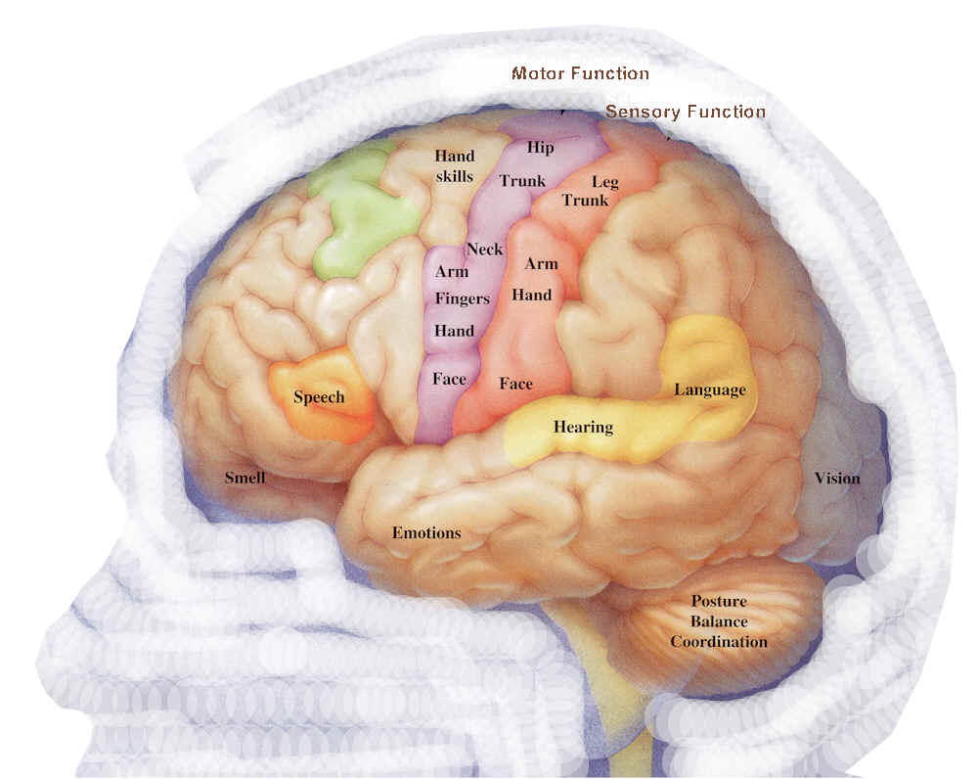
Neuroanatomy
Neuroanatomy is the study of the anatomy and stereotyped organization of nervous systems.

Slide 14
description
Our nervous system is segregated into the internal structure of the brain and spinal cord (together called the central nervous system, or CNS) and the routes of the nerves that connect to the rest of the body (known as the peripheral nervous system, or PNS). The delineation of distinct structures and regions of the nervous system has been critical in investigating how it works? For example, much of what neuroscientists have learned comes from observing how damage or "lesions" to specific brain areas affects behavior or other neural functions.

Slide 15
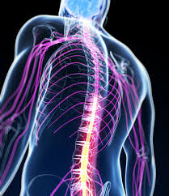
neurophysiology
Neurophysiology (from Greek νεῦρον, neuron, "nerve"; φύσις, physis, "nature, origin"; and -λογία, -logia) is a branch of physiology and neuroscience that is concerned with the study of the functioning of the nervous system.

Slide 16
description
Neurophysiology is connected with electrophysiology, neurobiology, psychology, neurology, clinical neurophysiology, neuroanatomy, cognitive science, biophysics, mathematical biology, and other brain sciences.

Slide 17
role of neuroscientists
1. In Human Brain Project
2. Mutation that arose long ago may be key to humans’ unique ability to produce and understand speech.
3. In engaging the mind.
4. Identify key role of language gene.

Slide 18
Approved By
E-signature: Michael A Kirby

Slide 19
OMICS Group Open Access Membership
OMICS publishing Group Open Access Membership enables academic and research institutions, funders and corporations to actively encourage open access in scholarly communication and the dissemination of research published by their authors.
For more details and benefits, click on the link below:
http://omicsonline.org/membership.php

