Slide 1
OMICS Journals are welcoming Submissions
OMICS International welcomes submissions that are original and technically so as to serve both the developing world and developed countries in the best possible way.
OMICS Journals are poised in excellence by publishing high quality research. OMICS International follows an Editorial Manager® System peer review process and boasts of a strong and active editorial board.
Editors and reviewers are experts in their field and provide anonymous, unbiased and detailed reviews of all submissions.
The journal gives the options of multiple language translations for all the articles and all archived articles are available in HTML, XML, PDF and audio formats. Also, all the published articles are archived in repositories and indexing services like DOAJ, CAS, Google Scholar, Scientific Commons, Index Copernicus, EBSCO, HINARI and GALE.
For more details please visit our website: http://omicsonline.org/Submitmanuscript.php

Slide 2
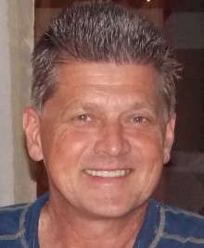
Michael Hoffmann Professor of Neurology (UCF, UF, courtesy) Director, cognitive neurology and stroke programs James A Haley VA Hospital Tampa, Florida , USA
Editor of
ANATOMY & PHYSIOLOGY: CURRENT RESEARCH

Slide 3
B I O G H R A P H Y
Professor Michael Hoffmann MD, PhD, FCP(SA), FAHA, FAAN received his initial medical degree, MBBch, at the University of Witwatersrand Johannesburg, South Africa, followed by a neurological registrarship at the University of Natal, Durban, South Africa with subsequent subspecialty fellowship training in Stroke at Columbia University Neurological Institute and Presbyterian Medical Center, New York. Currently, he is working as director of Cognitive Neurology and Stroke at the James A Haley VA Medical Center in Tampa, Florida and affiliate Professor of Neurology with the University Central Florida and courtesy Professor with the University of Florida. He is serving as an editorial member of several reputed journals and has authored over 200 research abstracts and manuscripts. He is a fellow of the American Academy of Neurology and American Heart Association Stroke Section.

Slide 4
RESEARCH INTEREST
Cognitive neurology, Cerebrovascular disease, Frontal lobe function, Neuro archeology.

Slide 5
RECENT PUBLICATIONS
Dolichoectasia - A Posterior Circulation, Large Vessel Vasculopathy with Unique Clinical and Radiologic Features Michael Hoffmann, Charles Brock Research Article: J Neurol Neurophysiol 2014, 5:216 doi: 10.4172/2155-9562.1000216
Assembly of the Human Mind: How Present Day Primates Reflect our MindÂ’s Anatomical and Physiological Evolution Michael Hoffmann Editorial: Anat Physiol 2013, 4: e132 doi: 10.4172/2161-0940.1000e132
Beyond the Three Dimensional Aspects of Neuro-anatomy: The Multidimensional Brain Michael Hoffmann Editorial: Anat Physiol 2011, 1: e101 doi: 10.4172/2161-0940.1000e101

Slide 6
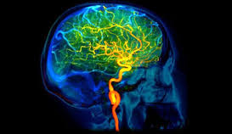

Slide 7
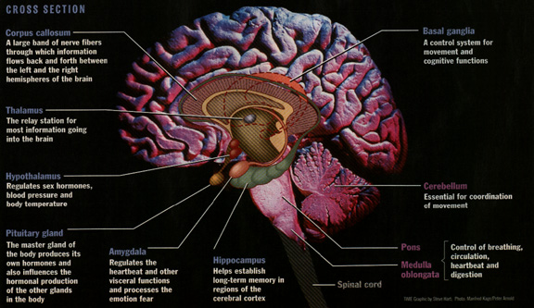

Slide 8
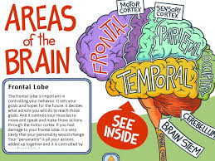
DEFINITION
Cerebrovascular disease refers to a International of conditions that affect the circulation of blood to the brain, causing limited or no blood flow to affected areas of the brain.

Slide 9
TYPES OF CEREBROVASCULOAR DISEASES
There are a number of different types of cerebrovascular disease. The four most common types are:
stroke – a serious medical condition where the blood supply to the brain is interrupted
transient ischaemic attack (TIA) – a temporary fall in the brain's blood supply, resulting in a lack of oxygen to the brain
subarachnoid haemorrhage – an uncommon cause of stroke where blood leaks out of the brain's blood vessels
vascular dementia – problems with the blood circulation, leading to parts of the brain not receiving enough blood and oxygen

Slide 10
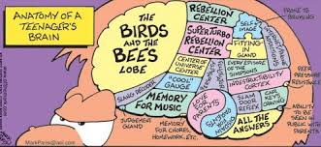

Slide 11
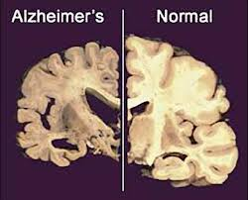

Slide 12
SYMPTOMS OF BRAIN DISORDERS
The following are some common symptoms brain disorders may present:
confusion or problems concentrating
headaches or migraines
seizures (convulsions)
memory problems
change in the way you normally behave
problems with your vision (double vision, for example)
lack of muscle control
vomiting or nausea

Slide 13
CAUSES!!!
Trauma to the brain
Stroke (restricted or reduced oxygen and blood in the brain that leads to cellular death)
Viral infections (viruses may cause inflammation and swelling in the brain’s tissue)
Disease and cancer
Abnormal growths (tumors)
Inherited conditions that affect the brain
Change in your brain’s electrical pathways (communication between neurons)

Slide 14
ARE YOU IN RISK ZONE????????
Brain disorders may have certain risks too which are as follows:
have blunt trauma to the head
have a family history of brain disorders or disease
have a viral infection
have a stroke
smoke tobacco products
stop breathing (can prevent oxygen from reaching the brain)

Slide 15
Diagnosing can be done in risk zone too…
Diagnosing can be done by various methods like:
Computed Tomography (CT) scan—to take images of your brain.
Magnetic Resonance Imaging (MRI)
Positron Emission Tomography (PET)
Electroencephalogram (EEG)

Slide 16
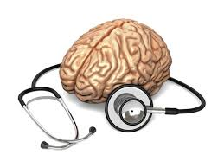
Go for treatment???
There can be different medications, medicines, advices too but the most reliable used method is to do MEDITATION and the other successful method for damaged brain is SURGERY.

Slide 17
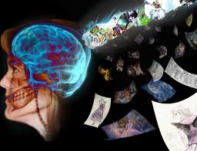

Slide 18
Approved By
E-signature: Michael Hoffmann

Slide 19
OMICS International Open Access Membership
OMICS publishing International Open Access Membership enables academic and research institutions, funders and corporations to actively encourage open access in scholarly communication and the dissemination of research published by their authors.
For more details and benefits, click on the link below:
http://omicsonline.org/membership.php

