Slide 1
Journal of Astrobiology and Outreach
Dr. Mikhail Igorevich Panasyuk
Editorial Board member
Director Department of Physics Moscow State University Russia
Notes:
Mikhail Igorevich Panasyuk

Slide 2
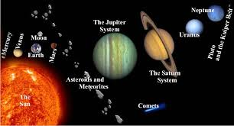
Biography
Dr. Mikhail Igorevich Panasyuk
Mikhail Igorevich Panasyuk, born in the year of 1945, graduated from the Department of Physics, M.V. Lomonosov Moscow State University in 1969. In 1972 on completing post-graduate course he started employment with D.V. Skobeltsyn Institute of Nuclear Physics of MSU. In 1991 he became a Chief of Space-Research Department and in 1992 he was elected as a Director of the Institute. M. Panasyuk is a specialist in the field of experimental studies of cosmic rays and solar-terrestrial physics, an author of over 350 scientific publications.Initially the scientific research of M. Panasyuk concerned physics of the Earths radiation belts of the Earth. M. Panasyuk leads an active educational work. Since 1993 he is a Professor of the Department of Physics of MSU.
Research Interests
Fundamental and applied studies within the field of space physics, astrophysics of cosmic rays, high-energy physics, nuclear physics, interaction of radiation with matter, studies of nanostructures, information technologies development.

Slide 3
Recent Publications
1. Ultraviolet flashes in the equatorial region of the earth, GK Garipov, MI Panasyuk, VI Tulupov… - Journal of Experimental,2005 - Springer
2. Academician DV Skobel'tsyn as the founder of the MSU school of nuclear physics, MI Panasyuk, EA Romanovskii - Physics-Uspekhi, 2013 - ufn.ru
3. The planetary distribution of auroras, MI Panasyuk, EA Romanovskii, VI Tulupov - Herald of the Russian, 2013 - Springer
4. SN Vernov and space physics: Apatity-Leningrad, 1968-1983, VA Dergachev - Physics-Uspekhi, 2011 - turpion.org
5. Coming of age and development of space physics at Moscow State University. Radiation in space: the legacy of SN Vernov, MI Panasyuk - Physics-Uspekhi, 2011 - turpion.org

Slide 4
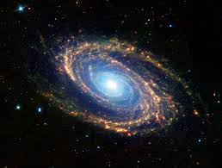
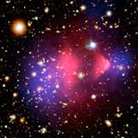
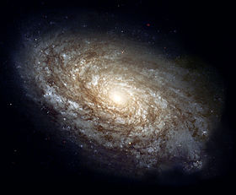
Astrophysics (from Greek astron, ἄστρον "star", and physis, φύσις "nature") is the branch of astronomy that deals with the physics of the universe, especially with "the nature of the heavenly bodies, rather than their positions or motions in space.
Among the objects studied are galaxies, stars, planets, extra solar planets, the interstellar medium and the cosmic microwave background.
Their emissions are examined across all parts of the electromagnetic spectrum, and the properties examined include luminosity, density, temperature, and chemical composition.
Because astrophysics is a very broad subject, astrophysicists typically apply many disciplines of physics, including mechanics, electromagnetism, statistical mechanics,thermodynamics, quantum mechanics, relativity, nuclear and particle physics, and atomic and molecular physics.

Slide 6
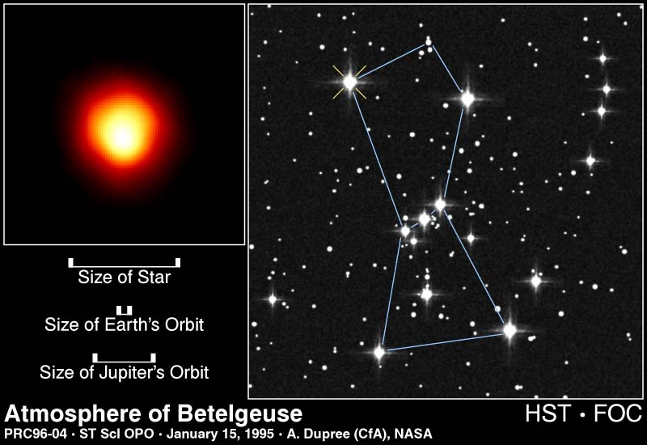
Stellar Sizes

Slide 11
How far is the asteroid belt?
It is 2 – 3.5 AU. An AU is the astronomical unit, the mean distance from the Earth to the Sun Distance = 2 * 1.496 x 108 km = 293200000000 m from the sun.

Slide 12
The most important thing about a star is MASS!
The mass of a normal star almost completely determines its LUMINOSITY & TEMPERATURE!
The LUMINOSITY of a star is the TOTAL ENERGY emitted per time from the surface of the star. This light bulb has a luminosity of 60 Watts The energy the Sun emits is generated by the fusion in its core…

Slide 13
COMETS: are frozen balls of ice and dust that can resemble a “dirty snowball”.They orbit the Sun is highly elliptical orbits. Their orbital periods can range from a few years to several thousand years. Halleys Comet is famous due to the fact that everyone has a chance to see it in their lifetime (Orbital Period of 77 years).
Light Year (ly): is the distance that light travels in one year. One light year equals 9.46 x 1015 metres.
c = distance/time
300000000 = distance/365x24x60x60
Stellar cluster: A number of stars that are held together in a group by a gravitational attraction.They were created at about the same time. There may be many thousands of stars in a group.

Slide 14
Galaxies
A galaxy is a collection of a very large number of starsmutually attracting each other through the gravitational forceand staying together. The number of stars varies between afew million and hundreds of billions. There approximately100 billion galaxies in the observable universe.
There are three types of galaxies: -
Spiral (Milky Way)
Elliptical (M49)
Irregular (Magellanic Clouds)

Slide 18
Locating Information
NASA’s Astrophysics Data System (ADS): http://adswww.harvard.edu/ and particularly http://adsabs.harvard.edu/abstract_service.html
SIMBAD: http://simbad.harvard.edu/simbad/ and http://simbad.u-strasbg.fr/simbad/ (there are 2 sites)
NOTE: VIRTUALLY ALL ELECTRONIC CATALOGS TODAY SEARCH SIMBAD FOR RESOLVING STAR NAMES AND GETTING THEIR COORDINATES. If SIMBAD is down, you may be out of luck!
18

Slide 19
Approved by
E-signature:

Slide 20
OMICS International Open Access Membership
OMICS International Open Access Membership enables academic and research institutions, funders and corporations to actively encourage open access in scholarly communication and the dissemination of research published by their authors.
For more details and benefits, click on the link below:
http://omicsonline.org/membership.php

