Slide 1

OMICS International
OMICS International through its Open Access Initiative is committed to make genuine and reliable contributions to the scientific community. OMICS International signed an agreement with more than 1000 International Societies to make healthcare information Open Access.
Contact us at: contact.omics@omicsonline.org

Slide 2

OMICS Journals are welcoming Submissions
OMICS International welcomes submissions that are original and technically so as to serve both the developing world and developed countries in the best possible way.
OMICS Journals are poised in excellence by publishing high quality research. OMICS International follows an Editorial Manager® System peer review process and boasts of a strong and active editorial board.
Editors and reviewers are experts in their field and provide anonymous, unbiased and detailed reviews of all submissions.
The journal gives the options of multiple language translations for all the articles and all archived articles are available in HTML, XML, PDF and audio formats. Also, all the published articles are archived in repositories and indexing services like DOAJ, CAS, Google Scholar, Scientific Commons, Index Copernicus, EBSCO, HINARI and GALE.
For more details please visit our website: http://omicsonline.org/Submitmanuscript.php

Slide 3


Slide 4


Slide 5


Slide 6
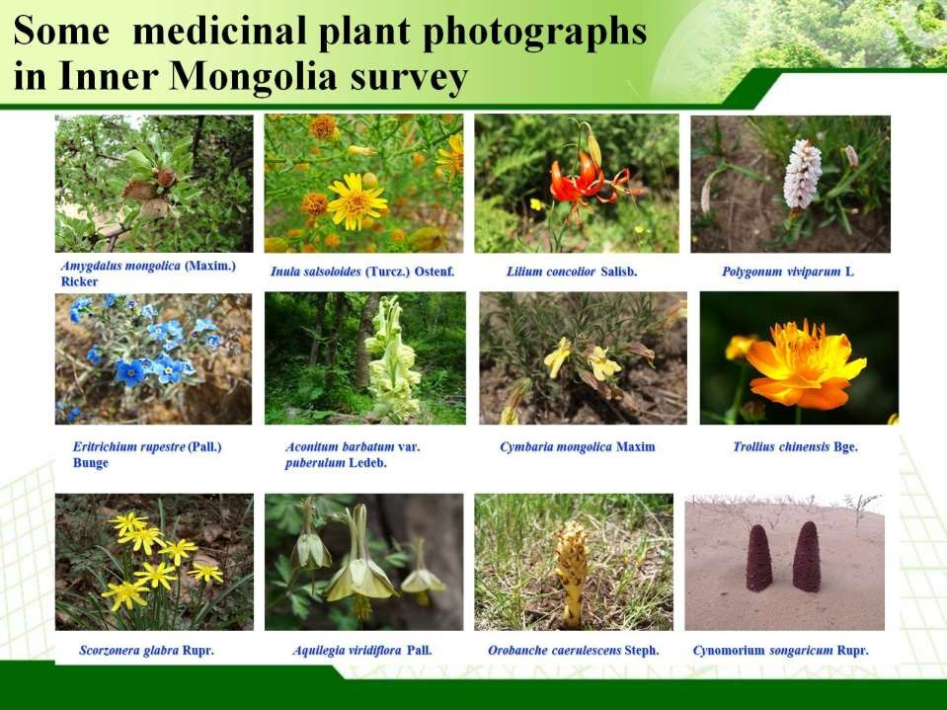

Slide 7
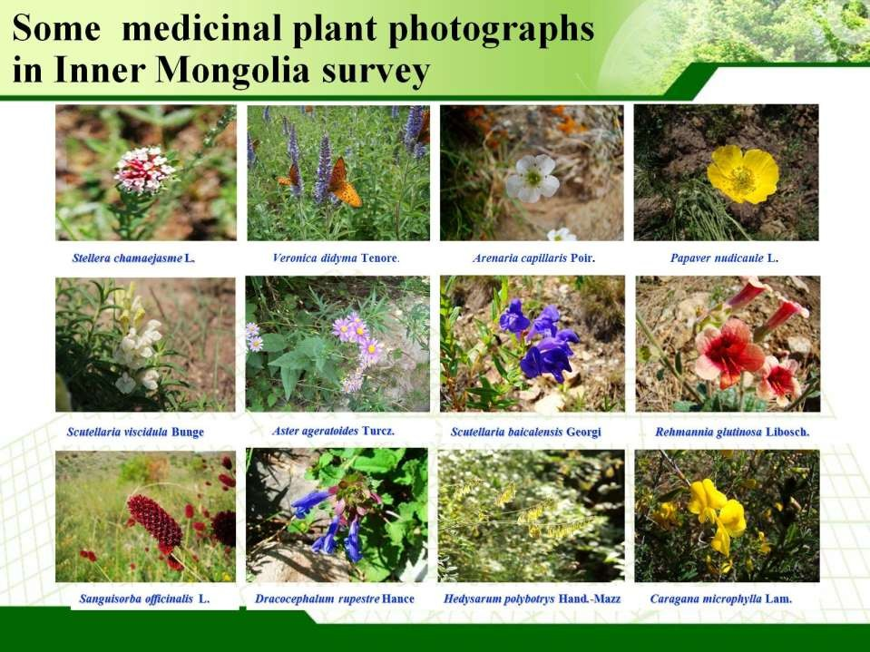

Slide 8
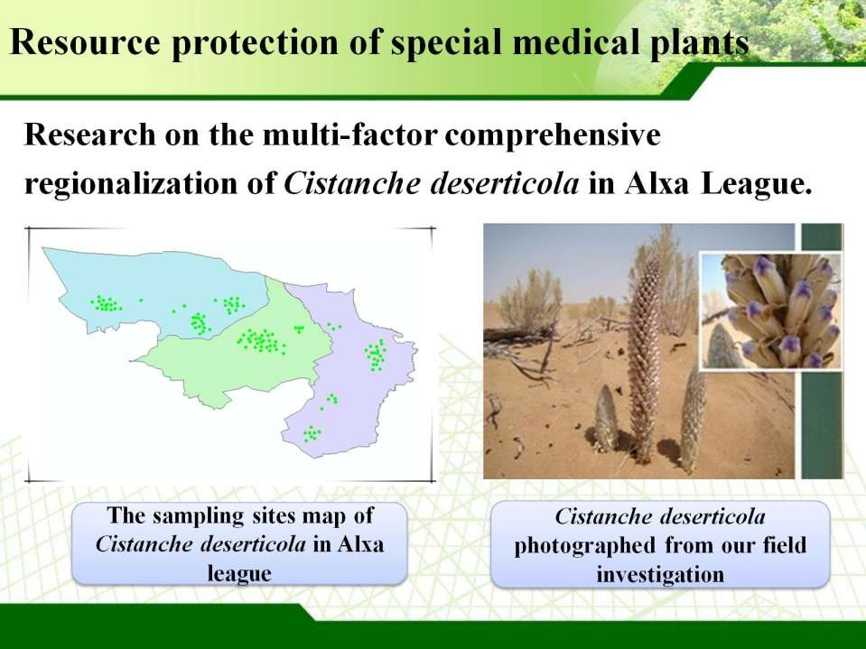

Slide 9
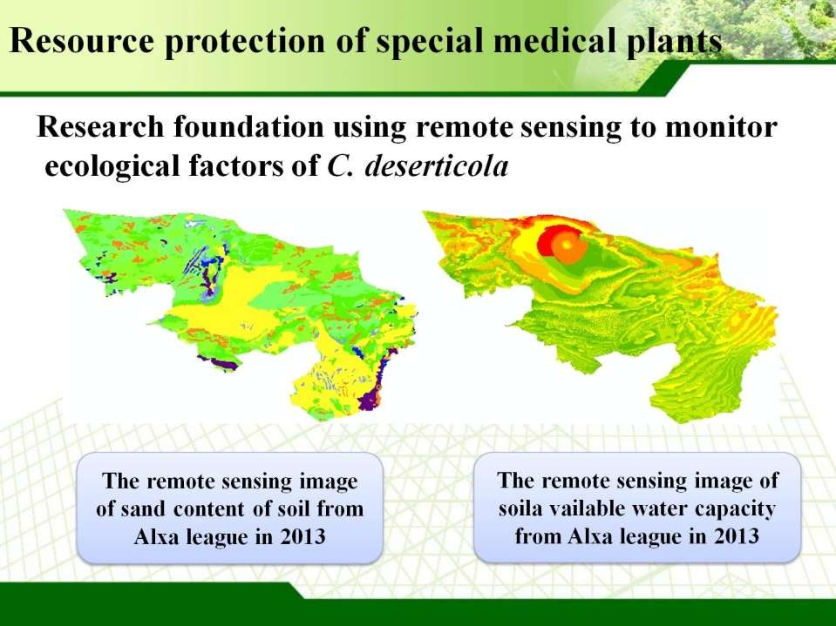

Slide 10
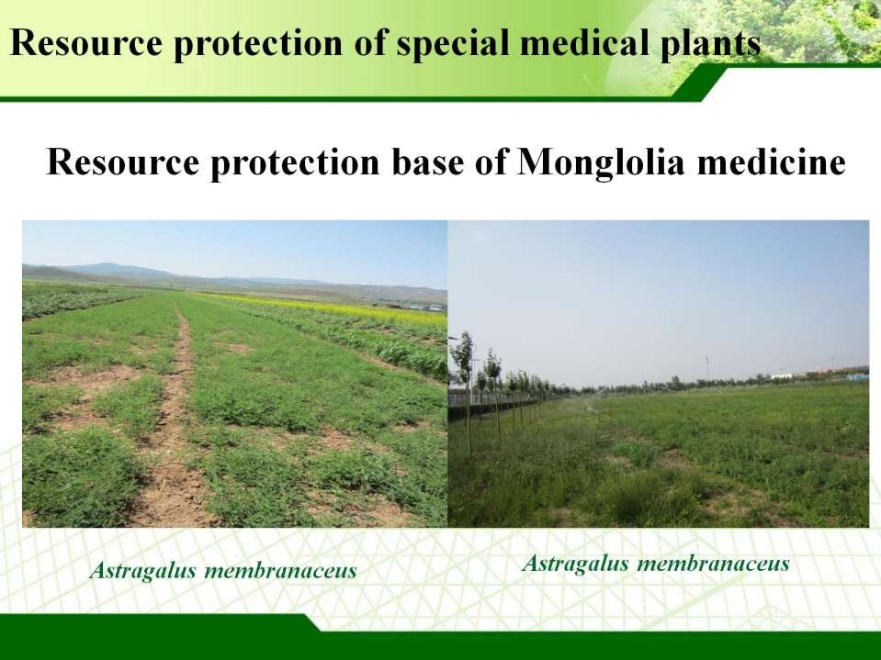

Slide 11
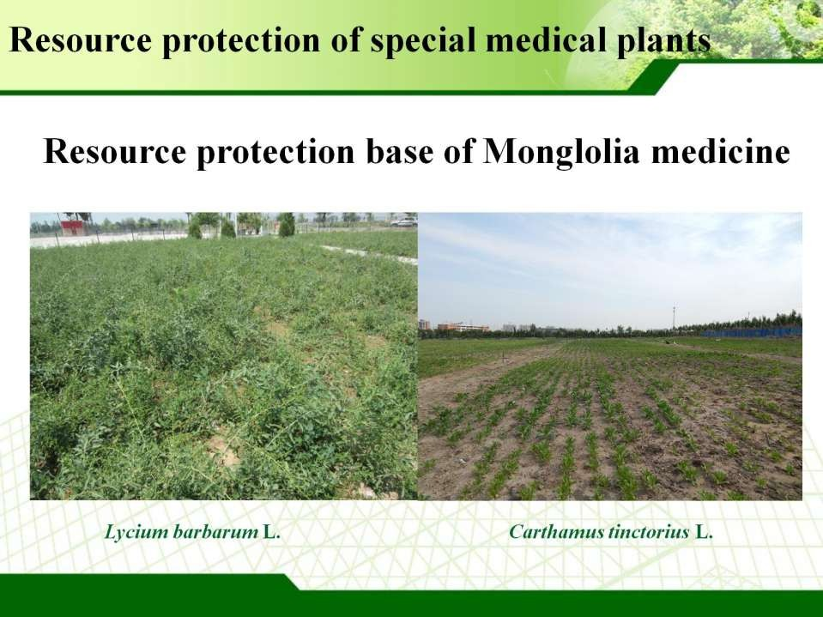

Slide 12
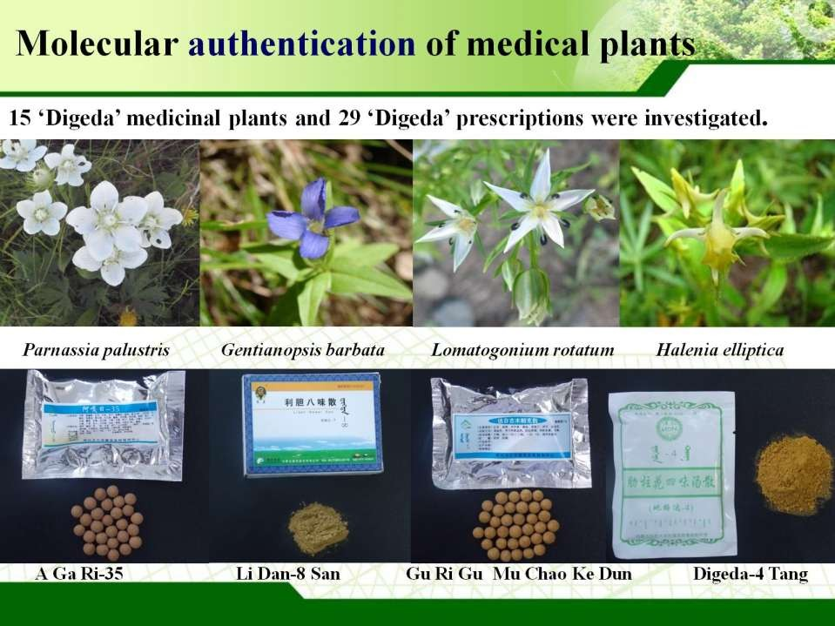

Slide 13
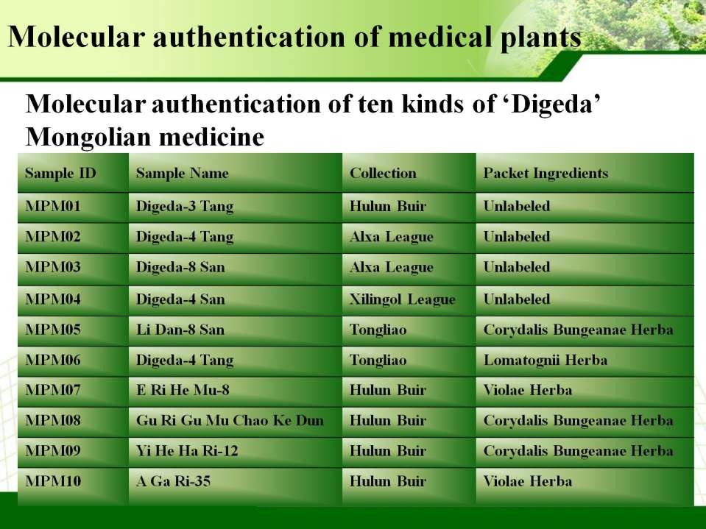

Slide 14
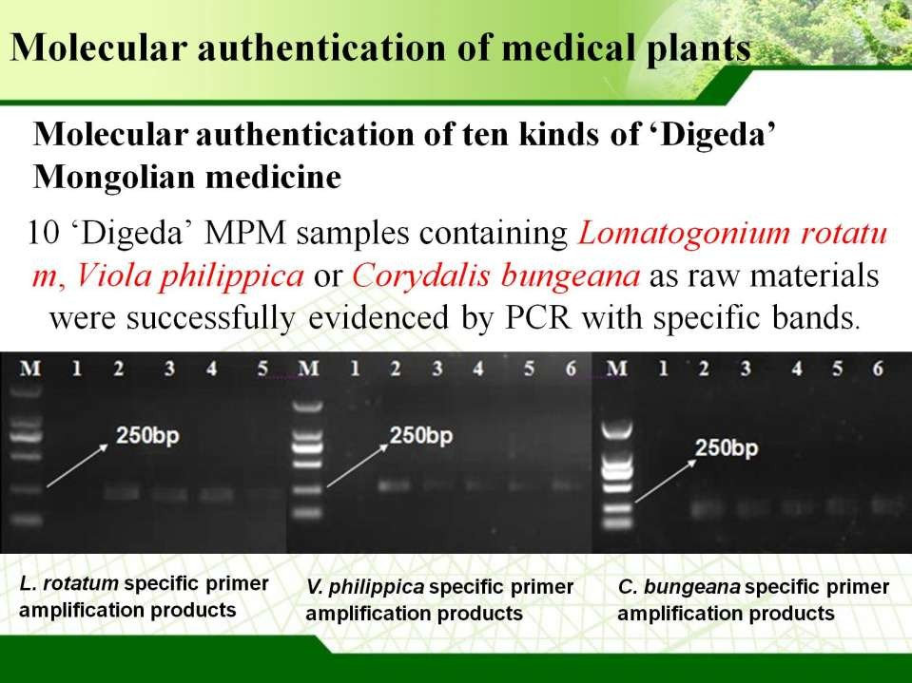

Slide 15
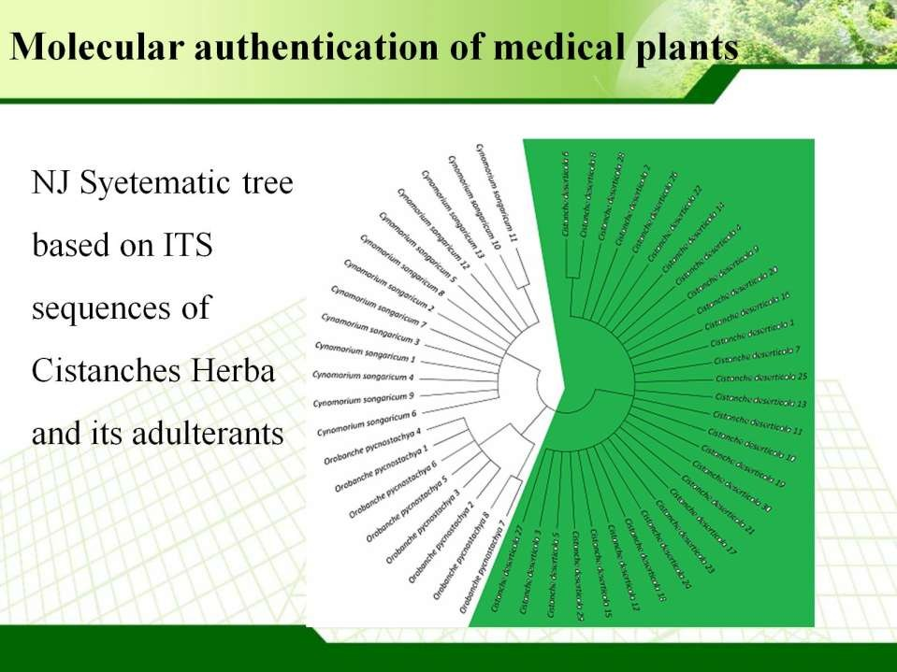

Slide 16
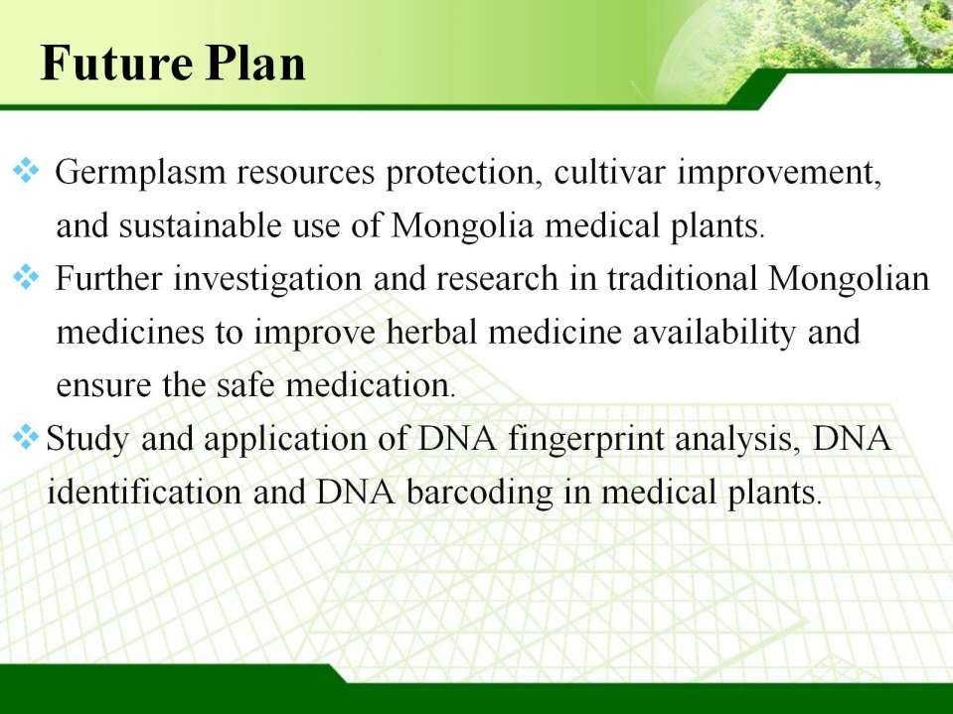

Slide 17


OMICS International
Conference
•
6th World Congress on
Biotechnology
November 30-December 02, 2015 HICC-Hyderabad, India
•
www.biotechnologycongress.com

Slide 18


