Slide 1
Research interest
Mingjie Chen
July 26, 2014

Slide 2
Overview of My Research
Two Topics:
Metabolic regulation mechanisms in controlling seed storage reserve accumulation and remobilization.
Plant abiotic stress tolerance.
Five Questions:
How carbon flux is reprogramed when acetyl-CoA carboxylase (ACCase) is genetically perturbed in developing oil seeds? (Plant Physiology (2009)150: 27-41)
How seed storage lipid catabolism is integrated with chloroplast biogenesis during seedling establishment? (Plant Cell (2010) 22: 77-90)
How plant cell membrane lipid desaturation is regulated by low temperature for cold and freezing tolerance? (Plant Cell (2013) 25:1430-1444)
How plants regulate photoassimilate allocation and partitioning? (Plant Cell (2011) 23: 2991-3006)
How genotype and environment Interactions shape seed metabolome in corn grain?

Slide 3
Methodology
Multi-dimensional approaches are applied, including:
Forward and reverse genetics
Biochemistry
Physiology
Molecular biology
Cell biology
Enzymology
System biology

Slide 4
Research projects
Carbon flux control in oil seeds during seed filling
Pyrimidine salvage activity for photoassimilate allocation and partitioning
Storage lipid remobilization during seed germination and seedling establishment
Membrane lipid desaturation for plant cold tolerance
Application of metabolomics to study genetic and environmental interaction

Slide 5
Research interest
------carbon flux regulation during seed filling
Different seeds contain very different composites: rice, corn, and wheat are high in starch; soybean and cotton seeds are rich in protein and oil. The only carbon resource for the seed filling is derived from the photosynthesized sucrose in the leaf; sucrose is transported into developing seeds and is converted into starch, protein, or oil. The metabolic pathways for these seed storage reserve biosynthesis are much known, but the regulation mechanisms for seed composition remains largely elusive. To discover the potential new metabolic regulation mechanisms in developing oil seeds, we applied a targeted genetic perturbation strategy. Acetyl-CoA carboxylase (ACCase) is the rate-limiting step for seed oil biosynthesis during seed filling, and is a protein complex with four subunits. Overexpression of one subunit (BCCP2) under seed-specific napin promoter resulted in reduced ACCase activity, the transgenic seed showed lower oil but higher storage protein contents. The dominant negative nature of this mutant provided unique opportunity to dissect how carbon is channeled into different metabolic pathways for storage oil or protein biosynthesis. I conducted transcriptomic and proteomic studies, then integrated these –omics data. These findings provided novel insights how carbon flux is regulated when oil biosynthesis is perturbed.

Slide 6
The overview of changes in the context of metabolic network in developing seeds

Slide 7
Several interesting observations
The plastid glycolysis pathway, which produce the precursor acetyl-CoA for fatty acid biosynthesis, was down-regulated; meanwhile, the cytosolic glycolysis pathway was concurrently up-regulated, remodeling of these two pathways may be important to shift the carbon resource from fatty acid biosynthesis to other end products
TCA cycle was found to play a critical role to control the carbon flux between oil and protein biosynthesis
The biosynthesis of biotin(a B2 type vitamin), also the cofactor of ACCase, is significantly enhanced.

Slide 8
Research interest
------photoassimilate allocation and partitioning regulation
The autotrophy of higher plants totally depends on their photosynthesis capacity, which harvest solar energy and converts CO₂ and H₂O into carbohydrates. The net product of photosynthesis, D-glyceraldehyde-3-phosphate (GAP), is used for transit starch biosynthesis in the chloroplast, or transported to cytoplasm for sucrose biosynthesis, or moved into mitochondrion for catabolism. The leaf sucrose is exported to sink organs; leaf transit starch is degraded to sustain plant growth during night period. There is a long standing interest to understand the mechanisms for photoassimilate allocation and partitioning, because it’s fundamental for plant life and has potential applications for the biomass improvement at both the quantity and quality levels. The biochemical study has demonstrated that glucose is activated by ATP or UTP to form ADP-glucose or UDP-glucose, ADP-glucose is destined for leaf transit starch biosynthesis, and UDP-glucose is used for both sucrose and cellulose biosynthesis, but it remains unclear if the nucleotide metabolism could play a role to regulate photoassimilate allocation and partitioning. All organisms have evolved two different routes to synthesize UTP: the de novo biosynthesis use small molecules such as amino acids to form UTP, while salvage pathway recycle the preformed nucleosides or nucleobases to synthesize UTP.

Slide 9
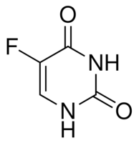
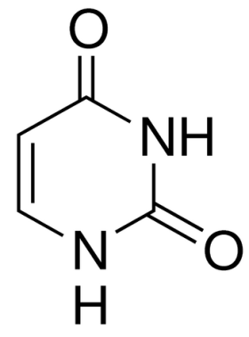
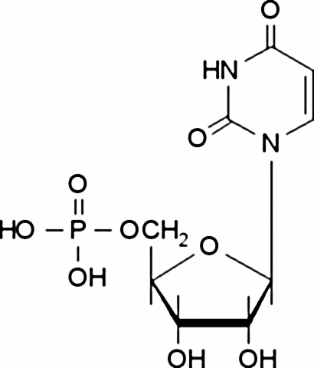
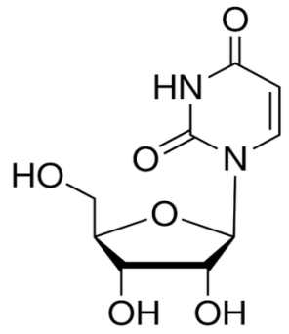
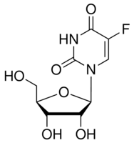
Pyrimidine can be salvaged through Uridine Kinase (UK) and Uracil Phosphoribosyltransferase (UPRT)
5-phospho-α-D-ribose
1-diphosphate (PRPP)
Uracil
5-fluorouracil (5-FU)
UPRT
F
Pi
PPi
Uridine-5’-
phosphate (UMP)
Uridine
5-FUMP
UDP
5-FUDP
UK
GTP
GDP
Pyrimidine Salvage Pathway
UTP
5-FUTP
5-fluorouridine(5-FD)

Slide 10
In Arabidopsis genome there are five UKLs members, UKL1 and 2 are localizes in plastid
UKL5 -----------MEKlSn----GvR-dhcLISdy------------------vSpSaPApl
UKL1 MPEdSsSldyAMEKASgpHFSGLR-fDGLLSSsPPnSsvvsSlrsavSSSspSsSDPeap
UKL2 MPEdStaidyvMEKASgpHFSGLR-lDGLLSSpskSSvsspShfrlsNSSfsAtdDPAap
UKL3 --maSKSdvniiEtSSkvHFSGfhqmDGLaSNrP-----------------eqmAEeeeh
UKL4 --mgSKSvvdmiEaASraHFSGLh-vnGhMnglePSalke-----------tTsAsediq
UKL5 kQPFVIGVAGGTASGKTTVCnMImsQLHDQRVVLVNQDSFYHsLTkEkLnKVHEYNFDHP
UKL1 kQPFiIGVsGGTASGKTTVCDMIIQQLHDhRVVLVNQDSFYrGLTsEELqRVqEYNFDHP
UKL2 hQPFVIGVtGGTASGKTTVCDMIIQQLHDhRIVLVNQDSFYrGLTsEELehVqEYNFDHP
UKL3 gQPFVIGVAGGaASGKTTVCDMImQQLHDQRaVvVNQDSFYHnvnEvELvRVHdYNFDHP
UKL4 rQPFVIGVAGGaASGKTTVCDMIIQQLHDQRVVLiNlDSFYHnLTEEELaRVHEYNFDHP
UKL5 DAFnTEvLLSCMEKLRSGQPVnIPsYDFKiHQ-SIessspVNPgDVIILEGILVlnDPRV
UKL1 DAFDTEQLLhCaEtLkSGQPyqvPiYDFKTHQRrsdtfRQVNasDVIILEGILVFHDsRV
UKL2 DAFDTEQLLhCvdiLkSGQPyqIPiYDFKTHQRkVdafRQVNacDVIILEGILVFHDsRV
UKL3 DAFDTEQLLSsMEKLRkGQaVDIPnYDFKsyknNVfppRRVNPsDVIILEGILIFHDPRV
UKL4 DAFDTEhLLSCMEKLRqGQaVDIPkYDFKTyrsSV--fRRVNPtDVIILEGILlFHDPRV
TP
UK
UPRT
UKL1
TP
UK
UPRT
UKL2
UK
UPRT
UKL3
UK
UPRT
UKL4
UK
UPRT
UKL5

Slide 11
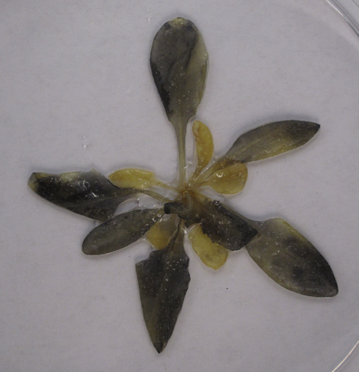
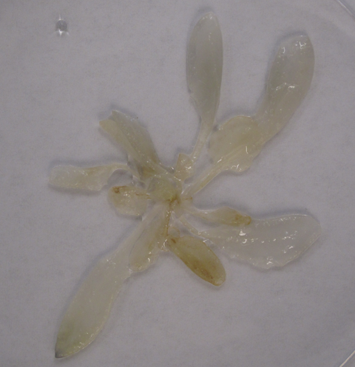
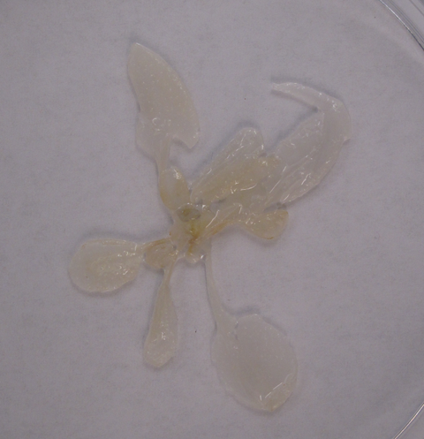
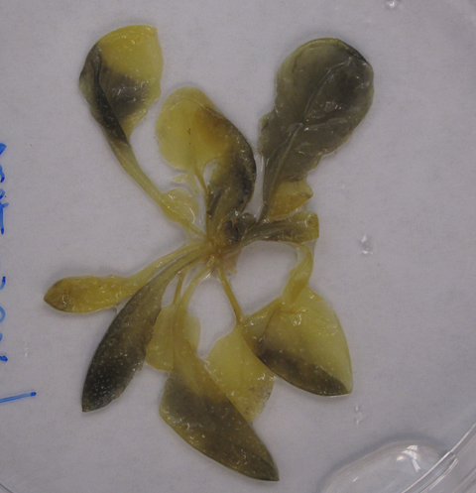
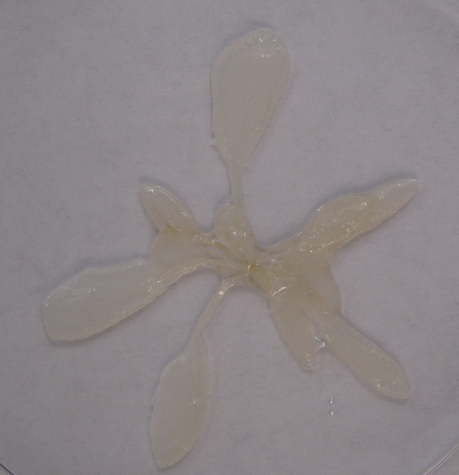
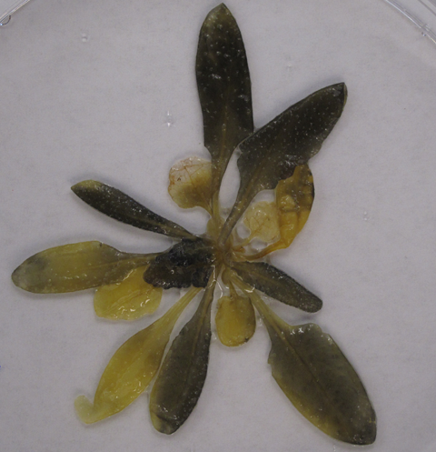
Transit Starch Content in Leaf and Developing Seeds Were Lower in ukl1 and ukl2 Mutant Plants
Col
ukl1
ukl2
8:00AM
6:00PM
*
*
*
*
DAF

Slide 12
The UTP/UDP Ratio Was Lower in The Mutants Compared With WT
ATP/ADP ratio
UTP/UDP ratio
Hours after light on

Slide 13

Network Analysis Reveal Metabolic Integration in Arabidopsis Leaf
NADH/NADPH
coumarins
Lignin
Calvin
cycle
ATP
Phe
Phe
4-coumarate
Sinapate
3CO₂
Shikimate
PEP
α-KGA
IsoCit
3-PGA
3-PGA
PEP
OAA
Asp
Glu
Cit
ukl2 > WT
DHAP
GAP
Glu
α-KGA
GAP
DHAP
Asp
ukl2 < WT
F-1,6-BP
F-1,6-BP
OAA
F-6-P
Mal
Mal
Cit
ukl2 = WT
F-6-P
G-6-P
G-6-P
Fum
Fum
R-5-P
Suc
G-1-P
PRPP
G-1-P
Mitochondrion
ATP
Uracil
OA
ADP-glucose
OMP
UTP
Starch
UMP
ADP
UKL1/2
UDP
UDP-glucose
Cellulose
Uridine
ATP
ATP
UTP
ADP
UDP
sucrose
Chloroplast
Cytoplasm

Slide 14
Messages derived from this project
UKL1 and UKL2 encode plastid isoform of uridine kinase (UK) but not uracil phosphoribosyltransferase (UPRT); both are functionally redundant.
Pyrimidine salvage activity coordinate leaf C- and N- assimilation.
Metabolic profiling in WT and ukl2 mutant plants revealed reprograming and integration of multiple metabolic pathways.
UKL1 and UKL2 are required for fixed-carbon allocation and partitioning in leaves and developing seeds.

Slide 15
Research interest
------Storage lipid remobilization during seed germination and seedling establishment
The packaging of nutrient reserves in seeds has evolved as a strategy to insure the survival of the next generation. These reserves (oil in the form of triacylglycerol, proteins, and carbohydrates) are remobilized to fuel germination and the establishment of a plant’s offspring. The seedling establishment and the hypocotyls elongation in darkness are driven by the catabolism of seed storage oil and involves the transition from a heterotrophic to a photoautotrophic seedling, which is manifested by the seedling greening and the biogenesis of a mature chloroplast. Establishment and growth of a seedling not only require the breakdown of energy-rich compounds, but also the synthesis of an array of metabolites for growth. Thus, during this transit early seedling stage, the reserve mobilization should be closely coordinated with its developmental program. Unfortunately, it still largely remains unclear how the seed carry out this metabolic integration. I made contribution to this knowledge gap by identifying a plastid isoform of triose phosphate isomerase (pdTPI), and demonstrated that pdTPI plays an essential role to integrate oil reserve mobilization with seedling establishment and chloroplast biogenesis. By understanding the mechanisms to regulate chloroplast biogenesis, one would be capable of improving the seedling vigor, and this should lead to a better growth performance of crop species.

Slide 16
Partial loss of pdTPI activity compromise seedling establishment and growth

Slide 17
Chloroplast morphology and ultrastructure altered in mutant (B,D,F,H) comparing with WT(A,C,E,G)

Slide 18
Research interest
------Membrane lipid desaturation for plant cold tolerance
Low temperature is one of the major environmental factors restricting plant geographic distribution, growing season and productivity. One strategy that plant used to combat with low temperature is to increase the membrane fluidity through the enhancement of the membrane lipid unsaturation. But the enzymes responsible for this membrane lipid desaturation remained largely unclear for a long period. By a combination of genetic, cellular, biochemical, and lipidomic approaches, I identified that a cold-inducible acyl-lipid desaturase 2 (ADS2) is playing crucial role for cold and freezing tolerance in Arabidopsis. When ADS2 gene was knocked out, the mutant plants grew much slower than WT and were also sterile under low temperature . At the biochemical level I identified that PG and MGDG are the substrates for ADS2 desaturation. The defects in membrane lipid desaturation in ads2 mutant plants were associated with their compromised growth under cold stress conditions.

Slide 19
Mutation in ADS2 resulted in reduced cold tolerance
Col
ads2-1
fad5-1
ads2-1 fad5-1
23°C
23°C
6°C
23°C
6°C

Slide 20
Schematic Representation of the Roles Played by ADS2 in MGDG and PG Biosynthesis in Arabidopsis Leaves
PE
Endoplasmic reticulum
16:0
18
DAG
PC
16:0
18
16:0
18
PI
PS
16:0
18
16:0
18
CDP-DAG
ADS2
PA
PG
PG
16(18)
16(18)
18:0
16:1
18:0
16(18)
18
18
Extraplastidic membrane
Mitochondria
Vacuoles
Plasma membrane
DAG
MGD2/3
MGDG
ADS2
MGDG
DGD2
DGDG
16(18)
16:1
18
16:0
18:1
16:1
18:1
18:1
Outer
DAG
MGD1
MGDG
ADS3
MGDG
DGD1
DGDG
18:1
16:0
18:1
16:0
18:1
16:1
18:1
16:1
Plastid
Thylakoid
Inner

Slide 21
Future directions
Expand our knowledge of metabolic regulation from model system to other important horticulture or crop species

Slide 22


Acknowledgements
Collaborators:
Dr. Jay J. Thelen
Previous and current lab member from Dr. Thelen’s lab
DuPont Pioneer
Dr. Jan Hazebroek
Dr. Vincent M. Asiago
Dr. Cathy Zhong
Kansas State University
Dr. Ruth Welti
Dr. Richard Jeannotte
Aarhus University (Denmark)
Dr. Ian Max Møller
Funding:
Swarthmore College
Dr. Nick Kaplinsky
National Laboratory of Genomics for the Biodiversity (Mexico)
Dr. Luis G. Brieba
University of Missouri
Dr. Gary Stacey
Dr. Brian P. Mooney
Dr. Dong Xu
Ms. Trupti Joshi
Dr. Mingyi Zhou
Life Sciences Fellowship to MC

Slide 23


OMICS International
www.omicsonline.org
OMICS International (and its subsidiaries), is an Open Access publisher and international conference Organizer, which owns and operates peer-reviewed Clinical, Medical, Life Sciences, and Engineering & Technology journals and hosts scholarly conferences per year in the fields of clinical, medical, pharmaceutical, life sciences, business, engineering, and technology. Our journals have more than 3 million readers and our conferences bring together internationally renowned speakers and scientists to create exciting and memorable events, filled with lively interactive sessions and world-class exhibitions and poster presentations. Join us!
OMICS International is always open to constructive feedback. We pride ourselves on our commitment to serving the Open Access community and are always hard at work to become better at what we do. We invite your concerns, questions, even complaints. Contact us at contact.omics@omicsonline.org. We will get back to you in 24-48 hours. You may also call 1-800-216-6499 (USA Toll Free) or at +1-650-268-9744 and we will return your call in the same timeframe.
Contact us at: contact.omics@omicsonline.org

