Slide 1
OMICS Group
OMICS Group International through its Open Access Initiative is committed to make genuine and reliable contributions to the scientific community. OMICS Group hosts over 400 leading-edge peer reviewed Open Access Journals and organizes over 300 International Conferences annually all over the world. OMICS Publishing Group journals have over 3 million readers and the fame and success of the same can be attributed to the strong editorial board which contains over 30000 eminent personalities that ensure a rapid, quality and quick review process. OMICS Group signed an agreement with more than 1000 International Societies to make healthcare information Open Access.
Contact us at: contact.omics@omicsonline.org

Slide 2
OMICS Journals are welcoming Submissions
OMICS Group welcomes submissions that are original and technically so as to serve both the developing world and developed countries in the best possible way.
OMICS Journals are poised in excellence by publishing high quality research. OMICS Group follows an Editorial Manager® System peer review process and boasts of a strong and active editorial board.
Editors and reviewers are experts in their field and provide anonymous, unbiased and detailed reviews of all submissions.
The journal gives the options of multiple language translations for all the articles and all archived articles are available in HTML, XML, PDF and audio formats. Also, all the published articles are archived in repositories and indexing services like DOAJ, CAS, Google Scholar, Scientific Commons, Index Copernicus, EBSCO, HINARI and GALE.
For more details please visit our website: http://omicsonline.org/Submitmanuscript.php

Slide 3
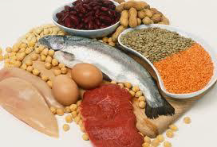
Food Proteins and Enzymes
Prof. Dr. Mohamed Fawzy Ramadan Hassanien Zagazig University, Egypt

Slide 4
Introduction to Food Proteins and Enzymes
Biological Importance of Protein
Biological Functions of Protein
Functions of Food Proteins
Sources of Food Proteins
Amino Acids (AA)
Classification of Amino Acids

Slide 5
Introduction to Food Proteins and Enzymes

Slide 6
Introduction to Food Proteins and Enzymes
Proteins play a central role in biological systems.
-Enzymes perform the biochemical processes that sustain the life of a cell/organism.
-Proteins (such as collagen and keratin) also function as structural components of cells and complex organisms.
-The functional diversity of proteins arises from their chemical makeup. Proteins are highly complex polymers, made up of 20 different amino acids.
-The constituents are linked via substituted amide bonds. The amide linkage in proteins is a partial double bond, which further underscores the structural complexity of protein polymers.
-Complicated protein structure gives rise to a multitude of three-dimensional structural forms with different biological functions.

Slide 7
Introduction to Food Proteins and Enzymes
At the elemental level, proteins contain 50–55% carbon, 6–7% hydrogen, 20–23% oxygen, 12–19% nitrogen, and 0.2–3.0% sulfur.
Protein synthesis occurs in ribosomes. After the synthesis, some amino acids are modified by cytoplasmic enzymes which changes the composition of some proteins.
Proteins that are not enzymatically modified in cells are called homoproteins, and those that are modified or complexed with nonprotein components are called conjugated proteins or heteroproteins.
The nonprotein components are referred to as prosthetic groups. -Examples of conjugated proteins include nucleoproteins (ribosomes), glycoproteins (casein), phosphoproteins (kinases, phosphorylases), lipoproteins (proteins of egg yolk, plasma proteins), and metalloproteins (hemoglobin, and several enzymes).

Slide 8
Introduction to Food Proteins and Enzymes
Proteins can be classified according to their structural organization.
Globular proteins are exist in spherical shapes, resulting from folding of the polypeptide chain(s) on itself.
Fibrous proteins are exist in rod-shapes containing twisted linear polypeptide chains (e.g., collagen, keratin, and elastin). Fibrous proteins also can be formed as a result of linear aggregation of small globular proteins, such as actin and fibrin.
A majority of enzymes are globular proteins, and fibrous proteins function as structural proteins.

Slide 9
Introduction to Food Proteins and Enzymes
Biological functions of proteins can be classified as
Enzyme catalysts,
Structural proteins,
Hormones (insulin and growth hormone),
Transfer proteins (serum albumin and hemoglobin),
Antibodies (immuno-globulins),
Storage proteins (egg albumen and seed proteins), and
Protective proteins (toxins and allergens).
Storage proteins are found in eggs and seeds. These proteins act as sources of nitrogen and amino acids for germinating seeds and embryos.
Protective proteins are a part of the defense mechanism for the survival of certain microorganisms and animals.

Slide 10
Introduction to Food Proteins and Enzymes
All biologically produced proteins can be used as food proteins. However, for practical purposes, food proteins may be defined as those that are easily digestible, nontoxic, nutritionally adequate, functionally useable in food products, and available in abundance.
Traditionally, milk, meats (including fish and poultry), eggs, cereals, and oilseeds have been the major sources of food proteins. However, because of the increase in world population, nontraditional sources of proteins for human nutrition need to be developed to meet the future demand.
The suitability of such new protein sources for use in foods, however, depends on their cost and their ability to fulfill the normal role of protein ingredients in processed and home-cooked foods.

Slide 11
Introduction to Food Proteins and Enzymes
The functional properties of proteins in foods are related to their structural and physicochemical characteristics.
A fundamental understanding of the physical, chemical, nutritional, and functional properties of proteins and the changes these properties undergo during processing is essential if the performance of proteins in foods is to be improved, and if new or less costly sources of proteins are to compete with traditional food proteins.

Slide 12
Introduction to Food Proteins and Enzymes
Enzymes are proteins with catalytic activity due to their power of specific activation and conversion of substrates to products:
Substrate(s) Product(s)
Some of enzymes are composed only of amino acids linked via peptide bonds to give proteins that range in size from about 12,000 MW to 1,000,000 MW. -Other enzymes contain additional components, such as carbohydrate, phosphate, and cofactor groups. Enzymes have all the chemical and physical characteristics of other proteins. -Composition-wise, enzymes are not different from other proteins found in nature and they comprise a small part of our daily protein intake in our foods. However, unlike other groups of proteins, they are highly specific catalysis for many chemical reactions required by living organisms.

Slide 13
Introduction to Food Proteins and Enzymes
Enzymes are synthesized in vivo by living organisms, based on expression (translation) of specific genes.
Enzymes are found in all living systems and make life possible, whether the organisms are adapted to growing near 0°C, or at 37°C (humans), or near 100°C (microorganisms found in hot springs).
Enzymes accelerate reactions by factors of thousand times.
Enzymes are highly selective for a limited number of substrates, since the substrate(s) must bind correctly into the active site before any catalysis occurs.
Enzymes control the direction of reactions, leading to specific product(s) that can be very valuable by-products for foods, nutrition, and health.

Slide 14
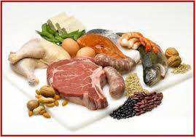
Proteins
Proteins are complex organic nitrogenous compounds of high molecular weight. Proteins are the most complex materials produced in nature.
They are consisting of α-amino acids linked together by peptide linkages.

Slide 15
Proteins
The name protein is derived from the Greek word proteios “of prime importance or the first kind” this is because proteins are the basis of the cytoplasm of cells and are present in all living organisms.
Proteins are the most abundant macromolecules in living cells and constitute 50% or more of their dry weight.

Slide 16
Proteins
Proteins are polymers of α-amino acids.
Proteins are synthesized from only 20 amino acids, known as the common amino acids.
Amino acids are formed mainly of carbon, hydrogen, oxygen and nitrogen.
Nitrogen is a characteristic component of proteins forming about 16% of their weight (i.e. 100 g of protein contains 16 g of nitrogen)

Slide 17
Biological Importance of Protein
Plasma membrane proteins (channel, carrier, pump proteins) regulate the transfer of many substances across the cell membrane
All receptors are protein in nature
All enzymes are proteins in nature
All antibodies (immuno-gobulins) are proteins in nature
Some hormones are proteins in nature (e.g. insulin and growth hormone).

Slide 18
Biological Importance of Protein (cont.)
Some proteins are protective
e.g. Keratins (skin, hair and nails) make the skin resistant to chemicals
Some proteins are supportive
e.g. Collagen; the most abundant protein in animals.
Hemoglobin is a protein carries O2 in blood.
Actin and myosin are contractile proteins found in muscle cells and responsible for muscular contraction.
Amino acids (AA) are converted to other nitrogenous substances of great physiological importance (e.g. creatine, histamine, heme, purines and pyrimidines).

Slide 19
Biological Functions of Protein
1. Catalytic function:
Nearly all chemical reactions in biological systems are catalyzed by specific enzymes.
2. Transport and storage:
For example;
Hemoglobin transports oxygen in blood.
Myoglobin carries and stores oxygen in muscle.
Albumin transports free fatty acids in blood.
Transferrin transports iron in blood.
3. Coordinated motion:
Actin and myosin are contractile proteins in muscle.

Slide 20
Biological Functions of Protein (cont.)
Structural and mechanical support:
Collagen (a fibrous protein in skin and bone).
Defense function:
Clotting factors (prevent loss of blood).
Immuno-globulins (protect against infection).
Generation and transmission of nerve impulses:
Receptor proteins (neuro-transmitters, e.g. acetyl choline), are responsible for transmitting nerve impulses.
Control of growth and differentiation:
The activities of different cells are coordinated by hormones. Many hormones are polypeptides and proteins, such as insulin and thyroid-stimulating hormone.

Slide 21
Functions of Food Proteins

Slide 22
Functions of Food Proteins
Amino acids, peptides and proteins are important constituents of food. -They supply the required building blocks for protein biosynthesis. -They contribute to the flavor of food and are precursors for aroma compounds.
They contribute, with other food compounds such as carbohydrates, to colors formed during thermal or enzymatic reactions in production, processing and storage of food.
Proteins contribute to food physical properties through their ability to build or stabilize gels, foams, emulsions and fibrillar structures. -The nutritional energy value of proteins (17 kJ/g or 4 kcal/g) is as high as that of carbohydrates.

Slide 23
Sources of Food Proteins
The most important sources of protein are grain, oilseeds and legumes, followed by meat and milk.
In addition to plants and animals, protein producers include algae (Chlorella, Spirulina spp.), yeasts and bacteria (single-cell proteins [SCP]).
Bacteria of the species Pseudomonas in aqueous methanol produce about 0.3 ton of protein per ton of alcohol.
Some products rich in protein also result from other processes, e. g., in oil and starch production.
Protein concentrates and protein isolates serve to enhance the nutritional value and to enhance of the physical properties of foods. They are added to traditional foods, such as meat and cereal products, but they are also used in the production of novel food items such as meat and milk substitutes.

Slide 24
Sources of Food Proteins (cont.)
Raw materials in which protein enrichment takes place include:
Legumes such as soybeans,
Wheat, which provide gluten as a by-product of starch production,
Potatoes; after starch production, protein isolated by thermal coagulation,
Eggs, which are processed into different products (e.g., whole egg, egg white and egg yolk products),
Milk, which supplies casein and whey protein,
Fish, which supplies protein concentrates after fat extraction,
Blood from slaughter animals, which is processed into blood meal, blood plasma concentrate and globin isolate,
Green plants grown for animal fodder, such as alfalfa, which are processed into leaf protein concentrates through the thermal coagulation of proteins.

Slide 25
Proteins
are polymer of amino acids

Slide 26
AMINO ACIDS
are the basic building blocks of
PROTEINS

Slide 27
Amino Acids (AA)
There are about 200 amino acids found in nature.
There are about 20 amino acids in a protein hydrolysate. -With a few exceptions, their general in the simplest case, R=H (aminoacetic acid or glycine). -In other amino acids, R is an aliphatic, aromatic or heterocyclic residue and may incorporate other functional groups.

Slide 28
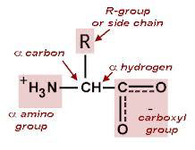
α-Amino acids are the building units of proteins.
Each α-amino acid consists of
an amino group (-NH2),
a carboxylic acid group (-COOH),
a hydrogen atom (-H) and
a side chain group (-R), all connected to a carbon atom called α- carbon atom. The α-carbon is the first carbon next to the –COOH group. -The side chain group (R) is specific and unique for each amino acid. -The R may be a hydrogen, a straight or branched-chain aliphatic group, an aromatic ring or a heterocyclic ring.

Slide 30
The R group determines the amino acid

Slide 31
Abbreviation for the 20 amino acids

Slide 32
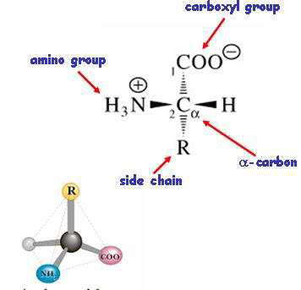
Basic amino acid structure
α-Carbon is chiral (Asymmetric
carbon) in all amino acids
except for glycine.
At pH 7 amino acids have
both +ve and -ve charges
so called dipolar ion or
zwitterions.
Amino acids have a tetrahedral structure (3D shape).

Slide 34
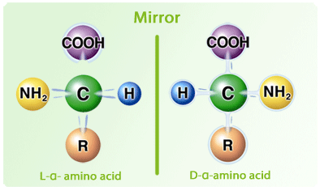
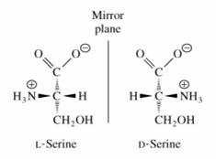
Natural amino acids are
inthe L-configuration
L and D forms are called
Optical isomers
(Stereoisomers = Enantiomers)
Biological system in all
organisms synthesize and use
only L-amino-acids

Slide 36
There are
20 amino acids
that make up
the proteins, each with
different side chain.

Slide 37
Side chains
vary in
Size, Shape, Charge,
Hydrogen-bonding capacity, and
Chemical reactivity

Slide 38
Classification of Amino Acids
Side chain (R group) classification.
Biological classification.
Metabolic classification.

Slide 39
1-Side Chain (R group) Classification
CHEMICAL CLASSIFICATION -The amino acids are classified according to the chemical structure of the side chain (R) into:
Aliphatic
Hydroxy
Sulfur containing
Aromatic
Acidic
Basic
Imino acids

Slide 40
Side Chain Classification Glycine

Slide 41
Non Polar (hydrophobic) Amino Acids
Side chains of non polar (hydrophobic) amino acids can not participate in hydrogen or ionic bonds, but they form hydrophobic interactions.
In aqueous environment, non polar amino acids tend to be present in the interior of proteins.
Non polar (hydrophobic) amino acids include: -Amino acids with aliphatic R group (glycine, alanine). -Amino acids with aliphatic branched R group (valine, leucine and isoleucine). -Amino acids with aromatic R group (phenylalanine, tryptophan). -Amino acids with sulfur containing R group (methionine). -Imino acid (proline).

Slide 42
Amino acids with non polar side chains (Aliphatic)
Glycine(Gly - G)
Alanine (Ala – A)

Slide 43
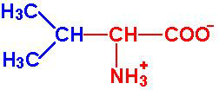
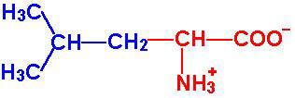
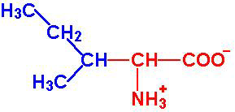
Amino acids with non polar side chains (branched chains, aliphatic)
Valine (Val – V)
Leucine (Leu – L)
Isoleucine (Ile – I)

Slide 44
Amino acids with non polar side chains (Aromatic)
Phenylalanine (Phe – F)
Tryptophan (Trp – W)

Slide 45
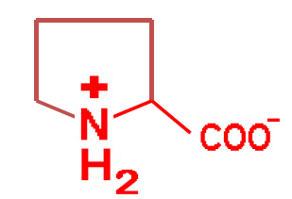
Amino acids with non polar side chains (imino)
Proline (Pro – P)

Slide 46
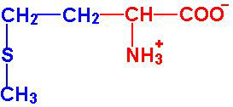
Amino acids with non polar side chains (sulfur containing)
Methionine (Met – M)

Slide 47
Polar (hydrophilic) Amino Acids
Side chains of polar (hydrophilic) amino acids can participate in hydrogen or ionic bonds.
Therefore, in aqueous environment polar amino acids tend to be present on the surface of proteins.
Polar (hydrophilic) amino acids are classified into: 1. Polar charged amino acids:
Acidic amino acids (aspartic & glutamic acids) and Basic amino acids (arginine, lysine, histidine)
2.Polar uncharged amino acids:
Amino acids with OH group (serine, threonine, tyrosine) Amino acids with SH group (cysteine)
Amino acids with amide group (glutamine, asparagine)

Slide 48
Amino acids with polar charged side chains (acidic group)
Aspartic acid (Asp – D)
Glutamic acid (Glu – E)

Slide 49
Amino acids with polar charged side chains (basic group)
Lysine (Lys – K)
Arginine (Arg – R)
Histidine (His – H)

Slide 50
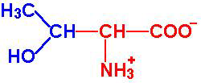
Amino acids with polar uncharged side chains (with OH group)
Serine (Ser – S)
Tyrosine (Tyr – Y)
Threonine (Thr – T)

Slide 51
Amino acids with polar uncharged side chains (with SH group)
Cysteine (Cys – C)

Slide 52
Amino acids with polar uncharged side chains (with amide group)
Asparagine (Asn – N)
Glutamine (Gln – Q)

Slide 53
2-Biological (Nutritional) classification
On nutritional basis AA are classified into essential or non-essential AA.
1- Non essential amino acids:
Amino acids that could be synthesized in the body, so they are not needed in the diet. They are 10 AA.
2- Essential amino acids:
Amino acids that could not be synthesized in the body, so they have to be taken in the diet, and their deficiency results in diseases.
The essential amino acids are not more important to our body than the non-essential amino acids.
Both (all 20 AA) are equally needed and equally essential for the normal growth and good health.

Slide 54
Biological classification

Slide 55
3-Metabolic classification (According to their metabolic fate in the body )
Glucogenic amino acids:
Amino acids that can give glucose.
Ketogenic amino acids:
Amino acids that can give ketone bodies.
Glucogenic/Ketogenic (mixed) amino acids:
Amino acids that can give both ketone bodies and glucose.

Slide 56
Metabolic and biological classification

Slide 57
Amino Acid deficiency in selected Vegetables and Grains

Slide 58
Related Journals of Journal of Food Processing & Technology
Nutritional Disorders & Therapy
Vitamins & Minerals
Nutrition & Food Sciences

Slide 59
Journal of Food Processing & Technology Related Conferences
4th International Conference and Exhibition on Food Processing & Technology

Slide 60
OMICS Group Open Access Membership
OMICS publishing Group Open Access Membership enables academic and research institutions, funders and corporations to actively encourage open access in scholarly communication and the dissemination of research published by their authors.
For more details and benefits, click on the link below:
http://omicsonline.org/membership.php

