Slide 1
Dr Md Enamul Hoque Associate Professor Department of Mechanical, Materials & Manufacturing Engineering University of Nottingham Malaysia Campus
Editorial Board Member
Automatic Control of Physiological State and Function

Slide 2
CAREER HISTORY
January 2011 – To date Associate Professor, Department of Mechanical, Materials & Manufacturing Engineering; University of Nottingham Malaysia Campus
August 2007 – December 2010 Assistant Professor, Department of Mechanical, Materials & Manufacturing Engineering; University of Nottingham Malaysia Campus
May 2000 – July 2007 Research Scholar, Division of Bioengineering, Department of Mechanical Engineering National University of Singapore
March 1999 – April 2000 System Support Engineer, Spectra Solutions Limited, Bangladesh

Slide 3
RESEARCH INTEREST
Rapid Prototyping Technology
Biomaterials
Tissue Engineering
Stem Cells
Bioenergy
Polymeric Composites
Nanomaterials
Food Technology

Slide 4
RECENT PUBLICATIONS (Selected)
Md Enamul Hoque, Terrence Teh Hooi Meng, Leng Chuan Yong, Moniruddin Chowdhury, Gunnaeswara Prasad Rangabhatala. Hybrid 3D scaffolds for potential tissue engineering applications: Fabrication and characterization. Materials Letters, Vol. 131, pp. 255, 2014;doi: http://dx.doi.org/10.1016/j.matlet.2014.05.111
Azizeh-Mitra Yousefi, Md Enamul Hoque, R.G.S.V.Prasad, Nicholas Uth. Current Strategies in Gradient-based Scaffold Design for Osteochondral Tissue Engineering: A Review. Journal of Biomedical Materials Research: Part A (Published online on 01 October 2014); DOI: 10.1002/jbm.a.35356
M. Enamul Hoque, M. A. I. M. Aminudin, M. Jawaid, M. S. Islam, Naheed Saba, M. T. Paridah. Physical, Mechanical, and Biodegradable Properties of Meranti Wood Polymer Composites. Materials and Design, Vol. 64, pp. 743, 2014.
http://dx.doi.org/10.1016/j.matdes.2014.08.024
Sheikh Imranudin Sheikh-Ali, Akil Ahmad, Siti-Hamidah Mohd-Setapar, Zainul Akmal Zakaria, Norfahana Abdul-Talib, Aidee Kamal Khamis, Md Enamul Hoque. The Potential Hazards of Aspergillus sp. in Food and Feeds, and the Role of Biological Treatment: A Review. Journal of Microbiology, Vol. 52(10), pp. 807-818, 2014; DOI: 10.1007/s12275-014-4294-7
Sheik Mohideen Mohamed Nainar, Shahida Begum, M. N. M. Ansari, Md. Enamul Hoque, S. Sharen Aini, M. H. Ng, B. H. I. Ruszymah. Effect of compatibilizers on in vitro biocompatibility of PLA-HA bioscaffold. Bioinspired, Biomimetic and Nanobiomaterials (Published online on 07 August 2014); DOI: 10.1680/bbn.14.00014

Slide 5
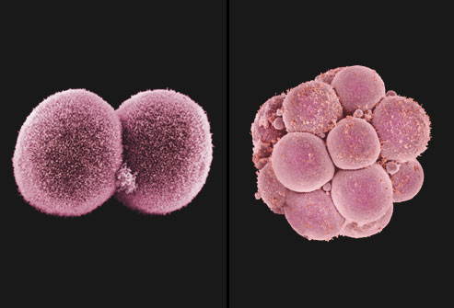
STEM CELLS

Slide 6
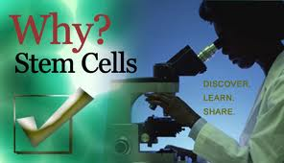
STEM CELLS
The body is made up of about 200 different kinds of specialised cells such as muscle cells, nerve cells, fat cells and skin cells etc.
All cells in the body come from stem cells
A stem cell is a cell that is not yet specialised
The process of specialisation is called differentiation
Once the differentiation pathway of a stem cell has been decided, it can no longer become another type of cell on its own

Slide 7
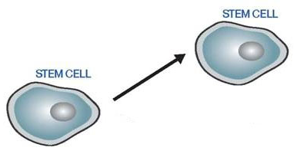
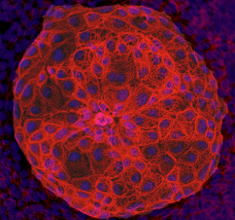
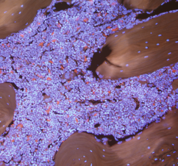
Why are Stem Cells Special?
Stem cells can:
self-renew to make more stem cells
differentiate into a specialized cell type
Stem cells that can become many types of cells in the body are called pluripotent
Stem cells that can become only a few types of cells are called multipotent
Embryonic stem cells (pluripotent)
Tissue stem cells (multipotent)
Notes:
This slide explains the basic properties of stem cells and introduces the concept of classification based on potency.

Slide 8
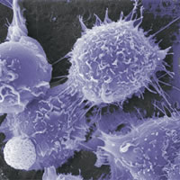
A Life Story…
Notes:
A life story…
Human development starts with just 1 cell – the fertilized egg. This cell divides to produce 2 ‘daughter cells’. These daughters divide, and their daughters divide again, and so on. There are a great many steps needed to form an adult body, or even a baby. Along the way, lots of different types of cells must be made.

Slide 9
Stem Cell History
1998 - Researchers first extract stem cells from human embryos
1999 - First Successful human transplant of insulin-making cells from cadavers
2001 - President Bush restricts federal funding for embryonic stem-cell research
2002 - Juvenile Diabetes Research Foundation International creates $20 million fund-raising effort to support stem-cell research
2002 - California ok stem cell research
2004 - Harvard researchers grow stem cells from embryos using private funding
2004 - Ballot measure for $3 Billion bond for stem cells

Slide 10
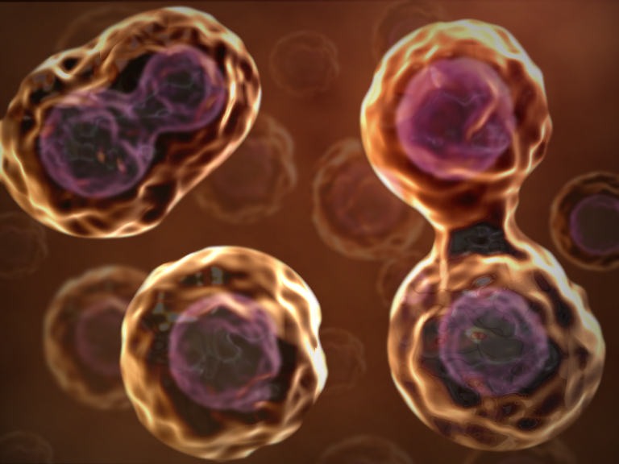
Stem Cell –Definition
A cell that has the ability to continuously divide and differentiate (develop) into various other kind(s) of cells/tissues

Slide 11
Kinds of Stem Cells
Stem Cell Type | Description | Examples
Totipotent | Each cell can develop into a new individual cell | Cells from early (1-3 days) embryos
Pluripotent | Cells can form any (over 200) cell types | Some cells of blastocyst (5 to 14 days)
Multipotent | Cells can form only a few types of cells | Fetal tissue, cord blood, and adult stem cells
Notes:
11
Stem cells can be classified into three broad categories, based on their ability to differentiate. Totipotent stem cells are found only in early embryos. Each cell can form a complete organism (e.g., identical twins). Pluripotent stem cells exist in the undifferentiated inner cell mass of the blastocyst and can form any of the over 200 different cell types found in the body. Multipotent stem cells are derived from fetal tissue, cord blood and adult stem cells. Although their ability to differentiate is more limited than pluripotent stem cells, they already have a track record of success in cell-based therapies. Here is a current list of the sources of stem cells:
Embryonic stem cells - are harvested from the inner cell mass of the blastocyst seven to ten days after fertilization.
Fetal stem cells - are taken from the germline tissues that will make up the gonads of aborted fetuses.
Umbilical cord stem cells - Umbilical cord blood contains stem cells similar to those found in bone marrow.
Placenta derived stem cells - up to ten times as many stem cells can be harvested from a placenta as from cord blood.
Adult stem cells - Many adult tissues contain stem cells that can be isolated.

Slide 12
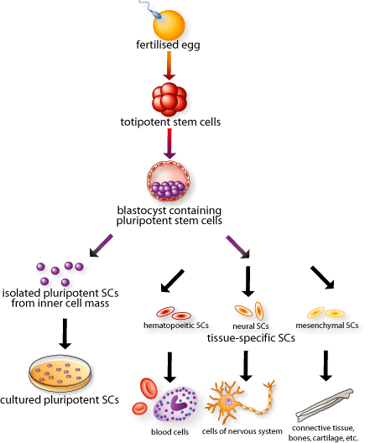
Totipotent
This cell
Can form the
Embryo and placenta
Pluripotent
This cell
Can just form the
embryo
Multi-
potent
Fully mature
Notes:
12
CLICK! This diagram will eventually show the entire range of development, from fertilized egg to mature cell types in the body.
Each cell in the 8-cell embryo, here in red, can generate every cell in the embryo as well as the placenta and extra-embryonic tissues. These cells are called CLICK! TOTIPOTENT stem cells. Why are they called totipotent? (wait for answers) Because one red cell can potentially make all necessary tissues for development. CLICK!
During In Vitro Fertilization, can parents choose whether their baby is going to be a boy or a girl? (wait) Yes, there is a widely-practiced procedure called pre-implantation genetic diagnosis, where one cell is removed from the 8-cell embryo and its DNA is examined. What might you look for when trying to identify the embryo’s sex? (wait) If there’s an X and Y chromosome it’s a boy and if there are two X’s it’s a girl. The parents can decide whether to implant it. Also parents with a genetic disease might want to see if their baby has any identifiable genetic disorders and decide whether to implant based on this information. Pre-implantation genetic diagnosis doesn’t destroy the embryo. Scientists are attempting to adapt this pre-implantation genetic diagnosis procedure and use it to create a stem cell line from one single TOTIPOTENT cell, without destroying the embryo.
The embryonic stem cells inside the blastocyst, here in purple, can generate every cell in the body except placenta and extra-embryonic tissues. These are called CLICK! PLURIPOTENT stem cells…why? (wait for answers) Because they can differentiate into all the 200+ cell types in the body, but they do not form the placenta. CLICK! Pluripotent stem cells can be isolated and grown in culture, or left to develop into more specialized cells in the body.
CLICK! Adult stem cells or tissue-specific stem cells have restricted lineages. Adult stem cells show up when the three distinct layers form in the 14-day-old embryo, and are present in the fetus, baby, child, and so forth. Adult just means they’ve gone further down their lineage pathway than the initial stem cells in the embryo. They are called CLICK! MULTIPOTENT stem cells because they will only become mature cells from the tissue in which they reside. Adult stem cells are present throughout your life and replace fully mature CLICK!, yet damaged and dying cells.
So to review (if time): TOTIPOTENT stem cells come from embryos that are less than 3 days old. These cells can make the TOTAL human being because they can form the placenta and all other tissues. PLURIPOTENT stem cells come from embryos that are 5-14 days old. Embryos and fetuses that are older than 14 days DO NOT contain pluripotent cells. These cells can form every cell type in the body but not the placenta. MULTIPOTENT stem cells are also called adult stem cells and these appear in the 14 day old embryo and beyond. At this point these stem cells will continue down certain lineages and CANNOT naturally turn back into pluripotent cells or switch lineages.

Slide 13
Kinds of Stem Cells
Embryonic stem cells
five to six-day-old embryo
Tabula rasa
Embryonic germ cells
derived from the part of a human embryo or fetus that will ultimately produce eggs or sperm (gametes).
Adult stem cells
undifferentiated cells found among specialized or differentiated cells in a tissue or organ after birth
appear to have a more restricted ability to produce different cell types and to self-renew.

Slide 14
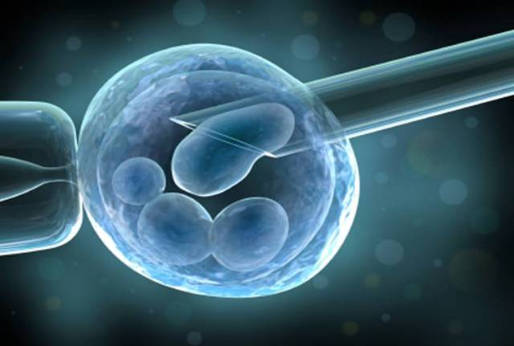
Embryonic Stem Cells
Mainly from IVF

Slide 15
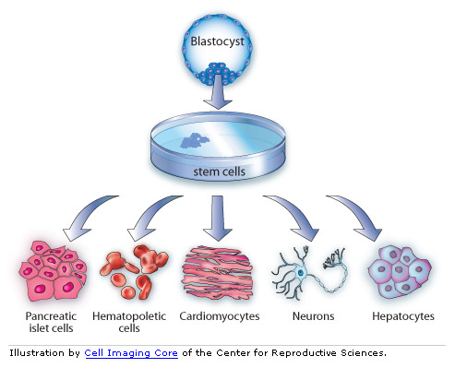
Pluripotent Stem Cells –More potential to become any type of cell

Slide 16
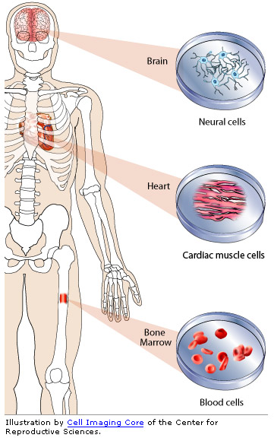
Multipotent stem cells
Multipotent stem cells – limited in what the cells can become

Slide 17
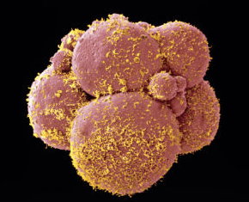
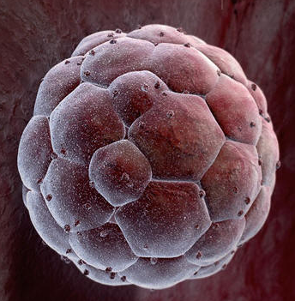
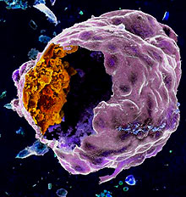
Stages of Embryogenesis
cleavage
8-cell stage
blastocyst
Blastocyst inner mass cells
Notes:
17
The early stages of embryogenesis are the point at which embryonic stem cell lines are derived. The fertilized egg (day 1) undergoes cell division to form a 2-cell embryo, followed by 4-cell, etc. until a ball of cells is formed by the fourth day. The ball becomes hollow, forming the blastocyst. This is the stage at which pluripotent embryonic stem cell lines are generated. Following the blastocyst stage, the tissues of the embryo start to form and the cells become multipotent.

Slide 18
Approved By
M. Enamul Hoque

Slide 19
OMICS International Open Access Membership
OMICS International Open Access Membership enables academic and research institutions, funders and corporations to actively encourage open access in scholarly communication and the dissemination of research published by their authors. For more details and benefits, click on the link below:
http://omicsonline.org/membership.php

