Slide 1
OMICS Journals are welcoming Submissions
OMICS International welcomes submissions that are original and technically so as to serve both the developing world and developed countries in the best possible way.
OMICS Journals are poised in excellence by publishing high quality research. OMICS International follows an Editorial Manager® System peer review process and boasts of a strong and active editorial board.
Editors and reviewers are experts in their field and provide anonymous, unbiased and detailed reviews of all submissions.
The journal gives the options of multiple language translations for all the articles and all archived articles are available in HTML, XML, PDF and audio formats. Also, all the published articles are archived in repositories and indexing services like DOAJ, CAS, Google Scholar, Scientific Commons, Index Copernicus, EBSCO, HINARI and GALE.
For more details please visit our website: http://omicsonline.org/Submitmanuscript.php

Slide 2
Munvar Miya Shaik Human Genome Centre School of Medical Sciences Universiti Sains Malaysia

Slide 3
Biography
Munvar Miya Shaik has Bachelor degree in Pharmacy and Medical Master degree in Medical Pharmacology. His PhD thesis was focused on Neurogenetics especially focusing on migraine genetics.
He has vast experience in teaching medical pharmacology to Medical and dental students.
Currently his research is focused on Migraine genetics.
He is also involved in Alzheimer's and Parkinson diseases research clusters.
He has published various research articles in high impact factor journals.
Currently he is located in Universiti Sains Malaysia, Kelantan, Malaysia.

Slide 4
Research interest
Neurogenetics focused on Neuro-degenarative disorders
Role of microRNA as biomarker and therapeutic target in Neuro-degenarative disorders
Pharmacoepigenomics of Migraine
Therapeutic targets from Traditional medicines to treat Neuro-degenarative disorders
Epigenetics of Neuro-degenarative disorders

Slide 5
Recent publications
2014 - 2012
MM Shaik, NB Hassan, HL Tan, SH Gan. Validity and Reliability of the Bahasa Melayu Version of the Migraine Disability Assessment Questionnaire. Biomed Research International, Volume 2014 (2014). http://www.hindawi.com/journals/bmri/2014/435856/ [ISI Indexed] (Available in Pubmed)
MM Shaik, HL Tan, SH Gan. Do folate, vitamins B₆ and B₁₂ play a role in the pathogenesis of migraine?: the role of pharmacoepigenomics. CNS & Neurological Disorders Drug Targets, 2014;13(5):828-35. [ISI Indexed] (Available in Pubmed)
MM Shaik, S Ahmed, SH Gan, AM Abuzenadah, E Ahmad, S Tabrez, F Ahmad, MA Kamal. How do periodontal infections affect the progression of type 2 diabetes and Alzheimer’s disease? CNS & Neurological Disorders Drug Targets, 2014, 13 (3), 460-466. [ISI Indexed] (Available in Pubmed)
MM Shaik, SH Gan, MA Kamal. Epigenomic approach in understanding of Alzheimer Diseases and type 2 Diabetes. CNS & Neurological Disorders Drug Targets, 2014, 13 (2), 283-289. [ISI Indexed] (Available in Pubmed)
MM Shaik. Enzymes as therapeutic agents in Alzheimer’s Disease (Editorial). Journal of Bimolecular Research & Therapeutics, 2014, 3:2 (Available in Google Scholar)
M Rasool, A Malik, A Qazi, IA Sheikh, A Manan, MH Qazi, A Chaudhary, AM Abuzenadah, M Asif, MH Alqahtani, SH Gan, MM Shaik, MA Kamal. Current view from Alzheimer’s disease to type 2 diabetes mellitus. CNS & Neurological Disorders Drug Targets, 2014, 13 (3), 533-542. [ISI Indexed, IF=3.810] [ISI Indexed] (Available in Pubmed)

Slide 6
Recent publications
M Arifullah, P Vikram, KK Chiruvella, MM Shaik, I Husna. A review on Malaysian plants used for screening of Antimicrobial activity. Annual Research & Review Biology, 4(13):2088-2132, 2014.
MM Shaik, NB Hassan, HL Tan, S.Bhaskar, SH Gan. Reliability and Validity of Malaysian Language Translated Version of Migraine Disability Assessment (MIDAS) Questionnaire – Late Breaking Abstracts of the 2013 International Headache Congress. Cephalalgia 33(11). 970-971. [ISI Indexed] (Available in Pubmed)
H Iftikhar, I Ahmad, SH Gan, MM Shaik, N Iftikhar, MS Nawaz, MA Kamal. Quinoline derivatives: candidate drugs for a class B G-protein coupled receptor, the Calcitonin gene related peptide receptor, a cause of migraines. CNS & Neurological Disorders Drug Targets, 2014. [ISI Indexed] (Available in Pubmed)
Shaik MM, Gan SH. Rapid resolution liquid chromatography method development and validation for the simultaneous determination of homocysteine, vitamin B₆, B₉ and B₁₂ in human serum. Indian Journal of Pharmacology. April 2013, 2013, 45(2), 159-167. [ISI Indexed] (Available in Pubmed)
R Basri, MM Shaik, MK Alam, MBA Mondol, QD Mohammad, SH Gan. Waist to hip ratio, waist to height ratio and body mass index predict stroke risk in a Bangladeshi population. International Medical Journal, 12/2013; 20(6):740-743. [ISI Indexed] (Available in Pubmed)
Shaik MM, Loo KW, Gan SH. Burden of stroke in Nepal. International Journal of Stroke, 2012, 7(6) :517-20 [ISI Indexed] (Available in Pubmed)

Slide 7
Pharmacoepigenomics of Migraine
Over the years, many pathological theories related to migraine were published
However, Migraine is not understood completely in view of Treatment
Various factors, such as alcohol, smoking, nutrition, stress, environmental changes, exercises and menstrual cycles in women, have been reported to play a role in causing migraines

Slide 8
Why ?
However, the Question is
Why certain precipitator cause migraine in some patients but not others ?
This is still UNKNOWN

Slide 9
Genetics
But there is a role of genetic vulnerability in selective physiological alterations.
This provides an opportunity to investigate the genetic basis of migraines based on previously published pathological theories of migraines due to migraine’s heritable nature.

Slide 10
Genetics
Based on Cortical Spreading Depression and other theories
Vascular Genes
(Related to blood vessels)
Based on Hormonal affect on Migraine
Hormonal Genes
(Related to Estrogen)

Slide 11
Vascular Genes
Homocysteine
Highly reactive amino acid
Higher levels of Homocysteine
Endothelial cell injury
(Research done in animals and cell lines)
↓↓ Vit. B₆, B₉ & B₁₂
(For methylation & Conjugation of HCY)
↑↑ Nitric Oxide
Diet
MTHFR Enzyme
(Methylene tetrahydro folate reductase)
MTHFR Gene
(Harker, Ross et al. 1976; Wall, Harlan et al. 1980); (Stamler, Osborne et al. 1993); (Cooke and Tsao 1994); (Hering-Hanit, Gadoth et al. 2001

Slide 12
Migraine
Higher levels of Homocysteine
Low levels of Vitamin B₆, B₉ and B₁₂
MTHFR gene defect

Slide 13
Vitamins B for Migraine ?
Lowering Homocysteine levels
Intake of Vit. B₆, B₉ & B₁₂
MTHFR gene defect
↓↓ Migraine disability

Slide 14
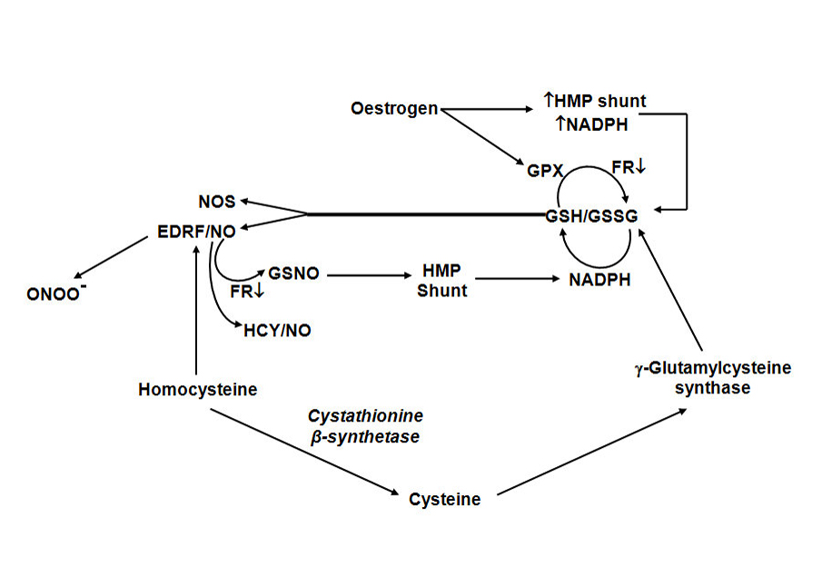
Estrogen & Homocysteine
MM Shaik, HL Tan, SH Gan. Do folate, vitamins B₆ and B₁₂ play a role in the pathogenesis of migraine?: the role of pharmacoepigenomics. CNS & Neurological Disorders Drug Targets, 2014;13(5):828-35. [ISI Indexed] (Available in Pubmed)

Slide 15
Estrogen & Vitamins
Vitamin B₆ → decrease the biological activities of oestrogen.
Vitamins B₆, B₁₂ and folate are key cofactors of the enzymes implicated in oestrogen conjugation and methylation.
Therefore, diminished concentrations of B vitamins can upset oestrogen detoxification and cause higher levels of circulating oestrogen

Slide 16
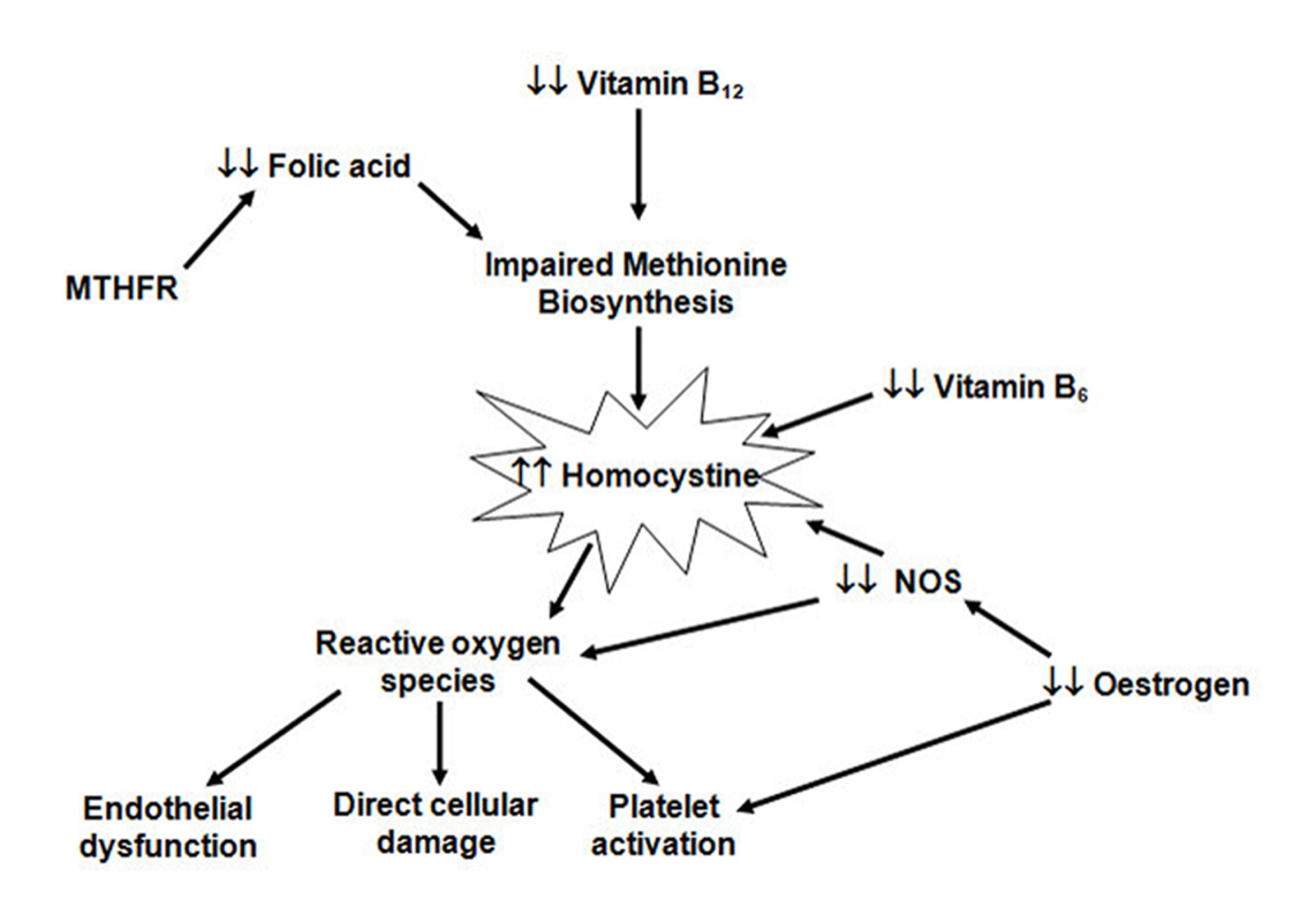
Estrogen & Homocysteine
MM Shaik, HL Tan, SH Gan. Do folate, vitamins B₆ and B₁₂ play a role in the pathogenesis of migraine?: the role of pharmacoepigenomics. CNS & Neurological Disorders Drug Targets, 2014;13(5):828-35. [ISI Indexed] (Available in Pubmed)

Slide 17
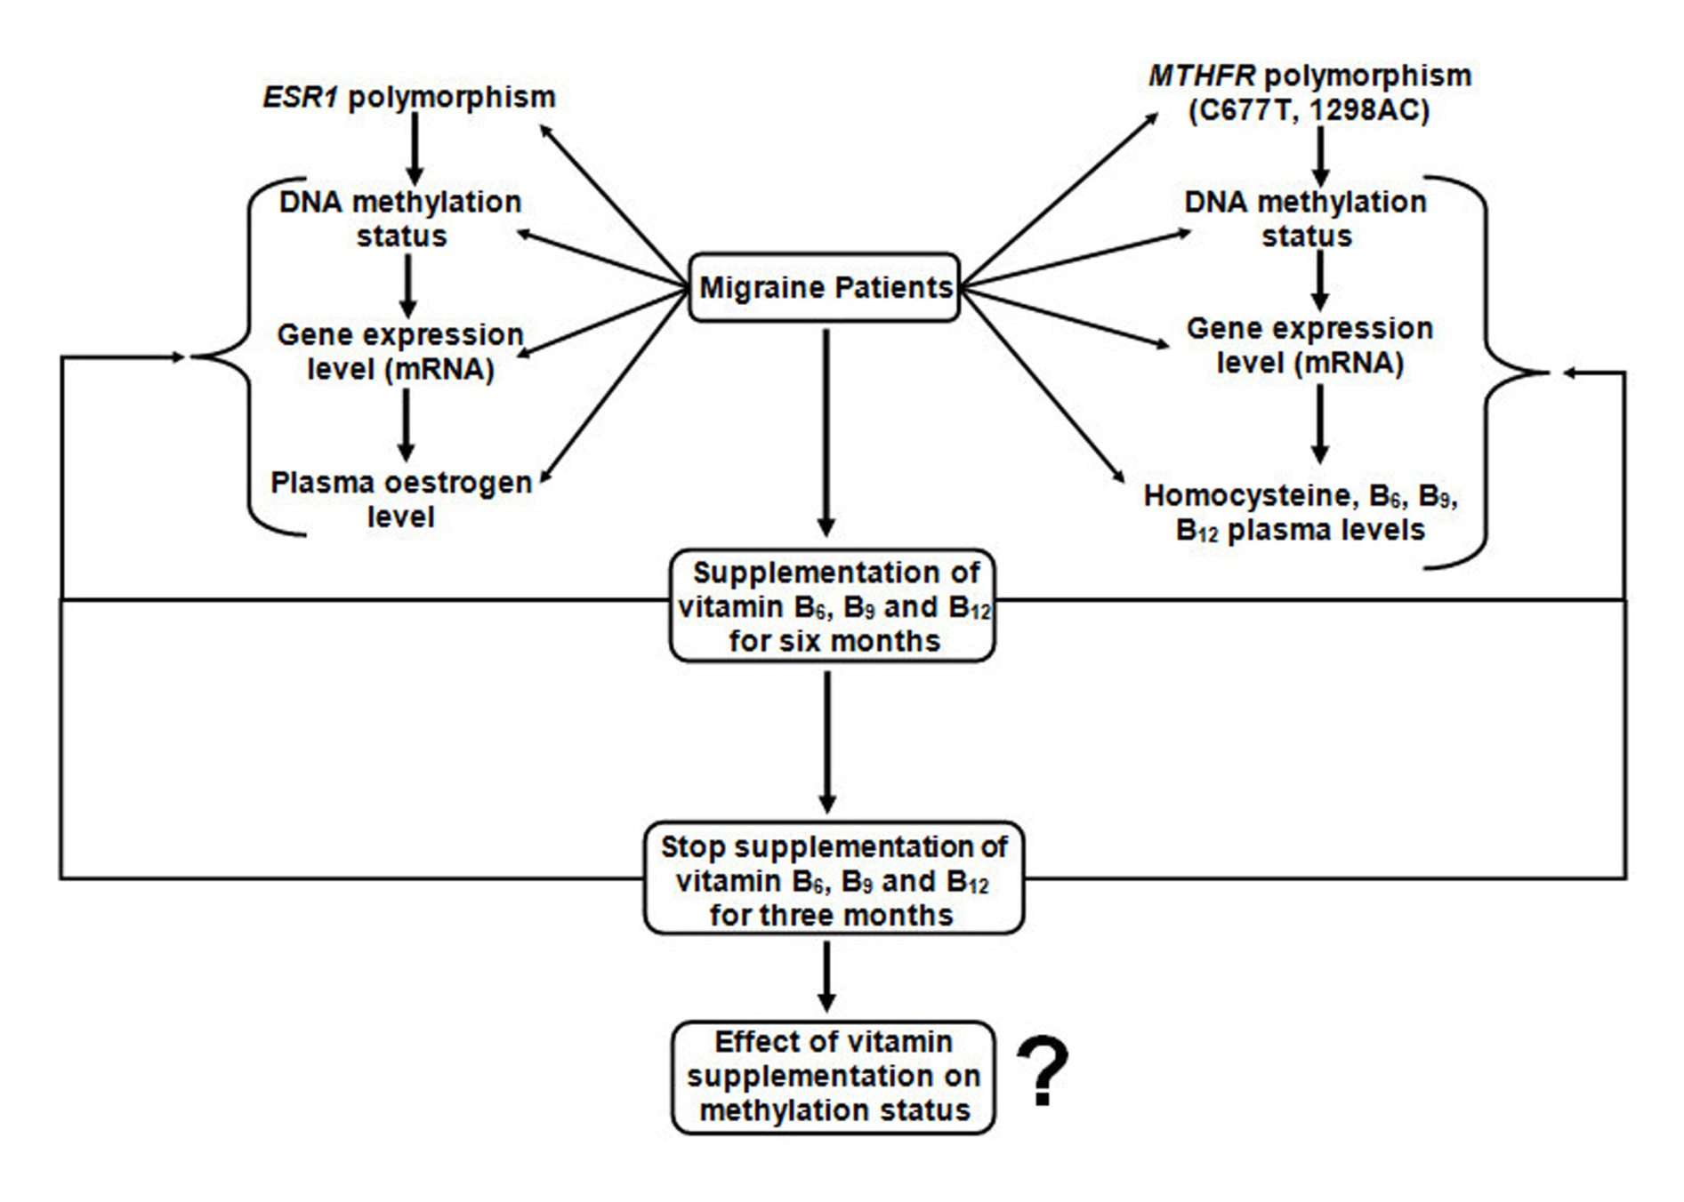
Estrogen & Homocysteine
MM Shaik, HL Tan, SH Gan. Do folate, vitamins B₆ and B₁₂ play a role in the pathogenesis of migraine?: the role of pharmacoepigenomics. CNS & Neurological Disorders Drug Targets, 2014;13(5):828-35. [ISI Indexed] (Available in Pubmed)

Slide 18
Hypothesis
The role of epigenetics in migraine is a new, unexplored field that has pharmacological implications.
The proposed study of vitamin supplements aims to examine the reduction of homocysteine levels associated with the MTHFR C677T polymorphism in migraine patients.
It would also be interesting to study the DNA methylation profiles of the promoter regions of candidate genes in migraine patients to better explain migraine occurrence.

Slide 19
Munvar Miya Shaik Human Genome Centre School of Medical Sciences, Universiti Sains Malaysia Kubang Kerian, 16150 Kelantan, Malaysia H/P: +60-10-9227448 Email: munvar.shaik@gmail.com http://scholar.google.com/citations?user=JeSDTZ0AAAAJ&hl=en
SIGNATURE

Slide 20
JOURNALS
1.Molecular Pharmaceutics & Organic Process Research
http://esciencecentral.org/journals/molecular-pharmaceutics-organic-process-research.php
2. Clinical Pharmacology & Biopharmaceutics
http://omicsgroup.org/journals/clinical-pharmacology-biopharmaceutics.php

Slide 21
OMICS International Open Access Membership
Open Access Membership with OMICS International enables academicians and research institutions, funders and corporations to actively encourage open access in scholarly communication and the dissemination of research published by their authors.
For more details and benefits, click on the link below:
http://omicsonline.org/membership.php

