Slide 1
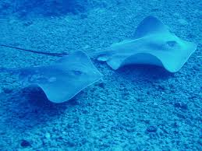
NAGENDRA SASTRY YARLA Department of Biochemistry GITAM UNIVERSITY India
Journal of Marine Science: Research & Development
ISSN: 2155-9910
Editorial Board Member
Journal of Marine Science: Research & Development

Slide 2
BIOGRAPHY
Dr. Sastry has completed his Secondary School Education from Board of Secondary Education, Andhra Pradesh in 2003 with 80 percentage and studied his Higher Secondary Education from Board of Intermediate Education, Andhra Pradesh in 2005 with 60 percentage and got into his BSc in Biotechnology, Biochemistry and Microbiology from Andhra University in 2008 with 68 percentage and achieved his masters M.Sc Biochemistry from GITAM University, Visakhapatnam in 2011 with 8.68 CGPA and currently doing his PhD in Gitam university, Visakhapatnam, India

Slide 3
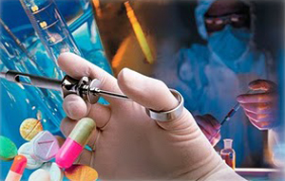
RESEARCH INTEREST
Cancer therapeutics
Human Infections
Immunology
Phytochemistry
Pharmacology
Enzymology
Drug Design.

Slide 4
Pharmacology
DEFINITIONS:
Pharmacology is the study of how drugs exert their effects on living systems.
Pharmacologists work to identify drug targets in order to learn how drugs work. Pharmacologists also study the ways in which drugs are modified within organisms.
In most of the pharmacologic specialties, drugs are also used today as tools to gain insight into both normal and abnormal function.

Slide 5
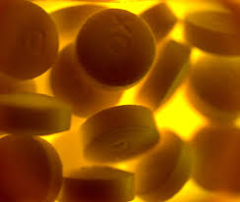
Pharmacology
Divisions of Pharmacology
Pharmacokinetics
Pharmacodynamics
Pharmacogenomics

Slide 6
Pharmacokinetics
Is what the body does to the drug.
The magnitude of the pharmacological effect of a drug depends on its concentration at the site of action.
Absorption
Distribution
Metabolism
Elimination

Slide 7
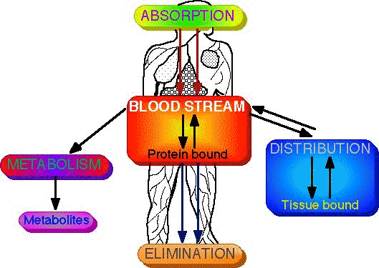
Pharmacokinetics

Slide 8
Pharmacodynamics
Is what the drug does to the body.
Interaction of drugs with cellular proteins, such as receptors or enzymes, to control changes in physiological function of particular organs.
Drug-Receptor Interactions
Binding
Dose-Response
Effect
Signal Transduction
Mechanism of action, Pathways

Slide 9
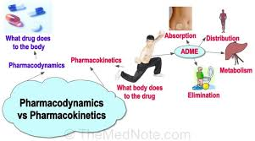

Slide 10
Pharmacogenetics
Area of pharmacology concerned with unusual responses to drugs caused by genetic differences between individuals.
Responses that are not found in the general population, such as general toxic effects, allergies, or side effects, but due to an inherited trait that produces a diminished or enhanced response to a drug.
Differences in Enzyme Activity
Acetylation polymorphism
Butylcholinesterase alterations
Cytochrome P450 aberration

Slide 11
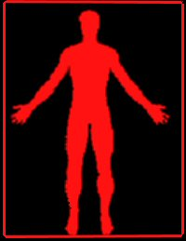
Drugs
HOWARD UNIVERSITY
Drugs can be defined as chemical agents that uniquely interact with specific target molecules in the body, thereby producing a biological effect.
Drugs can be stimulatory or inhibitory

Slide 12
Drugs
Drugs, as well as hormones, neurotransmitter, autocoids and toxins can make possible the transfer of information to cells by interaction with specific receptive molecules called “receptors”.
DRUG
Receptor

Slide 13
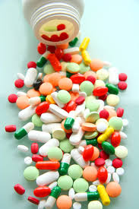
Drugs
Drugs interact with biological systems in ways that mimic, resemble or otherwise affect the natural chemicals of the body.
Drugs can produce effects by virtue of their acidic or basic properties (e.g. antacids, protamine), surfactant properties (amphotericin), ability to denature proteins (astringents), osmotic properties (laxatives, diuretics), or physicochemical interactions with membrane lipids (general and local anesthetics).

Slide 14
Receptors
Most drugs combine (bind) with specific receptors
to produce a particular response. This association or binding takes place by precise physicochemical and steric interactions between specific groups of the drug and the receptor.
Proteins
Carriers
Receptors
G protein-linked
Ligand gated channels
Intracellular
Enzymes
DNA

Slide 15
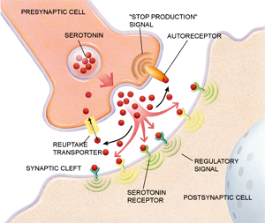
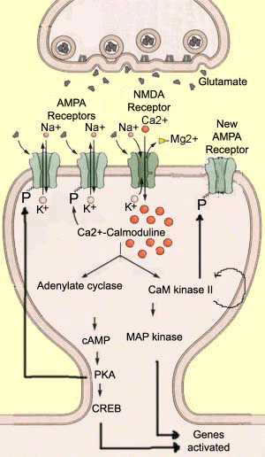
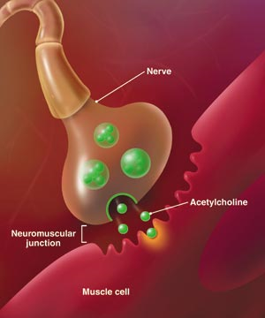
Endogenous compounds act on their Receptors
Neurotransmitter
Neuropeptides
Hormones
Ions

Slide 16
Receptor
Classification of Receptors
Pharmacological
Mediator (i.e. Insulin, Norepinephrine, estrogen)
Biophysical and Biochemical
Second messenger system (i,.e. cAMP, PLC, PLA)
Molecular or Structural
Subunit composition (i.e. 5HT1A )
Anatomical
Tissue (i.e muscle vsganglionicnAChRs)
Cellular (i.e. Membrane bound vs Intracellular)

Slide 17
Types of Receptors
MEMBRANE BOUND RECEPTORS
G-Protein-linked receptors
Serotonin, Muscarinic, Dopaminergic, Noradrenergic
Enzyme receptors
Tyrosine kinase
Ligand-gated ion channel receptors
Nicotinic, GABA, glutamate
INTRACELLULAR AND NUCLEAR RECEPTORS
Hormone receptors
Autocoid receptors
Growth factors receptors
Insulin receptors

Slide 18
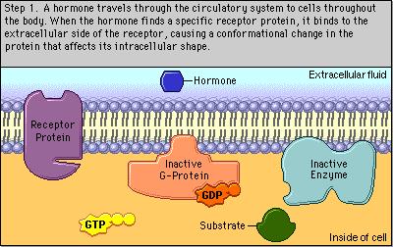
G Protein–linked Receptors

Slide 19
Enzyme-like Receptors

Slide 20
Ligand-gated Ion-Channel Receptors

Slide 21
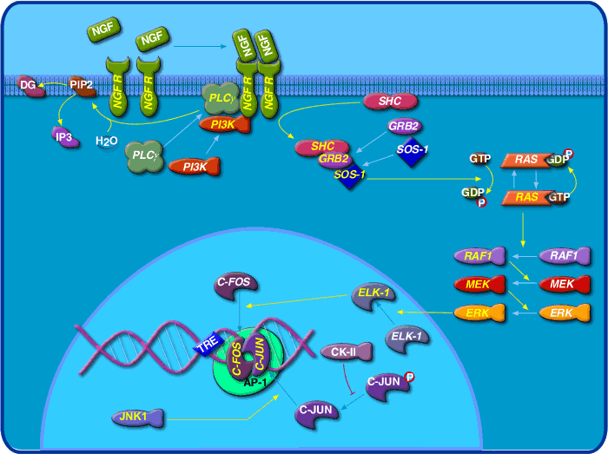
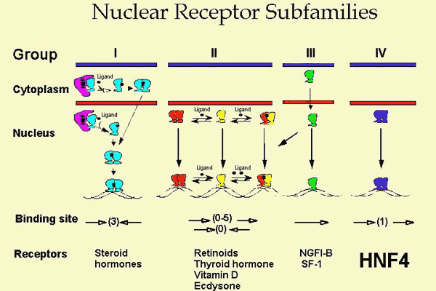
Nuclear Receptors

Slide 22
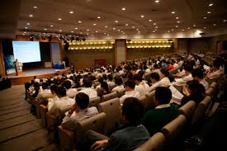
Pharmacology Related Conferences
2nd International Summit on Clinical Pharmacy December 2-3, 2014 San Francisco, USA
World Congress on Pharmacology July 20-22, 2015 Brisbane, Australia
4th International Conference and Exhibition on Neurology & Therapeutics July 27-29, 2015 Rome, Italy
4th Global Summit on Toxicology August 24-26, 2015 Philadelphia, USA
3rd International Conference on Clinical Pharmacy December 7-9, 2015 Atlanta, USAI
nternational Conference and Expo on Parenterals and Injectables August 17-19, 2015 Chicago, USA
American Veterinary Congress August 31-September 02, 2015 Florida, USA
Asia Pacific Pharma Congress July 13-15, 2015 Beijing, China
American Pharma Congress August 03-05, 2015 Philadelphia, USA
Pharma Middle East November 02-04, 2015 Dubai, UAE
Euro Veterinary Congress November 16-18, 2015 Nice, France

Slide 23
Approved By
Nagendra sastry Yarla. M.Sc (PhD)
E-signature:

Slide 24
OMICS Group Open Access Membership OMICS International Membership enables academic and research institutions, funders and corporations to actively encourage open access in scholarly communication and the dissemination of research published by their authors. For more details and benefits, click on the link below: http://omicsonline.org/membership.php

