Slide 1
OMICS Journals are welcoming Submissions
OMICS International welcomes submissions that are original and technically so as to serve both the developing world and developed countries in the best possible way.
OMICS Journals are poised in excellence by publishing high quality research. OMICS International follows an Editorial Manager® System peer review process and boasts of a strong and active editorial board.
Editors and reviewers are experts in their field and provide anonymous, unbiased and detailed reviews of all submissions.
The journal gives the options of multiple language translations for all the articles and all archived articles are available in HTML, XML, PDF and audio formats. Also, all the published articles are archived in repositories and indexing services like DOAJ, CAS, Google Scholar, Scientific Commons, Index Copernicus, EBSCO, HINARI and GALE.
For more details please visit our website: http://omicsonline.org/Submitmanuscript.php

Slide 2
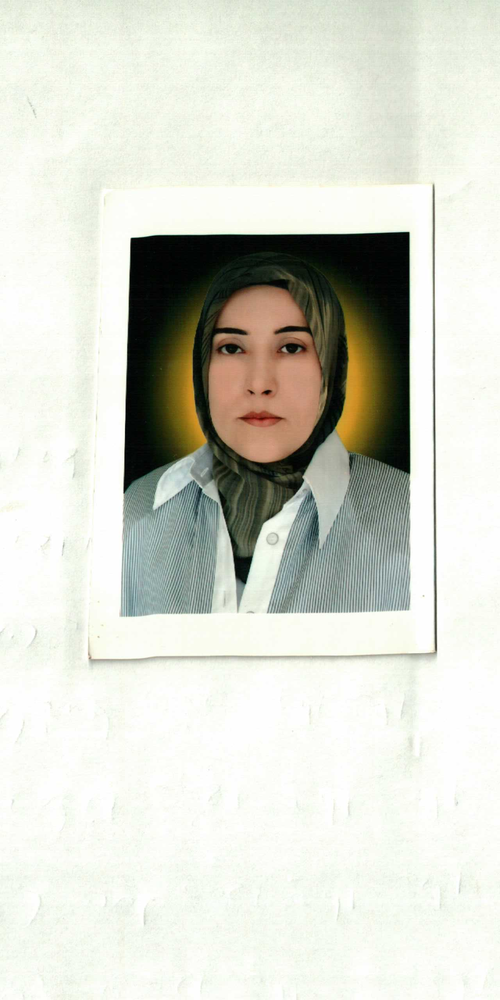
Dr.Nagham Mahmood Aljamali,
Department of chemistry , Assistance professor.
I have received Ph.D certificate in 2008 in
organic chemistry.
Assistance professor in 2011.

Slide 3
I have 35 published articles for organic chemistry , pharma , ansthesia , analytical , medical plants and plants extracted.
Research field : Organic chemistry , Pharmaceutical chemistry , Medical plants , Analytical chemistry
,......

Slide 4
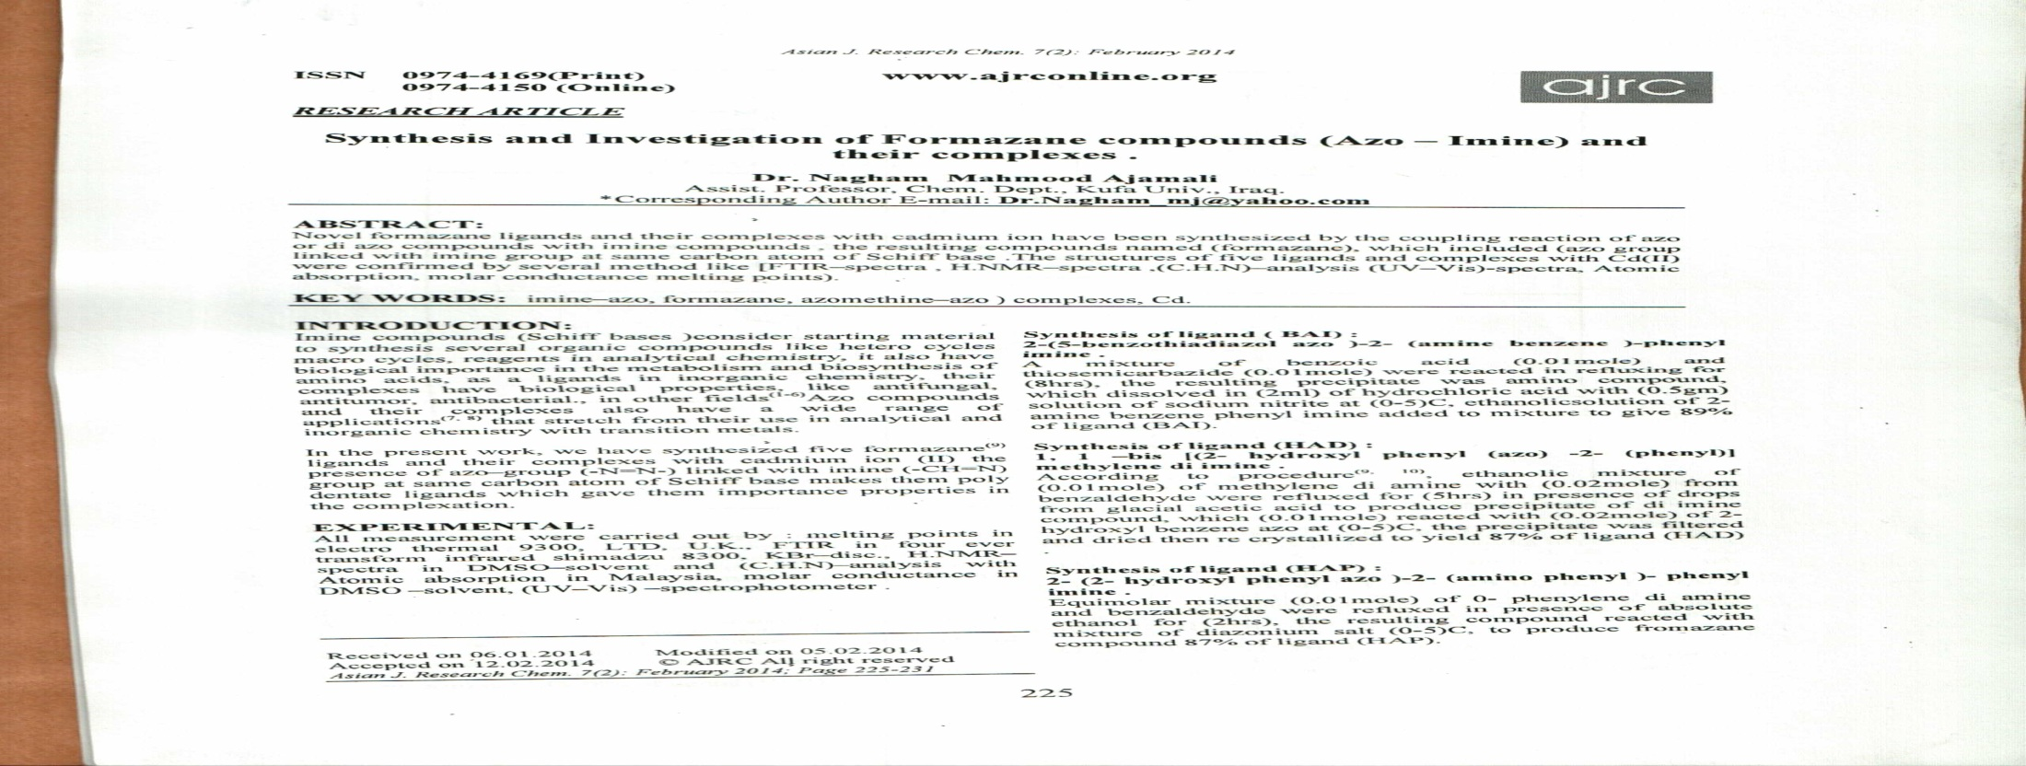
Asian J. Research Chem. 7(2): February 2014
225
ISSN 0974-4169(Print) www.ajrconline.org 0974-4150 (Online)
RESEARCH ARTICLE
Synthesis and Investigation of Formazane compounds (Azo – Imine) and their complexes .
Dr. Nagham Mahmood Aljamali
Assist. Professor, Chem. Dept., Kufa Univ., Iraq.
*Corresponding Author E-mail: Dr.Nagham_mj@yahoo.com

Slide 5
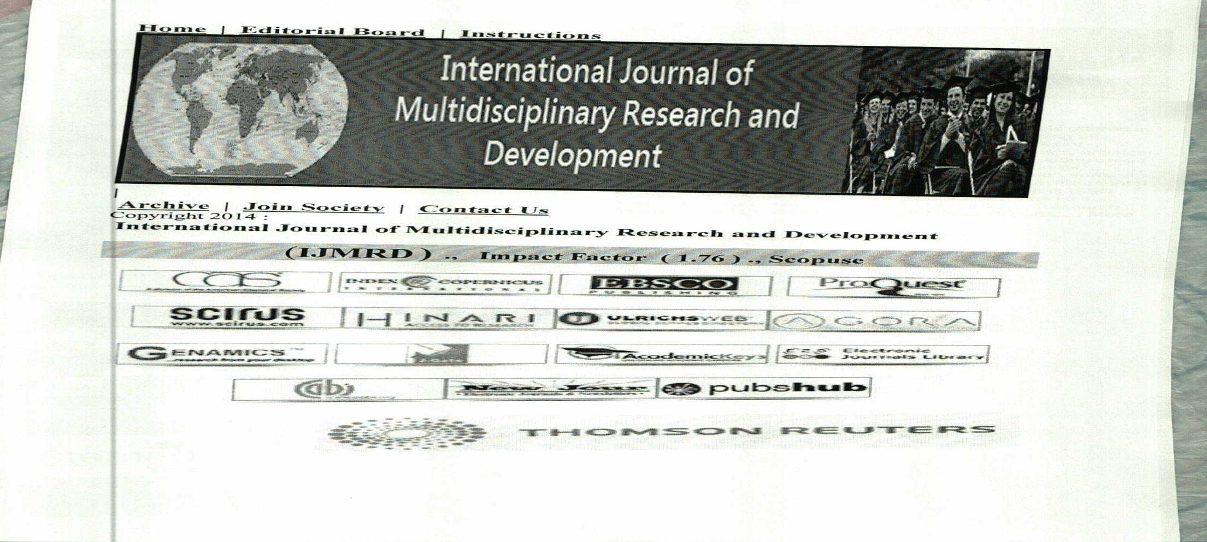
International Journal of Multidisciplinary Research and Development
2014; 1( 2): 45-46
Antimicrobial activity of Plants Oils
Dr. Nagham. Mahmood. Aljamali

Slide 6
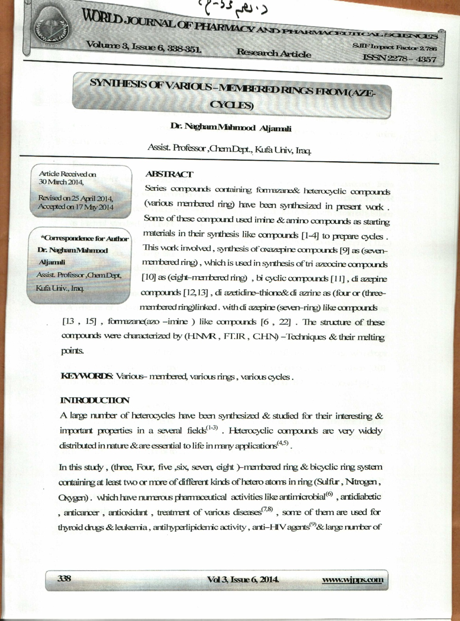
World Journal of Pharmacy and Pharmaceutical Sciences.
, 2014. Vol 3, Issue 6 ., Impact factor (2.76)
SYNTHESIS OF VARIOUS –MEMBERED RINGS FROM (AZE-CYCLES)
Dr. Nagham Mahmood Aljamali
Assist. Professor ,Chem.Dept., Kufa Univ, Iraq.

Slide 7
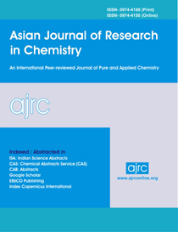
www.ajrconline.org .,
Asian J. Research Chem. 7(8): August 2014; Page 702-710
Synthesis, Characterization and Study of Chromatography Behavior of Novel (Azo–-Anil)-Heterocyclic Compounds
Dr. Nagham Mahmood Aljamali¹
¹Dr. Nagham Mahmood Aljamali

Slide 8
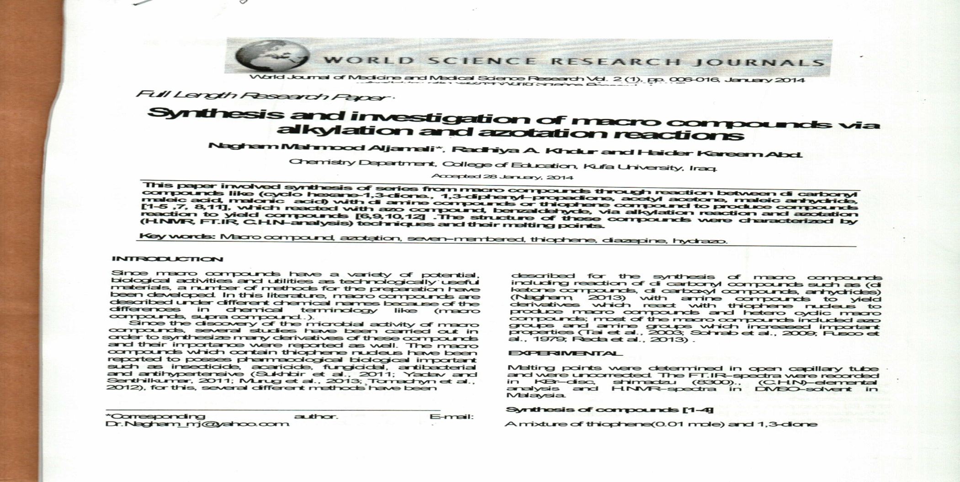
World Journal of Medicine and Medical Science Research
Vol. 2 (1), pp. 006-016, January 2014
Synthesis and investigation of macro compounds via alkylation and azotation reaction
Dr. Nagham Mahmood Aljamali¹

Slide 9
AMERICAN JOURNAL OF ADVANCED SCIENTIFIC RESEARCH
Dr. Nagham .Mahmood .Al –Jamali,
Vol. 1, Issue. 5, pp. 240-244, 2012
Synthesis of Cyclic Compounds via Intermolecular Cycloaddition

Slide 10
.
JOURNAL OF SCIENTIFIC & INNOVATIVE RESEARCH
Preparation and Identification of Macrocycles of Oxazepine Compounds
Dr. Nagham Mahmood Aljamali*
ABSTRACT
A new type of macrocycles of oxazepine compounds have been prepared in this article , the macrocycles [3] has been linked with (maleic anhydride, phthalic anhydride ,3- nitro phthalic anhydride) to produce new type which are macrocycles oxazepine [4-6].
Dr. Nagham Mahmood Aljamali*1

Slide 11
International Journal of Pharmacy and Pharmacology
ISSN: 2326-7267 Vol. 3 (2), pp. 149-153, February, 2014. www.internationalscholarsjournals.org
Synthesis and bio-chemical investigation of series of Bis-(Aldamine-sugar)
Dr.Nagham Mahmood Aljamali*
Chemistry Department, College Education for Women, Kufa University, Iraq.
E-mail: Dr.Nagham_mj@yahoo.com
The synthesized compounds in our work are calss of heterocyclic compounds in organic synthetic.In the present study, series of various organic compounds [1-11] were synthesized from anil –arabinose compound, which contain two imine –groups can be react as starting material with other compounds (sodium azide, chloro acetyl chloride, azo compound, thiol, secondary amine, maleic anhydride, primary amine) to produce cyclic and open cyclic compounds from (azitidine , form azane , diazepine , thiazine , diazane , sulfide). This work involved cyclization of imine group in some imine –sugar compounds to heterocyclic compounds several steps such as (condensation, alkylation, addition reactions

Slide 12
Synthesis of Heterocyclic Compounds from Imine and Study of Chromatography Applications .
Dr. Nagham Mahmood . Aljamali
Dr. Nagham Mahmood . Aljamali

Slide 13
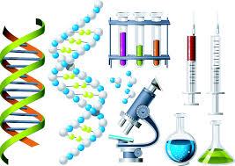
Biochemistry and Analytical Biochemistry Related Journals
Journal of Plant Biochemistry & Physiology
Arrow Bio molecular Research & Therapeutics
Arrow Biochemistry & Pharmacology: Open Access
Arrow Biochemistry & Physiology: Open Access

Slide 14
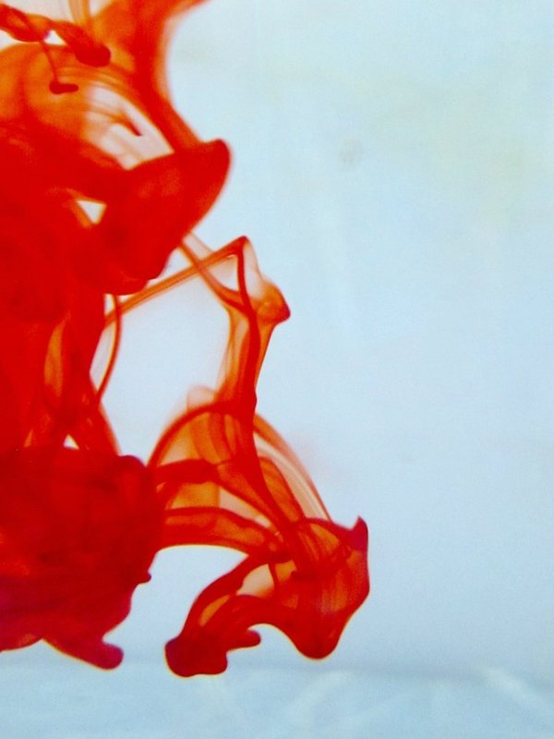
OMICS Group Open Access Membership
OMICS publishing Group Open Access Membership enables academic and research institutions, funders and corporations to actively encourage open access in scholarly communication and the dissemination of research published by their authors.
For more details and benefits, click on the link below:
http://omicsonline.org/membership.php

Slide 15
For more Upcoming Conference:
http://www.conferenceseries.com/

