Slide 1

OMICS International
OMICS International through its Open Access Initiative is committed to make genuine and reliable contributions to the scientific community. OMICS International journals have over 3 million readers and the fame and success of the same can be attributed to the strong editorial board which contains over 30000 eminent personalities that ensure a rapid, quality and quick review process. OMICS International signed an agreement with more than 1000 International Societies to make healthcare information Open Access.
Contact us at: contact.omics@omicsonline.org

Slide 2

OMICS Journals are welcoming Submissions
OMICS International welcomes submissions that are original and technically so as to serve both the developing world and developed countries in the best possible way.
OMICS Journals are poised in excellence by publishing high quality research. OMICS International follows an Editorial Manager® System peer review process and boasts of a strong and active editorial board.
Editors and reviewers are experts in their field and provide anonymous, unbiased and detailed reviews of all submissions.
The journal gives the options of multiple language translations for all the articles and all archived articles are available in HTML, XML, PDF and audio formats. Also, all the published articles are archived in repositories and indexing services like DOAJ, CAS, Google Scholar, Scientific Commons, Index Copernicus, EBSCO, HINARI and GALE.
For more details please visit our website: http://omicsonline.org/Submitmanuscript.php

Slide 3

CHEMISTRY AND APPLICATIONS
OF CYANOXIMES AND THEIR
METAL COMPLEXES
by
Nikolay Gerasimchuk
Department of Chemistry
NG-International -in-brief

Slide 4
My research interests are in the area of modern inorganic chemistry.
My International designs new ligands for preparation of a variety of metal complexes
for different applications.
NG-International -in-brief

Slide 5
Conventional ligand systems for coordination chemistry:
1) macrocycles: N, O-, S- crowns and their mixed donor analogs
2) aromatic macrocycles: porphyrins, phtalocyanins, texaphyrins
3) pyrazolylboranes, other tripodal ligands
4) heterocycles and heterocyclic mono-, polyamines
5) Schiff-bases
and many, many others…
Interesting chemical
properties, catalysis
Interesting physical
properties: magnetism…
Biological activity,
modeling of biological
systems, etc.
Unusual geometry,
crystal structures
NG-International -in-brief

Slide 6
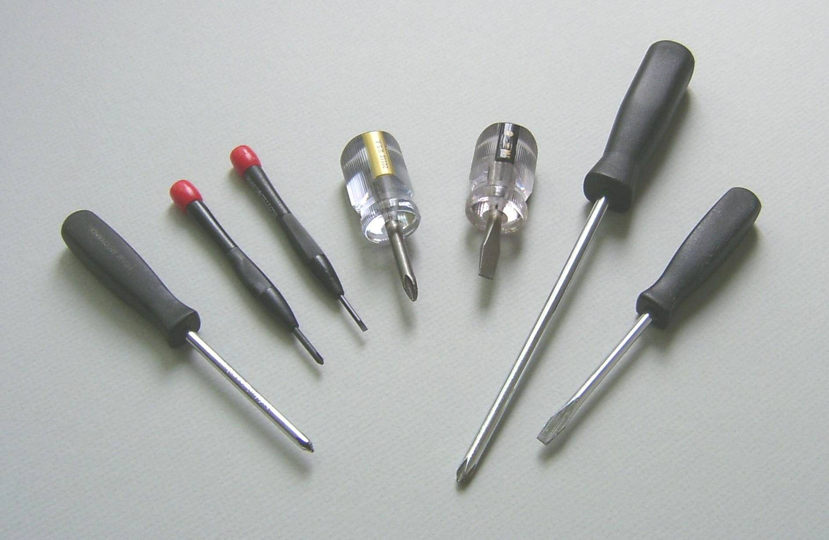
Unfortunately, many of them represent a boring set of tools…
NG-International -in-brief

Slide 7
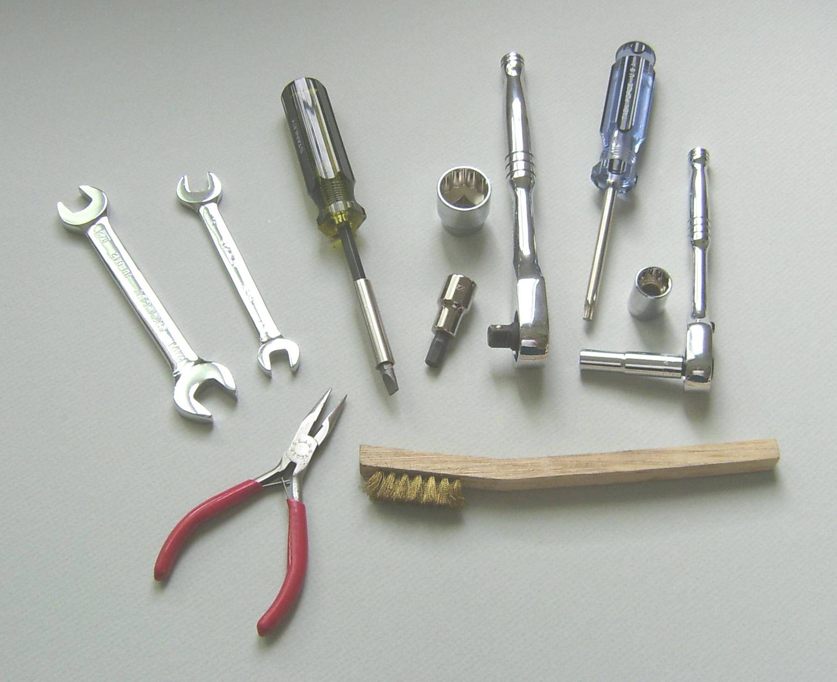
My goal is to design universal, better set of tools for
different and specific applications!
NG-International -in-brief

Slide 8
My choice of ligands is oximes, but not the usual ones!
NG-International -in-brief

Slide 9
Types of oximes and their precursors.
aldoximes
ketoximes
cyanoximes
NG-International -in-brief

Slide 10
Types of oximes and their precursors.
aldoximes
ketoximes
cyanoximes
NG-International -in-brief

Slide 11
Cyanoximes
R - electronwithdrawing International
presence of the CN-International :
- significantly increases acidity of the oxime
(100 - 10,000 times) which makes cyanoximes better ligands
- provides adequate solubility in organic and aqueous
media (as CH₃CN, CH₂(CN)₂, (CN)₂ )
- helps in crystallization of ligands and metal complexes
- allows further chemical modification of the ligand (hydrolysis,
and formation of amides, carboxylic acids; addition of H₂S, H₂Se)
NG-International -in-brief

Slide 12
Cyanoximes preparation: general methods.
furazanes
Sov. Progr. Chem., 1986, 52, Nº7, p.686.
Dokl. Acad. Nauk UkSSR, 1989, B, Nº4, p.37.
NG-International -in-brief

Slide 13
Development of the Meyer reaction for synthesis of cyanoximes.
J. Coord. Chem., 2004, 57, 1205
NG-International -in-brief

Slide 14
Development of the Meyer reaction for synthesis of cyanoximes.
40 are known
J. Coord. Chem., 2004, 57, 1205
NG-International -in-brief

Slide 15
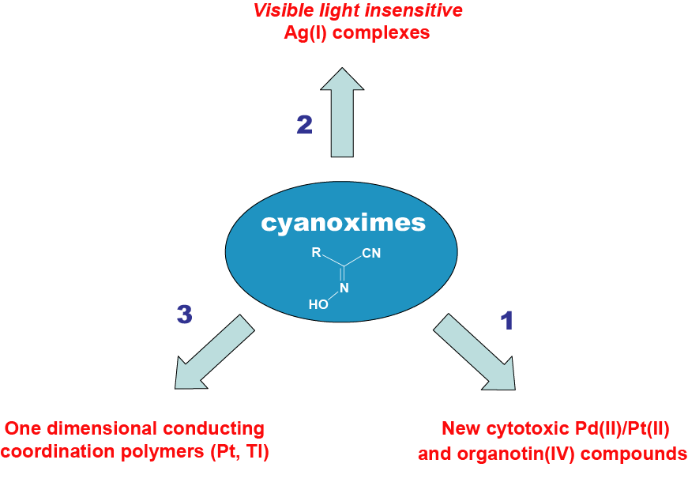
NG-International -in-brief

Slide 16
Applications of
silver(I) cyanoximates.
NG-International -in-brief

Slide 17
Battery-less
detectors of UV-radiation
Non-electrical sensors of
gases industrial importance
Light-insensitive AgL
Antimicrobial compounds as
additives to implants adhesives
Polymers. 2011, 3, 2
NG-International -in-brief

Slide 18
The sensor works in a passive-mode, without batteries, and changes color similarly to pH paper!
The sensor can be used as area detector for measurements of the UV-radiation fields in:
habitable space objects,
manufacturing sites with intensive welding
(cars, other metal constructions),
manufacturing of printed circuit boards
(electronics, computers, etc.)
The sensor can be further developed as a
self-adhesive film/strip that can be easily removed from the surface at any time!
NG-International -in-brief

Slide 19
Battery-less
detectors of UV-radiation
Non-electrical sensors of
gases industrial importance
Light-insensitive AgL
Antimicrobial compounds as
additives to implants adhesives
Polymers. 2011, 3, 2
NG-International -in-brief

Slide 20
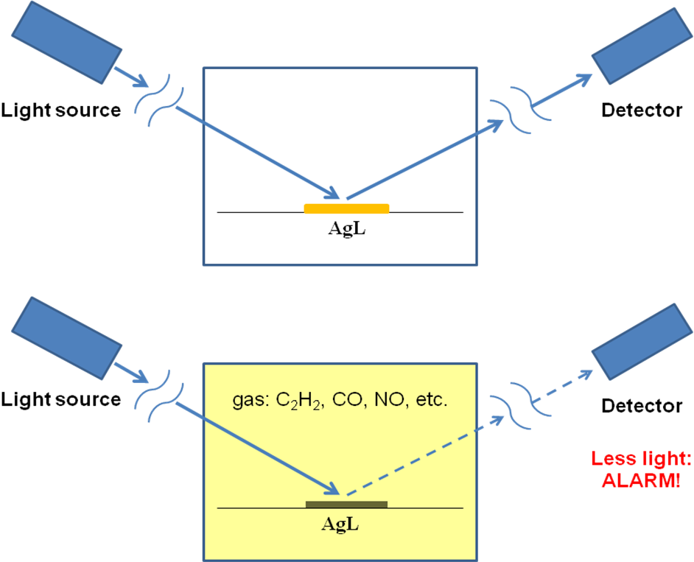
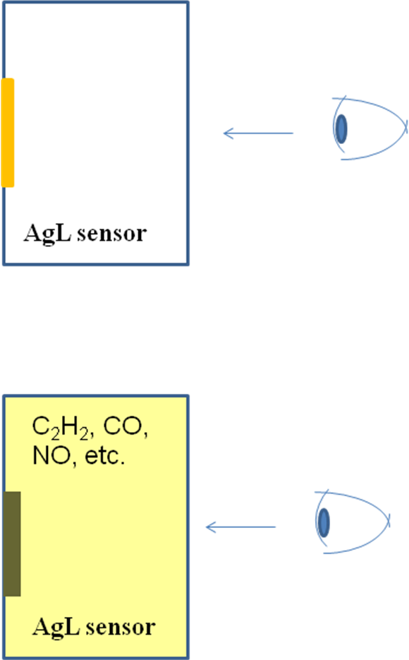
Schematic diagram for the visual inspection (A), or quantitative measurements using the optoelectronic pair (B) working in closed, illumined premises.
B
A
NG-International -in-brief

Slide 21
Battery-less
detectors of UV-radiation
Non-electrical sensors of
gases industrial importance
Light-insensitive AgL
Antimicrobial compounds as
additives to implants adhesives
Polymers. 2011, 3, 2
NG-International -in-brief

Slide 22
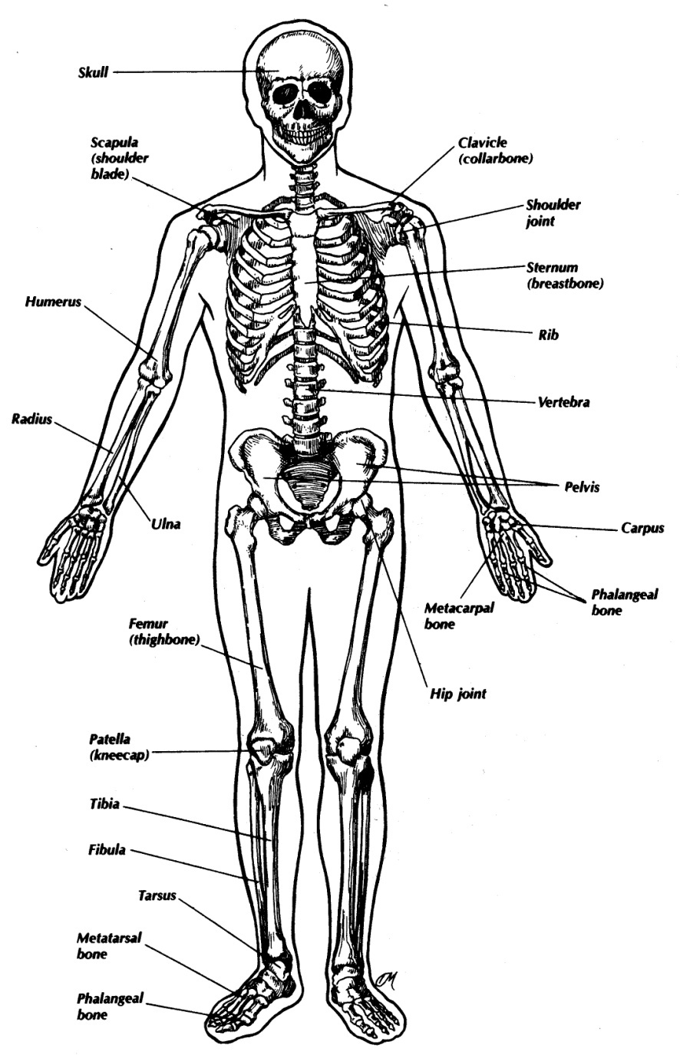
When we get old…
Joint
replacement therapy
In the United States alone, more than 4.4
million people have at least one internal
fixation device and more than 1.3 million
people have an artificial joint
NG-International -in-brief

Slide 23
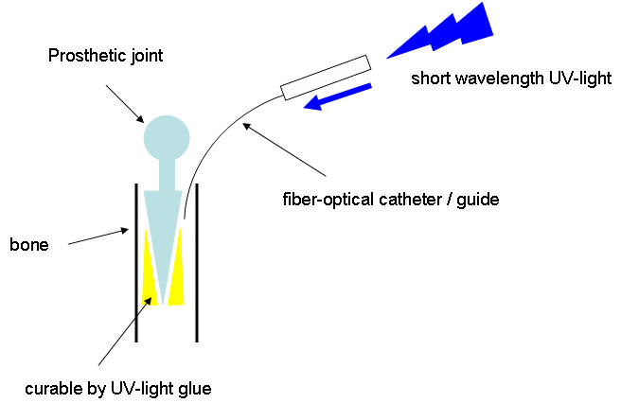
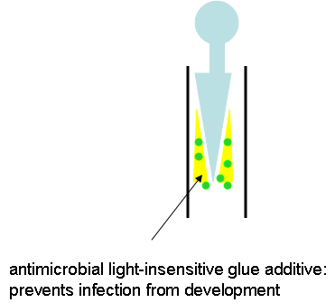
Artificial joints: insertion
NG-International -in-brief

Slide 24
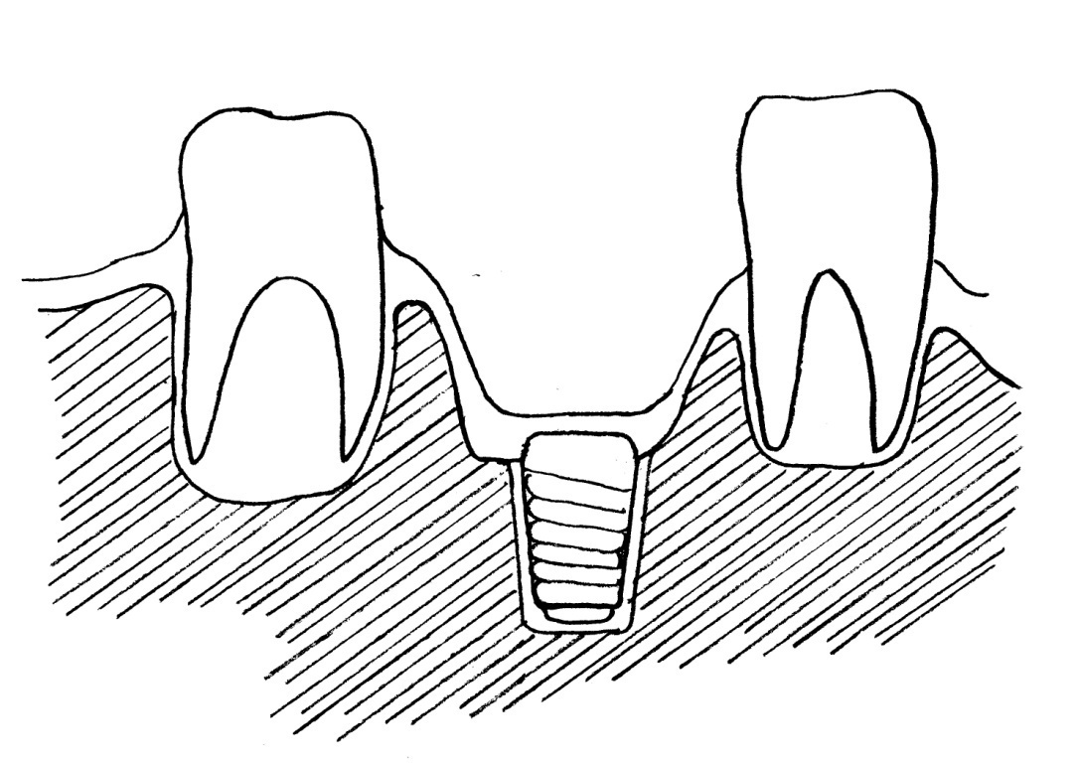
tooth implant (metal alloy)
soft tissue, gums
jaw bone
glue (to fix implant in place)
that contains water insoluble
antimicrobial additive Ag(I) compound
NG-International -in-brief

Slide 25
The US patents applications:
“Visible light-insensitive Silver(I) cyanoximates as
antimicrobial additives into polymeric light curable composites
used during introduction of indwelling medical devices”
Full patent, October 2012
“Antimicrobial, thermally and visible light stable silver(I)
cyanoximates that inhibit biofilm formation.”
Provisional patent, November 2013
Claims are:
      Water insoluble (can’t leach out)
      Easily survive minutes of curing light
      Demonstrate antimicrobial activity
      Thermally stable up to 150ºC
NG-International -in-brief

Slide 26
3
1D conducting coordination polymers
Pt(II/IV) mixed valence “poker chips” stacks
NG-International -in-brief

Slide 27
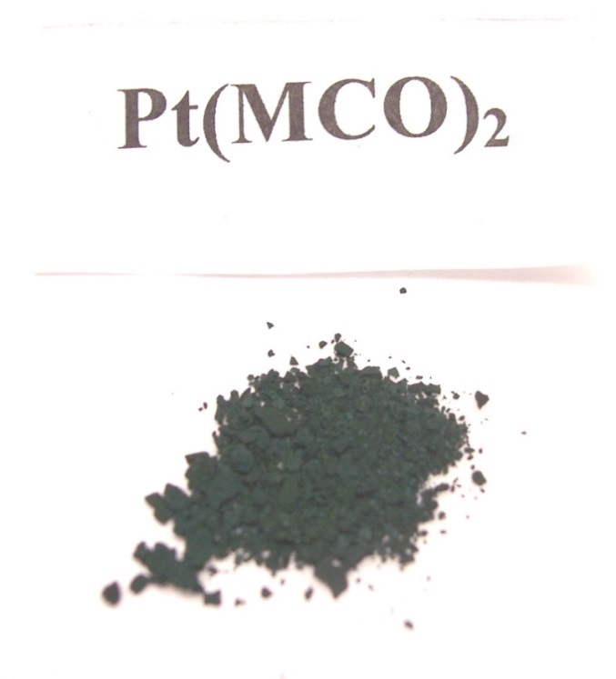
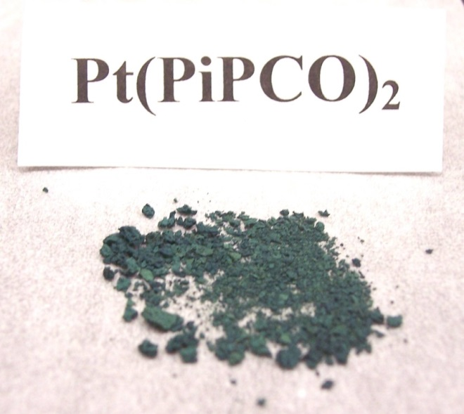
NG-International -in-brief

Slide 28
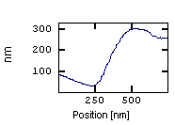
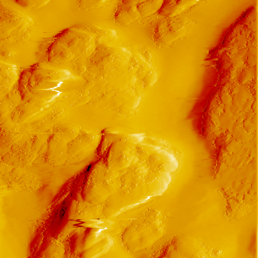
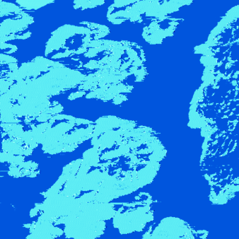
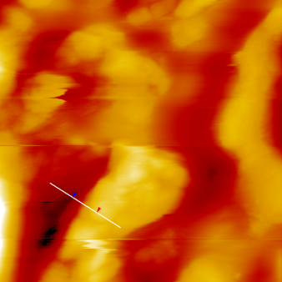
Electrical conductivity of solid samples (AFM method)
Deflection image
Current image
Topography image
Tip travel, nm
264 nm
σ_{ave}= 33.3 [S/cm]
Pt(MCO)₂
Average current=12.3 nA
Scan size: 2.5 × 2.5 mm
σ_{ave}= 22.8 [S/cm]
Pt(PiPCO)₂
Pt²⁺ + Ag⁺ → Pt⁴⁺ + Ag⁰
Pt---Pt
σ_{ave}= 805 [S/cm]
mixed valence species: Pt(II/IV) !
NG-International -in-brief

Slide 29
Heat dissipation is the most pressing problem in
miniature electronic devices…
Potential applications:
molecular electronics:
thin, conducting films that can be deposited
from solutions
NG-International -in-brief

Slide 30


Chemical Sciences
Related Journals
Journal of Thermodynamics & Catalysis
Journal of Plant Biochemistry & Physiology
Organic Chemistry: Current Research

Slide 31

Chemical Sciences
Related Conferences
Medicinal Chemistry & Computer Aided Drug Designing
3rd International Conference on Medicinal Chemistry & Computer Aided Drug Designing

Slide 32
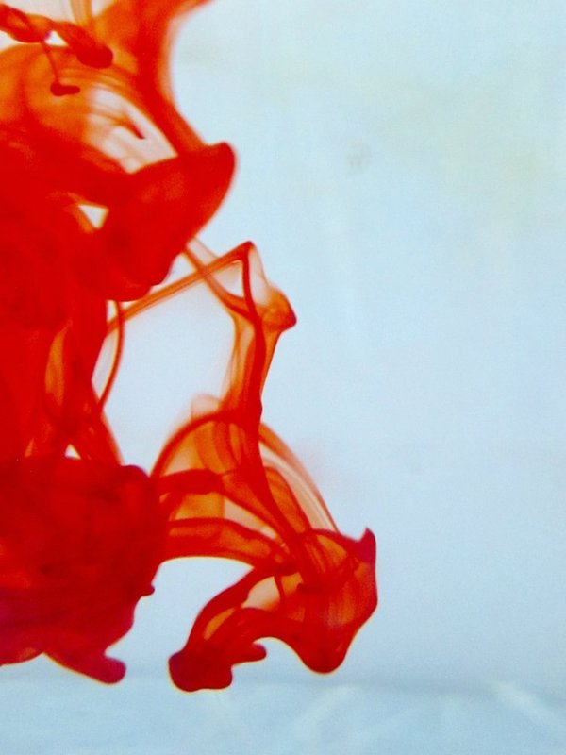

OMICS International Open Access Membership
OMICS International Open Access Membership enables academic and research institutions, funders and corporations to actively encourage open access in scholarly communication and the dissemination of research published by their authors.
For more details and benefits, click on the link below:
http://omicsonline.org/membership.php

