Slide 1
OMICS Journals are welcoming Submissions
OMICS International welcomes submissions that are original and technically so as to serve both the developing world and developed countries in the best possible way.
OMICS Journals are poised in excellence by publishing high quality research. OMICS International follows an Editorial Manager® System peer review process and boasts of a strong and active editorial board.
Editors and reviewers are experts in their field and provide anonymous, unbiased and detailed reviews of all submissions.
The journal gives the options of multiple language translations for all the articles and all archived articles are available in HTML, XML, PDF and audio formats. Also, all the published articles are archived in repositories and indexing services like DOAJ, CAS, Google Scholar, Scientific Commons, Index Copernicus, EBSCO, HINARI and GALE.
For more details please visit our website: http://omicsonline.org/Submitmanuscript.php

Slide 2
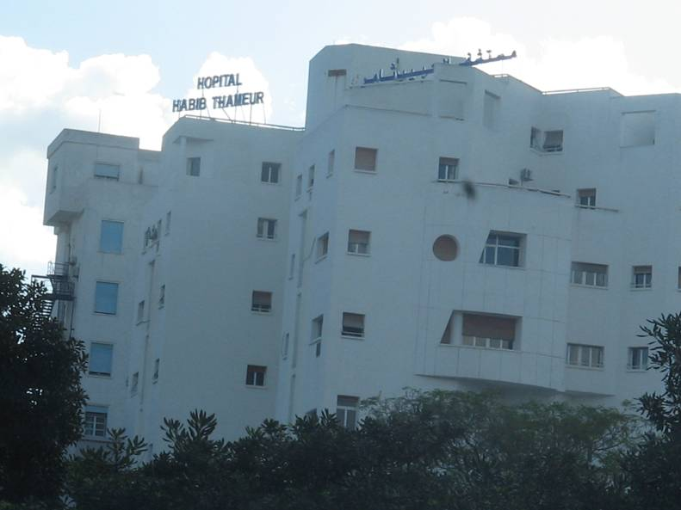
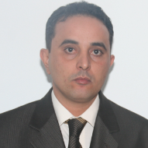
Dr Rabii Noomene
Gastro-intestinal surgeon
Department of general surgery
Habib Thameur Hospital Tunis Tunisia

Slide 3
Faculty of medicine Tunis Tunisia
Associate professor of surgery
and anatomy

Slide 4
Dr Rabii Noomene obtained his Medical degree from the faculty of medicine, Tunis Tunisia, in 2002. He fulfilled his national medical services as a medical practitioner in many hospital of Tunis.
He completed his training in general and gastro-intestinal surgery at the Rabta hospital. He is currently a senior surgeon in the department of visceral surgery in the Habib Thameur hospital Tunis Tunisia. He is an associate professor of surgery and anatomy teaching in the faculty of medecine and the health science high school Tunis Tunisia. He has authored over then 20 journal peer-reviewed publications. He is a regular reviewer and Editorial Board member in several journals.

Slide 5
Research interest

Slide 6
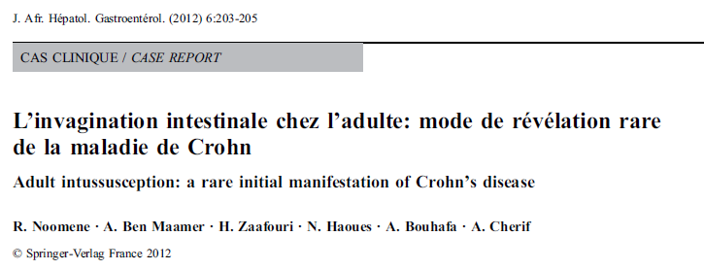
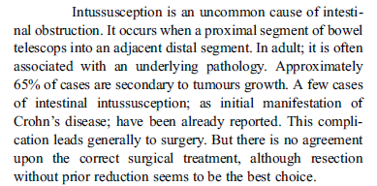
Adult intussusception

Slide 7
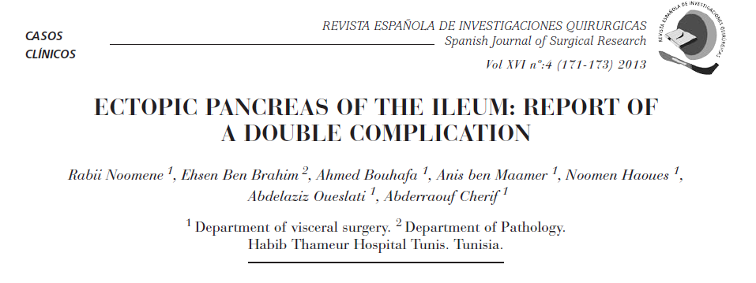

Slide 8
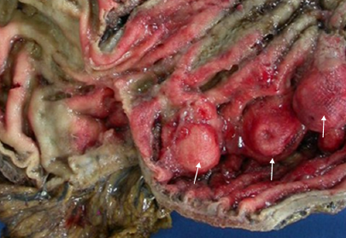
GISTs

Slide 12
Hydatid disease
Hydatid disease is endemic in Tunisia and has been considered as one of the most common surgical pathology. Several localizations have been described, but hydatidosis of the liver is the most frequent clinical entity. Primary hydatid cyst of the gallbladder is very rare. We report in this observation a new case of primary hydatid cyst of the gallbladder diagnosed by Magnetic Resonance Imaging (MRI).

Slide 13
Minimal invasive surgery

Slide 16
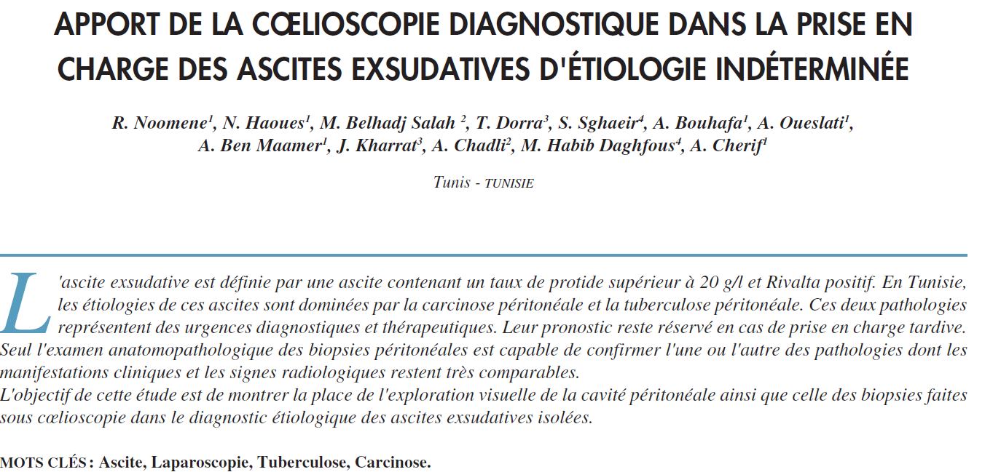

Slide 17
Hernia

Slide 18
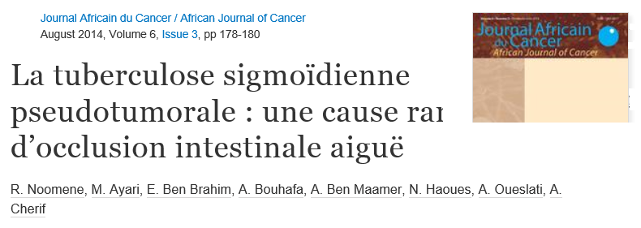
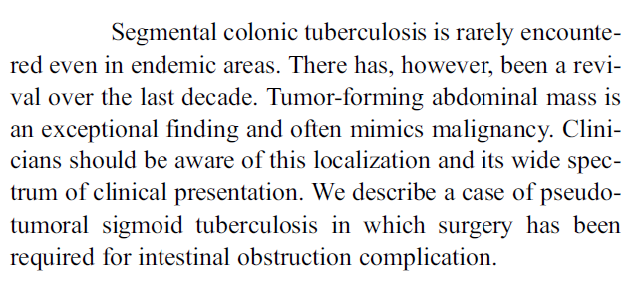
Tuberculosis

Slide 19
Dr Rabii Noomene
Habib Thameur Hospital
Faculty of medicine Tunis Tunisia
Phone: 0097465898
rabiinoomene@yahoo.fr
Dr Rabii Noomene ©

