Slide 1
Norimitsu Ichikawa Associate Professor Department of Electrical Engineering Kogakuin University Japan Editor-in-Chief Automatic Control of Physiological State and Function

Slide 2
BIOGRAPHY
Kogakuin University, Tokyo, JAPAN (04/01/2012 – the present) "Associate Professor", National Institute of Occupational Safety
and Health (JNIOSH), Tokyo, JAPAN (04/01/2010 – the present),Kogakuin University, Tokyo, JAPAN (04/01/2009 – 03/31/2012) "Assistant Professor", National Institute of Occupational Safety and Health (JNIOSH), Tokyo, JAPAN (04/01/2006 - 03/31/2009),National Institute of Industrial Safety (NIIS), Tokyo, JAPAN (04/01/2005 – 03/31/2006),Japan Society for the Promotion of Science, Tokyo, JAPAN (04/01/2004 – 03/31/2005),Tokyo University of Agriculture and Technology, Tokyo, JAPAN (04/01/2002 – 03/31/2003),Shibaura Institute of Technology, Tokyo, JAPAN (04/01/2000 – 03/31/2002) “Teaching Assistant (Lecturer for experiment)”

Slide 3
RESEARCH INTEREST
Induced voltage generated in a partly opened metal box when a human body moves, Study of technique for detecting electromagnetic pulse generated by discharge, The case study and statistical analysis of the accident with electrocution, Study of technique for detecting electromagnetic pulse generated by discharge.

Slide 4
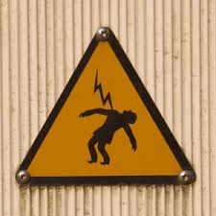
ELECTROCUTION
Definition:
“Death brought about by electricity”
Death, murder or a sudden accident caused by an electric shock.
Deliberate execution by means of an electric shock, such as an electric chair; "electrocution" is a portmanteau for "electrical execution". It has never been proven as cause of death

Slide 5
The nature of electrocution
An electrical current through the body can cause breathing or heart to stop and can also cause burns.
The current which causes electrocution usually comes from low or high voltage electricity and lightening.
Electrocution may be due to
Low Voltage (<1000 Volts)
High Voltage (>1000 Volts)
Lightning (up to 100,000,000 Volts)
Sources of low and high voltage electricity which may cause injuries can be found in appliances and cables found in the home, office, shops or workplace, however, these are often insulated by non conducting materials such as plastic or rubber to prevent injuries from occurring.

Slide 6
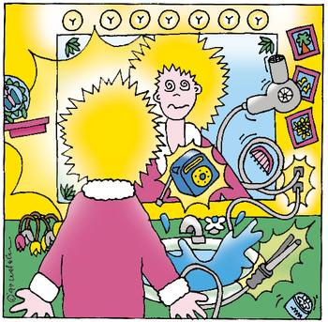
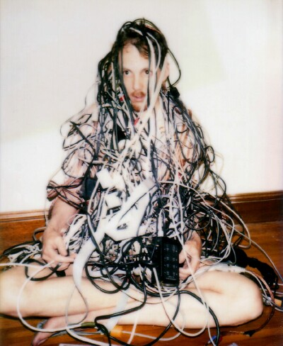
Water conducts electricity so using wet hands or standing on a wet floor when handling an electrical appliance may increase the risk of an electrical injury.

Slide 7
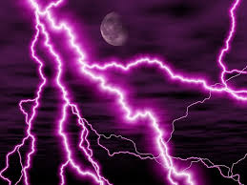
Factors affecting
Type of current (alternating or direct)
Amount of current (Amperage)
Potential difference (Voltage)
Resistance (Ohms)
Duration of event
Route of current

Slide 8
LIGHTNING
Lightening is a natural source of electricity which travels through a tall feature in the landscape in order to reach the ground. If struck by lightening the casualty may suffer shock, burns or even death.
Lightning is caused by atmospheric electricity
Temperatures of up to 30,000o C
Current of up to 20,000 A
Potential difference of up to 100,000,000 V
Direct or Indirect Strike
Side flash Strike
Step Potential
Streamer

Slide 9
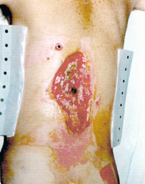
Electrical burns are often a consequence of faulty or misuse of electrical appliances. Downed power lines can be, in some cases, a potential source of severe electrical burns.

Slide 10
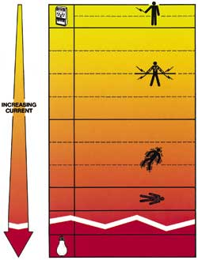
Electric shock
 | Mild Shock Trip setting for ground fault circuit interrupter
 | Muscle Contractions Victom cannot let go
 | Severe Shock Breathing difficult - possible respiratory arrest
 | Heart Stops pumping
 | Increasing probability of death
 | Enough current to light a 100-watt bulb
The effect of electric shock can depend on three main factors:
1) how much current is flowing through the body
2) the path of current through the body
3) how long the body is in the circuit.
Mild Shock

Slide 11
Mechanism of Death
Ventricular fibrillation
Commonest mechanism of death
Associated with passage of current though the heart
Current acts on cardiac myocytes, nodal tissue and conduction tracts
Respiratory Paralysis
Less common than ventricular fibrillation
severe contraction of respiratory muscles such as diaphragm and intercostal muscles
More commonly seen in high voltage deaths
Blunt Force Trauma
Contact with electricity may fling or throw the victim causing potentially lethal injuries or complications thereof leading to death

Slide 12
Signs and symptoms
Burns on the skin surface where the energy has entered and exited the body
Dazed and confused condition
Problems with sight
Paralysis (from disrupted nerve pathways)
Irritable or restless, whether conscious or unconscious
Weak, irregular, or absent pulse
Damage to internal muscles and tissues

Slide 13
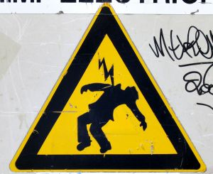
Irregular heartbeat or cardiac arrest
Blood pressure elevated or low with signs of shock
Shallow, irregular or absent breathing (tongue may swell and block the airway)
Multiple fractured bones and dislocations from intense muscular contractions or from falling
Seizures

Slide 14
It necessary to remove the victim from the source or to break the current if conditions allow and then immediately arrange for transport to a hospital to be treated properly.

Slide 15
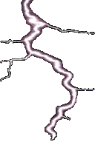
When treating Electrical and lightening burns it is important to:
Avoid or neutralise electrical and other dangers
Conduct a primary survey
Arrange medical aid as required
Remove victim to a safe environment
Remove all jewellery from the affected area
Provide oxygen to victims if necessary
Apply a dry sterile dressing to the wound

Slide 16
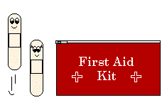
If the victim suffers a fracture:
If the victim suffers shock:
Prevent any movement at the site of the fracture
Immobilise the joint above and below the fracture site, if possible
If ambulance transport is not available, splint the fractured area in a position that is comfortable for the victim
Do not attempt to realign the body
Lay the victim down and elevate their legs
If possible, treat the cause
Monitor and record the victims vital signs
Comfort and reassure
Provide supplementary oxygen if able to
Maintain body temperature
Seek medical assistance

Slide 17
OMICS International Open Access Membership OMICS International Open Access Membership enables academic and research institutions, funders and corporations to actively encourage open access in scholarly communication and the dissemination of research published by their authors. For more details and benefits, click on the link below: http://omicsonline.org/membership.php

