Slide 1


Slide 2


Slide 3
Oncology and Palliative Care:
Promoting the Comfort and Cure Model
Parag Bharadwaj, MD FAAHPM

Slide 4
The Palliative Care Patient
?

Slide 5
Case Scenario
45 year old patient presents to the Emergency Room with severe abdominal pain
Patient gives history to progressive and significant weight loss over last 3 months
CT scan of the abdomen shows multiple liver masses

Slide 6
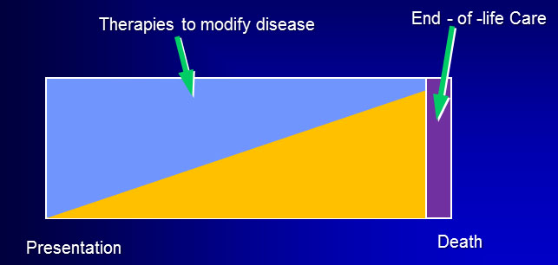
When do you call Palliative Care?

Slide 7
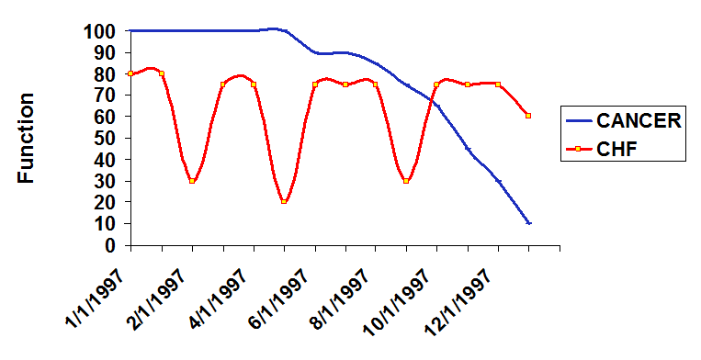
Prognostication Challenge

Slide 8
Palliative Care and Hospice
Palliative Care is not Hospice

Slide 9



Palliative Care and Hospice
All Hospice Care is Palliative, all Palliative Care is not Hospice

Slide 10
WHO definition of Palliative Care
Palliative care is an approach that improves the quality of life of patients and their families facing the problem associated with life-threatening illness……….
is applicable early in the course of illness, in conjunction with other therapies that are intended to prolong life, such as chemotherapy or radiation therapy, and includes those investigations needed to better understand and manage distressing clinical complications.

Slide 11
WHO model of Palliative Care

Slide 12
Center to Advance Palliative Care
Palliative care is provided by an interdisciplinary
team and offered in conjunction with all other
appropriate forms of medical treatment.
It is appropriate at any point in a serious illness
and can be provided at the same time as
treatment that is meant to cure.

Slide 13
Palliative Care
Interdisciplinary Care
Aims to
• relieve suffering
• improve quality of life
Combined with ALL OTHER appropriate medical treatments

Slide 14
Traditional Model: Comfort or Cure

Slide 15
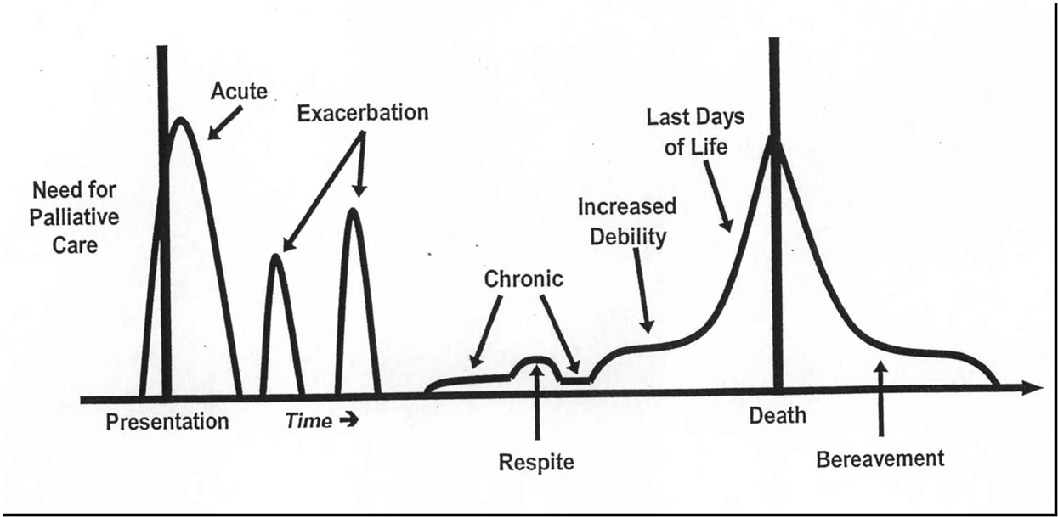
Suggested Need of Palliative Care
With permission from:
Frank D. Ferris, MD, Director, International Programs, San Diego Hospice and the Institute for Palliative Medicine, San Diego, California.

Slide 16
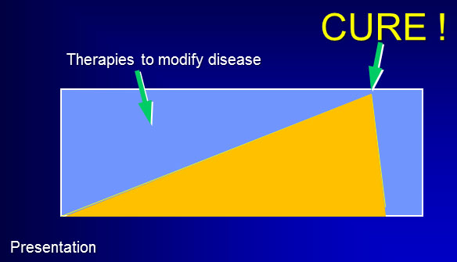
Comfort and Cure Model
Bharadwaj P, Shinde A, Lill M, Schwarz ER. Palliative Care: It is time to move toward a comfort and cure model.J Palliat Med. 2011 Oct; 14(10) : 1091-3.

Slide 17
Involvement of Palliative Care
Independent of treatment plan and prognosis
Focus on relief of suffering

Slide 18
Stem Cell Transplant
One-year survival after myeloablative conditioning for acute leukemias in any remission phase,
CML or MDS, age <50 years, by year of transplant and graft source, 1988-2009
One-Year Survival, %
Notes:
Slide 14: One-year survival rates after transplantation have generally improved in the last two decades. Outcomes of unrelated donor transplants are approaching those observed with related donors. Improvements in HLA-matching techniques, with consequently better donor selection, better overall patient selection for transplantation, and improvements in supportive care are the likely explanation for this trend.

Slide 19
Our Model
Starts before admission!!!!
Cancer Center Supportive Care Service
Involvement of inpatient service upon admission
Independent of diagnosis/ prognosis

Slide 20
Benefits of Early Palliative Care
Assessment at baseline
Smoother transitions
Continuity of care- transfers
Better symptom assessment
Continuity of care- transfers
Improved EOL care – transfer to hospice

Slide 21
Impact: Family
“They helped me to coordinate my husband's care. They listened to all my many concerns. Then they connected me to the resources appropriate to the needs. Thank you so much for having this service available.”

Slide 22
Impact: Burnout
Decrease clinician burnout

Slide 23
Palliation Prolongs life
Early Palliative Care for Patients with Metastatic Non–Small-Cell Lung Cancer
Temel JS et al. N Engl J Med. 2010 Aug 19;363(8):733-42
Comparing hospice and non hospice patient survival among patients who die within a three-year window
Connor SR et al. J Pain Symptom Manage. 2007 Mar;33(3):238-46

Slide 24
Care giving Increases Mortality
Increased risk of MI or cardiac death: RR 1.8 if care giving >9 hrs/wk for ill spouse
Lee et al. Am J Prev Med 2003;24:113
Increased risk of death: RR 1.6 among caregivers reporting emotional strain
Schulz et al. JAMA 1999;282:2215

Slide 25
Case Scenario
Palliative Care consulted on admission
Patient diagnosed with stage IV colon cancer
Advance care planning
Surgery
Chemotherapy
Hospice care
End of life care

Slide 26
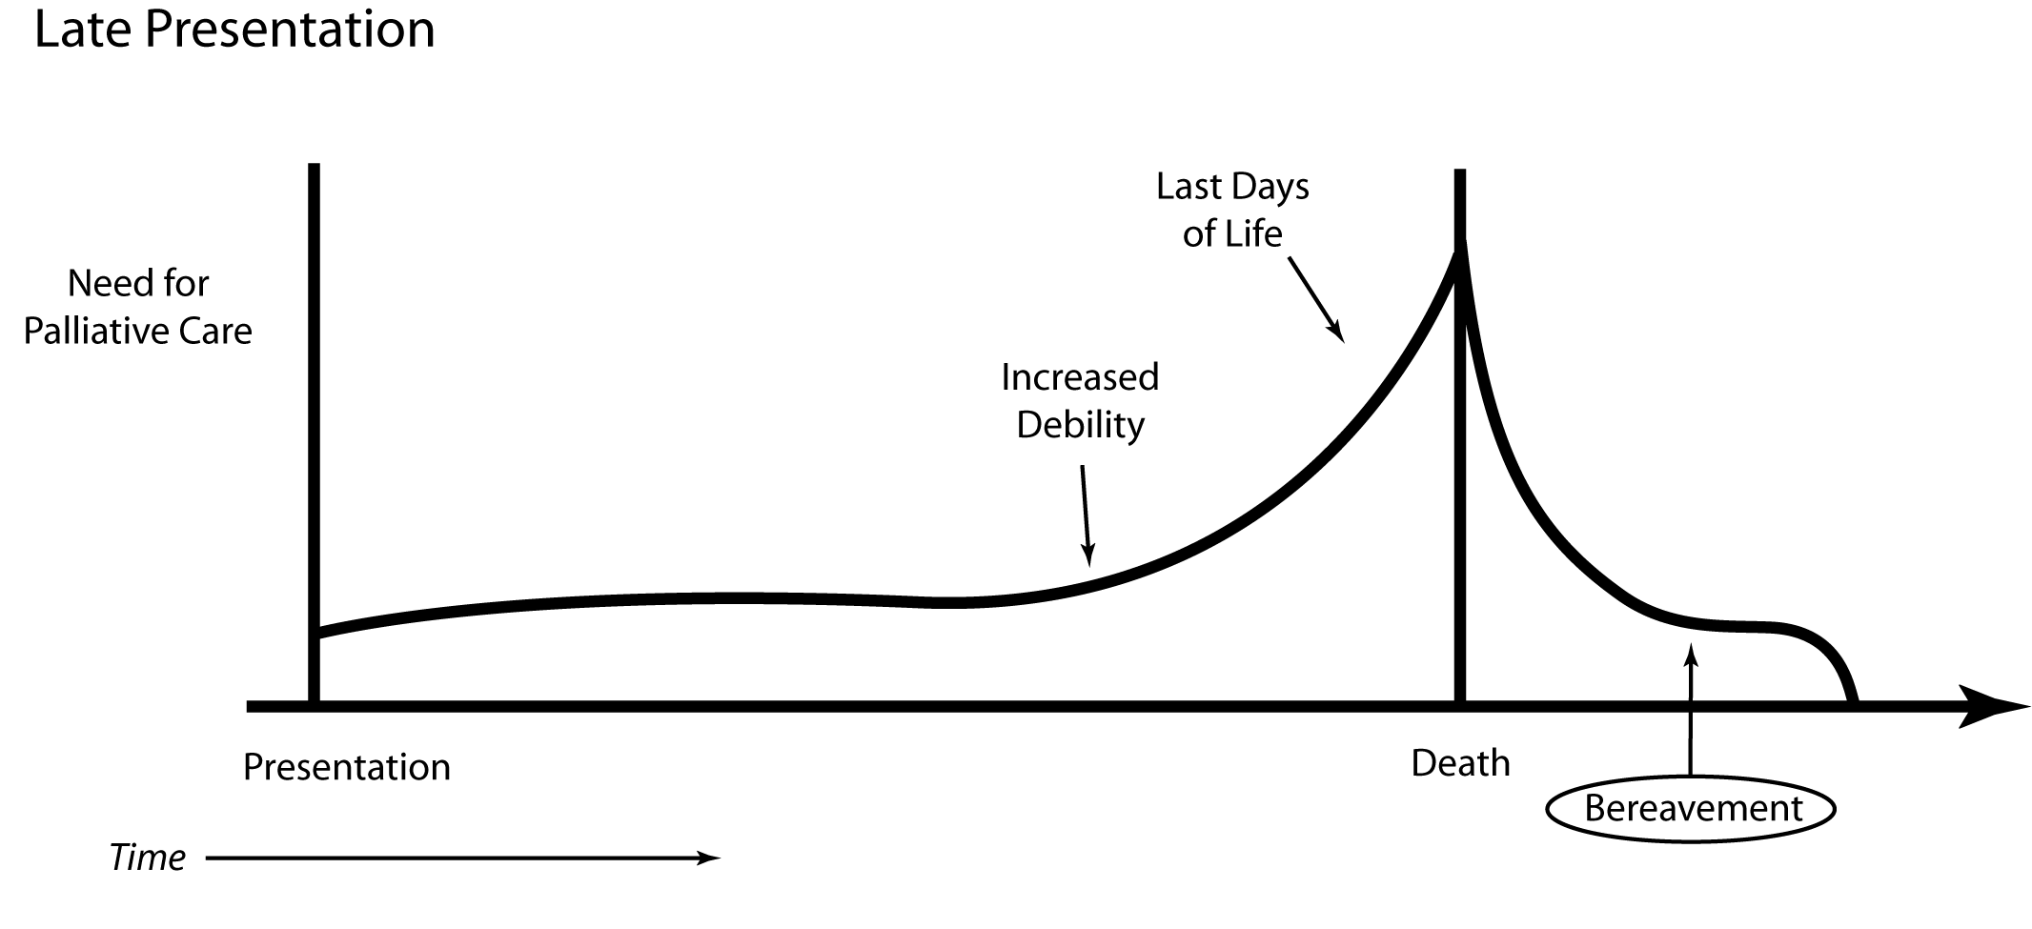
Involvement of Palliative Care
With permission from:
Frank D. Ferris, MD, Director, International Programs, San Diego Hospice and the Institute for Palliative Medicine, San Diego, California.

Slide 27
Take Home Message
Palliative Care should get involved early in the disease process, as close to diagnosis as possible

Slide 28


