Slide 1
OMICS Group
OMICS Group International through its Open Access Initiative is committed to make genuine and reliable contributions to the scientific community. OMICS Group hosts over 400 leading-edge peer reviewed Open Access Journals and organizes over 300 International Conferences annually all over the world. OMICS Publishing Group journals have over 3 million readers and the fame and success of the same can be attributed to the strong editorial board which contains over 30000 eminent personalities that ensure a rapid, quality and quick review process. OMICS Group signed an agreement with more than 1000 International Societies to make healthcare information Open Access.
Contact us at: contact.omics@omicsonline.org

Slide 2
OMICS Journals are welcoming Submissions
OMICS Group welcomes submissions that are original and technically so as to serve both the developing world and developed countries in the best possible way.
OMICS Journals are poised in excellence by publishing high quality research. OMICS Group follows an Editorial Manager® System peer review process and boasts of a strong and active editorial board.
Editors and reviewers are experts in their field and provide anonymous, unbiased and detailed reviews of all submissions.
The journal gives the options of multiple language translations for all the articles and all archived articles are available in HTML, XML, PDF and audio formats. Also, all the published articles are archived in repositories and indexing services like DOAJ, CAS, Google Scholar, Scientific Commons, Index Copernicus, EBSCO, HINARI and GALE.
For more details please visit our website: http://omicsonline.org/Submitmanuscript.php

Slide 3
Patricia L Darbishire
EB PPT

Slide 4
BIOGRAPHY
Dr. Patti Darbishire is a Clinical Associate Professor of Pharmacy Practice and Director for the Introductory Pharmacy Practice Experience Program at Purdue University. She teaches pharmacy practice, research-based independent study and experiential courses in the professional pharmacy program. She is a Service-Learning faculty fellow, faculty fellow with the Purdue Center for Instructional Excellence, and an active member of the American Association of Colleges of Pharmacy. She is an editorial board member for two peer-review journals, has published 28 peer reviewed articles on medications, disease states and experiential program development. She regularly gives national, state, and local presentations to pharmacists, healthcare providers and community organizations. Dr. Darbishire has received numerous awards and grants including Purdue Preceptor of the Year, assessment and engagement grants, as well as a HRSA grant to develop a comprehensive geriatric education program

Slide 5
RESEARCH INTEREST
Dr. Darbishire has developed clinical programs in community practice, ambulatory care, hospice care, and with underserved populations. Her research interests include medication management, community pharmacy operations, patient education and counseling, medication error prevention, medication adherence, as well as assessment methods and learning outcomes. She holds state and national certifications in several practice areas, including pharmaceutical care, diabetes management, and Medicare.

Slide 12
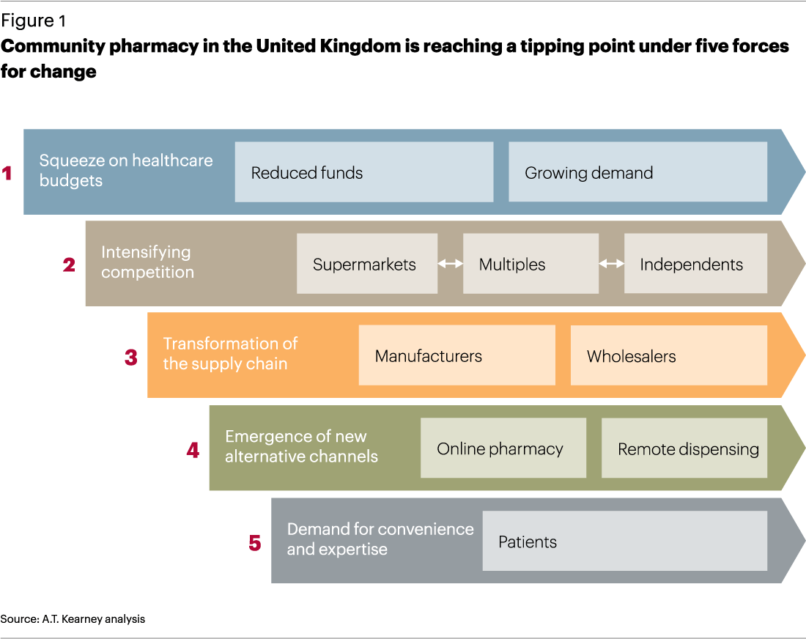

Slide 16
SIGNATURE
Patricia L Darbishire

Slide 17
Journals
Drug Designing
Drug Metabolism & Toxicology
Bioequivalence & Bioavailability

Slide 18
conferences
3rd international summit on gmp, gcp and quality control
http://www.pharmaceuticalconferences.com/gmp-gcp-quality-control-2014/
5th international conference and exhibittion on pharmaceuttics & novel drug delivery system
http://novel-drugdelivery-systems.pharmaceuticalconferences.com/
3rd International Conference and Exhibition on Pharmacognosy, Phytochemistry & Natural Products
http://pharmacognosy-phytochemistry-natural products.pharmaceuticalconferences.com/
3rd International Conference and Exhibition on Pharmacovigilance & Clinical Trials
http://www.pharmaceuticalconferences.com/pharmacovigilance-clinical-trials-2014/

Slide 19
OMICS Group Open Access Membership
OMICS publishing Group Open Access Membership enables academic and research institutions, funders and corporations to actively encourage open access in scholarly communication and the dissemination of research published by their authors.
For more details and benefits, click on the link below:
http://omicsonline.org/membership.php

