Slide 1
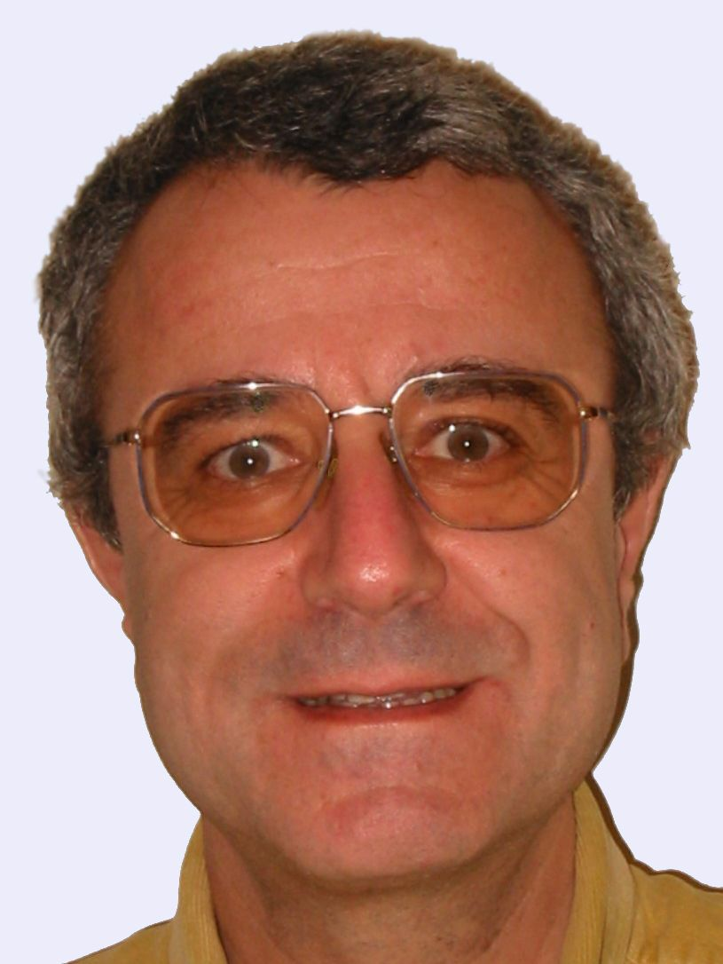
SENSOR NETWORKS AND DATA COMMUNICATIONS
Open Access
Patrick Siarry,
Ph.D.,
Editor-in-chief

Slide 2
BIOGRAPHY
Patrick Siarry was born in France in 1952. He received the PhD degree from the University Paris 6, in 1986 and the Doctorate of Sciences (Habilitation) from the University Paris 11, in 1994. He was first involved in the development of analog and digital models of nuclear power plants at Electricité de France (E.D.F.). Since 1995 he is a professor in automatics and informatics.

Slide 3
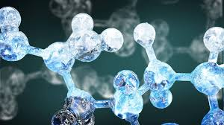
RESEARCH INTERESTS
His main research interests are computer-aided design of electronic circuits, and the applications of new stochastic global optimization heuristics to various engineering fields. He is also interested in the fitting of process models to experimental data, the learning of fuzzy rule bases, and of neural networks.

Slide 4
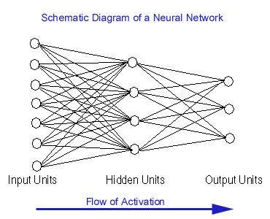
NEURAL NETWORKS
An Artificial Neural Network (ANN) is an information processing paradigm that is inspired by the way biological nervous systems, such as the brain, process information. The key element of this paradigm is the novel structure of the information processing system.

Slide 6
HISTORY
late-1800's - Neural Networks appear as an analogy to biological systems
1960's and 70's – Simple neural networks appear
Fall out of favor because the perceptron is not effective by itself, and there were no good algorithms for multilayer nets
1986 – Backpropagation algorithm appears
Neural Networks have a resurgence in popularity

Slide 8
Neural networks, with their remarkable ability to derive meaning from complicated or imprecise data, can be used to extract patterns and detect trends that are too complex to be noticed by either humans or other computer techniques. A trained neural network can be thought of as an "expert" in the category of information it has been given to analyse. This expert can then be used to provide projections given new situations of interest and answer "what if" questions.

Slide 9
Other advantages include:
Adaptive learning: An ability to learn how to do tasks based on the data given for training or initial experience.
Self-Organisation: An ANN can create its own organisation or representation of the information it receives during learning time.
Real Time Operation: ANN computations may be carried out in parallel, and special hardware devices are being designed and manufactured which take advantage of this capability.
Fault Tolerance via Redundant Information Coding: Partial destruction of a network leads to the corresponding degradation of performance. However, some network capabilities may be retained even with major network damage.

Slide 10
APPLICATIONS
Handwriting recognition
Recognizing spoken words
Face recognition
You will get a chance to play with this later!
ALVINN
TD-BACKGAMMON

Slide 11
ALVINN
Autonomous Land Vehicle in a Neural Network
Robotic car
Created in 1980s by David Pomerleau
1995
Drove 1000 miles in traffic at speed of up to 120 MPH
Steered the car coast to coast (throttle and brakes controlled by human)
30 x 32 image as input, 4 hidden units, and 30 outputs

Slide 12
TD-GAMMON
Plays backgammon
Created by Gerry Tesauro in the early 90s
Uses variation of Q-learning (similar to what we might use)
Neural network was used to learn the evaluation function
Trained on over 1 million games played against itself
Plays competitively at world class level

Slide 13
BASIC IDEA
Modeled on biological systems
This association has become much looser
Learn to classify objects
Can do more than this
Learn from given training data of the form (x1...xn, output)

Slide 14
PROPERTIES
Inputs are flexible
any real values
Highly correlated or independent
Target function may be discrete-valued, real-valued, or vectors of discrete or real values
Outputs are real numbers between 0 and 1
Resistant to errors in the training data
Long training time
Fast evaluation
The function produced can be difficult for humans to interpret

Slide 15
RECENT PUBLICATIONS
A framework for analysis of brain cine MR sequences. Nakib A, Siarry P, Decq P. Comput Med Imaging Graph. 2012 Mar;36(2):152-68.
Fast brain MRI segmentation based on two-dimensional survival exponential entropy and particle swarm optimization. Nakib A, Roman S, Oulhadj H, Siarry P. Conf Proc IEEE Eng Med Biol Soc. 2007;2007:5563-6.
Robust rigid registration of retinal angiograms through optimization. Dréo J, Nunes JC, Siarry P. Comput Med Imaging Graph. 2006 Dec;30(8):453-63. Epub 2006 Oct 10.
Optimized brainstem auditory evoked potentials estimation using simulated annealing. Cherrid N, Naït-Ali A, Siarry P. J Clin Monit Comput. 2005 Jun;19(3):231-8.
Fast simulated annealing algorithm for BAEP time delay estimation using a reduced order dynamic model. Cherrid N, Naït-Ali A, Siarry P. Med Eng Phys. 2005 Oct;27(8):705-11.

Slide 16
SENSOR NETWORKS AND DATA COMMUNICATIONS RELATED JOURNALS
Biosensors & Bioelectronics
Biosensors Journal

Slide 17
SENSOR NETWORKS AND DATA COMMUNICATIONS RELATED CONFERENCES
Global Summit on Electronics and Electrical Engineering, November 03-05, 2015 Valencia, Spain
4th International Conference and Exhibition on Biometrics & Biostatistics, November 16-18, 2015 San Antonio, USA
2ndInternational Conference on Big Data Analysis and Data Mining, November 30-December 02, 2015 San Antonio, USA
2nd International Conference and Business Expo on Wireless & Telecommunication April 21-22, 2016 Dubai, UAE

Slide 18
OMICS International Open Access Membership
OMICS International Group Open Access Membership enables academic and research institutions, funders and corporations to actively encourage open access in scholarly communication and the dissemination of research published by their authors.
For more details and benefits, click on the link below:
http://omicsonline.org/membership.php

Slide 19
E- Signature

