Slide 1

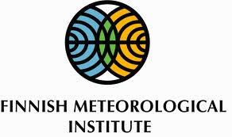

Journal of Astrobiology and Outreach
Dr. PekkaJanhunen
Editorial Board member
Research Manager
Finnish Meteorological Institute
Helsinki
Finland

Slide 2
Biography
Dr. PekkaJanhunen
Dr. Janhunen received his PhD on space plasma physics from University of Helsinki in 1994, the thesis topic was electrostatic simulation of ionospheric E-region irregularities and MHD simulation of ionosphere-magnetosphere coupling.
Thereafter Janhunen started to develop a global MHD-based ionosphere-magnetosphere coupling model “GUMICS” which was essentially completed in 1999-2000 and is in active use today.
Starting from 2000 he developed also hybrid plasma simulations for Mars and other unmagnetised planets, various other plasma simulations for auroral physics as well as analysed lots of satellite plasma physics data in collaboration with Swedish and other scientists.
He also made some contributions to astrobiological fields and in 2006 led a collaborative study which formulated a biosphere-geosphere interaction model for the evolutionary pressure required for the birth of multicellular life.
In recent years he has mainly worked with the electric solar wind sail deep-space propulsion method which he invented in 2004-2006.

Slide 3
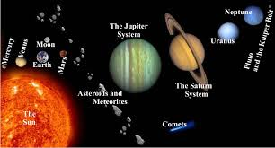
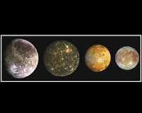
Research Interests
Space Plasma Physics,
MHD Simulation,
Particle-in-cell Simulation,
Hybrid Simulation, Auroral Physics,
Magnetospheric Physics,
Electric Solar Wind Sail Propulsion,
Space Technology,
Astrobiology

Slide 4
Recent Publications
Optimal interplanetary rendezvous combining electric sail and high thrust propulsion system ,Alessandro A. Quarta, Giovanni Mengali, Pekka Janhunen, Acta Astronautica, vol. 68, no. 5, pp. 603-621, 2011.
Status report of the electric sail in 2009, Pekka Janhunen, Acta Astronautica - ACTA ASTRONAUT , vol. 68, no. 5, pp. 567-570, 2011
Aalto-1: a hyperspectral Earth observing nanosatellite, Heikki Saari, Pekka Janhunen, 2011.
Aalto-1 - An experimental nanosatellite for hyperspectral remote sensing,Jaan Praks, , Pekka Janhunen, : Geoscience and Remote Sensing IEEE International Symposium - IGARSS , pp. 4367-4370, 2011.
Cassini Plasma Spectrometer and hybrid model study on Titan's interaction: Effect of oxygen ions, I. Sillanpää, D. T. Young, P. Janhunen, Journal of Geophysical Research , vol. 116, no. A7, 2011.

Slide 5
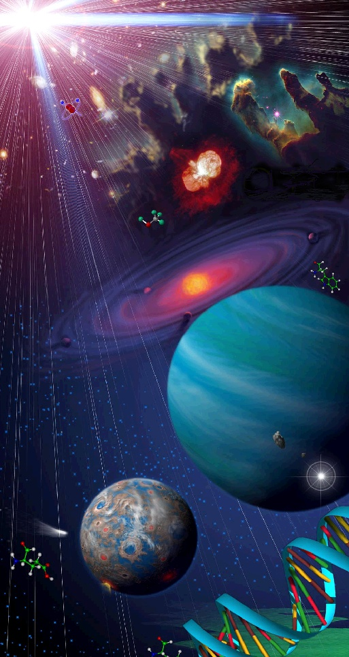
What is Astrobiology?
“Astrobiology is the study of life in the universe. It investigates the origin, evolution, distribution, & future of life on Earth, & the search for life beyond Earth. ”
Astrobiology addresses three fundamental questions:
1) How does life begin & evolve?
2) Is there life beyond Earth & how
can we detect it?
3) What is the future of life on Earth
& in the universe?”
Astrobiology addresses the question of whether life exists beyond Earth, and how humans can detect it if it does!!
Notes:
http://astrobiology.gly.bris.ac.uk/img/Astrobio-origins.jpg

Slide 6
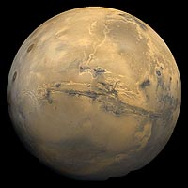
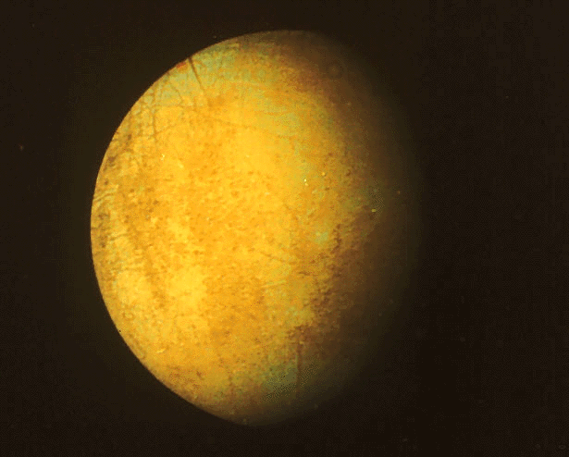
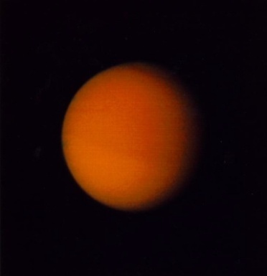
Life Elsewhere
Studies of life in extreme environments on Earth have led us to focus on some prime places to look for life
Mars
Europa (moon of Jupiter)
Titan (moon of Saturn)

Slide 7
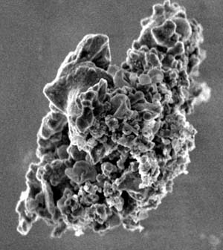
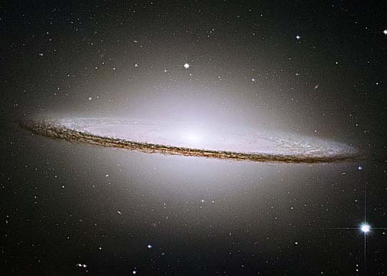
Life in the Universe
Hubble Space Telescope
image of Sedna-
takes 10,500 years
to circle the Sun!
Our Solar System has planets, dwarf planets, moons, asteroids, comets, and interplanetary dust.
Milky Way galaxy has 100 billion (100,000,000,000) stars.
Universe has 100 billion (or more) galaxies.
Many stars have planets.
Some like Jupiter and Saturn.
Some may be like Earth.
Potential for a large number of Earth-like planets (ELPs).
Interplanetary Dust
Particle -10 µm across
made by dying and exploded stars

Slide 8
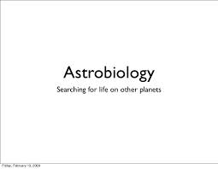
Astrobiology, Incremental Data Accumulation,
New Ideas & Understanding, Paradigm Shifts
NOTICE THE TIME FRAMES….
Search for Extrasolar Planets ~ 15 years
Deep Time: Reinterpreting Early Earth < 5-10 years
Life on the Edge (extreme environments) Late 70’s Vents
The Rock that Started it all- Scientific Process Mid 90’s
Asteroids and Dinosaur Extinction ~ ’79
Human Microbiomes ~ 5-10 years

Slide 9
Astrobiology makes use of physics, chemistry, astronomy, biology, molecular biology, ecology, planetary science, geography, and geology to investigate the possibility of life on other worlds and help recognize biospheres that might be different from the biosphere on Earth.
Astrobiology concerns itself with interpretation of existing scientific data; given more detailed and reliable data from other parts of the universe, the roots of astrobiology itself—physics, chemistry and biology—may have their theoretical bases challenged.
Although speculation is entertained to give context, astrobiology concerns itself primarily with hypotheses that fit firmly into existing scientific theories.
It has been proposed that viruses are likely to be encountered on other life-bearing planets.Efforts to discover current or past life on Mars is an active area of research.

Slide 10
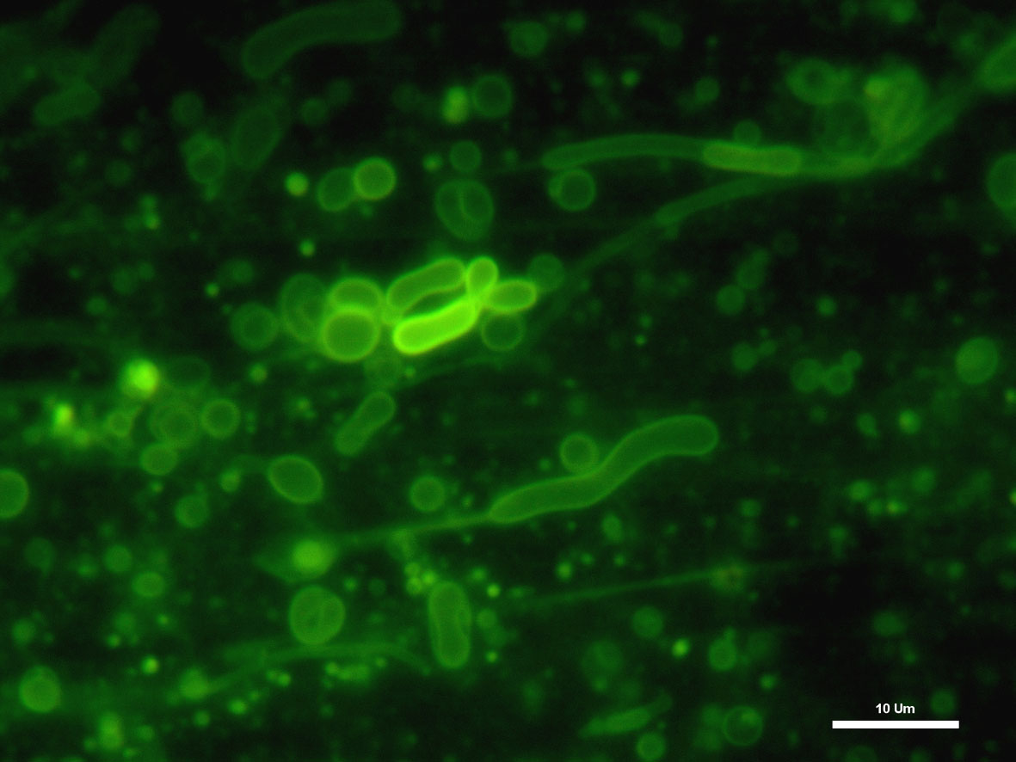
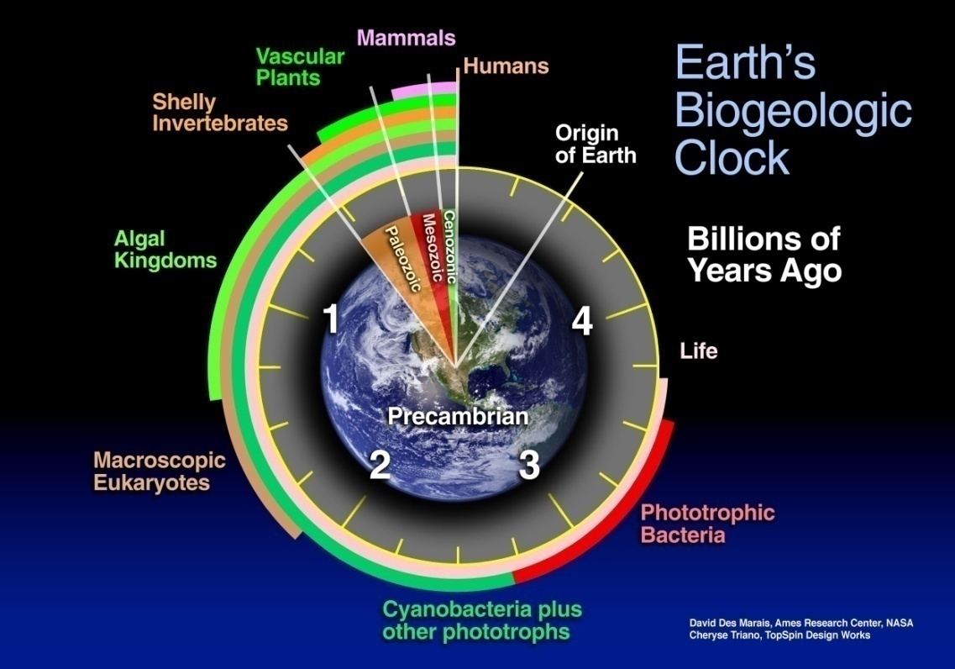
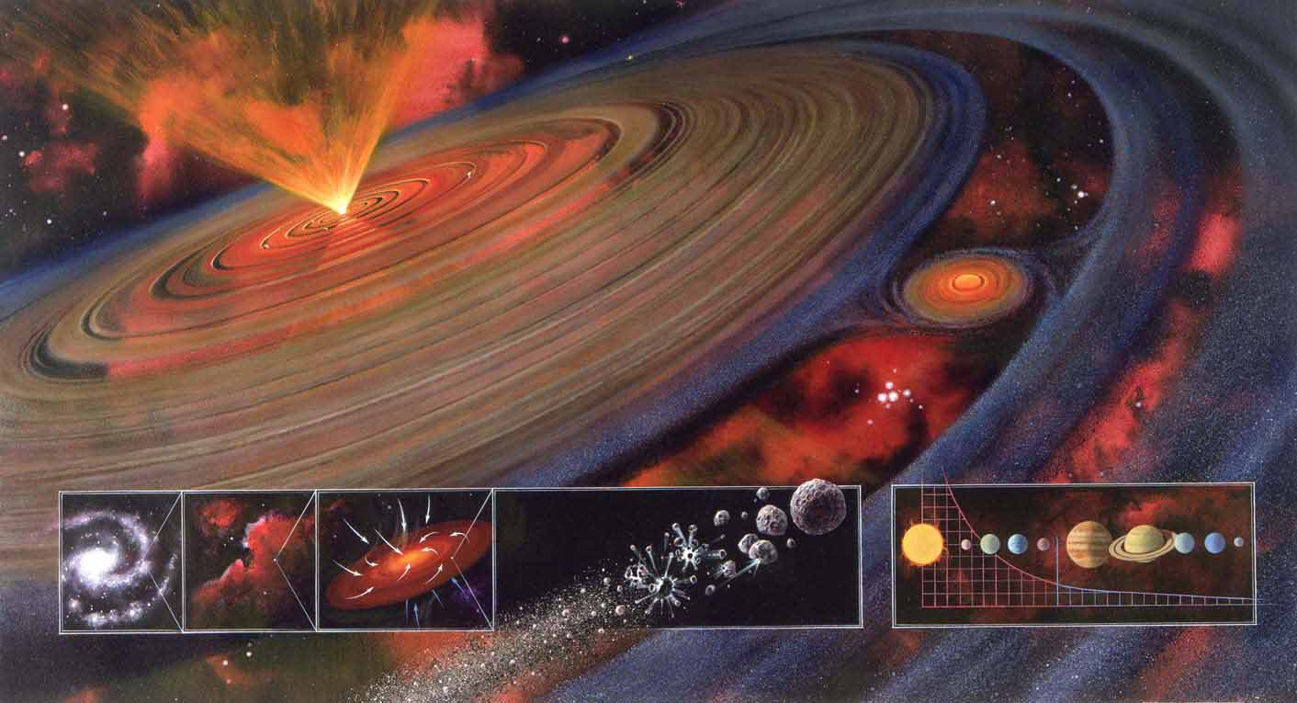
Astrobiology Unites Disciplines to Study Life in the Universe
Origins,
Evolution,
Distribution
and Future
of Life
Notes:
10

Slide 11
While it is an emerging and developing field, the question of whether life exists elsewhere in the universe is a verifiable hypothesis and thus a valid line of scientific inquiry. Though once considered outside the mainstream of scientific inquiry, astrobiology has become a formalized field of study.
Earth is the only place in the universe known to harbor life.However, recent advances in planetary science have changed fundamental assumptions about the possibility of life in the universe, raising the estimates of habitable zones around other stars, along with the discovery of hundreds of extrasolar planets and new insights into the extreme habitats here on Earth, suggesting that there may be many more habitable places in the universe than considered possible until very recently.
On 4 November 2013, astronomers reported, based on Keplerspace mission data, that there could be as many as 40 billion Earth-sized planets orbiting in the habitable zones of sun-like stars and red dwarf stars within the Milky Way Galaxy.11 billion of these estimated planets may be orbiting sun-like stars.

Slide 12
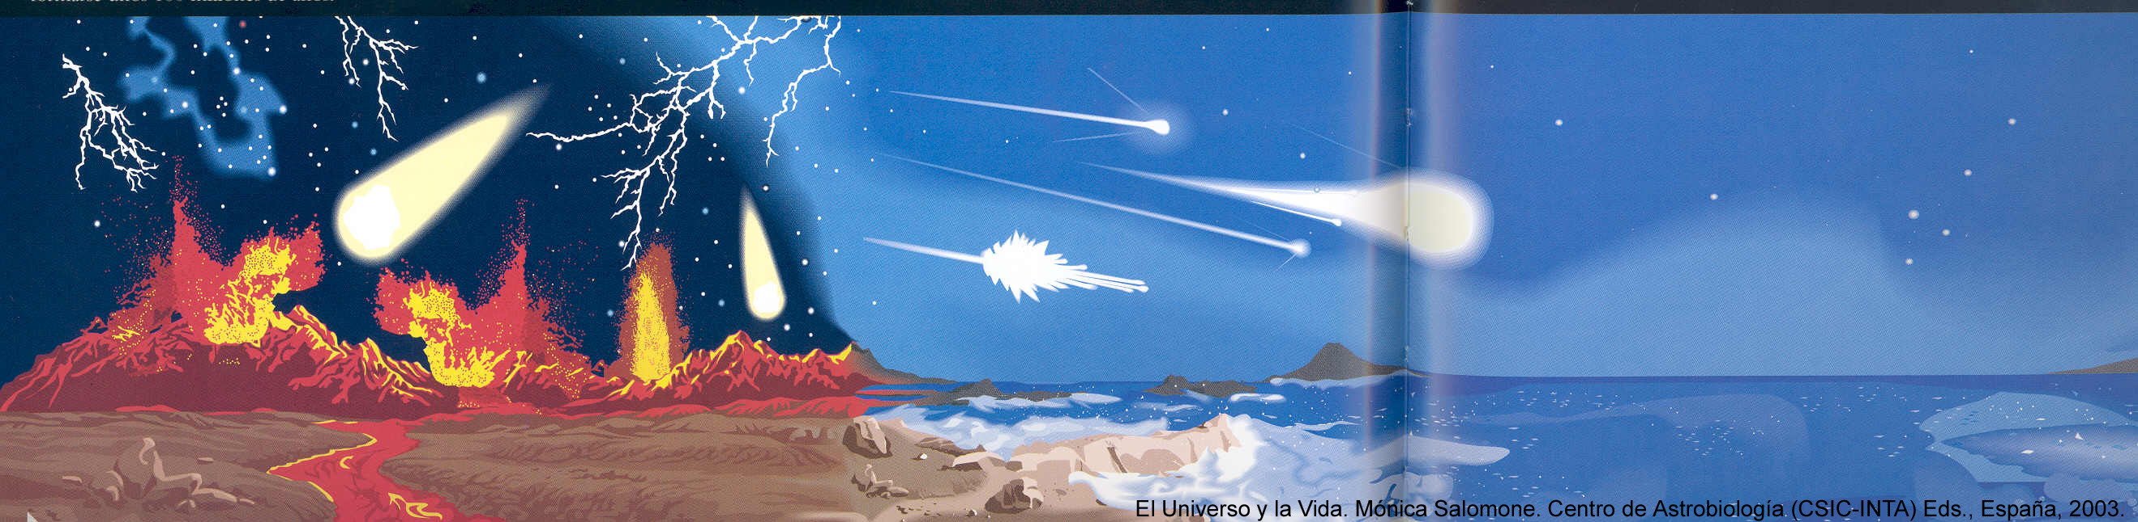
The Origin of Life on Earth
4 billion years ago
The nearest such planet may be 12 light-years away, according to the scientists.
A particular focus of current astrobiology research is the search for life on Mars due to its proximity to Earth and geological history. There is a growing body of evidence to suggest that Mars has previously had a considerable amount of water on its surface, water being considered an essential precursor to the development of carbon-based life

Slide 13
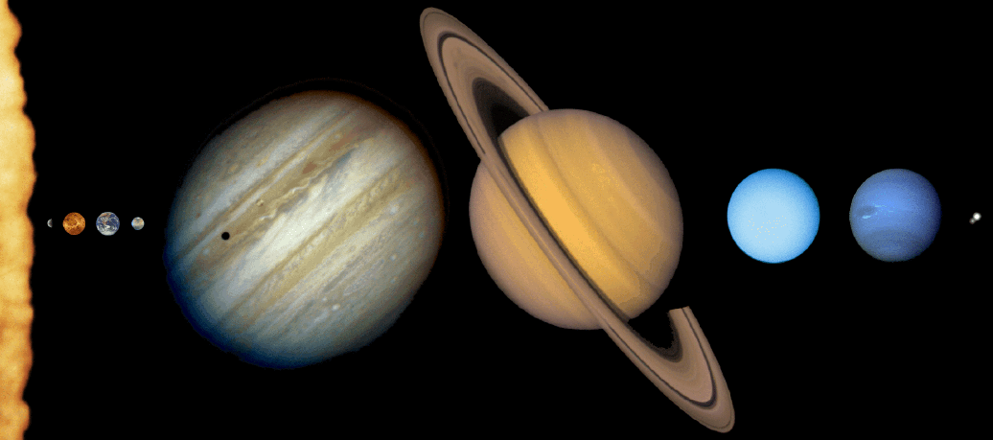
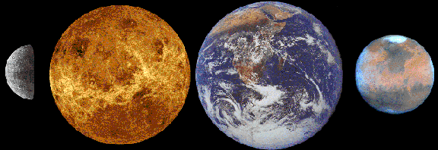
Our Solar System
Uranus
Pluto
Jupiter
Saturn
Neptune
Neptune
Mercury
Venus
Earth
Mars

Slide 14
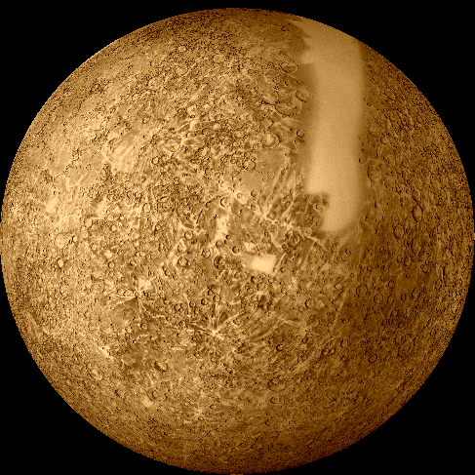
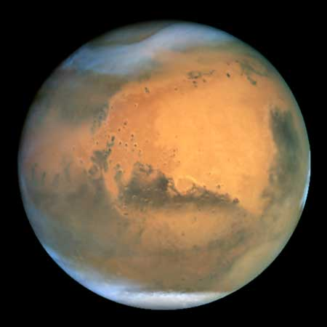
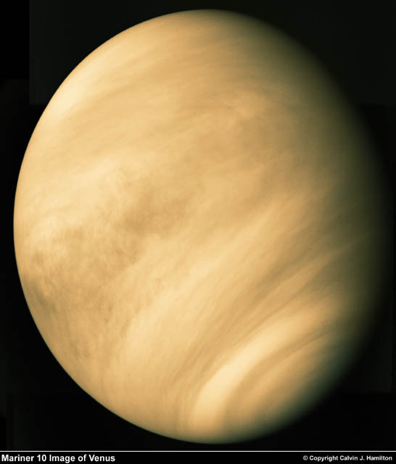
The Terrestrial Planets
Very hot because its atmosphere
Mercury
Mars
Very near the Sun
Venus
No atmosphere, cold but…

Slide 15
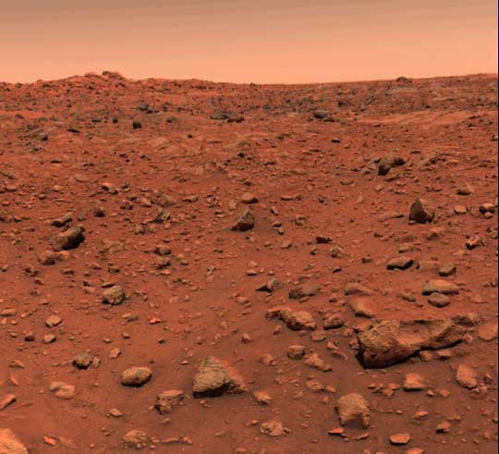
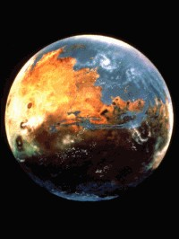
Mars

Slide 16
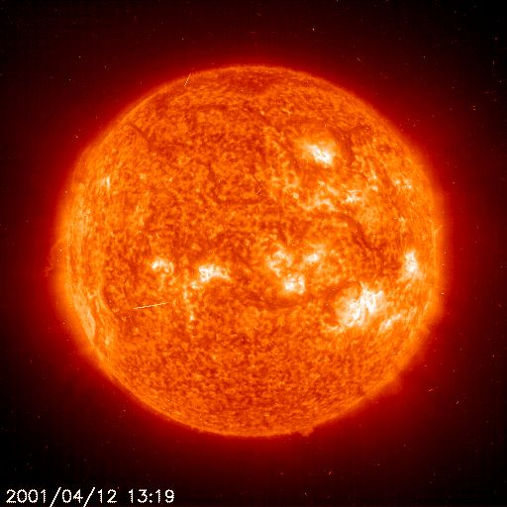
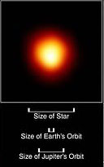
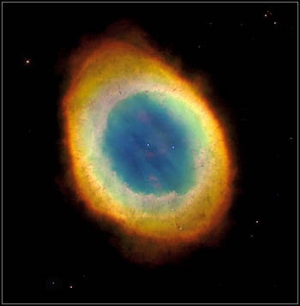
The life of the stars
Red Giant
Panetary nebula and white dwarf
Yellow dwarf
10 billion years

Slide 17
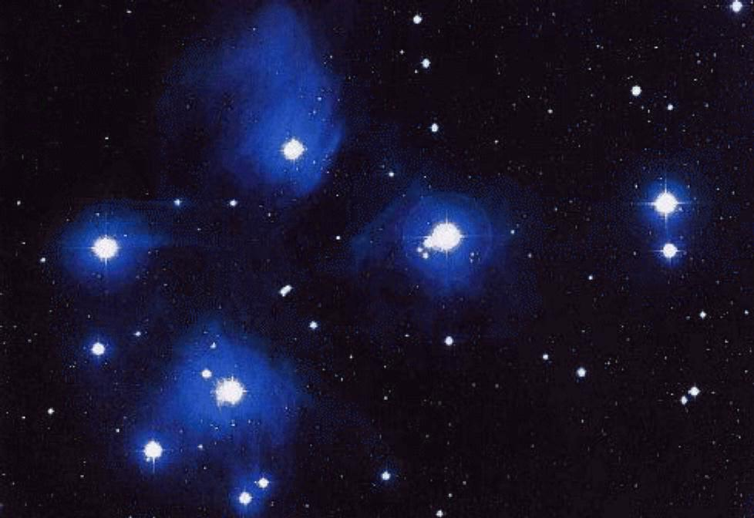
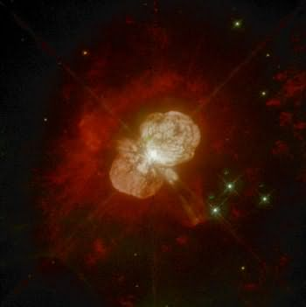
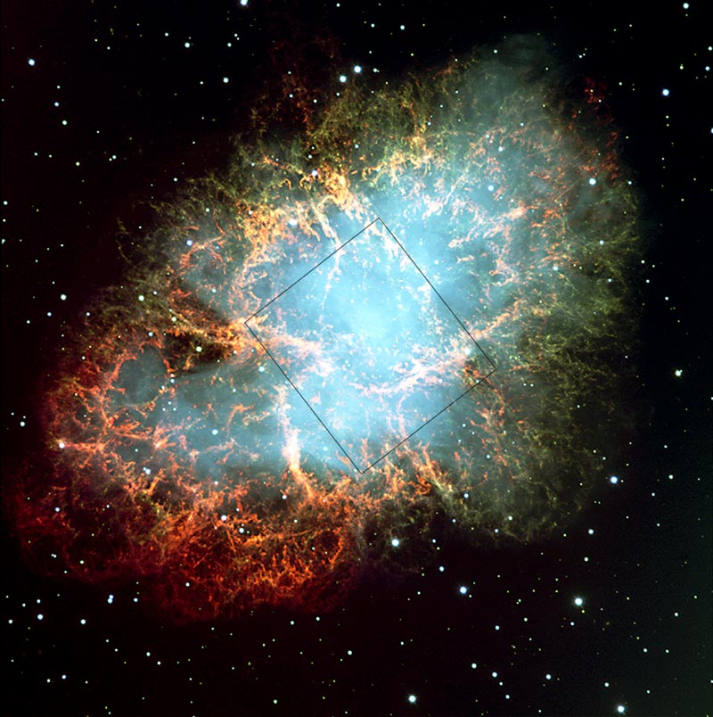
The life of the stars
Blue giants
100 million years
Supernova remmanent and neutron star
Supernova

Slide 18
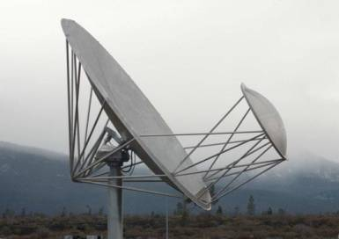
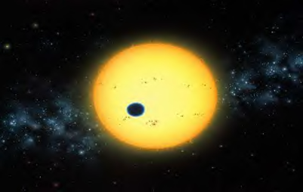
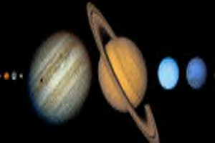
Multiple Different Search Types
SETI Searches
Extrasolar/Habitable Planets
Exobiology in the Solar System
Notes:
18

Slide 19
Multiple Different Search Types
SETI Searches
  Radio-telescopes - within Galaxy
  Discovery: Intelligent Life
  Unknown Biology or Chemistry
  Light Years Away (still exist?)
  Aliens ???
Extrasolar/Habitable Planets
Telescopes - within Galaxy
Discovery: Other Solar Systems; Terrestrial Planets?
Information on Atmospheres (Compostion/Conditions?)
Maybe Habitable?
Life ???
Notes:
19

Slide 20
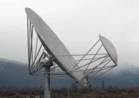
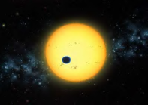
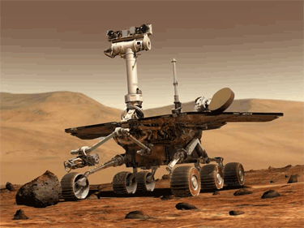
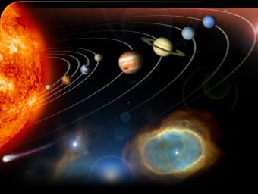
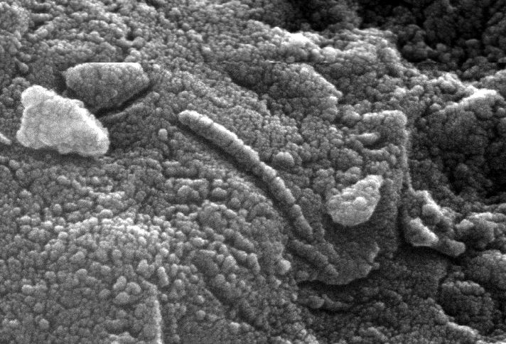

Multiple Different Search Types
SETI Searches
Extrasolar/Habitable Planets
Exobiology in the Solar System **
Missions -- visits
  Meteorites -- Fossil Evidence?
  Cosmochemistry (Process; Replication)
  Origin of Life Research (Lab Experiments)
** Real Time; Potential for Cross Contamination; Biohazards
Notes:
20

Slide 21
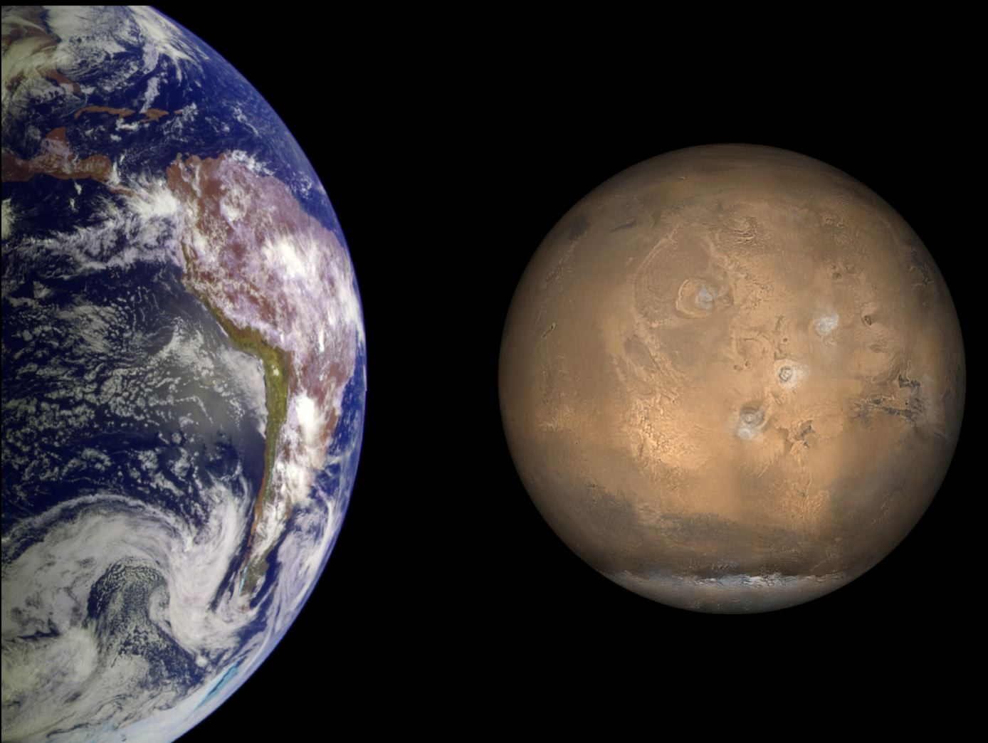
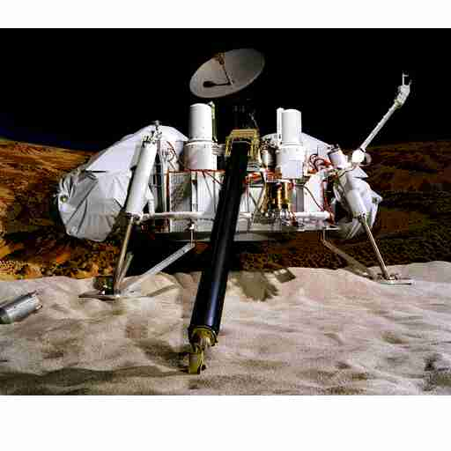
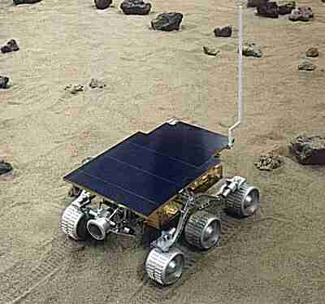
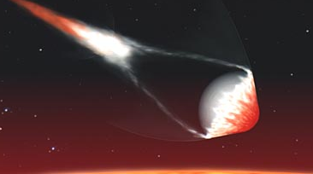
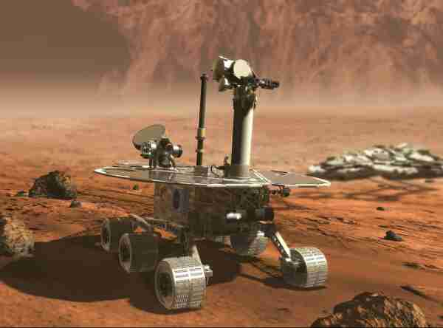
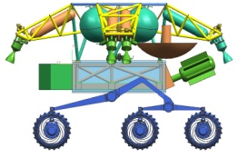
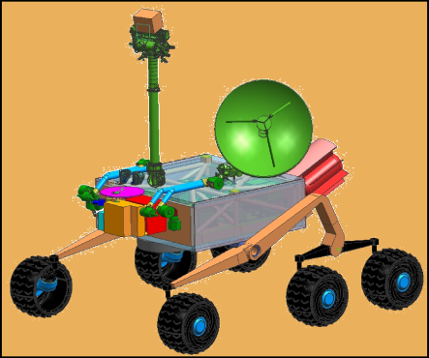
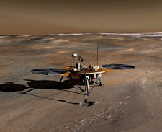
1976
Strategy Has Worked on Mars…
Built Understanding about Mars and its Environment over time...
1996
2003
2007
2011
More and more indications of water found…
Small and large scales…

Slide 22
According to Pekka Janhunen,,
From a mission analysis point of view, the performance of a hybrid propulsion concept for a two-dimensional transfer towards a planet of the Solar System.
The propulsion system is obtained by combining a chemical thruster, used for the phases of Earth escape and/or target planet capture, with an electric sail, which provides a continuous thrust during the heliocentric transfer.
Two possible mission scenarios are investigated: in the first case the sailcraft reaches the target planet with zero hyperbolic excess velocity, thus performing a classical rendezvous mission in a heliocentric framework.
In the second mission scenario, a given final hyperbolic excess velocity relative to the planet is tolerated in order to decrease the mission flight time.
The amount of final hyperbolic excess velocity is used as a simulation parameter for a tradeoff study in which the minimum flight time is related to the total velocity variation required by the chemical thruster to accomplish the mission, that is, for Earth escape and planetary capture.

Slide 23
Approved by
E-signature:
This powerpoint ahs been approved by Dr. PekkaJanhunen

Slide 24
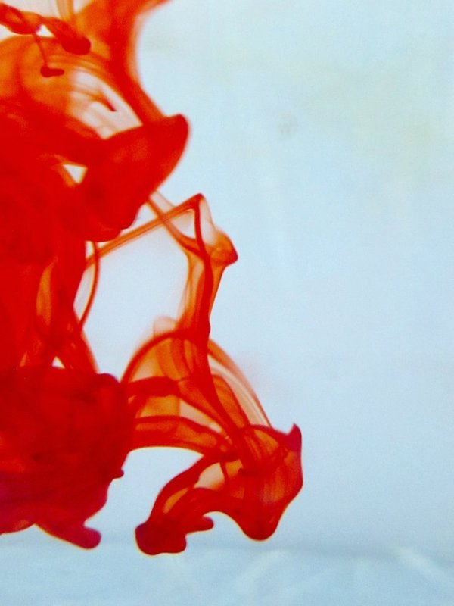

OMICS International Open Access Membership
OMICS International Open Access Membership enables academic and research institutions, funders and corporations to actively encourage open access in scholarly communication and the dissemination of research published by their authors.
For more details and benefits, click on the link below:
http://omicsonline.org/membership.php

