Slide 1

OMICS Journals are welcoming Submissions
OMICS International welcomes submissions that are original and technically so as to serve both the developing world and developed countries in the best possible way.
OMICS Journals are poised in excellence by publishing high quality research. OMICS International follows an Editorial Manager® System peer review process and boasts of a strong and active editorial board.
Editors and reviewers are experts in their field and provide anonymous, unbiased and detailed reviews of all submissions.
The journal gives the options of multiple language translations for all the articles and all archived articles are available in HTML, XML, PDF and audio formats. Also, all the published articles are archived in repositories and indexing services like DOAJ, CAS, Google Scholar, Scientific Commons, Index Copernicus, EBSCO, HINARI and GALE.
For more details please visit our website: http://omicsonline.org/Submitmanuscript.php

Slide 2

NSYSU
Journal of Lasers, Optics and Photonics
Mechanical & Micro-Mechanical Engineering
Understanding of workpiece defects induced by laser beam
P. S. Wei
Xi-Wan Chair Professor
Department of Mechanical and Electro-Mechanical Engineering
National Sun Yat-Sen University
Kaohsiung, Taiwan 80424, ROC
E-mail: pswei@mail.nsysu.edu.tw
Heat Transfer Lab for Manufacturing and Materials Processing

Slide 3
Abstract
NSYSU
Mechanical & Micro-Mechanical Engineering
This presentation deals with (1) defects of surface rippling and humping and root spiking and (2) pore formation due to super-saturation and liquid entrapment after solidification. Surface rippling and humping often accompany solute segregation, porosity, crack, deformation, etc. Spiking accompanies cold shut and porosity is another severe defect. Incapable drilling also results from collapse of the induced keyhole. Finding mechanisms of these defects is essentially required to control qualities of workpieces.
Heat Transfer Lab for Manufacturing and Materials Processing

Slide 4
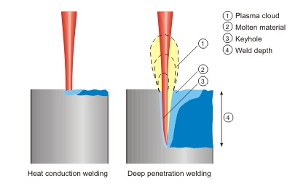
Introduction
NSYSU
Mechanical & Micro-Mechanical Engineering
Laser welding or melting (http://www.rofin.com/en/applications/laser_welding/welding_methods/)
Heat Transfer Lab for Manufacturing and Materials Processing

Slide 5
NSYSU
Experimental setup
Mechanical & Micro-Mechanical Engineering
TORVAC EBW, max. 60 kV, 50 mA, 60 mm/s, 3000 W
Heat Transfer Lab for Manufacturing and Materials Processing

Slide 6
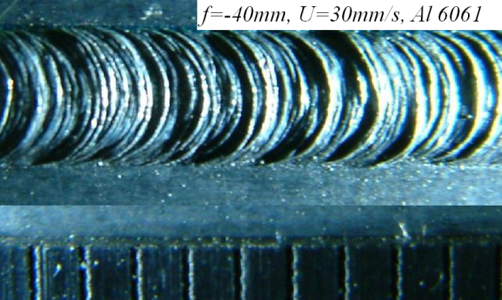
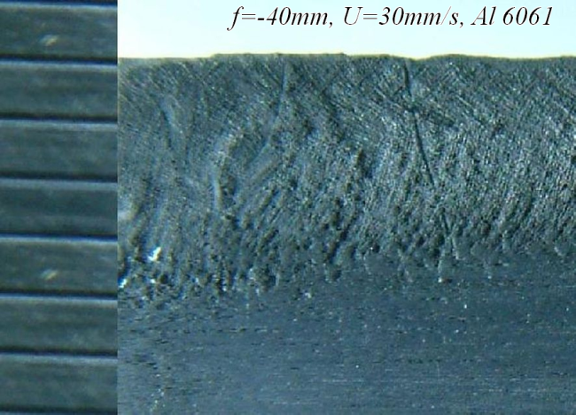
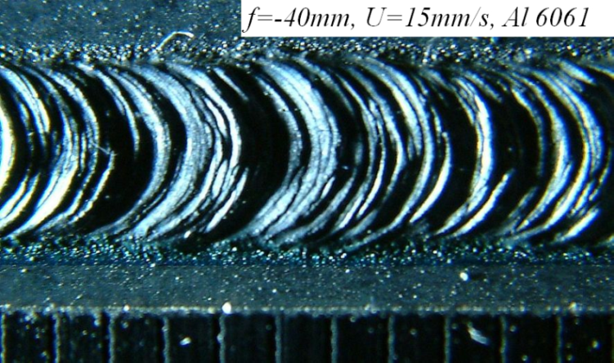
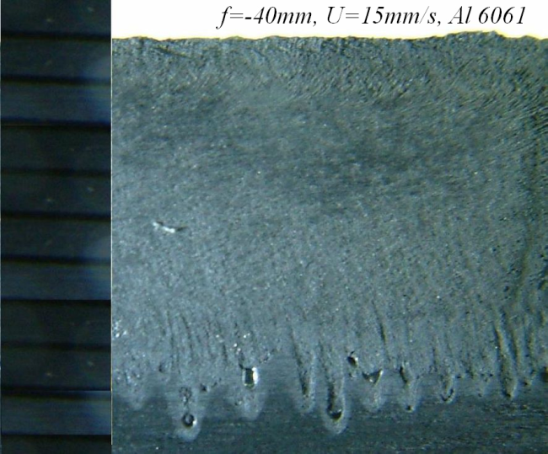
Observation and measurements
NSYSU
Mechanical & Micro-Mechanical Engineering
Rippling and spiking are decreased by increasing welding speed. Porosity can also be seen near the spiking tip (Wei et al. 2012, IEEE Trans. CPMT)
Heat Transfer Lab for Manufacturing and Materials Processing

Slide 7
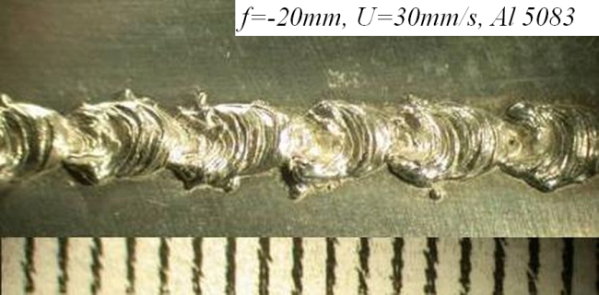
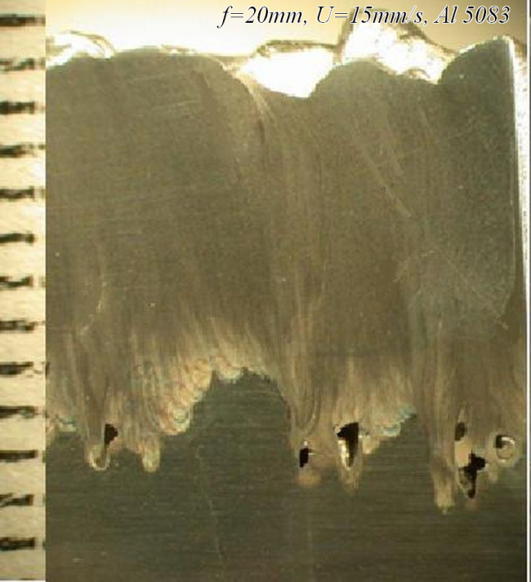
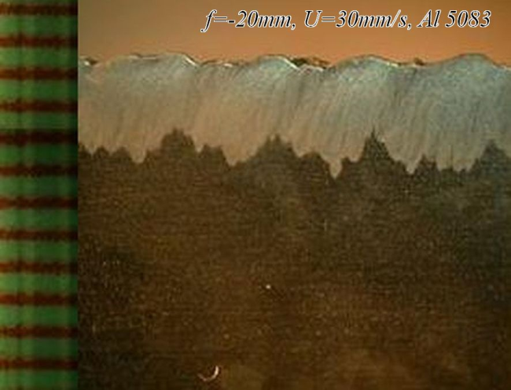
(continued)
NSYSU
Mechanical & Micro-Mechanical Engineering
Spiking and humping are decreased by increasing welding speed and raising focal location. Porosity can also be seen near the spiking tip (Wei et al. 2012. IEEE Trans. CPMT)
Heat Transfer Lab for Manufacturing and Materials Processing

Slide 8
(continued)
NSYSU
Mechanical & Micro-Mechanical Engineering
Spiking tendency by considering energy conservation in welding and
vertical directions is given by (Wei et al. 2012, IEEE Trans. CPMT)
where melting efficiency is
Heat Transfer Lab for Manufacturing and Materials Processing

Slide 9
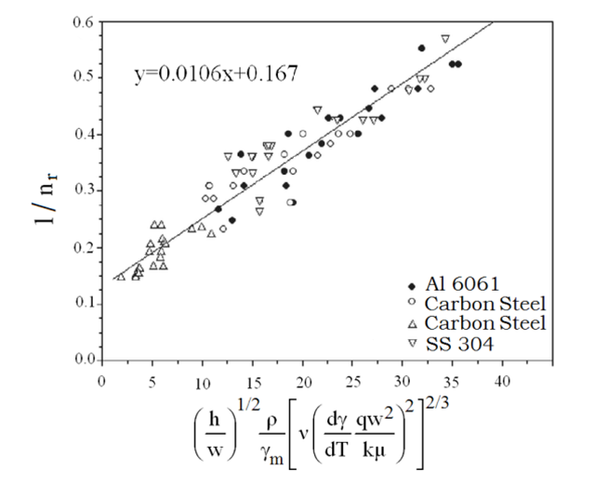
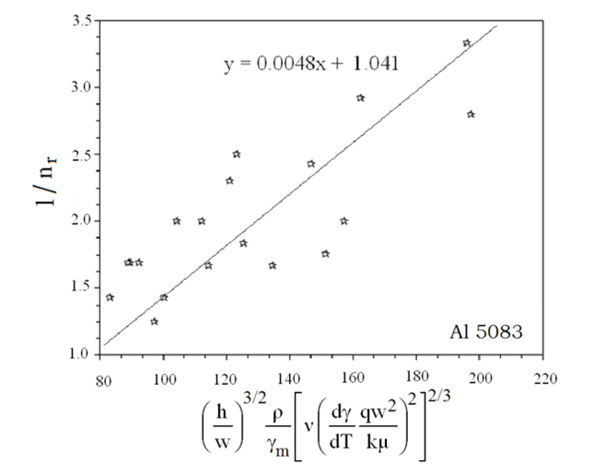
NSYSU
(continued)
Mechanical & Micro-Mechanical Engineering
Average pitch of humping or spiking for alloys in the absence and presence of volatile elements are, respectively,
Heat Transfer Lab for Manufacturing and Materials Processing

Slide 10

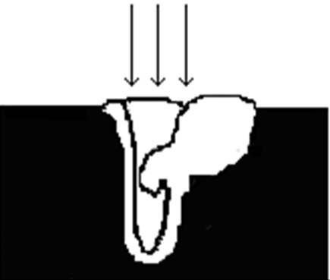

Pore formation
NSYSU
Mechanical & Micro-Mechanical Engineering
Pore formation due to liquid entrapment in keyhole welding
(Pastor et al. 2001, Weld. Int.)
Bubble nucleated due to super-saturation
Heat Transfer Lab for Manufacturing and Materials Processing

Slide 11
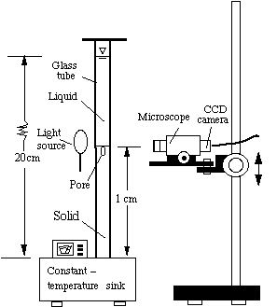
Experimental setup
NSYSU
Mechanical & Micro-Mechanical Engineering
Experimental Setup (Wei et al. 2003, Metall. Mater. Trans B;
Wei et al. 2004, JCG)
Heat Transfer Lab for Manufacturing and Materials Processing

Slide 12
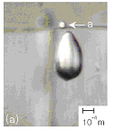
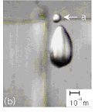
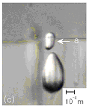
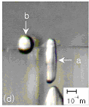
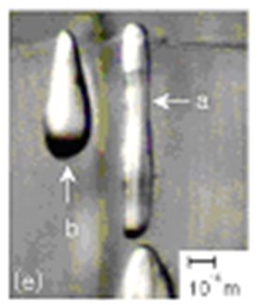
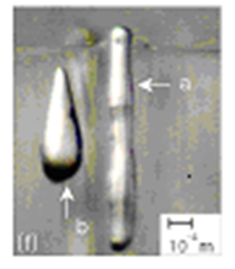
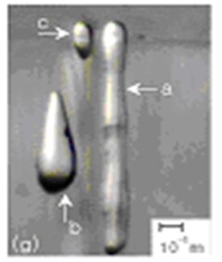
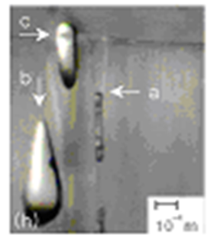
Bubbles trapped in solid at different times or locations near the location of 1 cm (a) 0, (b) 5, (c) 20, (d) 60, (e) 120, (f) 150, (g) 180, and (h) 206 s during the freezing of water containing oxygen gas content of 0.0041 g/100 g and temperature of the constant temperature sink of -25⁰C (Wei et al. 2004, JCG).
(continued)
NSYSU
Mechanical & Micro-Mechanical Engineering
Heat Transfer Lab for Manufacturing and Materials Processing

Slide 13
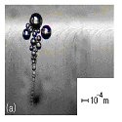
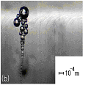
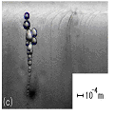
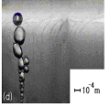
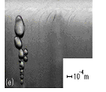
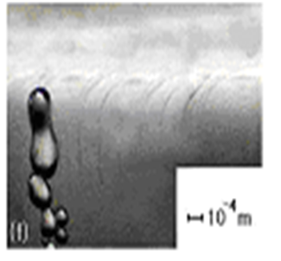

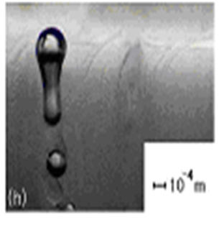
Bubbles trapped in solid at different times or locations near a location of 1 cm (a) 0 s,(b) 450 s, (c) 540 s, (d) 810 s, (e) 900 s, (f) 1170 s, (9) 1350 s, (h) 1440 s during the freezing of water containing oxygen gas content of 0.0037 g/100 g and temperature of -25⁰C of the constant temperature sink (Wei et al. 2004).
(continued)
NSYSU
Mechanical & Micro-Mechanical Engineering
Heat Transfer Lab for Manufacturing and Materials Processing

Slide 14
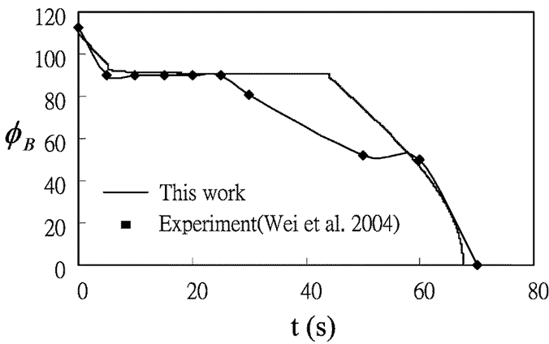
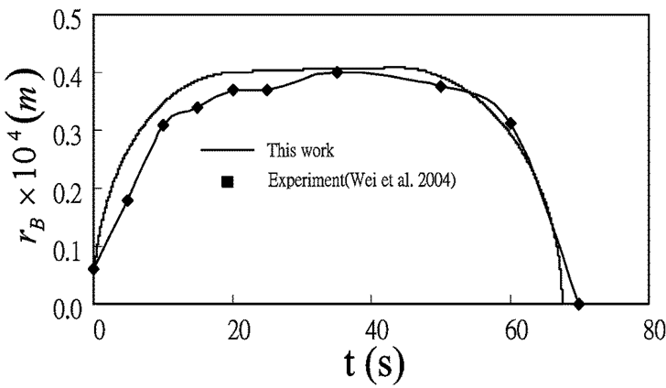

Pore formation due to super-saturation
NSYSU
Mechanical & Micro-Mechanical Engineering
Differentiating equation of state with time
Mass transfer to the bubble is given by
Volume change rate is
Henry’s law is
Heat Transfer Lab for Manufacturing and Materials Processing

Slide 15
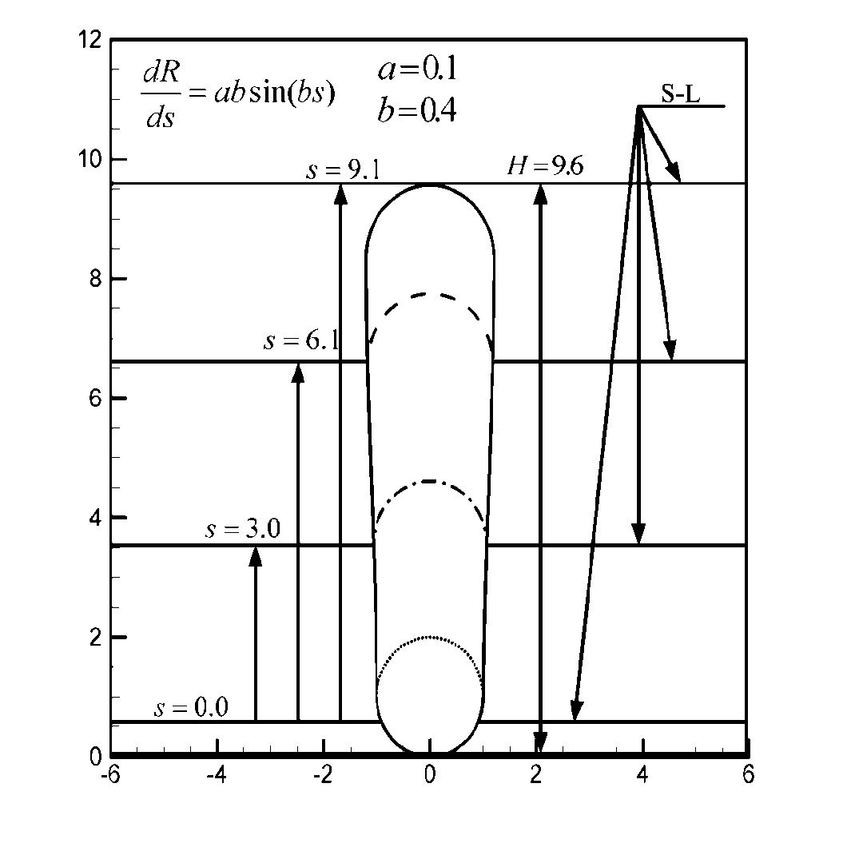
(continued)
NSYSU
Mechanical & Micro-Mechanical Engineering
Development of pore shape for dR/ds= 0.04sin(0.4s) (Wei and Hsiao, 2012)
Heat Transfer Lab for Manufacturing and Materials Processing

Slide 16
(continued)
NSYSU
Mechanical & Micro-Mechanical Engineering
Equations of mass, momentum are, respectively
Heat Transfer Lab for Manufacturing and Materials Processing

Slide 17
(continued)
NSYSU
Mechanical & Micro-Mechanical Engineering
Conservation equations of energy, concentration and phase field equations are, respectively
Heat Transfer Lab for Manufacturing and Materials Processing

Slide 18
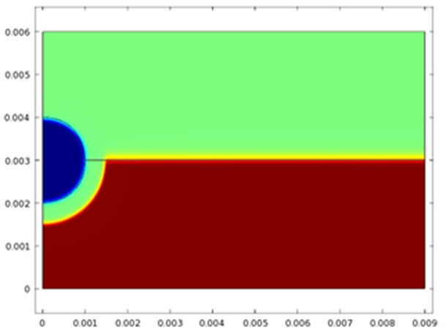
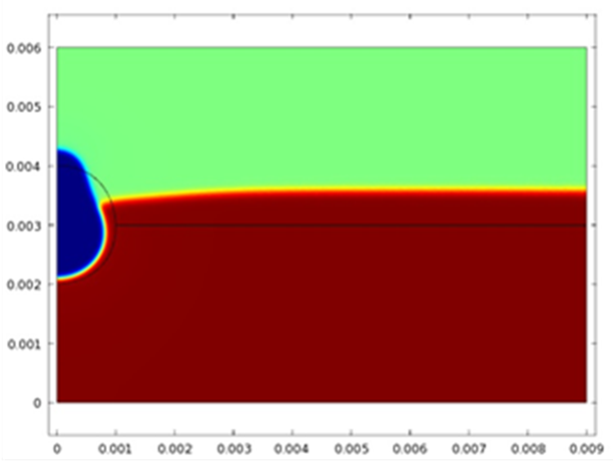
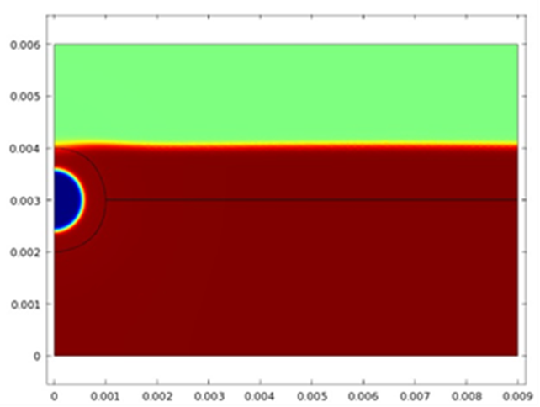
(continued)
NSYSU
Mechanical & Micro-Mechanical Engineering
Predict pore formation in aluminum
Heat Transfer Lab for Manufacturing and Materials Processing

Slide 19

Pore formation due to liquid entrapment
NSYSU
Mechanical & Micro-Mechanical Engineering
Equations of mass, momentum and energy are, respectively
The higher the gas pressure, the easier and smaller the pore can be formed
Heat Transfer Lab for Manufacturing and Materials Processing

Slide 20
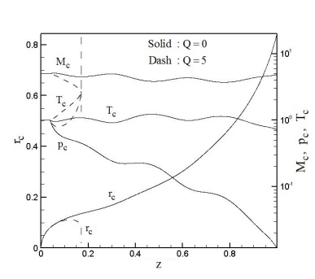
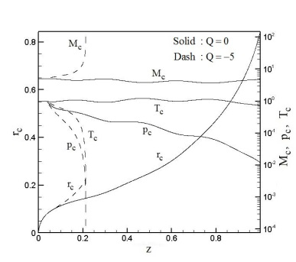
(continued)
NSYSU
Mechanical & Micro-Mechanical Engineering
Pore formation or keyhole collapse for energy absorption for a supersonic flow (Wei et al. 2014, IEEE Trans. CPMT)
Heat Transfer Lab for Manufacturing and Materials Processing

Slide 21
Conclusions
NSYSU
Mechanical & Micro-Mechanical Engineering
Mechanisms of different types of surface patterns such as rippling, gouging, undercut, and humping, and root spiking are still unclear.
Pore formation is characterized by different mechanisms: (1) super-saturation of dissolved gases in liquid ahead of the solidification front, and (2) liquid entrapment such as keyhole collapse during keyhole welding.
All these defects involve strong deformation of the free surface and different types of instabilities coupled with complicated transport processes. Controlling factors need to be clarified and determined.
Heat Transfer Lab for Manufacturing and Materials Processing

Slide 22



Journal of Laser Optics & Photonics
Journal of Photonics
Journal of Wave theory
Journal of Optics
Journal of Lasers
Signal Crystal

Slide 23

Journal of Laser Optics & Photonics
For upcoming Conference visit
http://www.conferenceseries.com/

