Slide 1


OMICS Group
OMICS Group International through its Open Access Initiative is committed to make genuine and reliable contributions to the scientific community. OMICS Group hosts over 400 leading-edge peer reviewed Open Access Journals and organizes over 300 International Conferences annually all over the world. OMICS Publishing Group journals have over 3 million readers and the fame and success of the same can be attributed to the strong editorial board which contains over 30000 eminent personalities that ensure a rapid, quality and quick review process. OMICS Group signed an agreement with more than 1000 International Societies to make healthcare information Open Access.
Contact us at: contact.omics@omicsonline.org

Slide 2
OMICS Journals are welcoming Submissions
OMICS Group welcomes submissions that are original and technically so as to serve both the developing world and developed countries in the best possible way.
OMICS Journals are poised in excellence by publishing high quality research. OMICS Group follows an Editorial Manager® System peer review process and boasts of a strong and active editorial board.
Editors and reviewers are experts in their field and provide anonymous, unbiased and detailed reviews of all submissions.
The journal gives the options of multiple language translations for all the articles and all archived articles are available in HTML, XML, PDF and audio formats. Also, all the published articles are archived in repositories and indexing services like DOAJ, CAS, Google Scholar, Scientific Commons, Index Copernicus, EBSCO, HINARI and GALE.
For more details please visit our website: http://omicsonline.org/Submitmanuscript.php

Slide 3
Prof. Peng Fan, University of Utah
Research interests
Powder metallurgy,
Hard materials
Functionally graded materials
Extractive metallurgy
Thermal energy storage materials
Renewable and sustainable energy

Slide 4
Functionally graded WC-Co
WC-Co, cemented tungsten carbide, is the most widely used industrial tool materials
It is extensively used in metal machining, oil and gas drilling, mining, and construction.
Prof. Fan and his colleagues invented a novel process to produce functionally graded WC-Co with significantly improved life time of WC-Co tools.

Slide 5
Concept of functionally graded WC-Co
Unlike conventional WC-Co with uniform Co distribution, FG WC-Co has lower Co content at surface region and thus a hard-surface tough-core structure, which leads to superior combinations of mechanical properties, e.g., increased wear resistance without sacrificing fracture toughness.

Slide 6
Novel process to make FG WC-Co

Slide 7
Key process parameter: temperature
Processing temperature needs to be in the three phase region of 1275 to 1325 C.
Co content profiles in sintered WC-10%Co specimens before and after carburizing heat treatment at different temperatures.

Slide 8
Mechanism of process
stoichiometry
A vertical section of the ternary phase diagram of W-Co-C at constant 10wt% Co.

Slide 9
Mechanism of process
Surface carburization =>
Solid Co in surface region partially or totally transforms to liquid =>
Liquid Co in surface region increase =>
Balance of liquid Co distribution between surface and core regions breaks =>
Liquid Co migrates from surface region to core region =>
Co gradient forms.

Slide 10
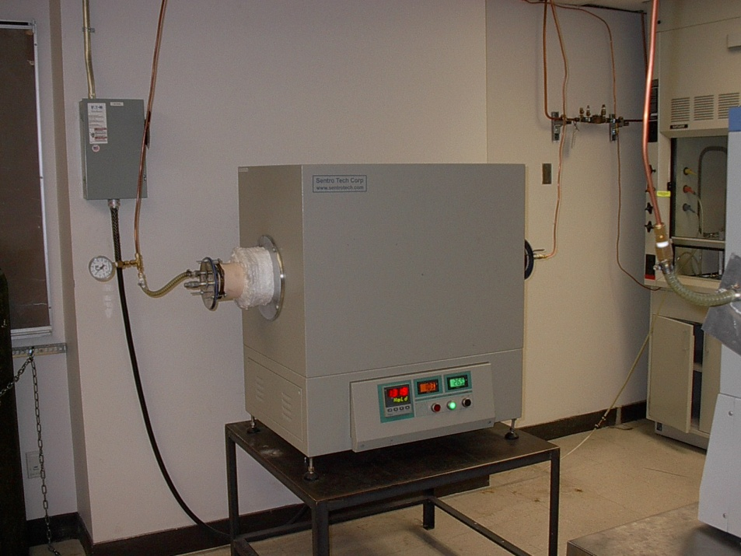
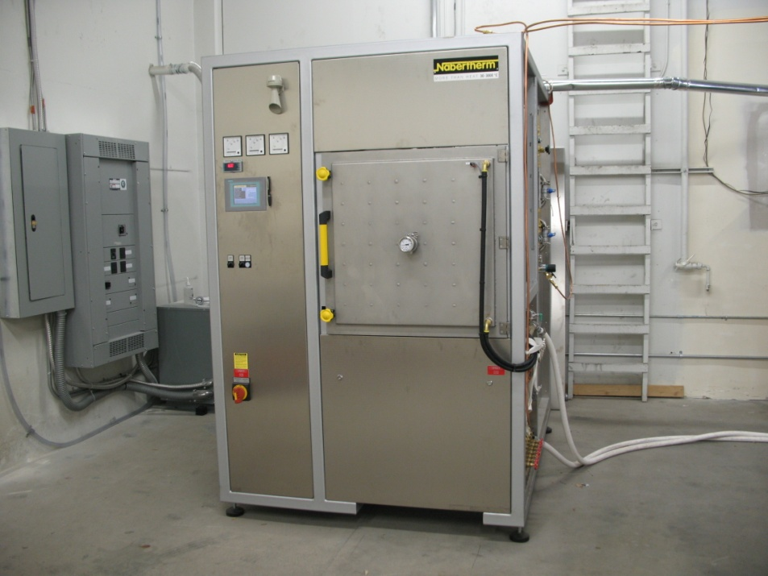
Successful scale up of process
Tube furnace:
<1 kg WC-Co per run
Pilot production furnace:
>50 kg WC-Co per run

Slide 11
Direct reduction of Ti slag to make Ti

Slide 12
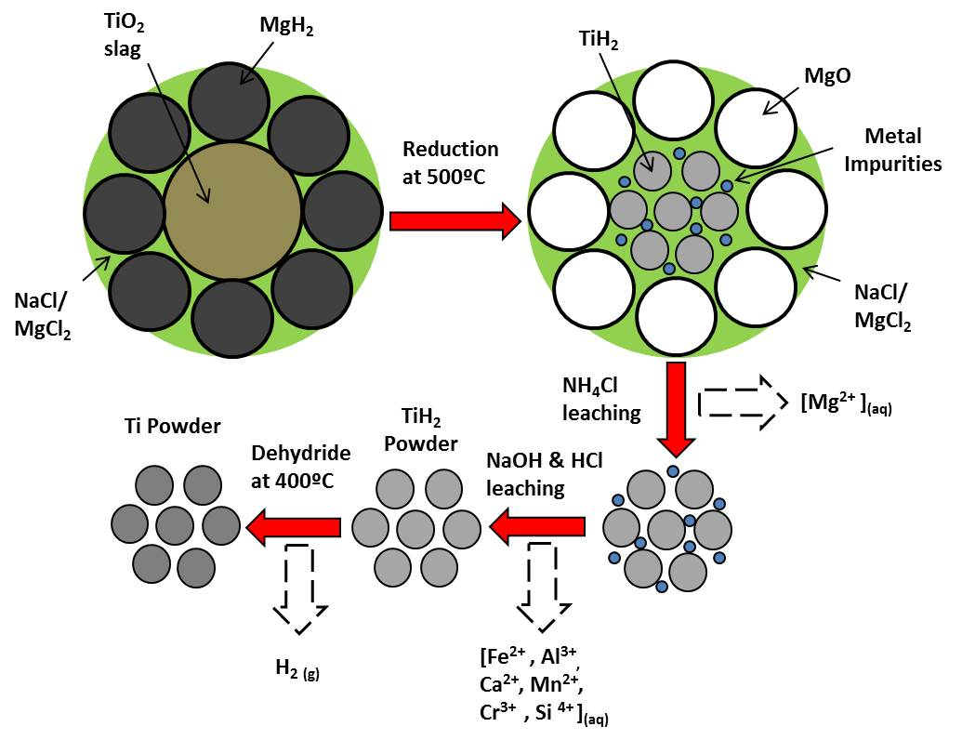
Mechanism of process

Slide 13
Thermodynamic feasibility analysis

Slide 14
Process flow chart
Ti slag
Milling/Blending
MgH₂ & Salts
Direct Reduction
H₂
NH₄Cl
_{solution}
NH₄Cl Leach&wash
CaO
MgO
NaOH
_{solution}
NaOH Leach&wash
Al₂O₃
SiO₂
HCl
_{solution}
HCl Leach&Wash
Fe
Mn
Cr
Drying
TiH₂ Powder
Dehydriding
Ti powder

Slide 15
Removing nitrogen in molten steel
Nitrogen in steel needs to minimized in view of its adverse effects on steel’s properties.
Two methods were attempted to remove nitrogen from molten steel – vacuum degassing and flux treatment.
Prof. Fan and his colleagues invented a novel process to more effectively remove nitrogen from molten steel using titanium monoxide slag.

Slide 16
Experimental data using various slags
Table I Initial slag compositions, experimental methods, final metal and slag compositions

Slide 17
Effective N removal using TiO slag
High values of nitrogen distribution ratio using titanium monoxide slag indicated more effective removal of nitrogen from molten steel.
Nitrogen distribution ratio between slag and molten steel using various slags at 1673K

Slide 18
N removal limit using various slags
Nitrogen removal limit vs slag amount using various slags

Slide 19
Thermal energy battery
Application: provide heating and cooling for electric vehicles

Slide 20
Thermal energy battery
Operating principles of thermal energy battery
Thermal chemical energy storage
Charging by plugging into the wall
Discharging – converting stored energy into heat / cold
Heating (or cooling) of cabin through heat exchanger

Slide 21
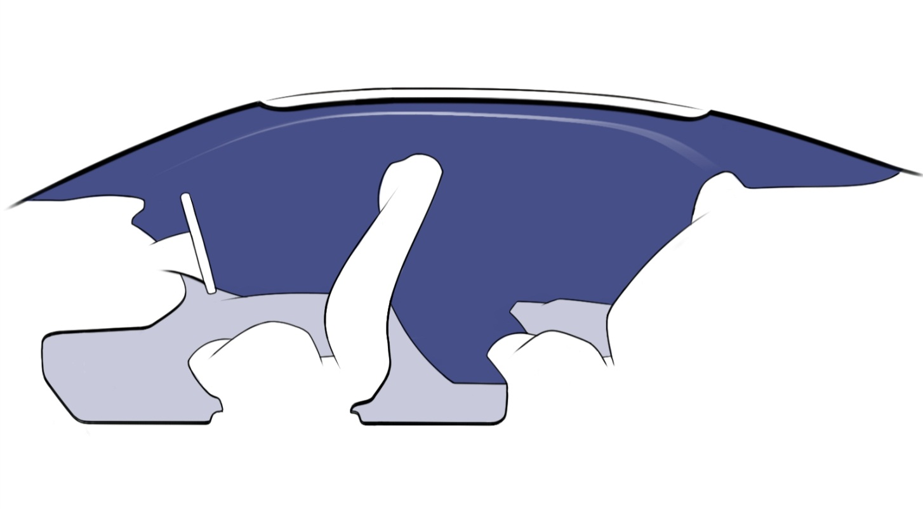
HVAC system based on thermal battery
Cooling in Warm Weather
Heat
M₁H + Heat -> M₁ + H₂
Warm Air
Heat
LT-HB
De-hydriding (Endothermic reaction)
Cool Air
H₂
Hydriding (Exothermic reaction)
HT-HB
Heat
M₂ + H₂ -> M₂ + Heat
Warm Environment Air
Hot Air into Environment

Slide 22
HVAC system based on thermal battery
Warming in Cool Weather
Heat
M₂ + H₂ -> M₂ + Heat
Cool Air
Hydriding (Exothermic reaction)
HT-HB
Warm Air
H₂
De-hydriding (Endothermic reaction)
LT-HB
Heat
Cold Air into Environment
M₁H + Heat -> M₁ + H₂
Cool Environment Air

Slide 23
HVAC system based on thermal battery
Recharge
M₂ + H₂ -> M₂ + Heat
Cool Air from Cabin or Outside Environment
Hydriding (Exothermic reaction)
HT-HB
Warm Air to Cabin, Electrical Batteries, or Outside Environment
H₂
De-hydriding (Endothermic reaction)
LT-HB
M₁H + Heat -> M₁ + H₂
Heat

Slide 24
Powder Metallurgy & Mining Related Journals
Journal of Chemical Engineering & Process Technology
Journal of Material Sciences & Engineering
Journal of Nanomaterials & Molecular Nanotechnology

Slide 25
Powder Metallurgy & Mining Related Conferences
3rd International Conference and Exhibition on Material Science and Engineering 2014, San Antonio, USA

Slide 26
OMICS Group Open Access Membership
OMICS publishing Group Open Access Membership enables academic and research institutions, funders and corporations to actively encourage open access in scholarly communication and the dissemination of research published by their authors.
For more details and benefits, click on the link below:
http://omicsonline.org/membership.php

