Slide 1







Dr. Pinliang Dong
Associate Professor Department of Geography University of North Texas USA

Slide 2


Biography
Dr. Dong teaches Intermediate GIS, Advanced GIS, Advanced GIS Programming,
Introduction to Remote Sensing, and Special Problems. He advises graduate student research in GIS, remote sensing, and applications in geographic and environmental sciences. Recent graduate theses include selecting optimal residential locations using GIS, vegetation mapping using NASAs EO-1 hyperspectral image data, development of a GIS toolkit for wildlife tracking, and small-area population estimation using high resolution satellite images and LiDAR data.

Slide 3

Research Interest
Spatial analysis and modeling
GIS and remote sensing for environmental science, geosciences, public health, and
population studies
LiDAR data applications in built-up and forest environments
Digital image analysis

Slide 4
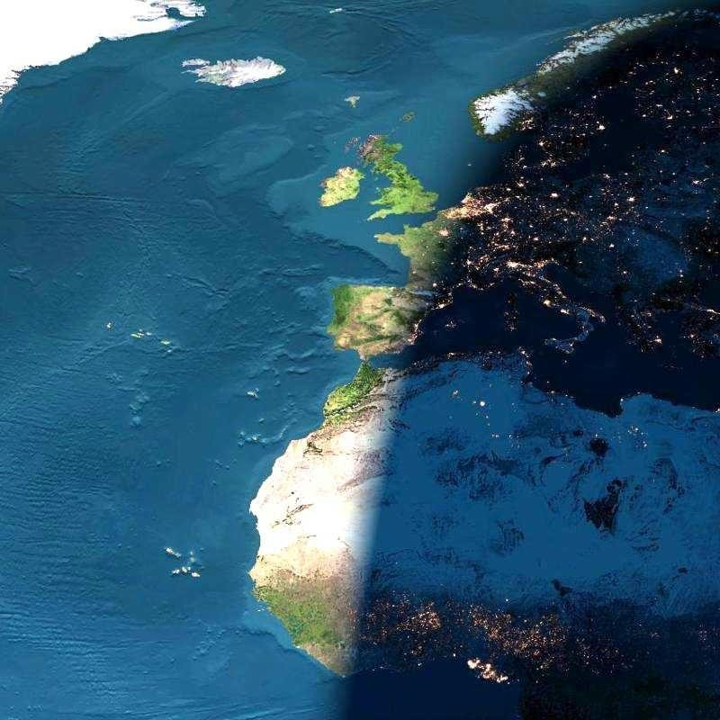






Remote Sensing
REMOTE SENSING is the process of sensing and
measuring objects from a distance without physical
contact with them

Slide 5
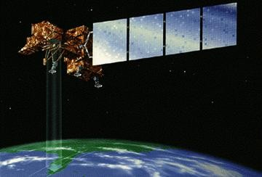

Sensing
1.Scanning 2.Characterizing 3.Classification
4.Identification/ Quantification 5.Analysis

Slide 6


REMOTE SENSING
"Remote sensing is the science of acquiring information
about the Earth's surface without actually being in contact with it. This is done by sensing and recording reflected or emitted energy and processing, analyzing, and applying that information."
Three Essential Things for Remote
Sensing
Object to be sensed
Sensor
Electro Magnetic Radiation

Slide 7

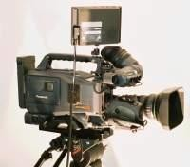
SIX STAGES IN REMOTE SENSING
1
2
4
5 (Film)
6
4
3
3
Stage-1. Source of energy
Stage-2. Transmission of EMR towards the Object
Stage-3. Interaction of EMR with the Object
Stage-4. Transmission of Interacted EMR towards the
3
Sensor
Stage-5. Recording of the Image by the Detector
Stage-6. Analysis of the Imagery

Slide 8


Fundamental Principle
Most remote sensing instruments (sensors) are designed to measure
photons. The fundamental principle underlying sensor operation centers on what happens in a critical component - the detector. This is the concept of the photoelectric effect This, simply stated, says that there will be an emission of negative particles (electrons) when a negatively charged plate of some appropriate light-sensitive material is subjected to a beam of photons. The electrons can then be made to flow from the plate, collected, and counted as a signal. A key point: The magnitude of the electric current produced (number of photoelectrons per unit time) is directly proportional to the light intensity. Thus, changes in the electric current can be used to measure changes in the photons (numbers; intensity) that strike the plate (detector) during a given time interval.

Slide 9



















Types of RS system
Active RS system
Passive RS system
Artificial Energy
source
Natural Energy
source
e.g.sensors on satellites Landsat,SPOT
e.g. radar systems
SLAR,SAR

Slide 10
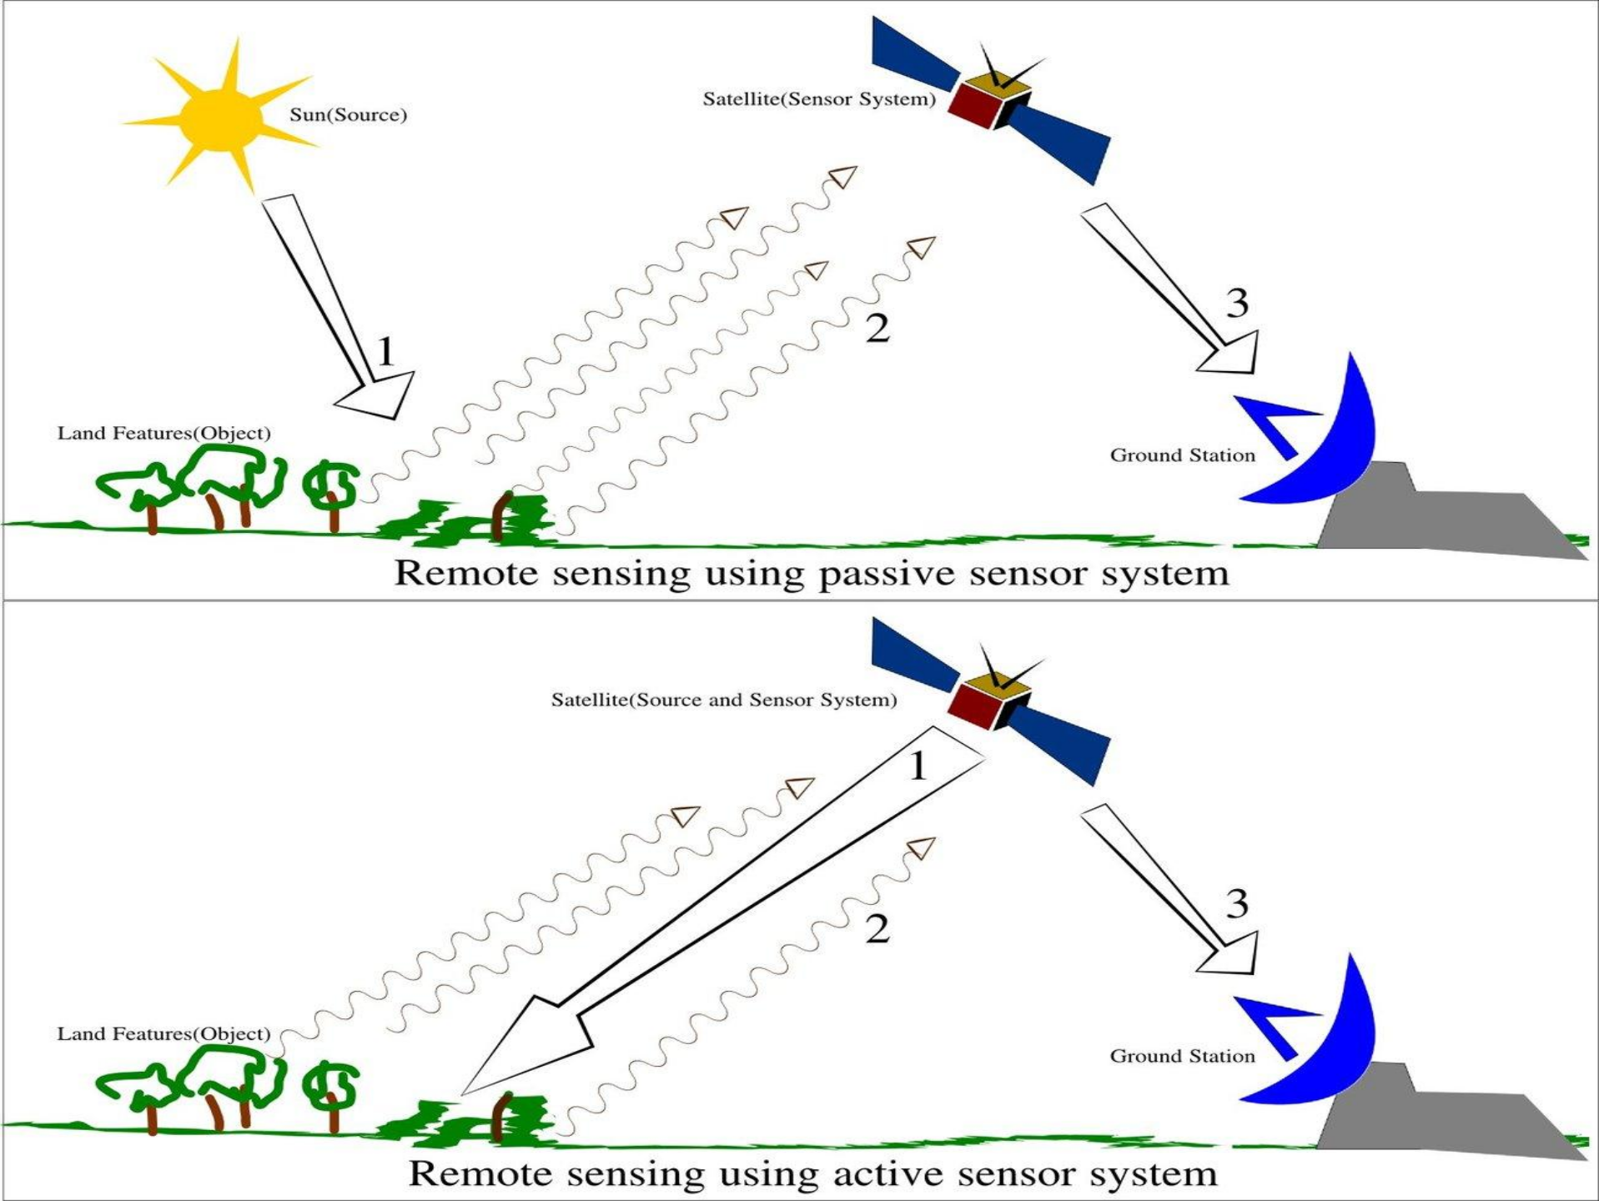

Slide 11
Sensor Detection
1. Passive Detection
Sensors measure levels of energy that are naturally emitted, reflected, or transmitted by the target object.
Passive sensors are those which detects naturally occurring energy. Most often, the source of radioactive energy is the sun.
Detection of reflected solar energy, for example, can only proceed when the target is illuminated by the sun, thus limiting visible light sensors on satellites from being used during a nighttime pass.
The Thematic Mapper, the primary sensor on the Landsat satellites, is a good example of a passive sensor.

Slide 12
2. Active detection
Active Sensors provide their own energy source for illumination of the
target by directing a burst of radiation at the target and use sensors to
measure how the target interacts with the energy.
Most often the sensor detects the reflection of the energy, measuring the angle of reflection or the amount of time it took for the energy to return.
Active sensors provide the capability to obtain measurements anytime,
regardless of the time of day or season.
They can be used for examining energy types that are not sufficiently provided by the sun, such as microwaves, or to better control the way a target is illuminated. However, active systems require the generation of a fairly large amount of energy to adequately illuminate targets.
Doppler radar is an example of an active remote sensing technology.

Slide 13
IMAGING SENSORS
Sensors which provide output to create an image
Eg : LISS I,LISS II, LISS III etc.
NON IMAGING SENSORS
Sensors which provide numerical respect to the quantum of radiation
output
with
Eg: Radiometer,Scatterometer etc.

Slide 14
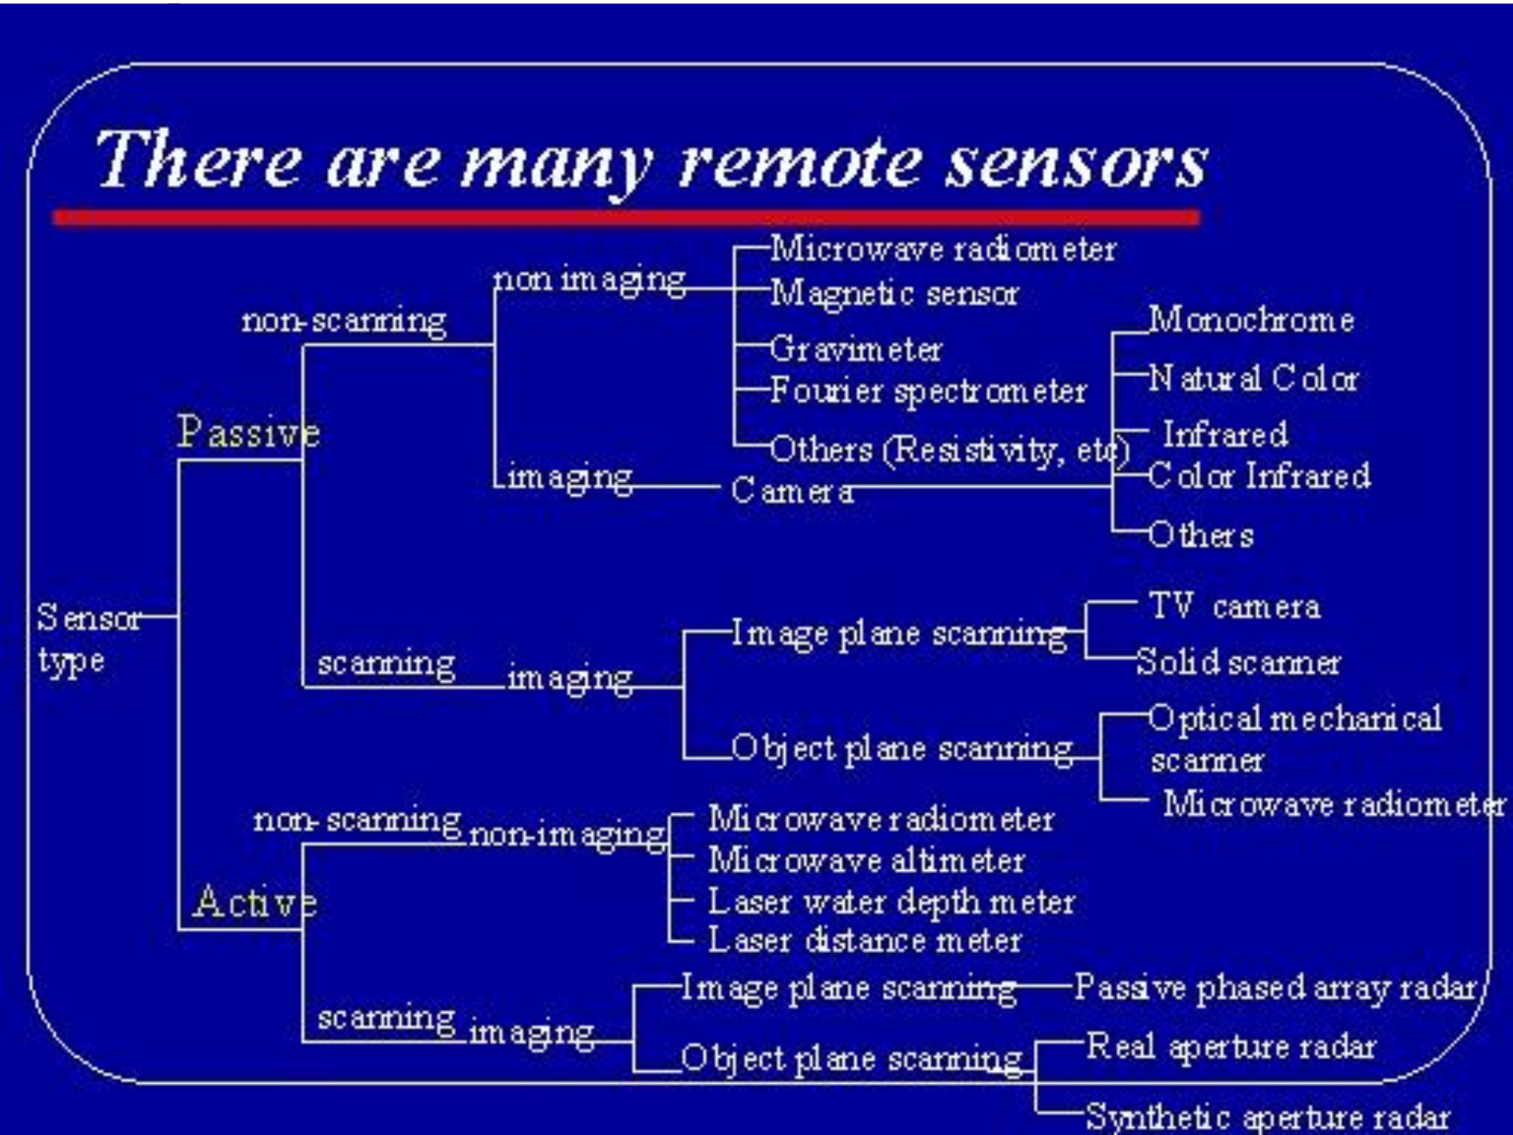

Slide 15



Applications of Remote Sensing
Coastal water mapping, soil/vegetation discrimination, classification, man-made feature identification
forest
Vegetation discrimination and health monitoring, man-made
feature identification
Plant species identification, man-made feature identification
Soil moisture monitoring, vegetation monitoring, water
discrimination
body
Vegetation moisture content monitoring
Surface temperature, vegetation stress monitoring, soil moisture monitoring, cloud differentiation, volcanic monitoring
Mineral and rock discrimination, vegetation moisture content

Slide 16


OMICS International Open Access Member
OMICS International Open Access Membership enables academic and research institutions, funders and corporations to actively encourage open access in scholarly communication and the dissemination of research published
by their authors. For more details and benefits, click on the link below: http://omicsonline.org/membership.php

