Slide 1
OMICS International
OMICS International through its Open Access Initiative is committed to make genuine and reliable contributions to the scientific community. OMICS International journals have over 3 million readers and the fame and success of the same can be attributed to the strong editorial board which contains over 30000 eminent personalities that ensure a rapid, quality and quick review process. OMICS International signed an agreement with more than 1000 International Societies to make healthcare information Open Access.
Contact us at: contact.omics@omicsonline.org

Slide 2
OMICS Journals are welcoming Submissions
OMICS International welcomes submissions that are original and technically so as to serve both the developing world and developed countries in the best possible way.
OMICS Journals are poised in excellence by publishing high quality research. OMICS International follows an Editorial Manager® System peer review process and boasts of a strong and active editorial board.
Editors and reviewers are experts in their field and provide anonymous, unbiased and detailed reviews of all submissions.
The journal gives the options of multiple language translations for all the articles and all archived articles are available in HTML, XML, PDF and audio formats. Also, all the published articles are archived in repositories and indexing services like DOAJ, CAS, Google Scholar, Scientific Commons, Index Copernicus, EBSCO, HINARI and GALE.
For more details please visit our website: http://omicsonline.org/Submitmanuscript.php

Slide 6
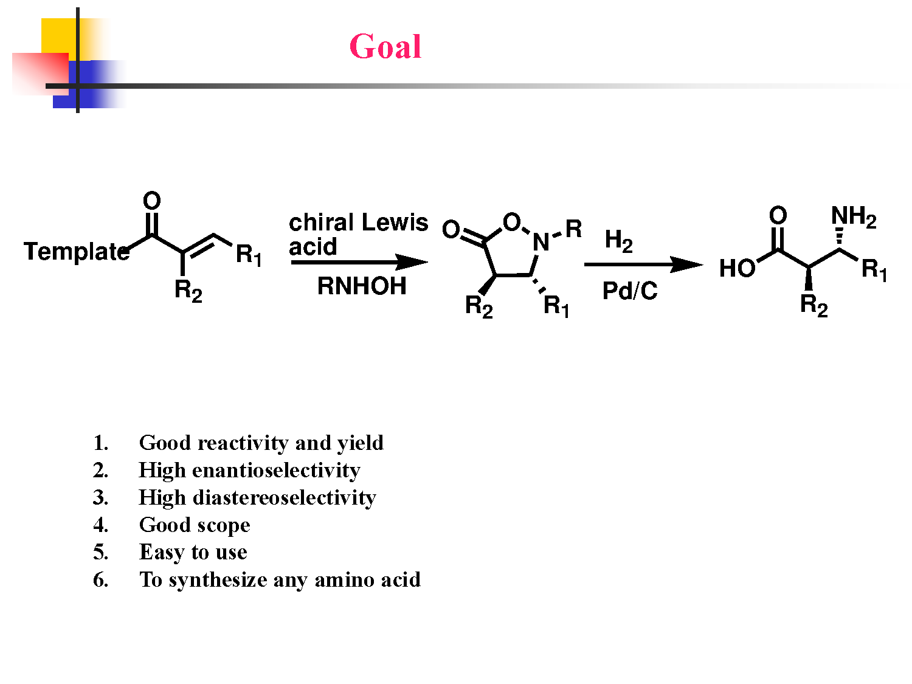

Slide 10
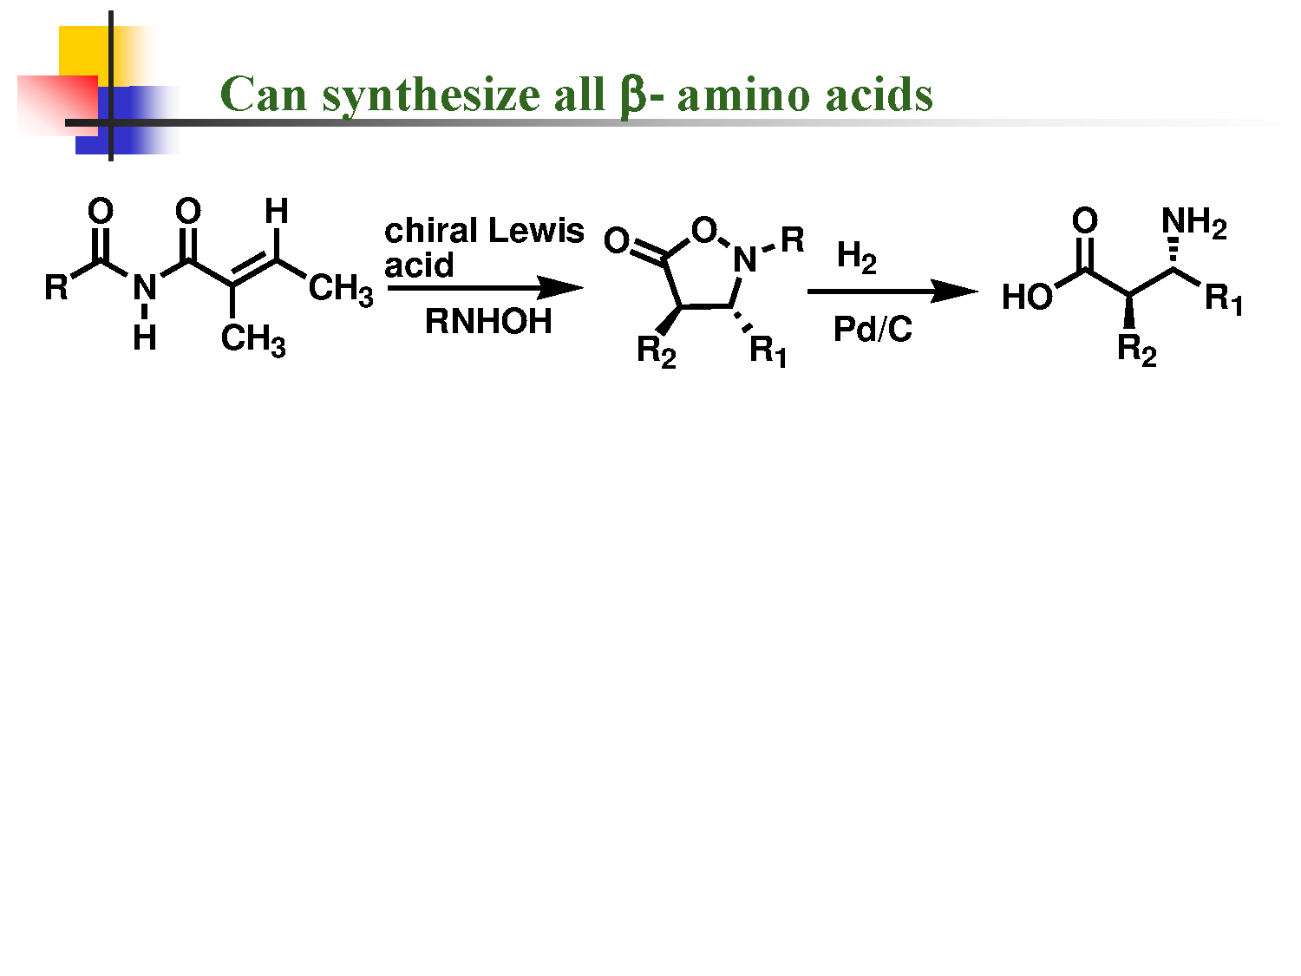

Slide 12
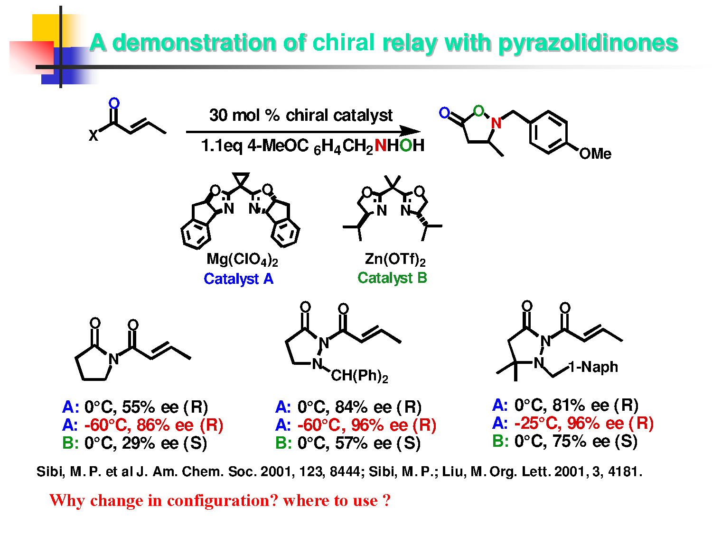

Slide 16
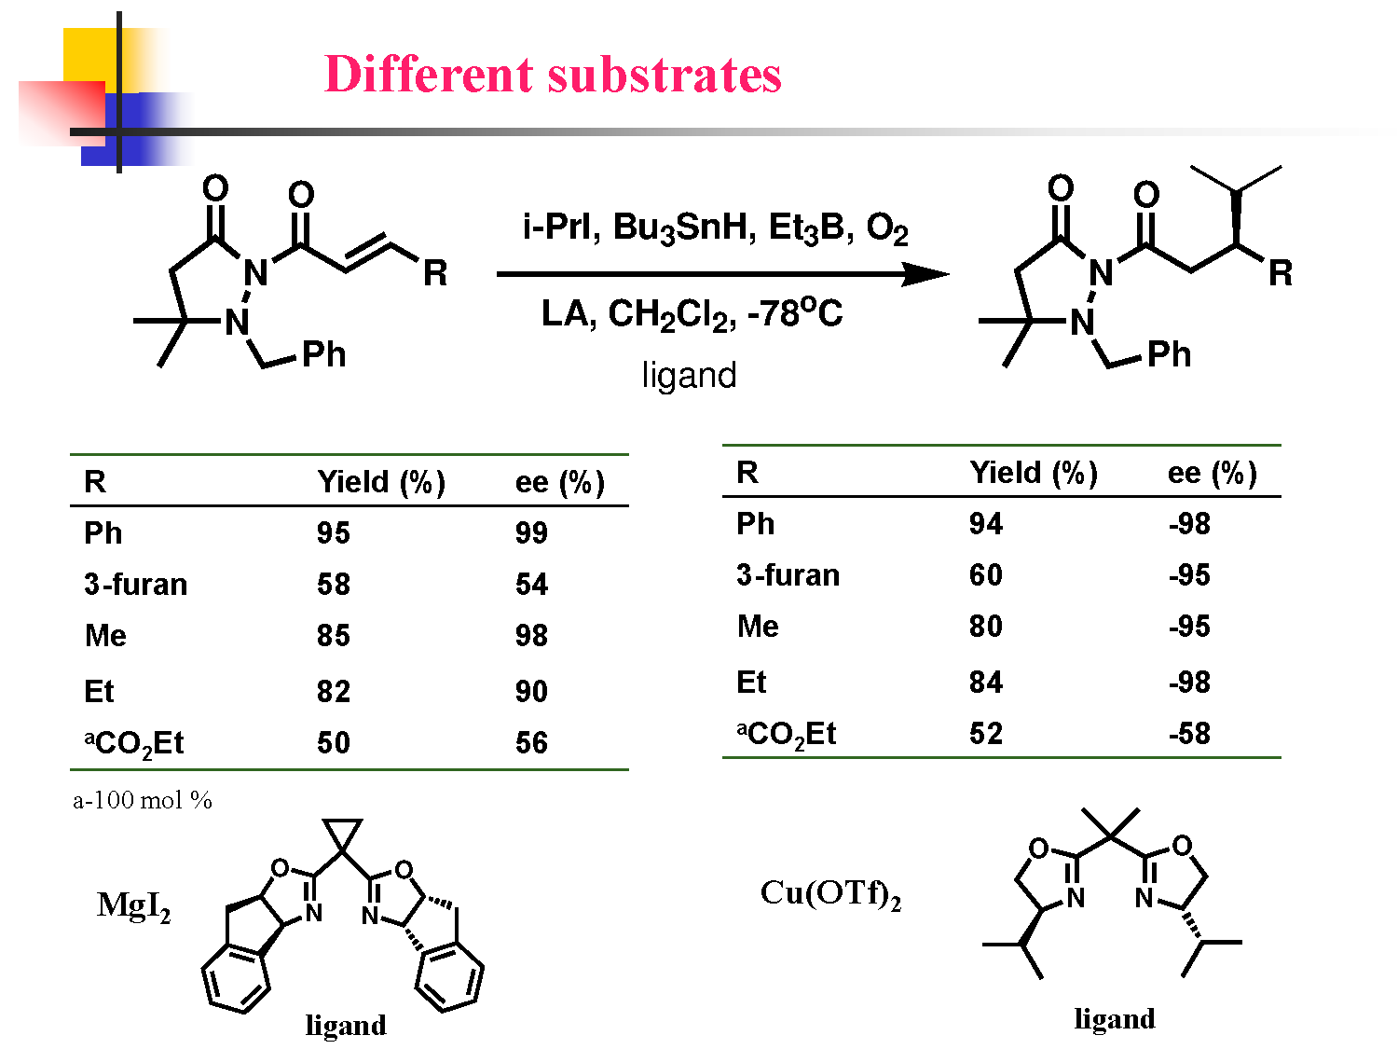

Slide 18
Chemical Sciences Related Journals
Journal of Thermodynamics & Catalysis
Journal of Plant Biochemistry & Physiology
Organic Chemistry: Current Research

Slide 19
Chemical Sciences Related Conferences
Medicinal Chemistry & Computer Aided Drug Designing
3rd International Conference on Medicinal Chemistry & Computer Aided Drug Designing

Slide 20
OMICS International Open Access Membership
OMICS International Open Access Membership enables academic and research institutions, funders and corporations to actively encourage open access in scholarly communication and the dissemination of research published by their authors.
For more details and benefits, click on the link below:
http://omicsonline.org/membership.php

