Slide 1
OMICS Journals are welcoming Submissions
OMICS International welcomes submissions that are original and technically so as to serve both the developing world and developed countries in the best possible way.
OMICS Journals are poised in excellence by publishing high quality research. OMICS International follows an Editorial Manager® System peer review process and boasts of a strong and active editorial board.
Editors and reviewers are experts in their field and provide anonymous, unbiased and detailed reviews of all submissions.
The journal gives the options of multiple language translations for all the articles and all archived articles are available in HTML, XML, PDF and audio formats. Also, all the published articles are archived in repositories and indexing services like DOAJ, CAS, Google Scholar, Scientific Commons, Index Copernicus, EBSCO, HINARI and GALE.
For more details please visit our website: http://omicsonline.org/Submitmanuscript.php

Slide 2
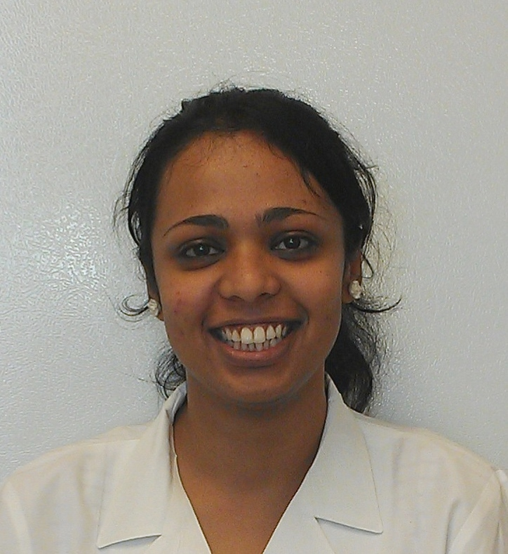
Preethi Ravindranathan UT Southwestern Medical Center 5323 Harry Hines Blvd, JA5.130D Dallas TX 75390 Ph: 214-648-3363/3764
Research Focus:
Prostate cancer
Designing and evaluating small molecules to inhibit protein interactions to block prostate cancer progression
Studying the role of variants of AR protein in advanced stages (castration -resistant) of prostate cancer (CRPC) and evaluating rationally designed peptidomimetics in blocking AR variant activity
Development of tumor culture model for the evaluation of therapeutic agents in human solid tumors
SHORT BIO
Areas of interest
Prostate cancer
Small molecule drugs
Peptidomimetics
Androgen Receptor
Breast cancer
Molecular endocrinology

Slide 3
Employment History
Education
Research Associate
May 2014-Present
UT Southwestern Medical Center, Dallas TX
Research Technician II
Jun 2014-May 2014
UT Dallas, Dallas, TX
(Site of activity: UT Southwestern Medical Center, Dallas TX)
Research Technician II
Dec 2008-Apr 2011
UT Southwestern Medical Center, Dallas TX
Graduate Research Assistant
Aug 2006-Oct 2008
UT Health Science Center at Tyler, Tyler TX
Intern
Dec 2005-May 2006
Central Leather Research Institute, Chennai, India
Master of Science
(Biotechnology)
Aug 2006-Oct 2008
Stephen F. Austin State University, Nacogdoches, TX
Bachelor of Technology
(Industrial Biotechnology)
May 2002-Jun 2006
Anna University, Chennai, India
Recipient of Gold Medal for securing 8th position among 607 candidates who graduated with Bachelor of Technology (Industrial Biotechnology) degree in Apr 2006 from Anna University, India
SHORT BIO
Member Affiliations
American Association for Cancer Research (AACR)
Society for Basic Urologic Research (SBUR)

Slide 4
Peptidomimetic targeting of critical androgen receptor-coregulator interactions in prostate cancer; Preethi Ravindranathan, Tae-Kyung Lee, Lin Yang, Margaret Centenera, Lisa Butler, Wayne Tilley, Jer-Tsong Hsieh, Jung-Mo Ahn, Ganesh Raj; Nature Communications, May 2013, 4:1923
Central role for PELP1 in non-androgenic activation of androgen receptor in prostate cancer; Lin Yang, Preethi Ravindranathan, Payal Kapoor, Meera Raman, Ganesh Raj; Molecular Endocrinology, April 2012, 26(4):550 –561
Dual roles of PARP-1 promote cancer growth and progression; Matthew Shiewer, Jonathan Goodwin, Sumin Han, Chad Brenner, Michael Augello, Jeffry Dean, Fengzhi Liu, Jamie Planck, Preethi Ravindranathan, Arul Chinnaiyan, Peter McCue, Leonard Gomella, Ganesh Raj, Adam Dicker, Jonathan Brody, John Pascal, Margaret Centenera, Lisa Butler, Wayne Tilley, Felix Feng, Karen Knudsen; Cancer Discovery, December 2012, 2(12):1134-49
Progesterone receptor-B enhances estrogen responsiveness of breast cancer cells via scaffolding PELP1- and estrogen receptor-containing transcription complex; Andrea Daniel, Angela Gaviglio, Todd Knutson, Julie Ostrander, Preethi Ravindranathan, Yan Peng, Ganesh Raj, Douglas Yee, Carol Lange; Oncogene , advance online publication January 2014, DOI: 10.1038
Ablation of the oncogenic transcription factor ERG by Deubiquitinase inhibition in prostate cancer; Shan Wang, Rahul Kollipara, Nishi Srivastava, Rui Li, Preethi Ravindranathan, Elizabeth Hernandez, Eva Freeman, Caroline Humphries, Payal Kapur, Yair Lotan, Ladan Fazli, Martin Gleave, Stephen Plymate, Ganesh Raj, Jer-Tsong Hsieh, Ralf Kittler; PNAS, March 2014, 111(11):4251-6
The social network of PELP1 and its implications in breast and prostate cancer (a review); Vijay Gonugunta, Lu Miao, Sareddy Reddy, Preethi Ravindranathan, Ratna Vadlamudi, Ganesh Raj; Endocrine Related Cancer, May 2014, 21(4):T79-T86
Key publications
JOURNAL ARTICLES

Slide 5
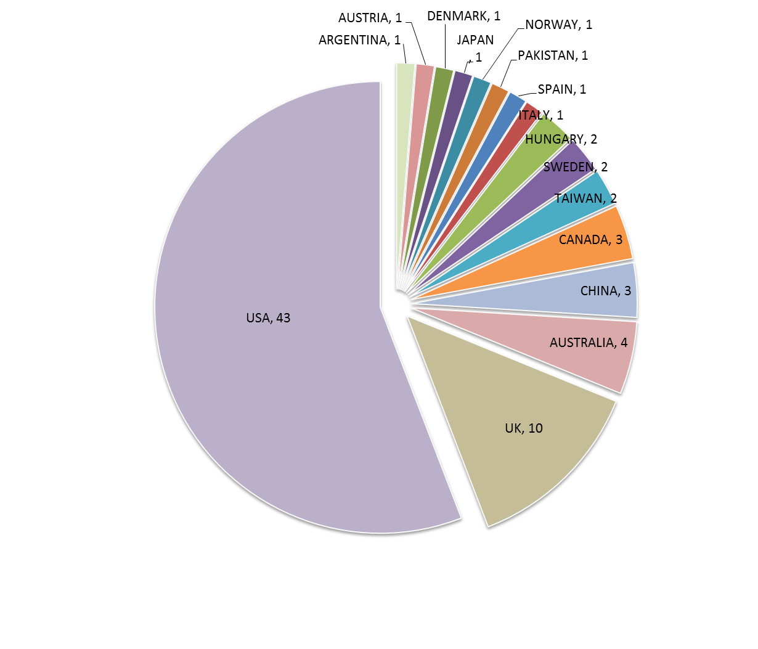
Research referred by researchers from all over the world*
WORLDWIDE IMPACT
*Based on country of citing of corresponding author

Slide 6
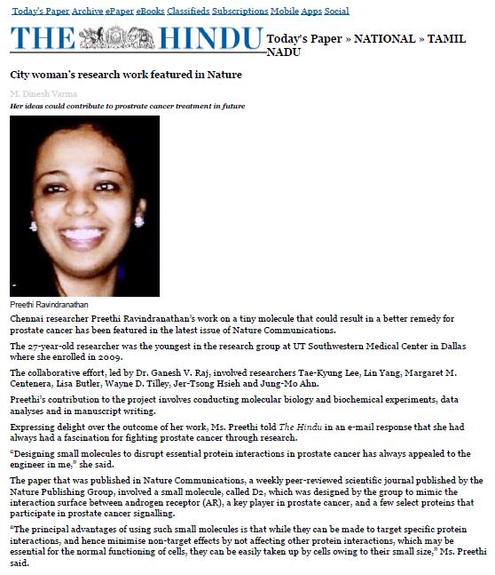
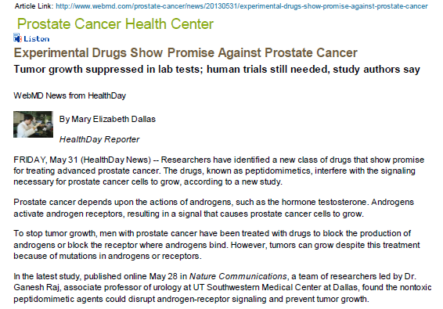
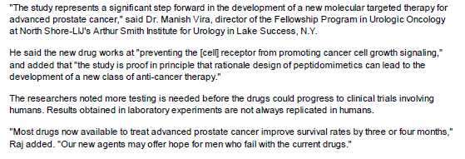
Mainstream-media coverage of research work
1 of 3
Picked up by 6 news outlets:
MEDIA ATTENTION

Slide 7
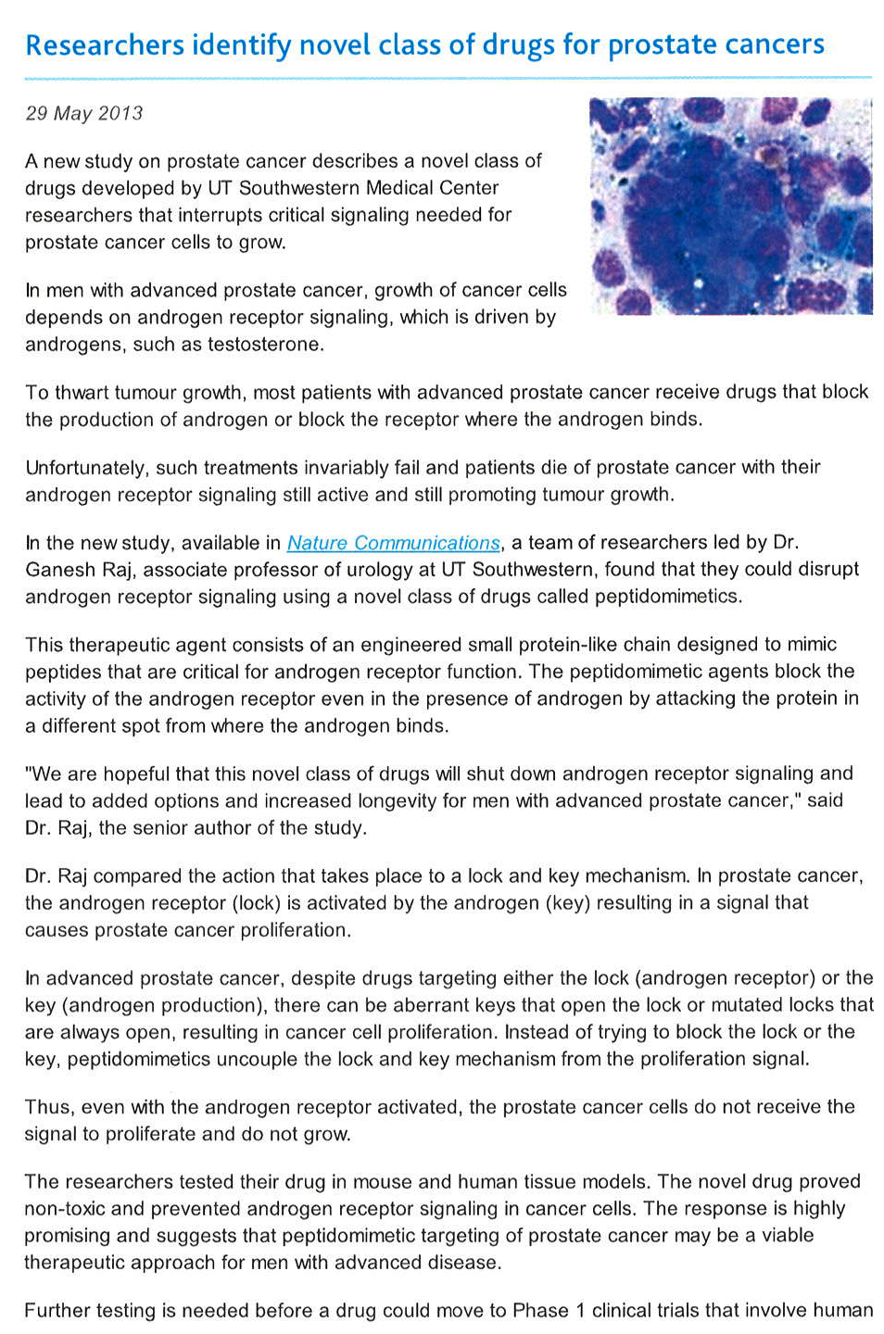
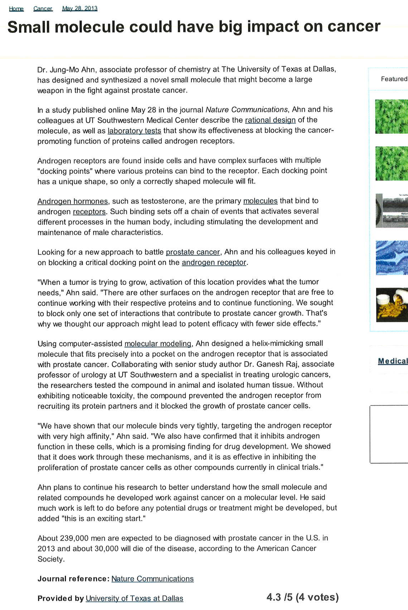
C. Mainstream-media coverage of research work
2 of 3
MEDIA ATTENTION

Slide 8
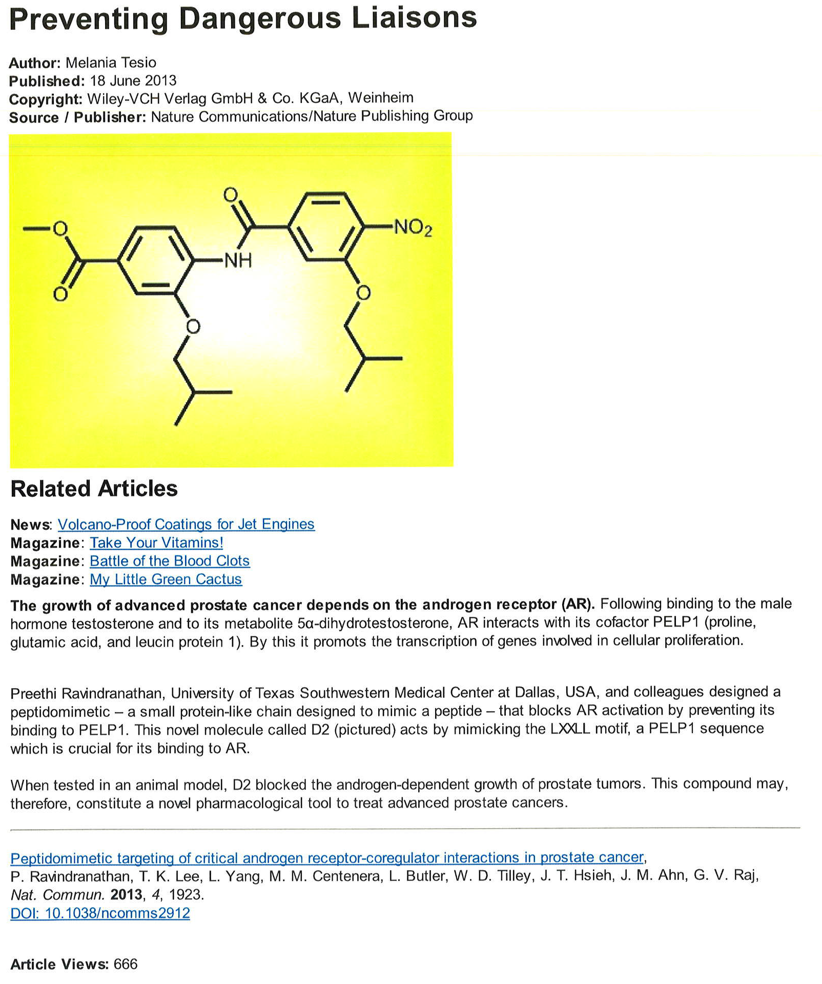
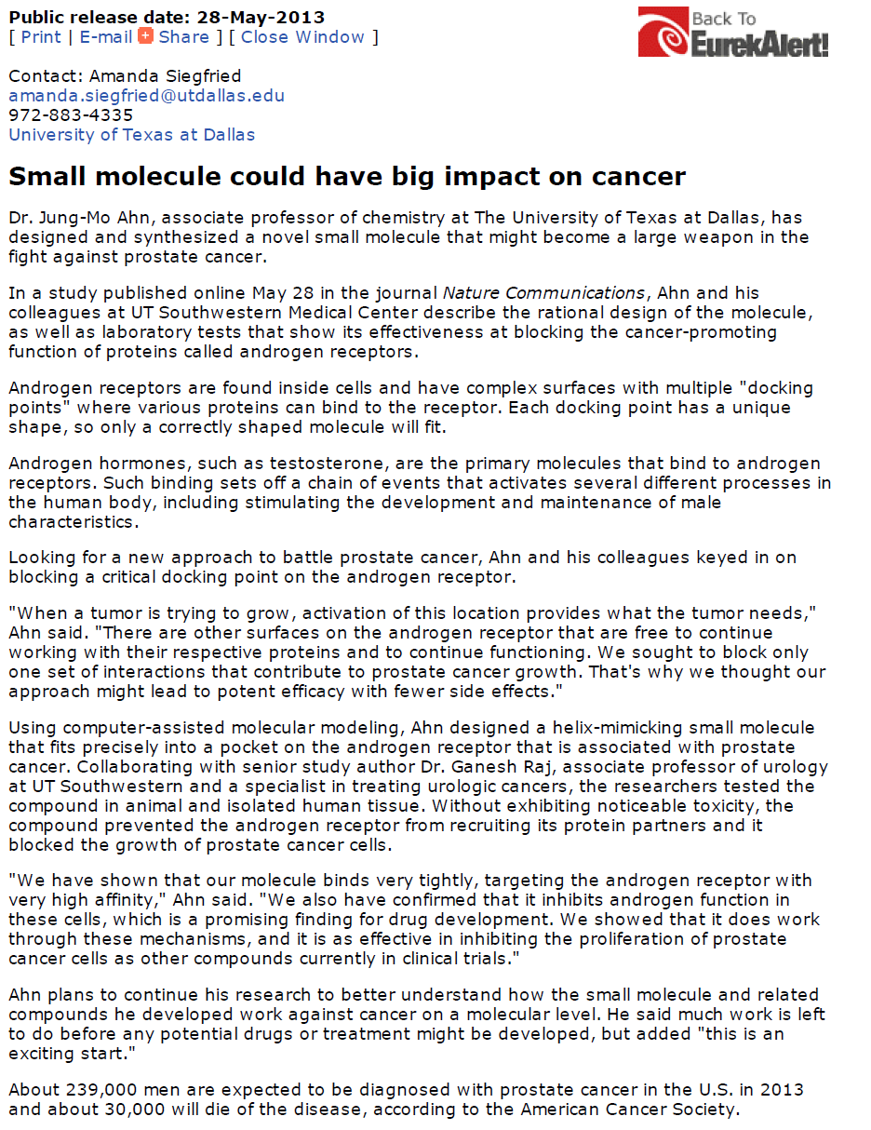
C. Mainstream-media coverage of research work
3 of 3
MEDIA ATTENTION

Slide 9
Journal of Blood and Lymph Related Conferences
Second international conference on Hematology and blood Disorders.

Slide 10
Journal of Blood and Lymph Related Journals
Blood Disorders and Transfusion
Bone marrow Research

Slide 11
OMICS Group Open Access Membership
OMICS InternationalOpen Access Membership enables academic and research institutions, funders and corporations to actively encourage open access in scholarly communication and the dissemination of research published by their authors.
For more details and benefits, click on the link below:
http://omicsonline.org/membership.php

